Slide 2
Students can define peer pressure and give examples of how it can happen online
Students can consider how a good friend should behave and assess if they are a good online friend
Students can give advice to others about how to resist peer pressure online and offline

Slide 3
Starter discussion
Watch film
Discussion questions about film
-------------------------------------------
Activity 1: What is a good friend?
Activity 2: What would you do? Quiz
Activity 3: What advice would you give? Poster campaign
Plenary

Slide 4
Starter discussion -
Defining peer pressure
In pairs you have 1 minute to write a definition of peer pressure.
1 minute

Slide 5
How does peer pressure make you feel?
What can you do if you feel peer pressure?
#
Who can put peer pressure on you?
What can peer pressure online look like?
!!!
???
What is the difference between pressuring someone and encouraging them?

Slide 6
Activity –
Peer pressure:
myths –v- truths?
Your teacher will read out statements about peer pressure. If you think it is a myth, stick your thumb down, if you think it is a truth, do a thumbs up!

Slide 7
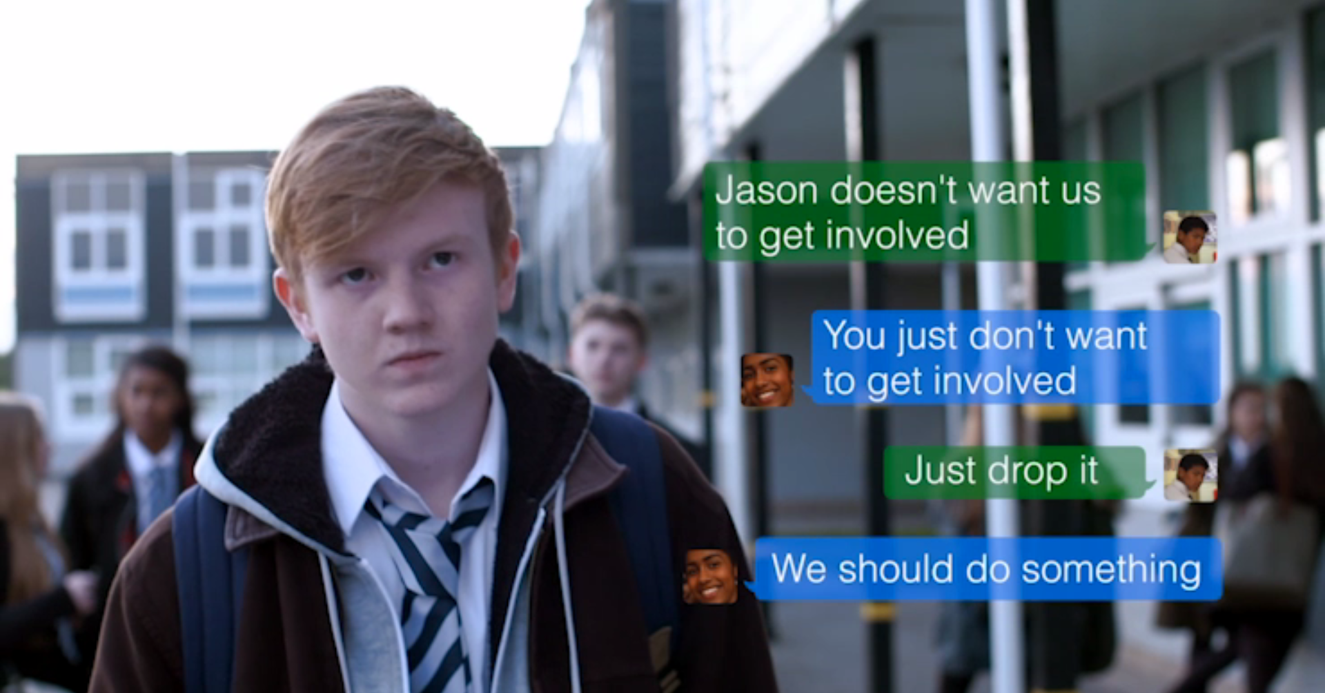
Watch “Back me up”
http://www.childnet.com/resources/pshetoolkit/peer-pressure/back-me-up

Slide 8
Is this story realistic? Is it difficult sometimes to know what the right thing to do online is, especially when it comes to standing up for and to your friends?
The title of this toolkit is called ‘Crossing the Line’. Leah says in the film that Charlie always goes “too far”. In this film, where do you think the line was crossed from harmless banter, to cyberbullying?
This film is about how friends deal with online bullying. Which friend’s response do you relate to most? Jenna? Ben? Leah? Jack? Why?

Slide 9
Why does Jack go along with what Charlie is doing? Why is Charlie able to manipulate him?
Are Jack and Charlie equally responsible for bullying Jason? eg. because Jack allowed Charlie to use his phone?
If others like the pictures or share them, are they also joining in with the bullying?
A bystander is someone who sees bullying happen and although they don’t get involved, they don’t speak out against it either. Can you name the bystanders in this film?

Slide 10
Ben, Jenna and Leah are Jason’s friends. Why are they reluctant to stand up for Jason or want to get involved? Do you think they are bad friends? Would you expect your friends to stick up for you online?
What would happen if Jenna, Leah and Ben wrote back on behalf of Jason and said something mean back to Charlie?

Slide 11
Why do you think the teacher, Ms Thomas, wants to speak to Jack?
Charlie says the picture with the mean comments will ‘disappear in a second, no harm done’. Is this true?
Do we know who stepped in to take action to report the cyberbullying to the school? Leah? Ben? Someone else anonymously? Why did they step in at that point? Was this the right thing to do?
What do you think happens at the end of the film? Does the situation improve?
What do you think would happen if no one reported or said anything about the cyberbullying to the school. Is there a reason why you might not report to the school?

Slide 12
(if “Gone too far” hasn’t been watched)
One image in this film insinuates that Jason and his friend Ben are gay. A caption says ‘Gay-mer boy-friends’. Why do you think Charlie uses the term ‘gay’? What does he want it to mean?
How do you think it might feel if you were gay, to see this word being used to embarrass others?
What could you do if you overheard someone using the word ‘gay’ to mean something ‘rubbish or uncool’?

Slide 13
Activity 1 -
What is a good friend?
In groups of three, cut up worksheet 3.1 into 9 parts and then rank them, with the most important quality of being a good friend at the top.
5 minutes
Most important
Mo
Least important

Slide 14
Activity 1 continued-
What is a good friend?
Now think about what makes a good online friend? If you need to make changes to your diamond so far, turn each part over and write qualities of a good online friend.
5 minutes
Most important
Mo
Least important

Slide 15
Activity 2 -
Activity 2 -
Activity 2 -
What would you do quiz?
What would you do quiz?
In pairs, ask and answer the quiz on worksheet 3.2. Be as honest as you can!
In pairs, ask and answer the quiz on worksheet 3.2. Be as honest as you can!
10 minutes
10 minutes

Slide 16
Activity 3 -
What advice would you give?
In pairs, come up with 3 examples of slogans to encourage others to resist peer pressure online (eg. Don’t share it! Choose friends wisely! Don’t give in!)
Then, individually design a poster with your preferred slogan to put up on the PSHE wall.
10 minutes

Slide 17
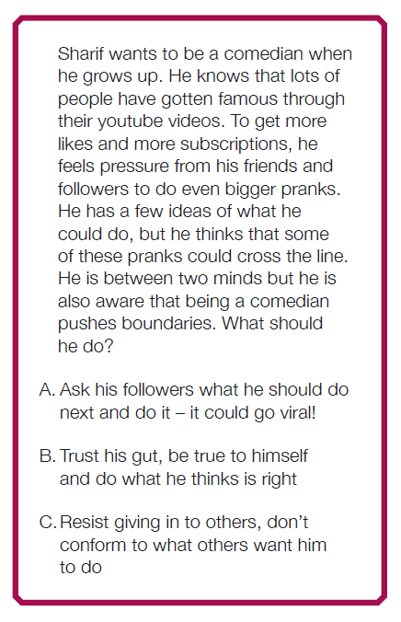
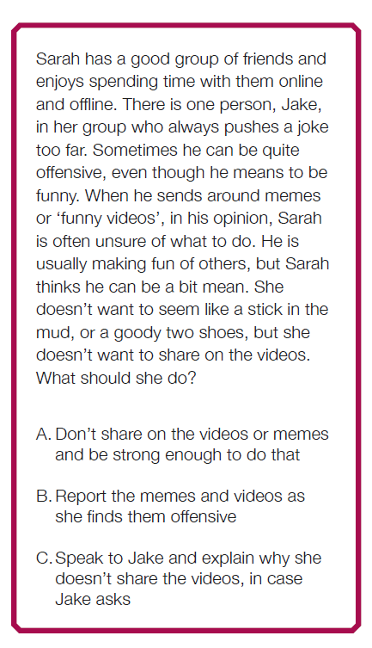

Slide 18
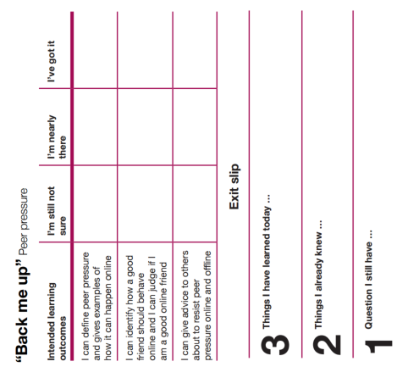
Review the myths and truths from the starter activity
Fill out exit slip and tear off any question you have and put it in the anonymous question box. This will be answered at the next lesson.

Slide 19
Part of the
PSHE Toolkit
Available to download at:
www.childnet.com/pshetoolkit
Co-funded by
Crossing the Line PSHE toolkit 2016 by Childnet International is licensed under a Creative Commons Attribution-NonCommercial-ShareAlike 4.0 International License.

