Slide 2
Students can reflect on how life online can idealised and may not reflect reality
Students can empathise with others and offer advice to those who may be struggling online
Students can devise strategies to boost their self-esteem and consider ‘how to be happy’

Slide 3
Starter discussion
Watch 3 short films
Discussion of themes of films
--------------------------------------------------------
Activity 1: What can you guess from a profile picture?
Activity 2: How can you help? Advice for self-esteem problems
Activity 3: How to boost self-esteem
Plenary

Slide 4
Discussion
“When young people go online, they feel better about themselves”
In pairs, talk to the person beside you. Do you agree? Do you disagree? Why?
Class vote

Slide 5
Can the internet be a source of comfort and support for people?
###
????
These short ‘talking heads’ are about self-esteem, what does self-esteem mean?
Do you think this statement rings true for both girls and boys, or are girls affected more by the images and content they might see online?
!!!

Slide 6
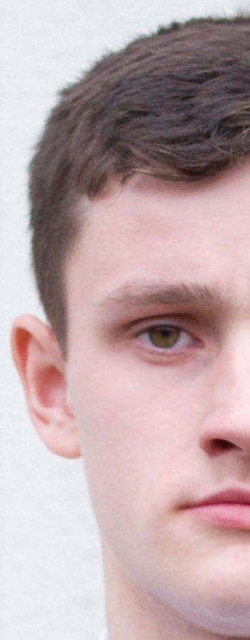
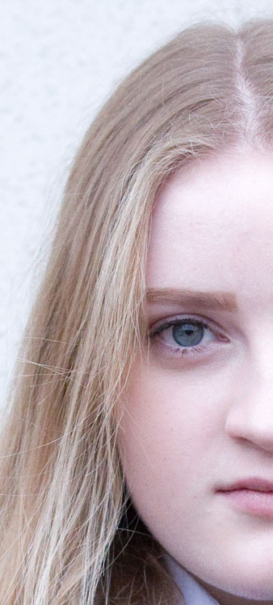
Watch the three Talking Heads
http://www.childnet.com/resources/pshetoolkit/self-esteem/talking-heads

Slide 7
Eve says it is embarrassing if no one likes or comments on a picture that she has uploaded, why do you think this is? How do you feel if others get more likes than you? Do you think it is realistic that someone might delete a picture if they don’t get any ‘likes’?
Do you agree with Eve that people’s lives seem so much better online than they do offline? Why is this? Do they seem realistic?
Do you think people might think twice about uploading content online as they are worried people might think differently of them? Why?
Do people judge others by how they portray themselves online? What do they judge?

Slide 8
Do you think girls feel pressure to look a certain way online? Why is this? Do you think it is the same for boys?
When Brandon says he is surprised that some people put up selfies of themselves and he asks if they have no shame, do you think there are others who feel the same way?
An editing app that allows you to make ‘perfect’ selfies reports that it has been downloaded 60,000,000 times. Why do you think people use photo editing apps?
Brandon thinks girls are more affected by negative comments online and make a big deal out of them, whereas boys just forget about it. Do you think this is true?

Slide 9
Leah says that although she is online a lot, she doesn’t post often, for fear of being judged. Why is this?
Do you think it is true that guys like the girls who post selfies?

Slide 10
Activity 1 -
Can you guess from
a profile picture?
In groups of four, look at the profile pictures on worksheet 4.1.
Discuss and write answers for the following:
Why did these people choose this profile picture?
What 3 adjectives would you use to describe these people?
Then, read the diaries on worksheet 4.2 and try to guess which diary entry goes with which profile picture
10 minutes

Slide 11
The school council is rolling out a PSHE campaign to see if they can help students more online. Students share their problems with things online anonymously and in groups, you must give advice on how they can solve their problem.
Activity 2 -
How can you help?
In groups of three, write your advice for each problem on an A4 page.
Remember, it is very brave of these people to share their problems, try to be tactful and diplomatic in your answers!
10 minutes

Slide 12
Show you have listened and understood the problem
You can offer personal anecdotes or support if you wish, if you think it will make the other person feel better
Phrases like ‘It can get better.’ and ‘Hang in there, you’re not alone.’ can help
Emphasize that talking about the issues and problems really help
Point out who they could speak to about their issues: a friend, Childline, a teacher at school
Emphasize balance and doing things they enjoy

Slide 13
Activity 3 -
How to boost self-esteem
This is a private task:
Individually, write a list of things you are happy and proud about yourself. Examples could include:
I have a nice smile, I’m a good listener, I’m talented at sports.
No one will see this list and you won’t be asked about it.
3 minutes

Slide 14
Activity 3 -
How to boost self-esteem
Continued
Then, write a list of things you would like to improve about yourself.
No one will see this list and you won’t be asked about it.
Feedback: In general, which list is usually easier to write? Why?
3 minutes

Slide 15
Activity 3 -
How to boost self-esteem
Continued
Positive thinking
In pairs, on worksheet 4.4, try to correct the negative thinking that some people express and rephrase it so it is positive instead.
5 minutes

Slide 16
Activity 3 -
How to boost self-esteem
Continued
How to feel great: a guide to life
In groups of four, devise and write 5 strategies that will help people boost their self-esteem.
There are some helpful pointers on the next page.
5-7 minutes

Slide 17
Examples could include:
Don’t compare yourself to others
Don’t judge others
Write down compliments people give you
Eat well
Remember a time you did something well
Take deep breaths and exercise
Be nice and friendly to others, usually you will be treated the same in return.

Slide 18
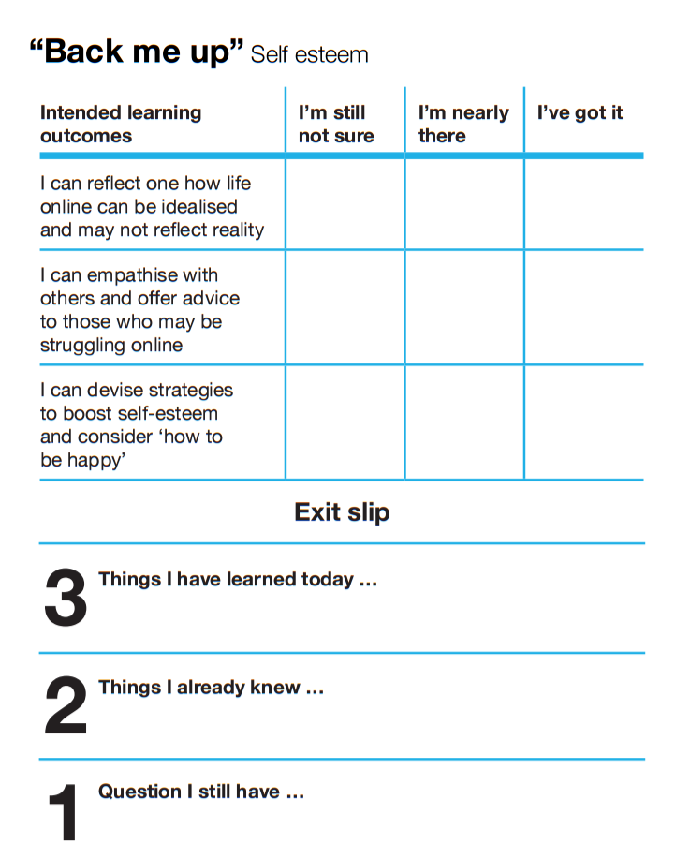
How will you help others
to feel good about themselves
online?
Fill out exit slip and tear off any question you have and put it in the anonymous question box. This will be answered at the next lesson.

Slide 19
Part of the
PSHE Toolkit
Available to download at:
www.childnet.com/pshetoolkit
Co-funded by
Crossing the Line PSHE toolkit 2016 by Childnet International is licensed under a Creative Commons Attribution-NonCommercial-ShareAlike 4.0 International License.

