Slide 2
Students can understand the pressures on young people to send naked pictures (sexts)
Students can give advice to others to avoid sending a sext
Students can understand the possible consequences of sending a sext, including the legal consequences
Students can discuss if girls have a (more) negative experience online

Slide 3
Starter discussion
Watch film
Discussion questions
---------------------------------------
Activity 1: How to help Abi
Activity 2: Quiz
Activity 3: Moral thermometer
Plenary

Slide 4
“Girls have a more negative experience online”
Starter -
What do you think?
Speak to the person beside you: do you agree, do you disagree? Why?
Class vote

Slide 5
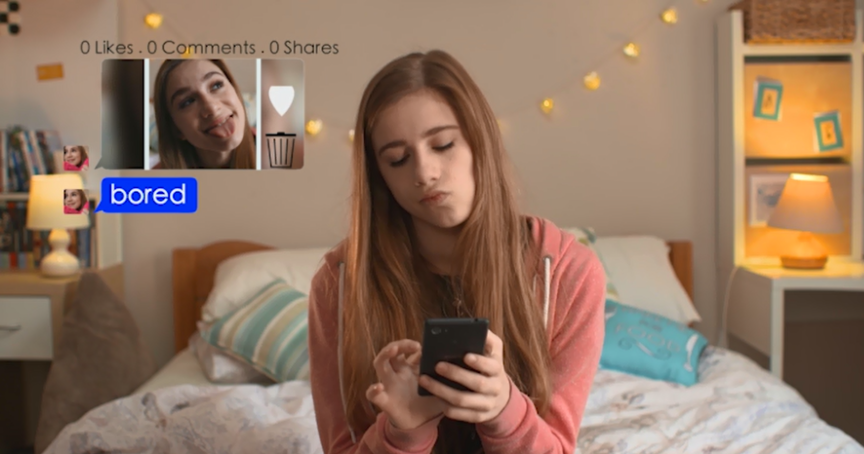
Watch “Just send it”
http://www.childnet.com/resources/pshetoolkit/sexting/just-send-it

Slide 6
Is this story realistic? Could a similar situation happen in this school?
The title of this toolkit is ‘Crossing the Line’. In this film, where do you think the line was crossed?
Why does Josh mention possible involvement from the police at the end of the film? Who do you think broke the law in this film?
Notes:
Suggested answers for teachers:
2) When Josh asked for the photo? When Abi sent the photo? When Brandon shared the photo?
3) Read more about the laws online in the guidance for educators section

Slide 7
Abi was reluctant at first to send the image to Josh. What made her change her mind?
Why did Josh ask for the photo? Did he feel any pressure to have images like this?
Did Abi give consent for her photo to be shared around the school? In this situation, who is more at fault – Josh, Abi or Brandon? Anyone else?
Do you think Josh respected Abi? How can you tell if someone respects you?
Notes:
Suggested answers for teachers:
Influence from her friends? Pressure from Josh? Wanting to keep Josh as her boyfriend?
4) He/she doesn’t pressure you into doing anything you don’t want to, they want to keep you happy

Slide 8
Some of the comments under Abi’s photo are quite mean. None of them seem to portray Josh in a negative light. Do you think there are different standards between boys and girls: if a guys sends the picture around or if a girl does?
Abi receives a naked picture of Josh first. What would happen if Abi decided to share this picture around to others?
What do you think of the comment that Eve makes when she says, “Gotta keep your man happy”? Is this how girls can feel; that they must keep their boyfriends or friends happy?

Slide 9
Instead of sharing the naked photo, what could Abi have done to let Josh know that although she likes him, she doesn’t want to send him a nude photo?
When she discovered the picture had been shared around, Abi didn’t want to go to school. She eventually told her mum, but who else could she have spoken to about her situation?
What could the other characters have done to help Abi?
What do you think happens next in the film? What happens when Abi goes back to school? What happens when Abi meets Josh for the first time? Would Abi want to meet Josh again?
Notes:
Suggested answers for teachers:
Zip-it app, made a joke, shared a selfie of herself but not a naked one
A pastoral head in school, a Year Head, Childline, friends, older brothers and sisters
Asked others to delete the picture, not share the picture around, explain/consider the consequences more

Slide 10
Activity 1 -
How to help Abi
In groups of three, use worksheet 2.1 to devise the response Abi should have written back to Josh in response for the naked picture, and the conversation she may have had with her friend Jenna about it.
7 minutes

Slide 11
Activity 2 -
‘What does the law say?’
1. Answer the quiz (worksheet 2.2) by yourself, to the best of your knowledge. (3 minutes)
2. Then, check your answers with the person beside you. (2 minutes)
3. In pairs, once you have received the laws online (worksheet 2.3), read through the laws and correct your answers.
10 minutes

Slide 12
Activity 3 -
Moral compass
There are signs up around the class, saying ‘I agree’, ‘I disagree’ and ‘I’m not sure/it depends’.
Your teacher will read out some controversial statements and you need to walk to the sign that best reflects how you feel about that statement.
10 minutes
Reminder: Your teacher may ask you to explain your position and why

Slide 13
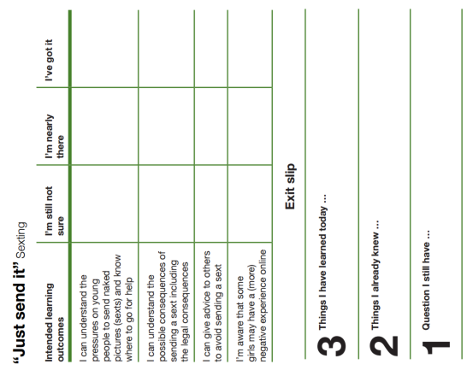
What do you now think about our starter question?
“Girls have a more negative experience online”
Fill out exit slip and tear off any question you have and put it in the anonymous question box. This will be answered at the next lesson.

Slide 14
Part of the
PSHE Toolkit
Available to download at:
www.childnet.com/pshetoolkit
Co-funded by
Crossing the Line PSHE toolkit 2016 by Childnet International is licensed under a Creative Commons Attribution-NonCommercial-ShareAlike 4.0 International License.

