Slide 1
DIGITAL RESILIENCE

Slide 2
To examine how going online can influence the way we feel, think and act
To understand what digital resilience is
To devise ways to build your own digital resilience and support others

Slide 3
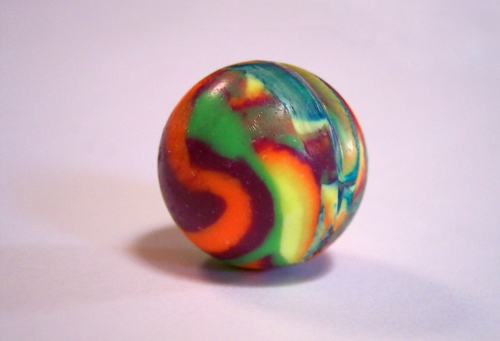
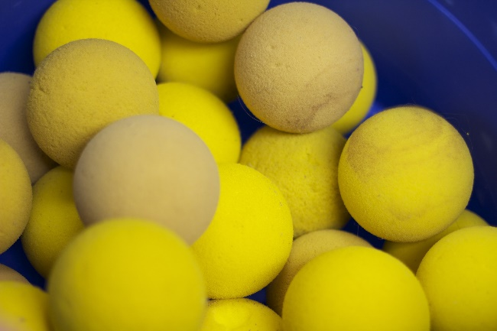
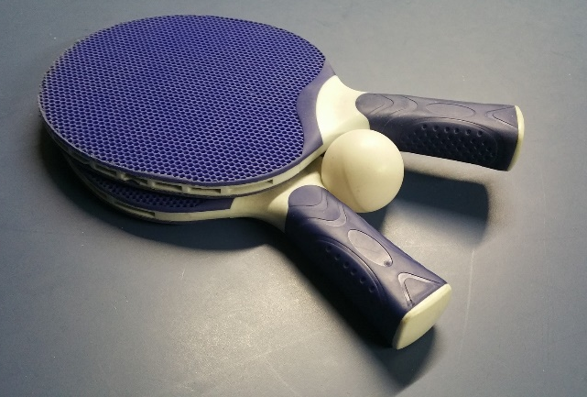
Starter - What IS RESILIENCE?
Which ball do you think is the most resilient? Why?
A RUBBER BALL?
A FOAM BALL?
A PING PONG BALL?
Notes:
Rubber ball - Photo by cohdra at Morguefile.com – Download here at: https://morguefile.com/photos/morguefile/1/rubber%20ball/pop
Foam ball – Photo by landersb at Pixabay.com – Used under CCO license CC0 1.0. Download here: https://pixabay.com/en/balls-tennis-foam-670056/
Ping pong ball – Photo by EBTConsultancy at Pixabay.com - Used under CCO license CC0 1.0. Download here: https://pixabay.com/en/tennis-sport-ping-pong-ball-1141703/

Slide 4
Resilience is not about trying to be ‘so tough’ that nothing impacts us. Resilience is not about putting up with things.
Resilience is the ability to recover from setbacks. It is ok to feel sad, angry, happy, worried…it is how we respond and adapt that is key.

Slide 5
DEFINITION OF DIGITAL RESILIENCE
Digital resilience is the ability to bounce back from difficult times online over time

Slide 6
Activity 1
How does going online make people feel?
???
Angry
Happy
Worried
Sad
Going online stirs up a variety of emotions. Use the colour code and think of any more emotions to show how people might feel. Remember one incident could cause many emotions.
5 minutes

Slide 7
Is online influence a positive or negative thing?

Slide 8
Activity 2 – UNDER PRESSURE
Online influences and pressures can be positive and negative.
Fill in the sheet with online pressures and your advice for that person
10 minutes

Slide 9
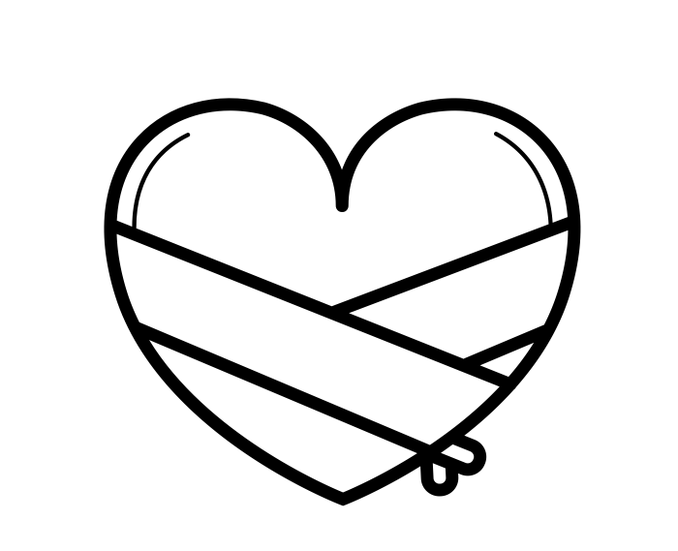
Bouncing back with digital resilience!
Notes:
Recovering heart graphic created by Vector Bakery. Sourced from the Noun Project with thanks.

Slide 10
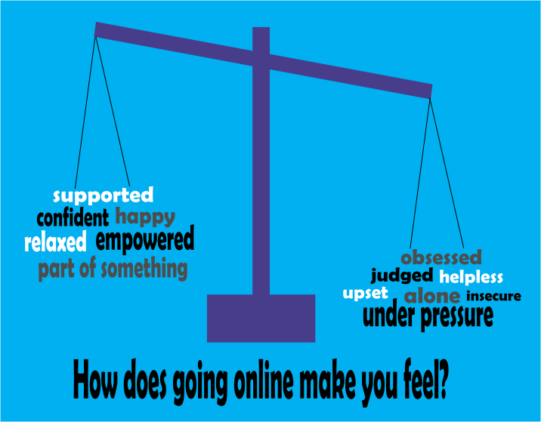
WHEN MIGHT SOMEONE NEED DIGITAL Resilience?

Slide 11
So…how do you become more digitally resilient?
Build a support network
Give yourself a break
Make some lifestyle changes
Look after your physical health
These 4 fantastic tips are from the charity Mind – www.mind.org.uk
We will now explore how to do this….
Notes:
For more information on Mind and their tips on resilience : www.mind.org.uk/information-support/types-of-mental-health-problems/stress/developing-resilience

Slide 12
ACTIVITY 3: CREATE A DIGITAL RESILIENCE TOOLBOX
Work together to fill up your digital resilience toolbox with as many ideas as you can
5 minutes
Notes:
Toolbox created by Andrejs Kirma, LV from the Noun Project with thanks. Download here at: https://thenounproject.com/search/?q=toolbox&i=1821185
Idea bulb create by Pause08 from the Noun Project with thanks – Download here at: https://thenounproject.com/search/?q=light%20bulb&i=1422926

Slide 13
PAIRS - 5 minutes
Target = 30 ideas
No disruptions
No slacking
No distractions
STARTING IN 5,4,3,2,1…

Slide 14
Share your ideas Add any new ones to your toolbox
Celebrate your successes
Call a friend
Do something you really enjoy
Notes:
Toolbox created by Andrejs Kirma, LV from the Noun Project with thanks. Download here at: https://thenounproject.com/search/?q=toolbox&i=1821185
Idea bulb create by Pause08 from the Noun Project with thanks – Download here at: https://thenounproject.com/search/?q=light%20bulb&i=1422926

Slide 15
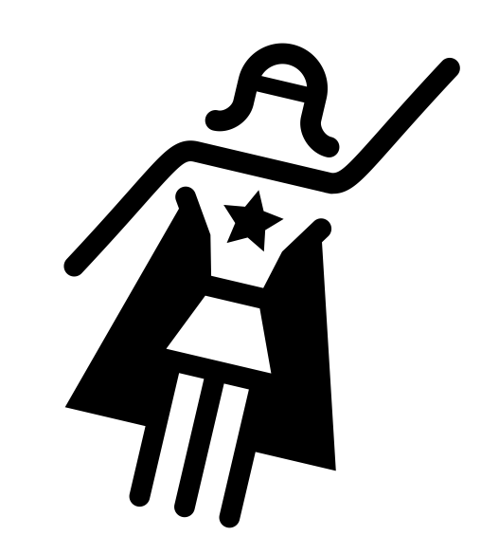
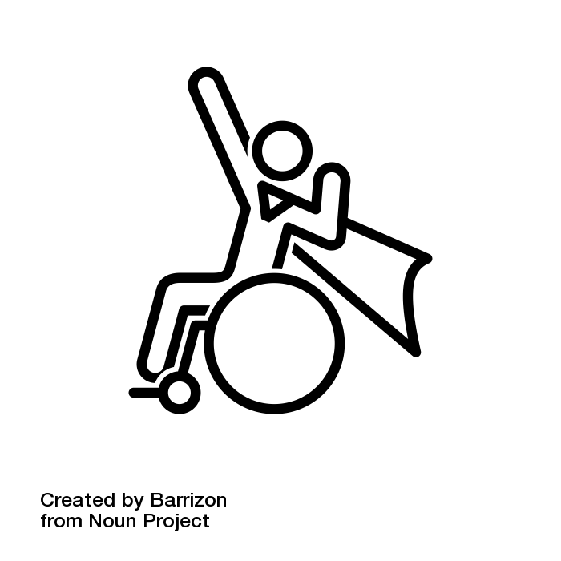
PLENARY– Digital resilience Superheroes
Step 1: Think of a person who has shown digital resilience e.g. a celeb, someone you know or follow or you could make it up.
Step 2: Note down any characteristics or “special powers” they have shown e.g. asking for help, talking to others, perseverance…
Step 3: Create something to showcase your Digital Resilience Superhero. This could be a drawing, poem, cartoon, speech or a sentence.
10 minutes
Notes:
From Left to Right
Superhero created by Barrizon from the Noun Project with thanks. Download here at: https://thenounproject.com/search/?q=superhero&i=550572
Wonder Woman created by Éléonore Sabaté from the Noun Project with thanks. Download here at: https://thenounproject.com/search/?q=wonder%20woman&i=638563
Superhero created by Moriah Rich from the Noun Project with thanks. Download here at: https://thenounproject.com/search/?q=superhero&i=12709

