Slide 1
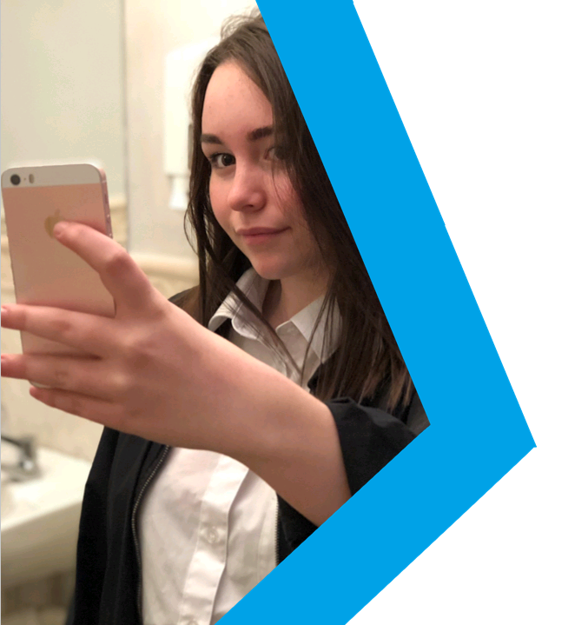
MYTH
VS
REALITY
Body Image
Lesson Plan

Slide 2
Students can identify where the pressures to look a certain way online comes from.
Students can make comparisons between what is considered the ‘ideal’ body image online and the actual reality.
Students can propose effective strategies to help young people develop a healthy and positive attitude towards their body image.
Students will know where they can go for advice and support with body image concerns.

Slide 3
Starter discussion
Watch the talking heads
Discussion questions
-----------------------------------------
Activity A: Challenging online myths
Activity B: Changing the way we look online
Activity C: Be the change
Plenary: #RealityCheck

Slide 4
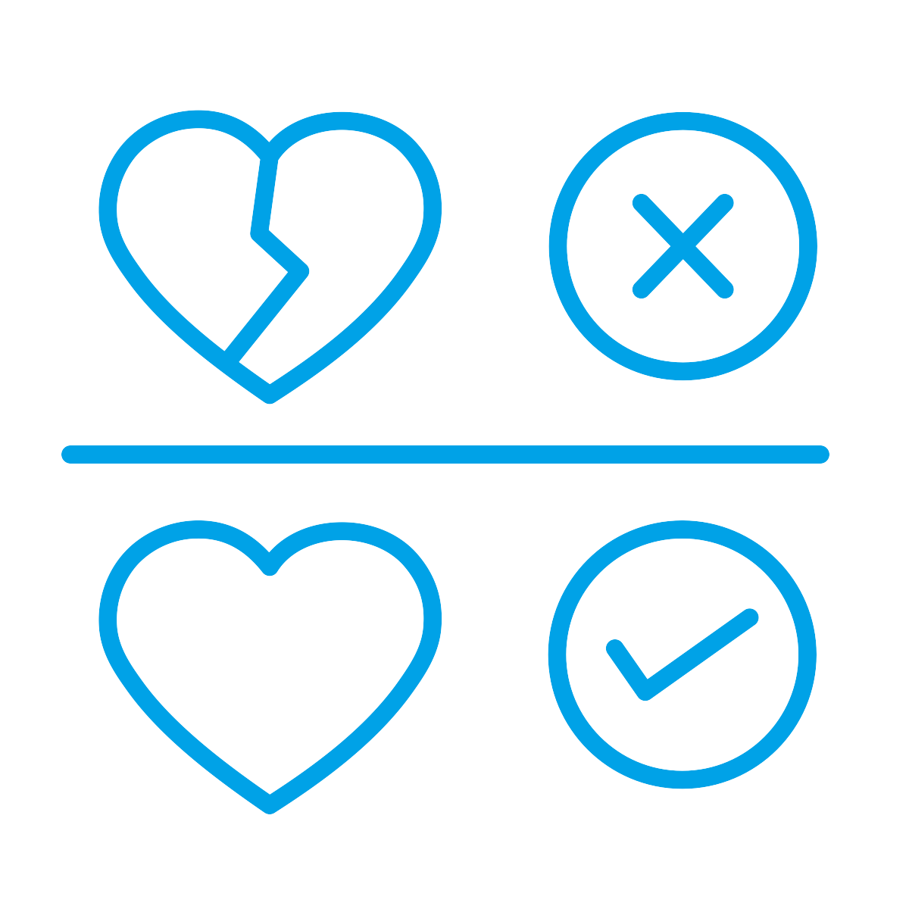
Discuss and establish ground rules
for the session
We listen and respect everyone when they are speaking and when we are responding.
We know that we don’t have to participate in any activities or questions which make us feel uncomfortable.
We know that we are not expected to share our own personal experiences but are free to do so without judgement if we want to.
We speak about a ‘friend’ or ‘someone we know’ instead of using real names if we share experiences or stories.
Refer to page 16 of the guidance for full details
Notes:
NB - You may wish to establish these rules as a group and use these as a guide

Slide 5
Size matters
inferior
What does
#skinnygoals
curvy
Body Image
‘body image’
Celebrities
#bodygoals
mean to you?
Confident
Task: Think of any words, phrases, hashtags, photo crazes etc. which define body image to you.
5 minutes
Refer to page 53 of the guidance for full details

Slide 6
Talking heads starter questions
How influential are the images we see online? Who has a greater influence – celebrities or our peers?
Do you think people are more concerned with how they look online or offline and why?
Do you think there is more edited or unedited content online and what would people prefer to see?

Slide 7
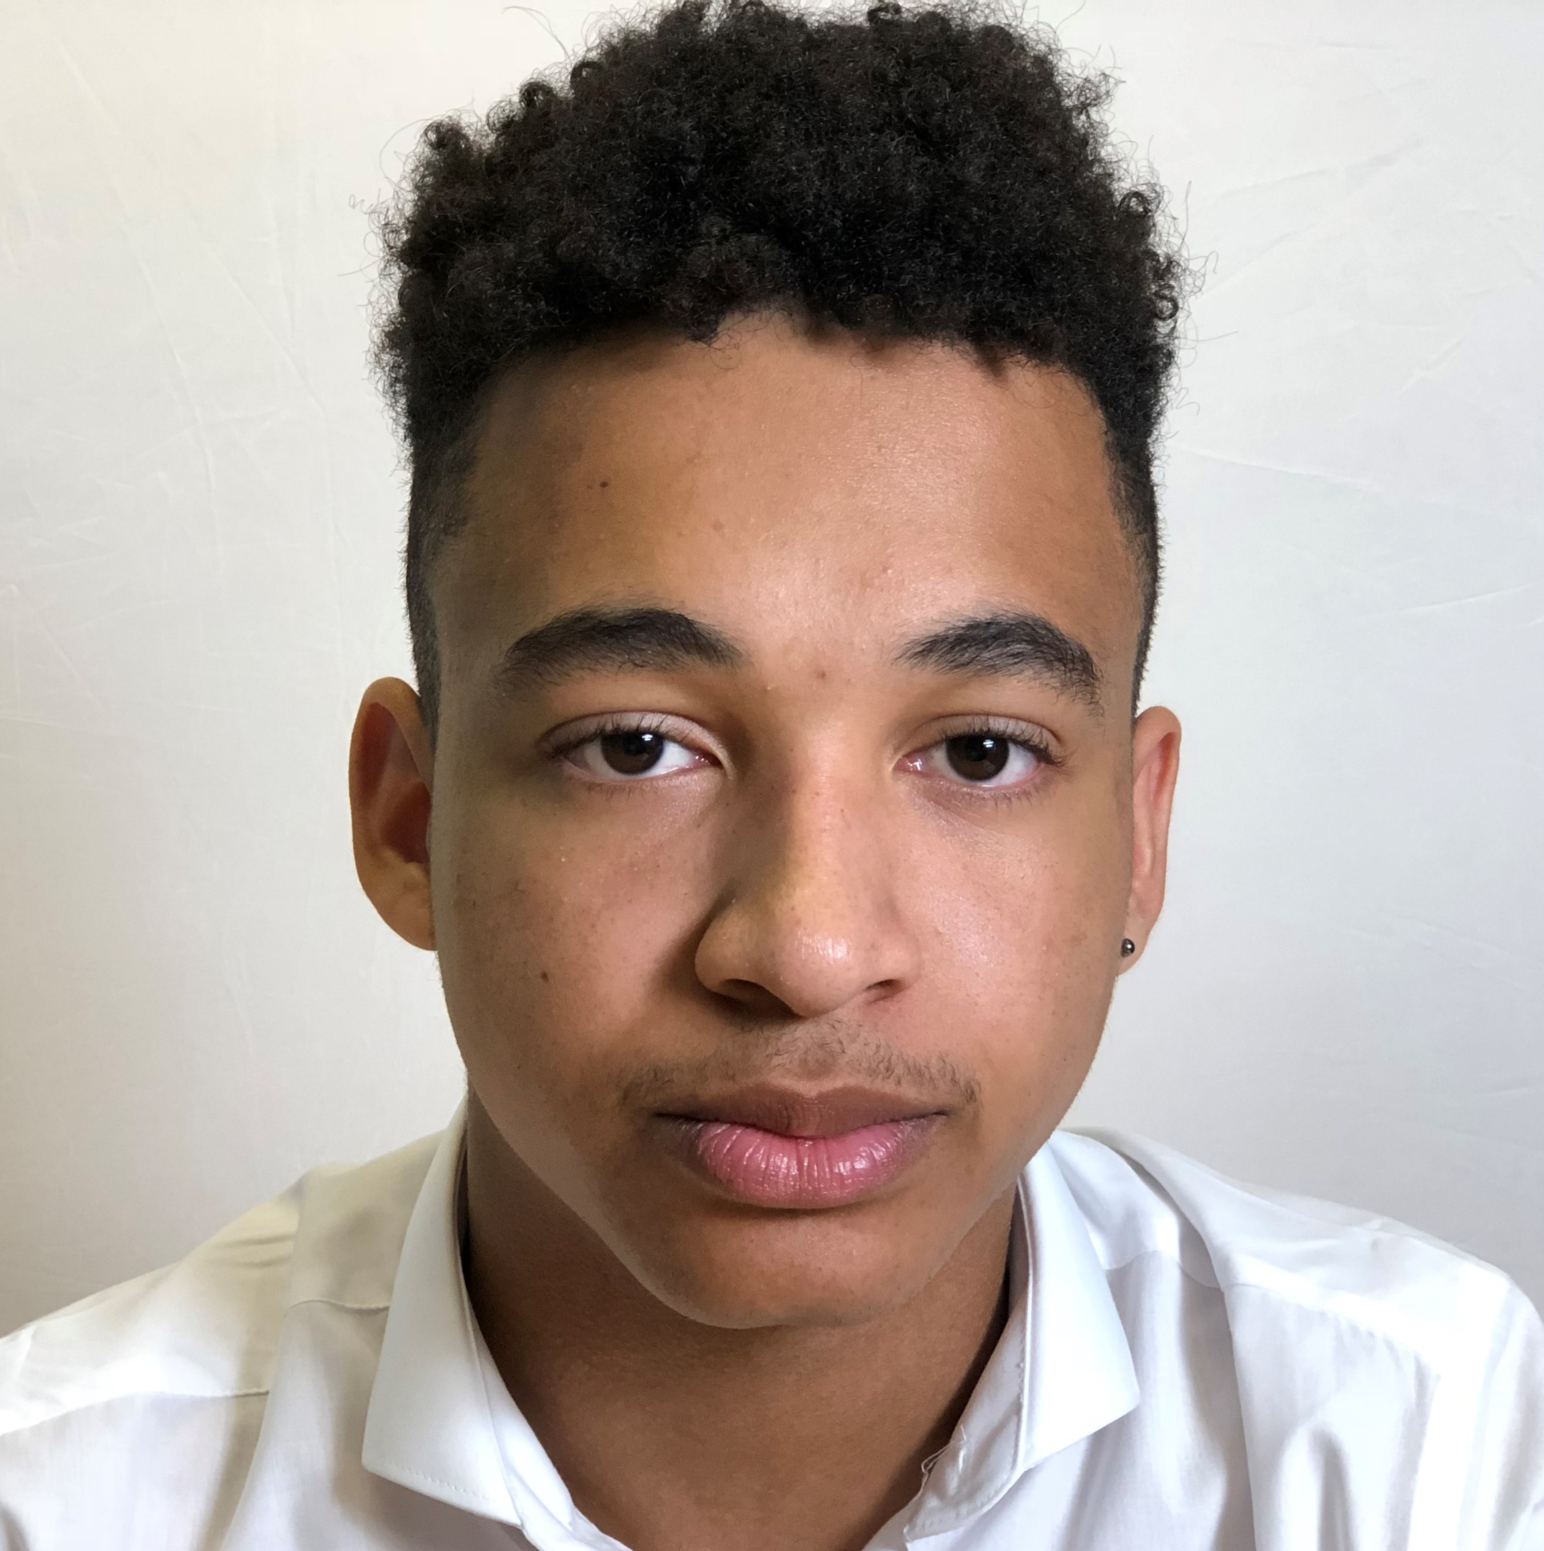
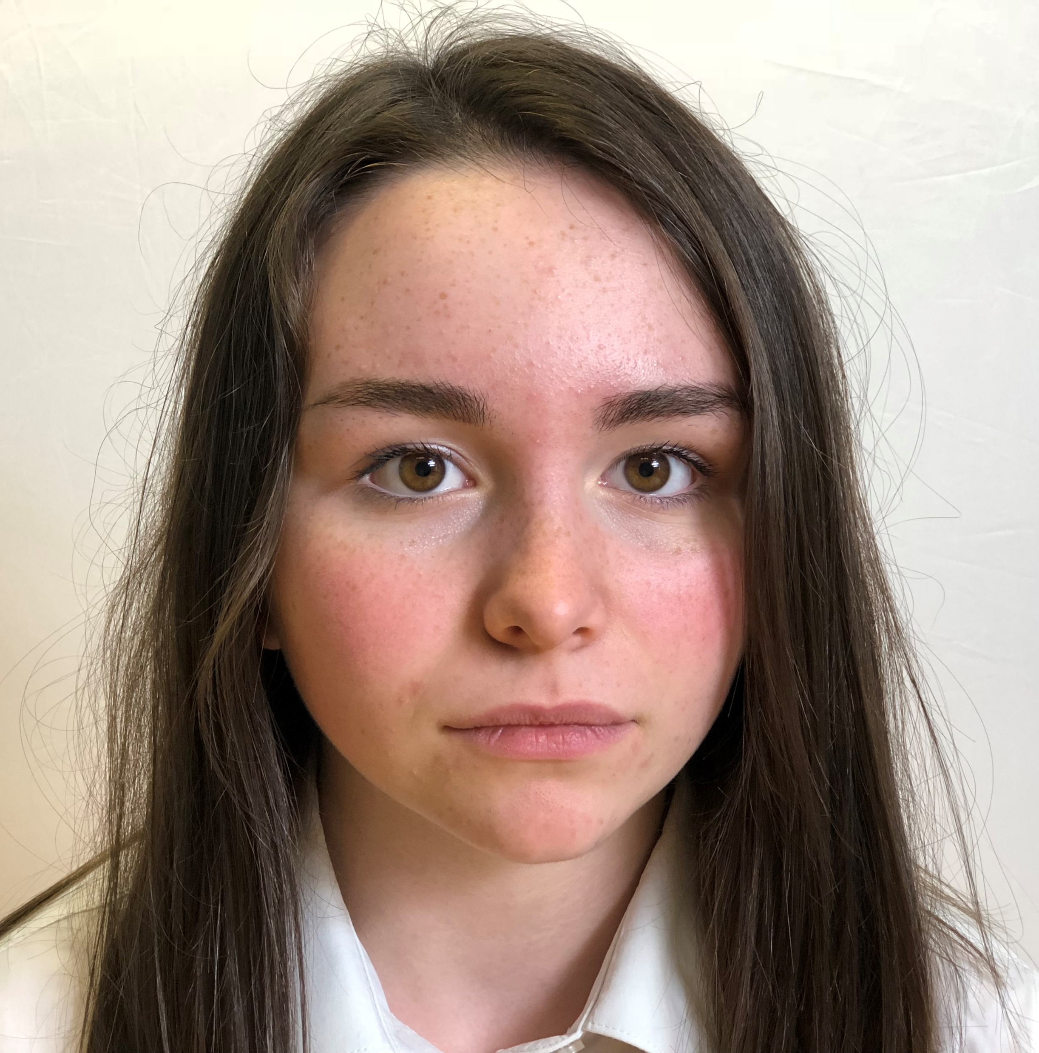
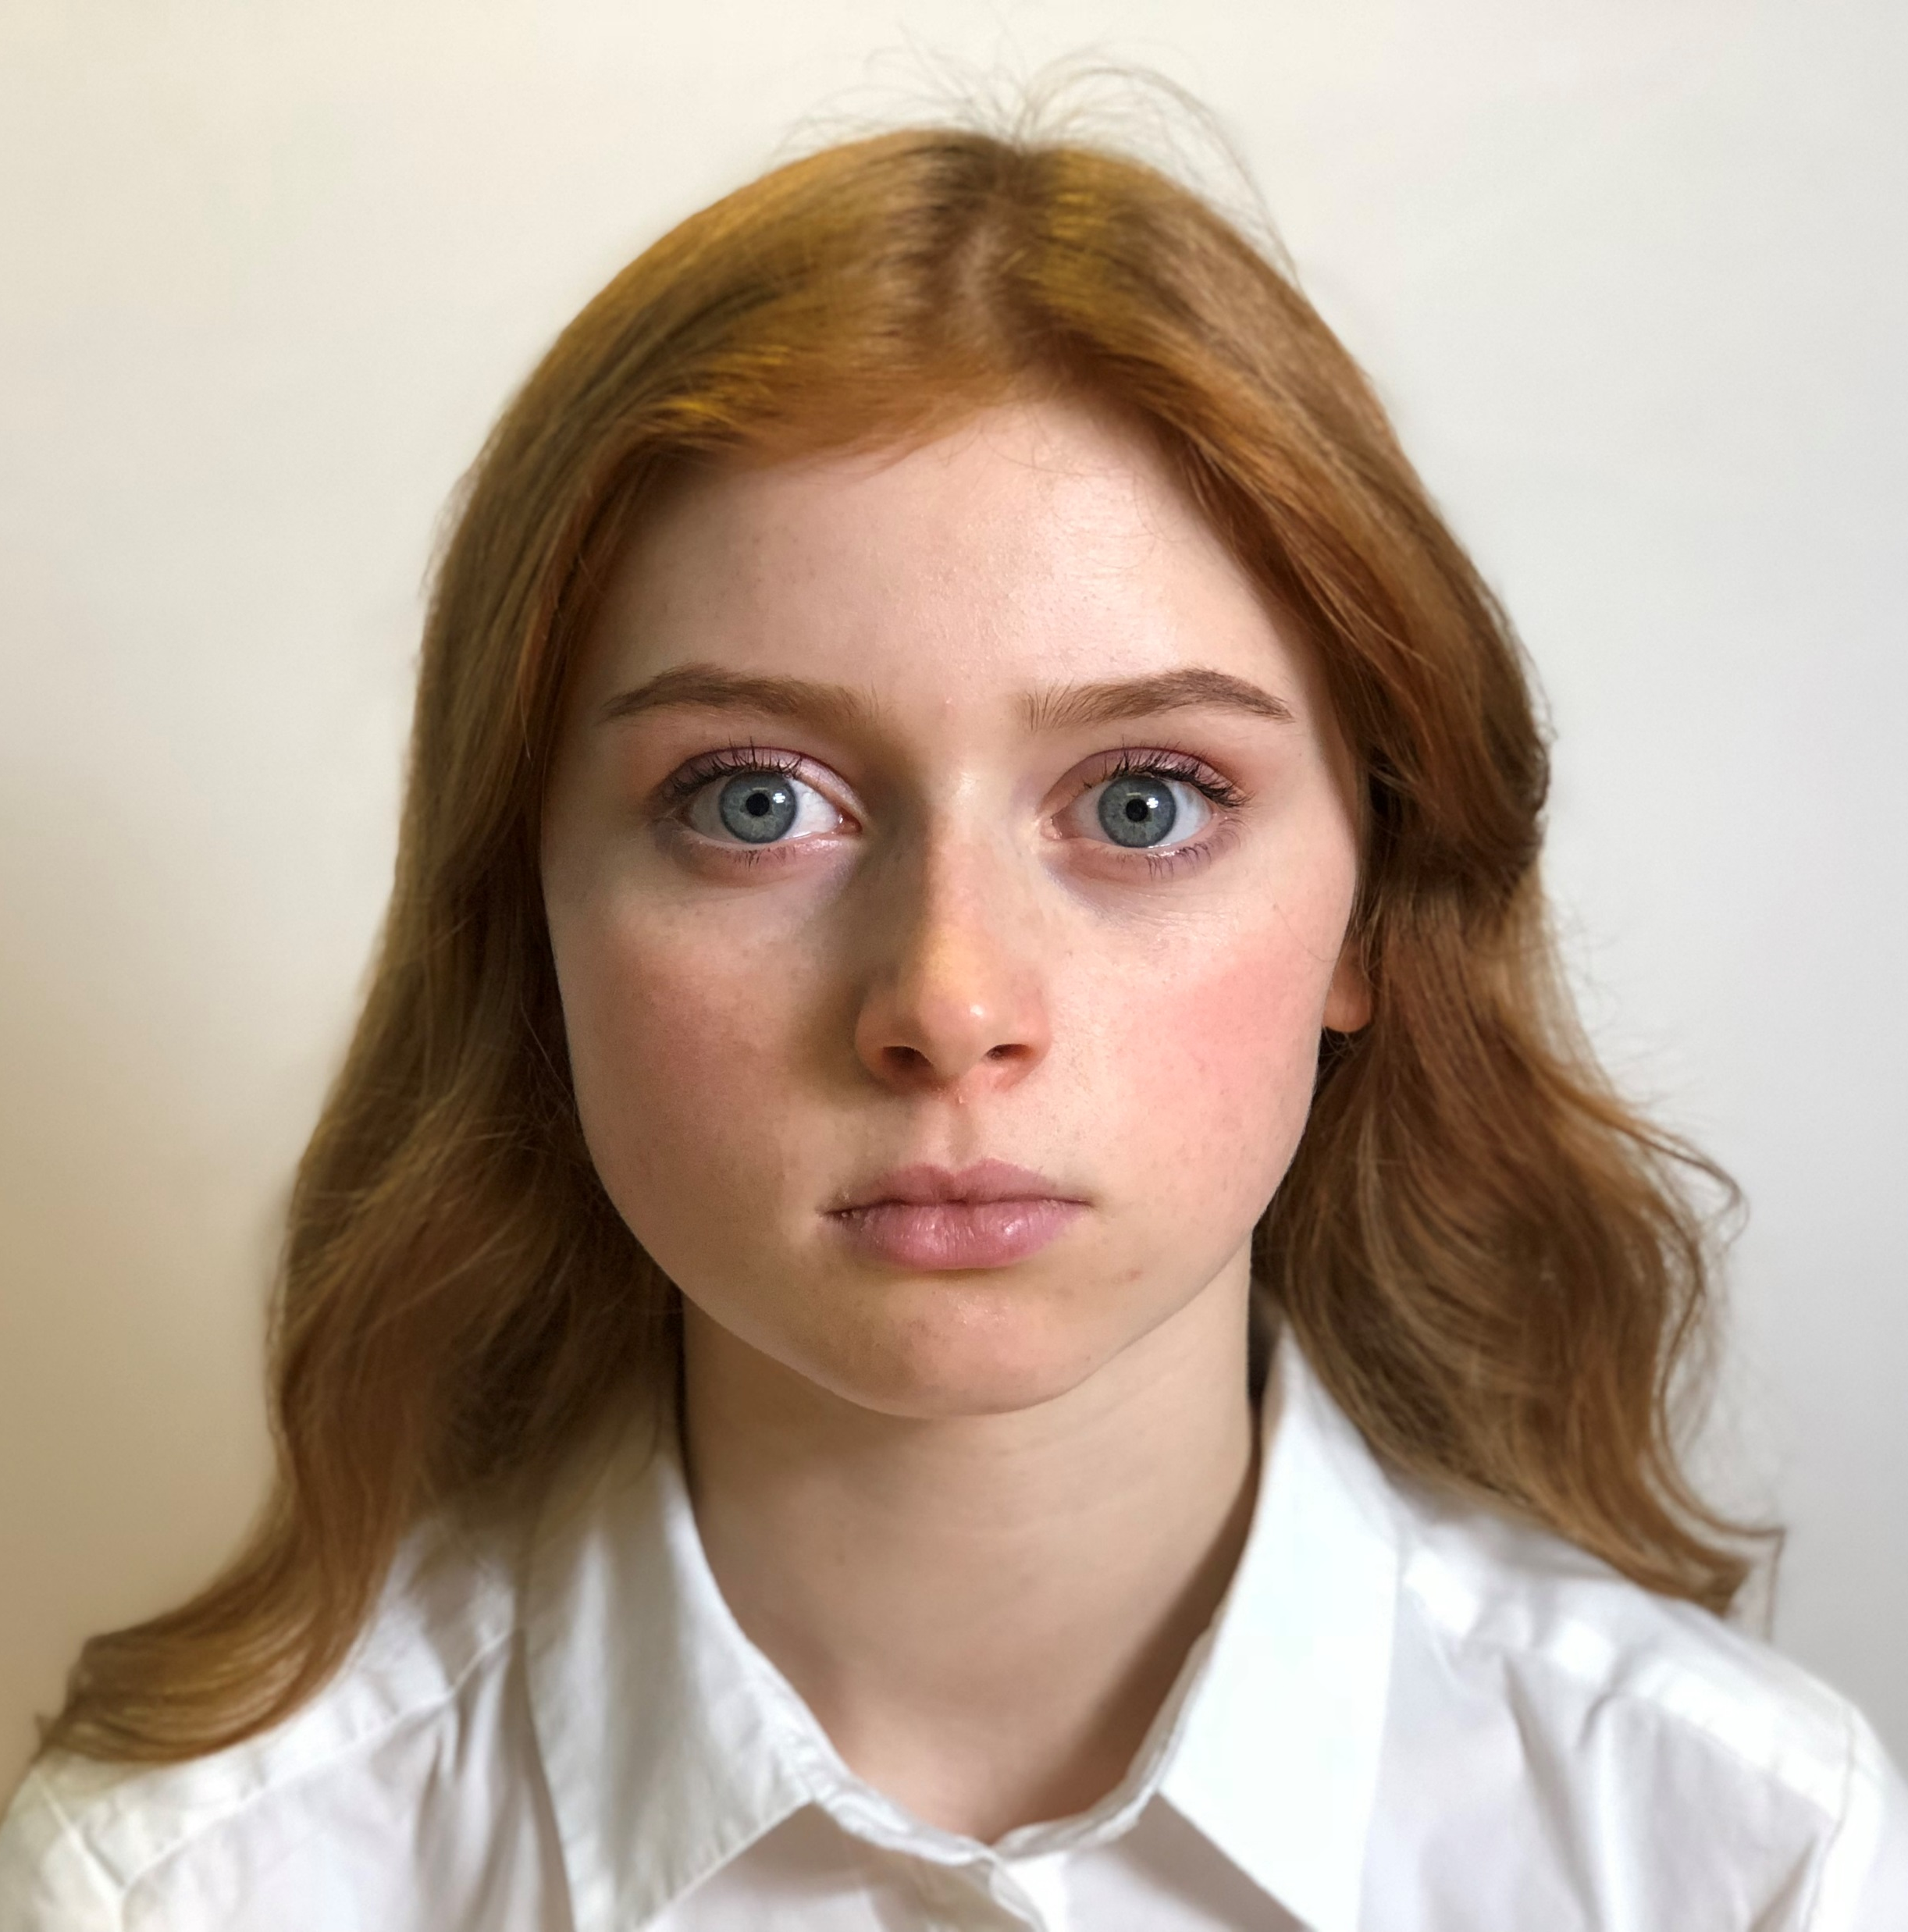
Watch the talking heads
Ryan
“It’s just how it is.”
Beth
“How do I compare?”
Sadie
“It’s what people think.”

Slide 8
Ryan
“It’s just how it is”
Ryan thinks there’s an equal but different type of pressure for boys to look good online as there is for girls. Do you agree and what are these pressures?
Online appearance is clearly very important to Ryan.
On a scale of 1-10 (10=extremely high) how important do you think appearance online is to young people?
Ryan says that you will get more likes if you’re fitter, skinnier or prettier – is this comment realistic? Fair?
Why does Ryan feel the need to post ‘topless pictures’ of himself?

Slide 9
Beth
“How do I compare?”
Beth talks about diets she has seen online and how much the images she sees online impact on how she feels about her body and weight. What advice would you give someone who was feeling this way?
Beth says that ‘slim people are happier and more popular’ and this influences how she wants her online image to be. Do you think people compare themselves more to others online or offline?
Beth tells us that she will take several selfies in order to obtain the perfect picture. How many selfies do you think someone would take before they post it online? Why do you think someone would choose not to post the first selfie they take online?
By doing this, Beth is carefully creating her online image. How might this impact on other people that see it? What other choices might someone make in order to build their online image?

Slide 10
Sadie
“It’s what people think”
Sadie talks about ‘body shaming.’ What is body shaming? How does it happen online and how does it make people feel?
Sadie talks about how some people may take down a picture if it doesn’t get a nice comment. What has more impact – a positive or a negative comment online and why do you think this is?
Can being online ever support someone to make healthy choices or improve how they feel about themselves and how does it do this?
Sadie challenges the idea that ‘only good people should post pictures online’ and is confident in ignoring the online pressures on body image. What do you think her strategy is?

Slide 11
Is it more important to look good online than offline?
Activity A
Challenging online myths
Task: Crack the online myths to reveal the offline truth.
10 minutes
Refer to page 57 of the guidance for full details

Slide 12
It is more important to look good online than offline
Myth 1
Myth 2
Young people are obsessed with how they look online
Only girls care about how they look online
Myth 3
Are these myths targeted at one gender in particular?
Where has this myth come from and what/ who reinforces it?
What could the issue be for a young person if they were to believe the myth?

Slide 13
Activity B
Changing the
way we look online
Task: What changes do people make to the way they look online before and after taking a picture/ video?
10 minutes
Refer to page 57 of the guidance for full details

Slide 14
Before
Angle
Cropping
Clothing change
Filter
Lighting
Caption
After

Slide 15
Activity C
‘Everyone at our school feels confident in themselves and happy with their body image.’
Be the change
Task: How true is the statement above for your school and how could you make it happen?
10 minutes
Refer to page 58 of the guidance for full details

Slide 16
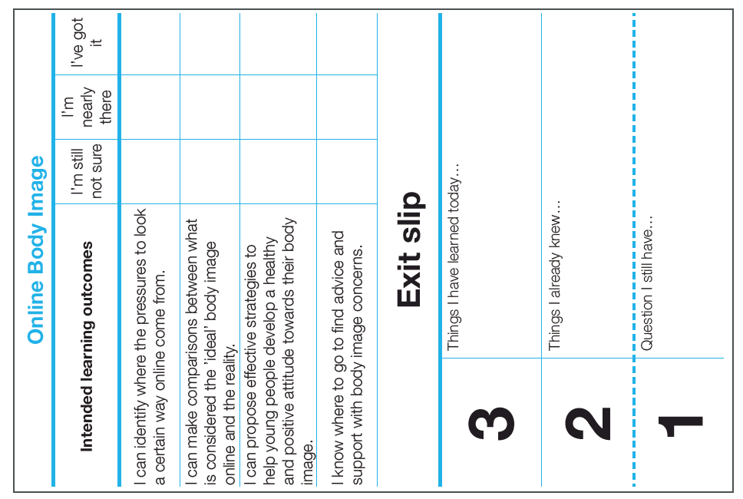
‘My friends, the people I follow, everyone always looks way better than me. It’s impossible not to compare yourself to others.’
How would you respond to this statement?
What advice would you give?

Slide 17
Helplines for young people
Services for young people talk to someone anonymously without judgement via chat, or via phone, on whatever issue they would like.
0800 11 11 - A service for under 18s
0808 808 4994 – A service for 13-25s
0808 801 0711 – Youth hotline to support anyone worried about, or affected by, eating disorders
Where can I go for advice, help and support?
Website for advice and support
Advice
Online support for young people with visible difference – conditions or injuries affecting their appearance www.ypfaceit.co.uk.
A youth charity focused on mental health and wellbeing which offers information, advice and guidance for young people on anything which may impact on your wellbeing www.youngminds.org.uk.
Support

Slide 18
Available to download at:
www.childnet.com/pshetoolkits
Myth vs Reality PSHE toolkit 2019 by Childnet International is licensed under a Creative Commons Attribution-NonCommercial-ShareAlike 4.0 International License.

