Slide 1
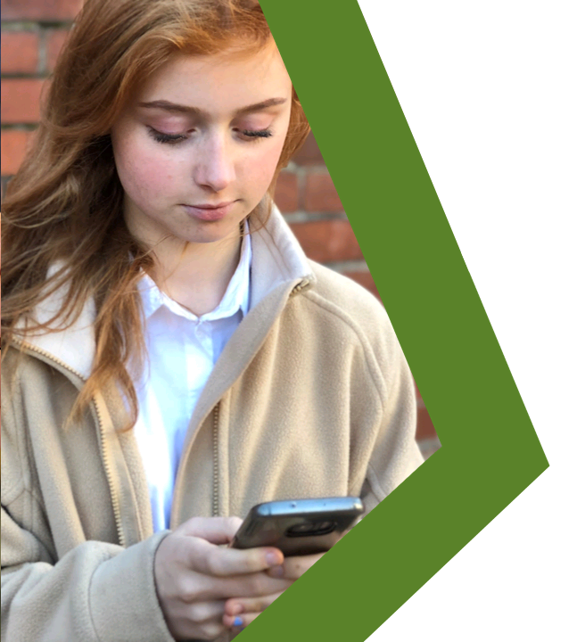
MYTH
VS
REALITY
Healthy Relationships
Lesson Plan

Slide 2
Students will understand the key components of a healthy relationship online.
Students will recognise the signs of an unhealthy relationship online.
Students will explore misconceptions about what is ‘normal’ behaviour in healthy relationships online.
Students will know where to go for help and advice on healthy
Relationships.

Slide 3
Starter discussion
Watch the talking heads
Discussion questions
--------------------------------------
Activity A: Healthy or unhealthy?
Activity B: Spot the signs
Activity C: Myth vs reality
Plenary: #RealityCheck

Slide 4
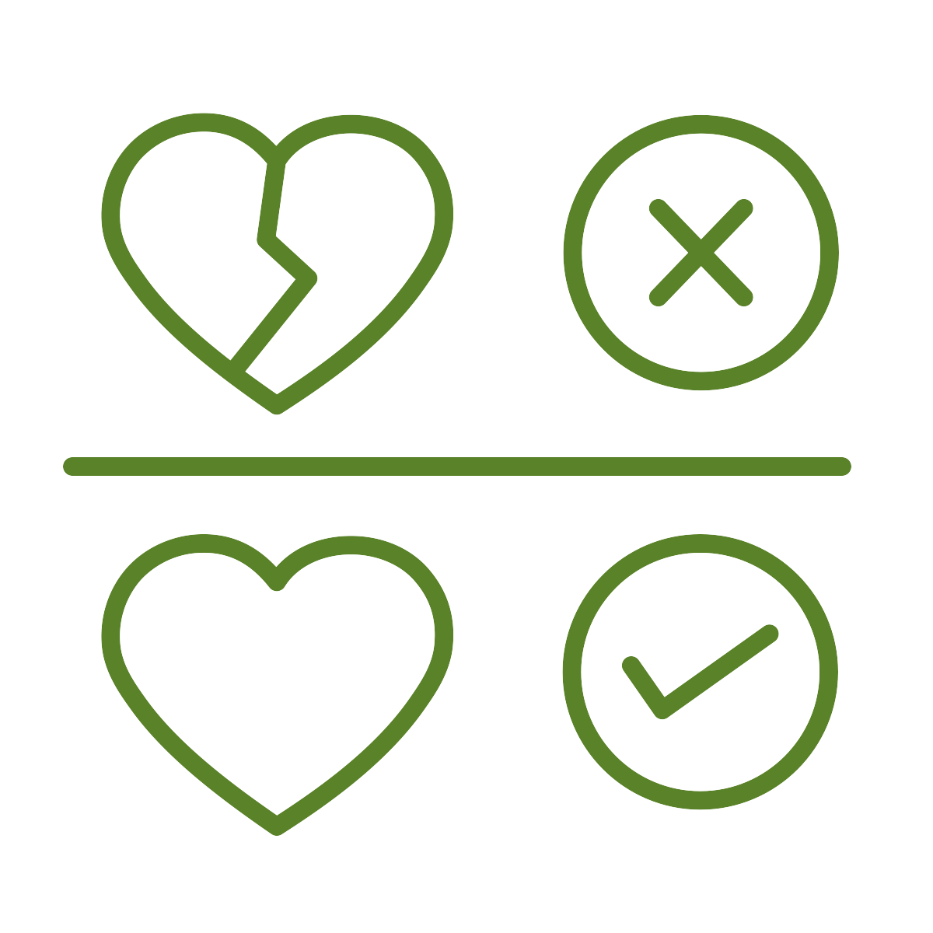
Discuss and establish ground rules
for the session
We listen and respect everyone when they are speaking and when we are responding.
We know that we don’t have to participate in any activities or questions which make us feel uncomfortable.
We know that we are not expected to share our own personal experiences but are free to do so without judgement if we want to.
We speak about a ‘friend’ or ‘someone we know’ instead of using real names if we share experiences or stories.
Refer to page 16 of the guidance for full details
Notes:
NB - You may wish to establish these rules as a group and use these as a guide

Slide 5
What are the traits of a healthy or unhealthy relationship?
Who do you
communicate most
with online?
Task: Generate a list of healthy and unhealthy relationship traits.
5 minutes
Refer to page 38 of the guidance for full details

Slide 6
Talking heads starter questions
What makes a healthy relationship?
What is consent?
How is consent given online and offline?

Slide 7
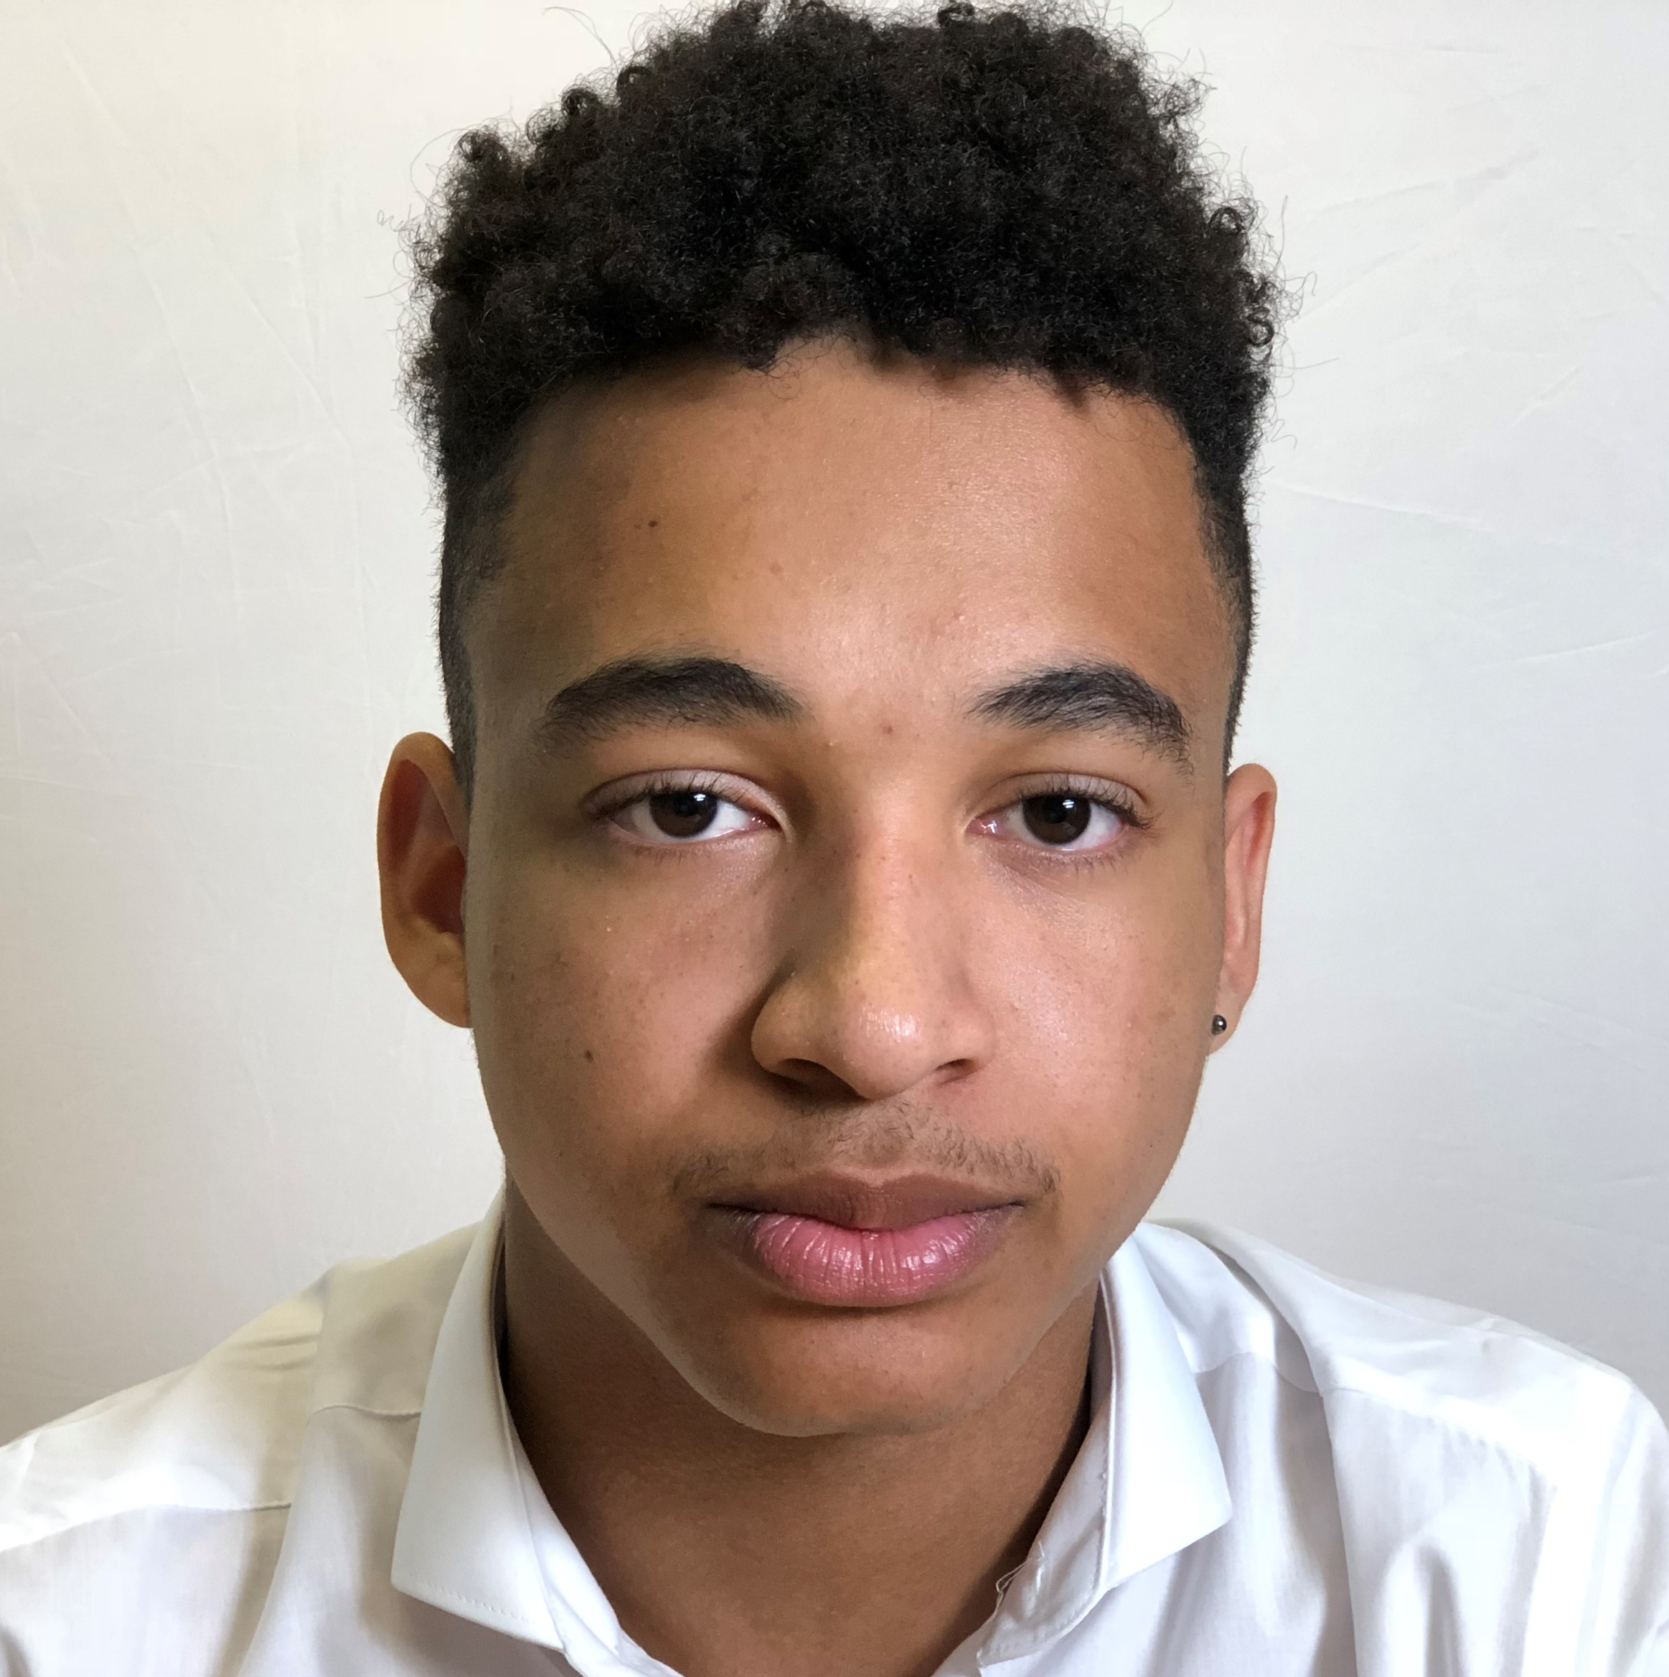
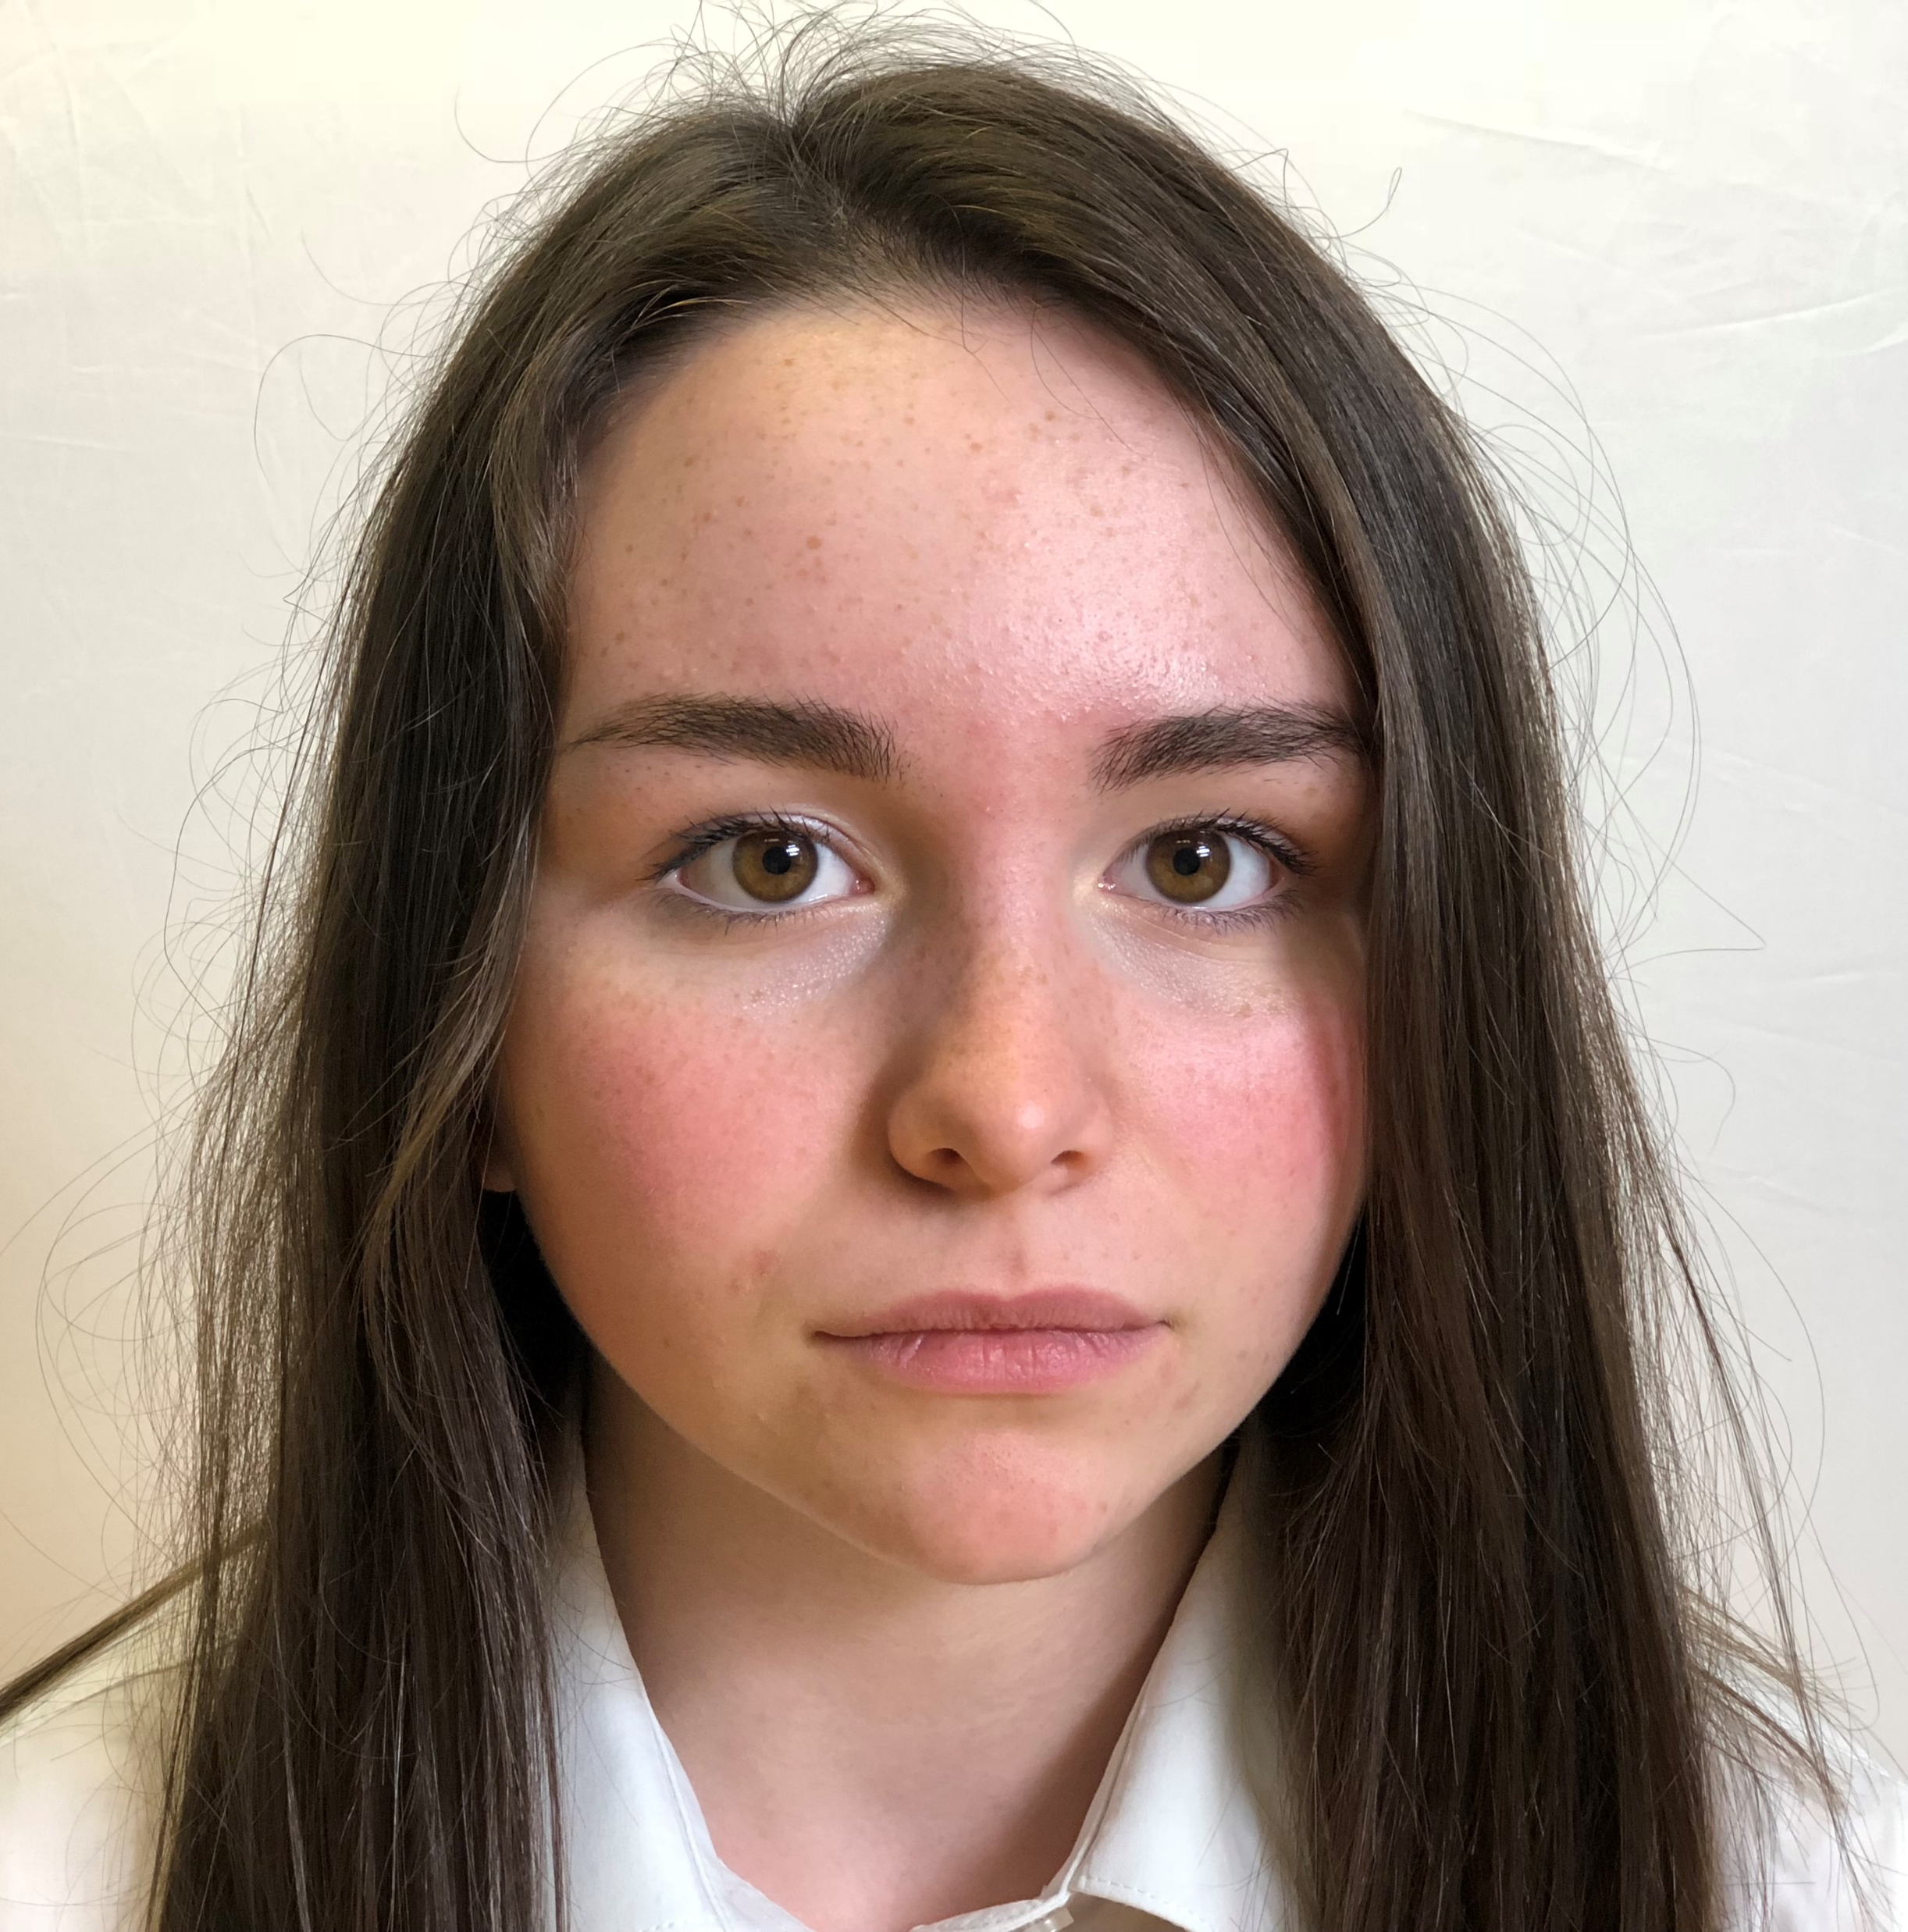
Watch the talking heads
Ryan
“It’s what I expect.”
Beth
“Is this what I should do?”
Sadie
“What’s the right thing to do?”

Slide 8
Ryan
“It’s what I expect.”
Ryan states that he broke up with someone because they didn’t reply to his message within 10 minutes. Do you think this is fair? What do you think is an acceptable amount of time to reply to a message?
What do you think about the comment Ryan makes when he says that it’s up to him what he shares or posts online when in a relationship?
Is it ever okay to share pictures or information of someone online without their consent or knowledge?
What should happen to posts and messages shared during a relationship once it comes to an end?

Slide 9
Beth
“Is this what I should do?”
She comments that her friend posted too much information about her relationship online. How much is too much?
Do you think you find out more about what’s going on in people’s relationships from what you read online or what you see in real life? Why?
Are there any other unwritten rules of relationships and if so, what are they?
Beth thinks that it would be okay to share her password. Is this a wise move and what could be the repercussions of doing this?
What would happen if someone didn’t follow these unwritten rules?

Slide 10
Sadie
“What’s the right thing to do?”
Sadie says that it makes her feel a bit down when she sees other people’s relationship posts. Why might it make someone feel this way and what advice would you give them?
What could Sadie do if she was concerned about one of her friends again?
What makes a healthy relationship?
Sadie tells us about her friend who in a controlling relationship. Which behaviours do you consider to be controlling in a relationship?
What do you consider to be your rights and responsibilities when you are in a relationship?

Slide 11
Activity A
Healthy or unhealthy?
Task: Sort the behaviours on worksheet 2.2 onto a traffic light of behaviours from healthy to unhealthy.
10 minutes
Refer to page 42 of the guidance for full details

Slide 12
Share your passwords/ PINS to your online accounts/ devices
Feel you have to respond to messages instantly so you don’t upset the other person
Let the other person deal with online problems by themselves
Feel angry if the other person reads a message but takes a long time to reply
Message or call the other person more than they do
Message or call the other person less than they do
Update your online status to prove you are in a relationship
Tag each other in silly photos or memes because it’s just a joke
‘Like’ all of each other’s posts/photos
Take screenshots of each other’s messages
Set your profile picture as a photo of you and the other person
Check the other person’s messages/phone without asking

Slide 13
Activity B
Spot the
Signs
Task: Discuss the messages within the scenarios and write a response to the message as if you were receiving it
10 minutes
Refer to page 42 of the guidance for full details

Slide 14
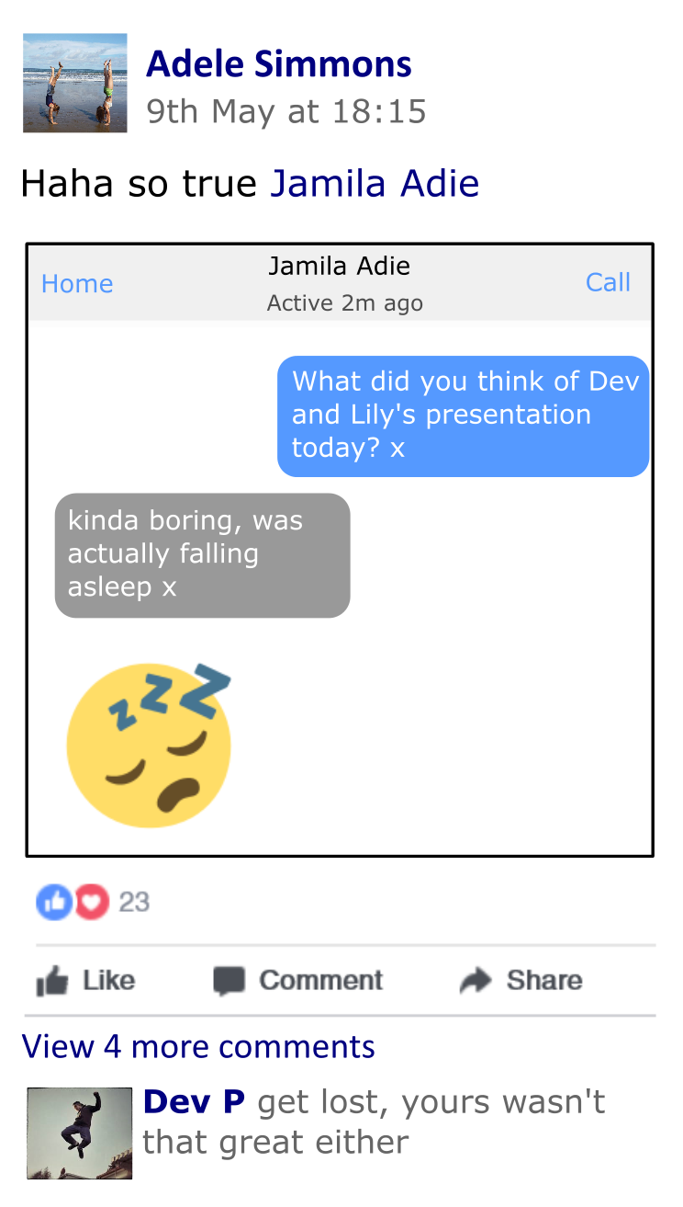
What type of relationship is this?
Does it seem unhealthy or healthy? Why?
Are there examples or both types of behaviour in this message? What does it tell you about the relationship?
How would you reply?

Slide 15
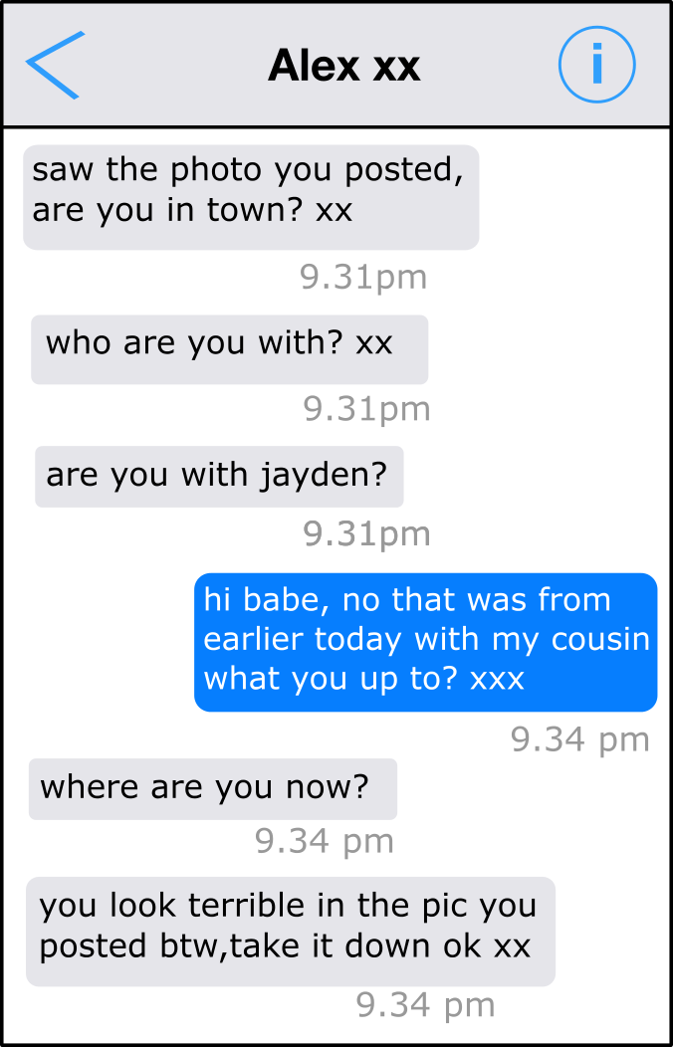
What type of relationship is this?
Does it seem unhealthy or healthy? Why?
Are there examples or both types of behaviour in this message? What does it tell you about the relationship?
How would you reply?

Slide 16
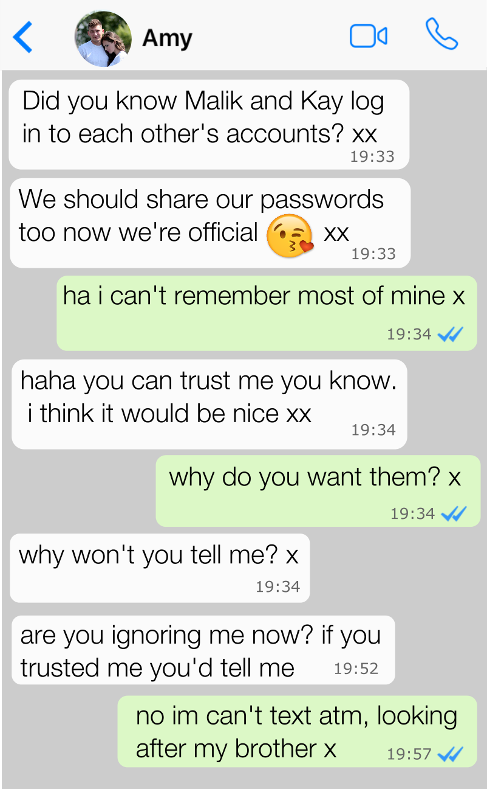
What type of relationship is this?
Does it seem unhealthy or healthy? Why?
Are there examples or both types of behaviour in this message? What does it tell you about the relationship?
How would you reply?

Slide 17
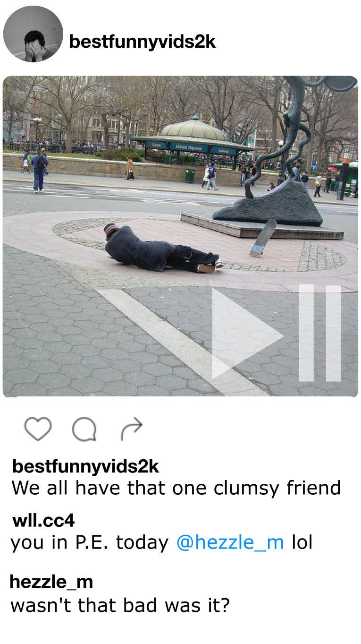
What type of relationship is this?
Does it seem unhealthy or healthy? Why?
Are there examples or both types of behaviour in this message? What does it tell you about the relationship?
How would you reply?

Slide 18
Be direct – express your feelings
without arguing or accusing, e.g.
“I’m not ok with you sharing photos of me”
Be honest – healthy relationships are built
on trust and respect, e.g. “I feel uncomfortable when you ask for my passwords”
TOP
TIPS
Use humour – sometimes this can get your point across in a light-hearted way
Give a reason – in healthy relationships, each person can see things from the other’s point of view, e.g. “I can’t always reply after 10:30pm because I’m not allowed my phone in my room”
For handing uncomfortable online messages/ situations
Tell someone – if you are ever having a difficult time online, ask a trusted friend or adult for advice on how to handle the situation

Slide 19
Activity C
Myth vs
Reality
Task: Match the online myths to the offline reality.
10 minutes
Refer to page 43 of the guidance for full details

Slide 20
Myth vs Reality
You don’t have to prove you trust your best friend / boyfriend/ girlfriend by sharing your passwords
You don’t have to reply immediately to messages, there are lots of reasons why people don’t/ can’t reply straight away
Everyone shares their passwords with their best friend/ boyfriend/ girlfriend
You don’t have to feel worried if someone reads your message straight away, they might be busy, or waiting for a time to give your message more attention
It’s rude if you don’t respond to someone’s message within 10 minutes of reading it
Getting angry at someone for taking a long time to reply is not helpful. Everyone is allowed space, they will reply when they are ready
It’s a worrying sign if you see someone has read your message but hasn’t replied
It’s acceptable to get angry at someone if they take a long time to reply to you
You don’t have to post images of your relationship online to prove you are happy
People sometimes only share what they want people to see and not what is actually going on…
Posting images of your relationship online proves you are happy
When people in relationships seem happy in the photos and comments they share, that means their relationship is healthy
Even if people online like and comment on each other’s posts, it doesn’t mean they have better friendships than you do
Other people have better friendships than you if they are always liking and commenting on each other’s posts
The internet shows us what other people are really thinking and feeling
It’s easy to pretend about how you are feeling and what you are thinking when online
If you break up with someone, you can say whatever you want about them online
If you break up with someone, you still need to be respectful if you talk to them, or about them online
When you are in a new relationship, you need to update your online status to prove it
When you are in a new relationship, you shouldn’t have to update your status to prove it if you don’t want to
When you are in a new relationship, you need to update your online status to make your boyfriend/ girlfriend happy
When you are in a new relationship, you shouldn’t have to update your online status to make a boyfriend/ girlfriend happy
It’s OK to screenshot a message and share it publicly if you are good friends with someone
It’s OK to tag someone in a silly picture or meme when it is really funny
You need to ask before you share a private conversation with other people…
If someone is annoyed you won’t share your password with them, you need to share it to make them happy
Think carefully before you tag someone in a silly picture or meme…
Followers online are really important and if you don’t have that many then you aren’t appreciated
Although not advisable, if you do decide to share your password, it should be because you want to, not because you feel pressure to
If you don’t have many likes or followers it doesn’t mean you are not appreciated…

Slide 21
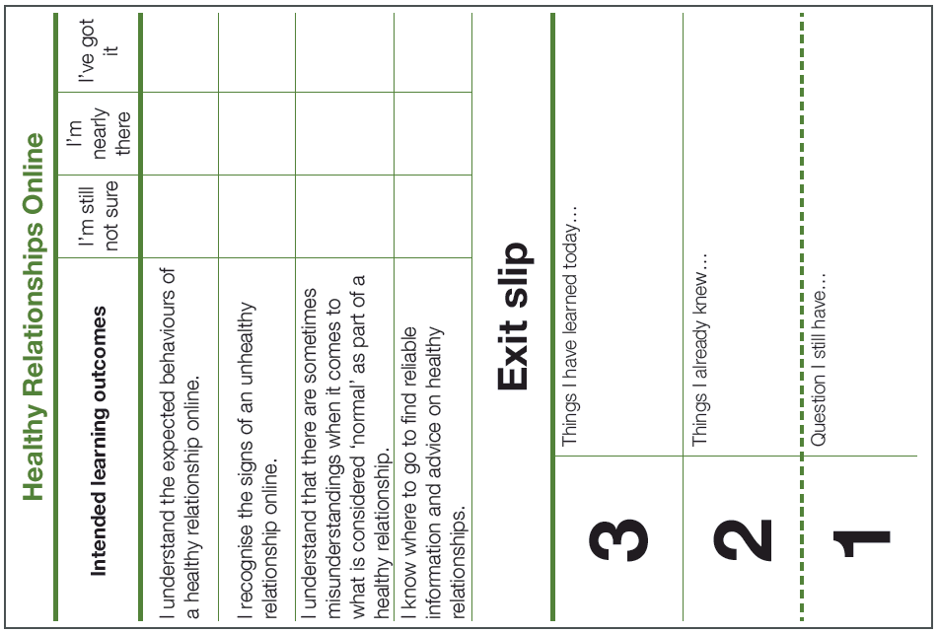
How do you maintain positive relationships online?
Write 3 ways you could keep or make relationships healthy online

Slide 22
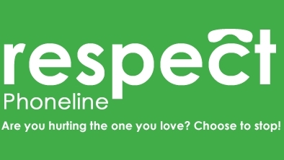
Helplines for young people
Where can I go for advice, help and support?
Services for young people to talk to someone
anonymously without judgement via chat, or via
phone, on whatever issue they would like.
0800 11 11 - A service for under 18s
0808 808 4994 – A service for 13-25s
0808 802 4040 – A confidential service for anyone concerned about violence or abuse in a relationship
Website for advice and reporting
Advice
If someone has asked you to do things online that you don’t feel comfortable with or to meet up offline, Thinkuknow offers a reporting tool and advice about staying safe online www.thinkuknow.co.uk.
Support

Slide 23
Available to download at:
www.childnet.com/pshetoolkits
Myth vs Reality PSHE toolkit 2019 by Childnet International is licensed under a Creative Commons Attribution-NonCommercial-ShareAlike 4.0 International License.

