Slide 1
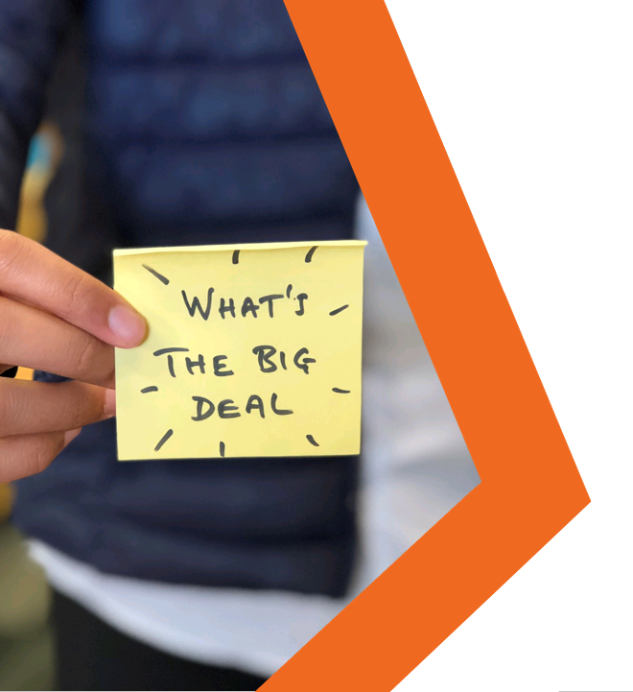

MYTH
VS
REALITY
Online Pornography
Lesson Plan

Slide 2


Students will understand that pornography can show a stereotypical portrayal of relationships, bodies, gender and sex.
Students will discuss and develop strategies for resisting pressure to view pornography.
Students will know where they can go to find reliable information
about sex and relationships.

Slide 3


Starter discussion
Watch the talking heads
Discussion questions
--------------------------------------
Activity A: Myth or reality?
Activity B: Gender stereotypes
Activity C: Resisting the pressure
Plenary: #RealityCheck

Slide 4

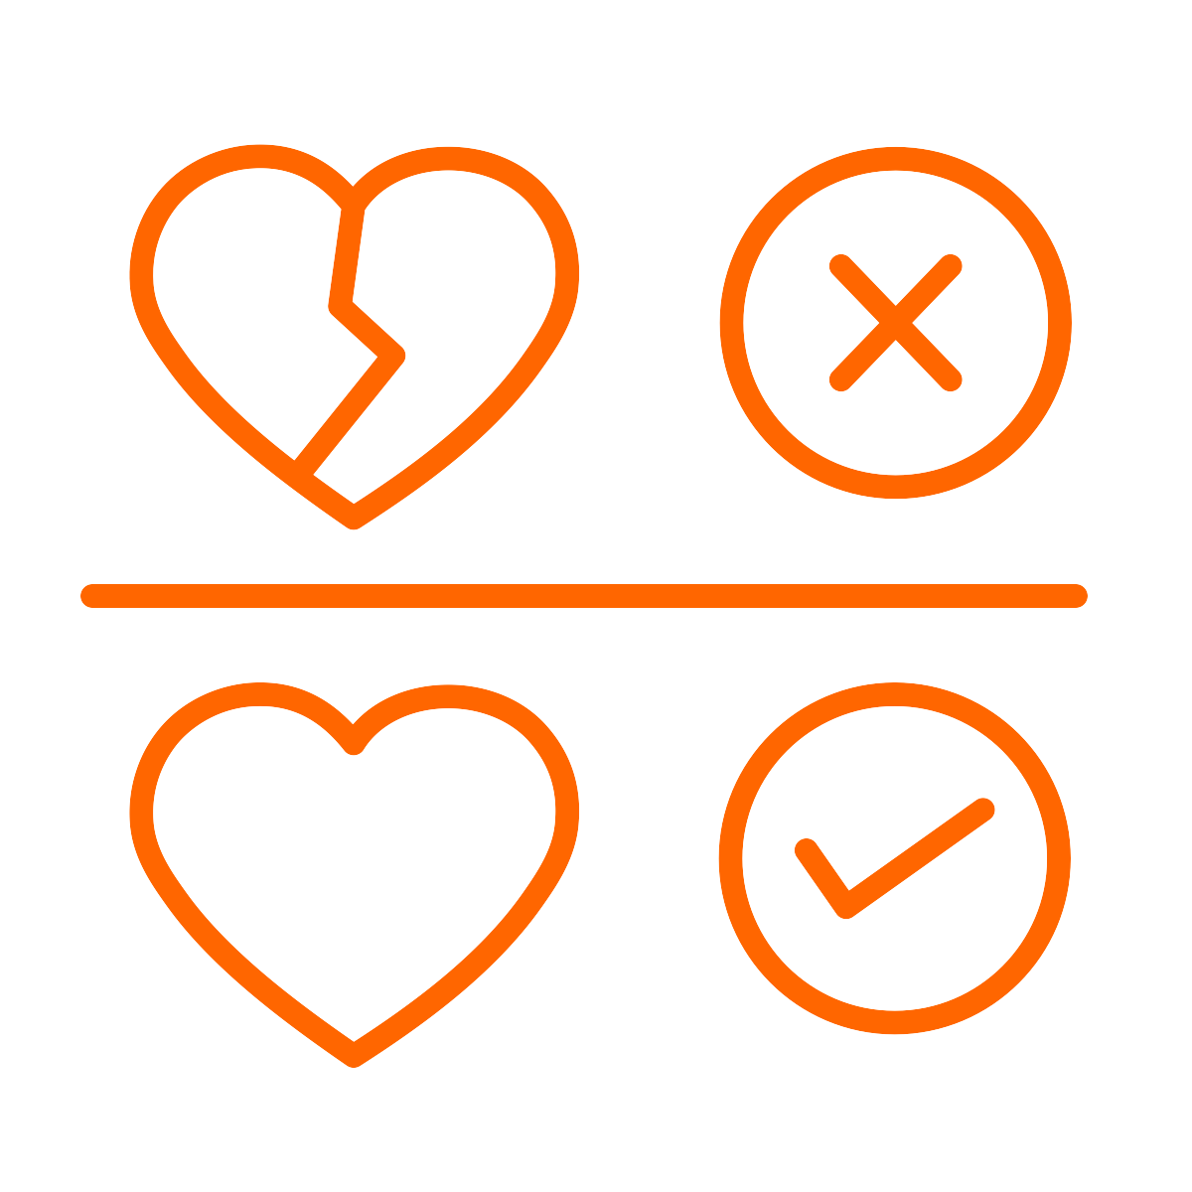
Discuss and establish ground rules
for the session
We listen and respect everyone when they are speaking and when we are responding.
We know that we don’t have to participate in any activities or questions which make us feel uncomfortable.
We know that we are not expected to share our own personal experiences but are free to do so without judgement if we want to.
We speak about a ‘friend’ or ‘someone we know’ instead of using real names if we share experiences or stories.
Refer to page 16 of the guidance for full details
Notes:
NB - You may wish to establish these rules as a group and use these as a guide

Slide 5



It’s OK to watch porn, everyone does it.
How true
is this comment?
Task: Discuss the comment and hold a class/ group vote.
5 minutes
Refer to page 21 of the guidance for full details

Slide 6
Talking heads starter questions
What impact could watching pornography have on a young person?
What do you think the gender ratio of viewing pornography might be?

Slide 7
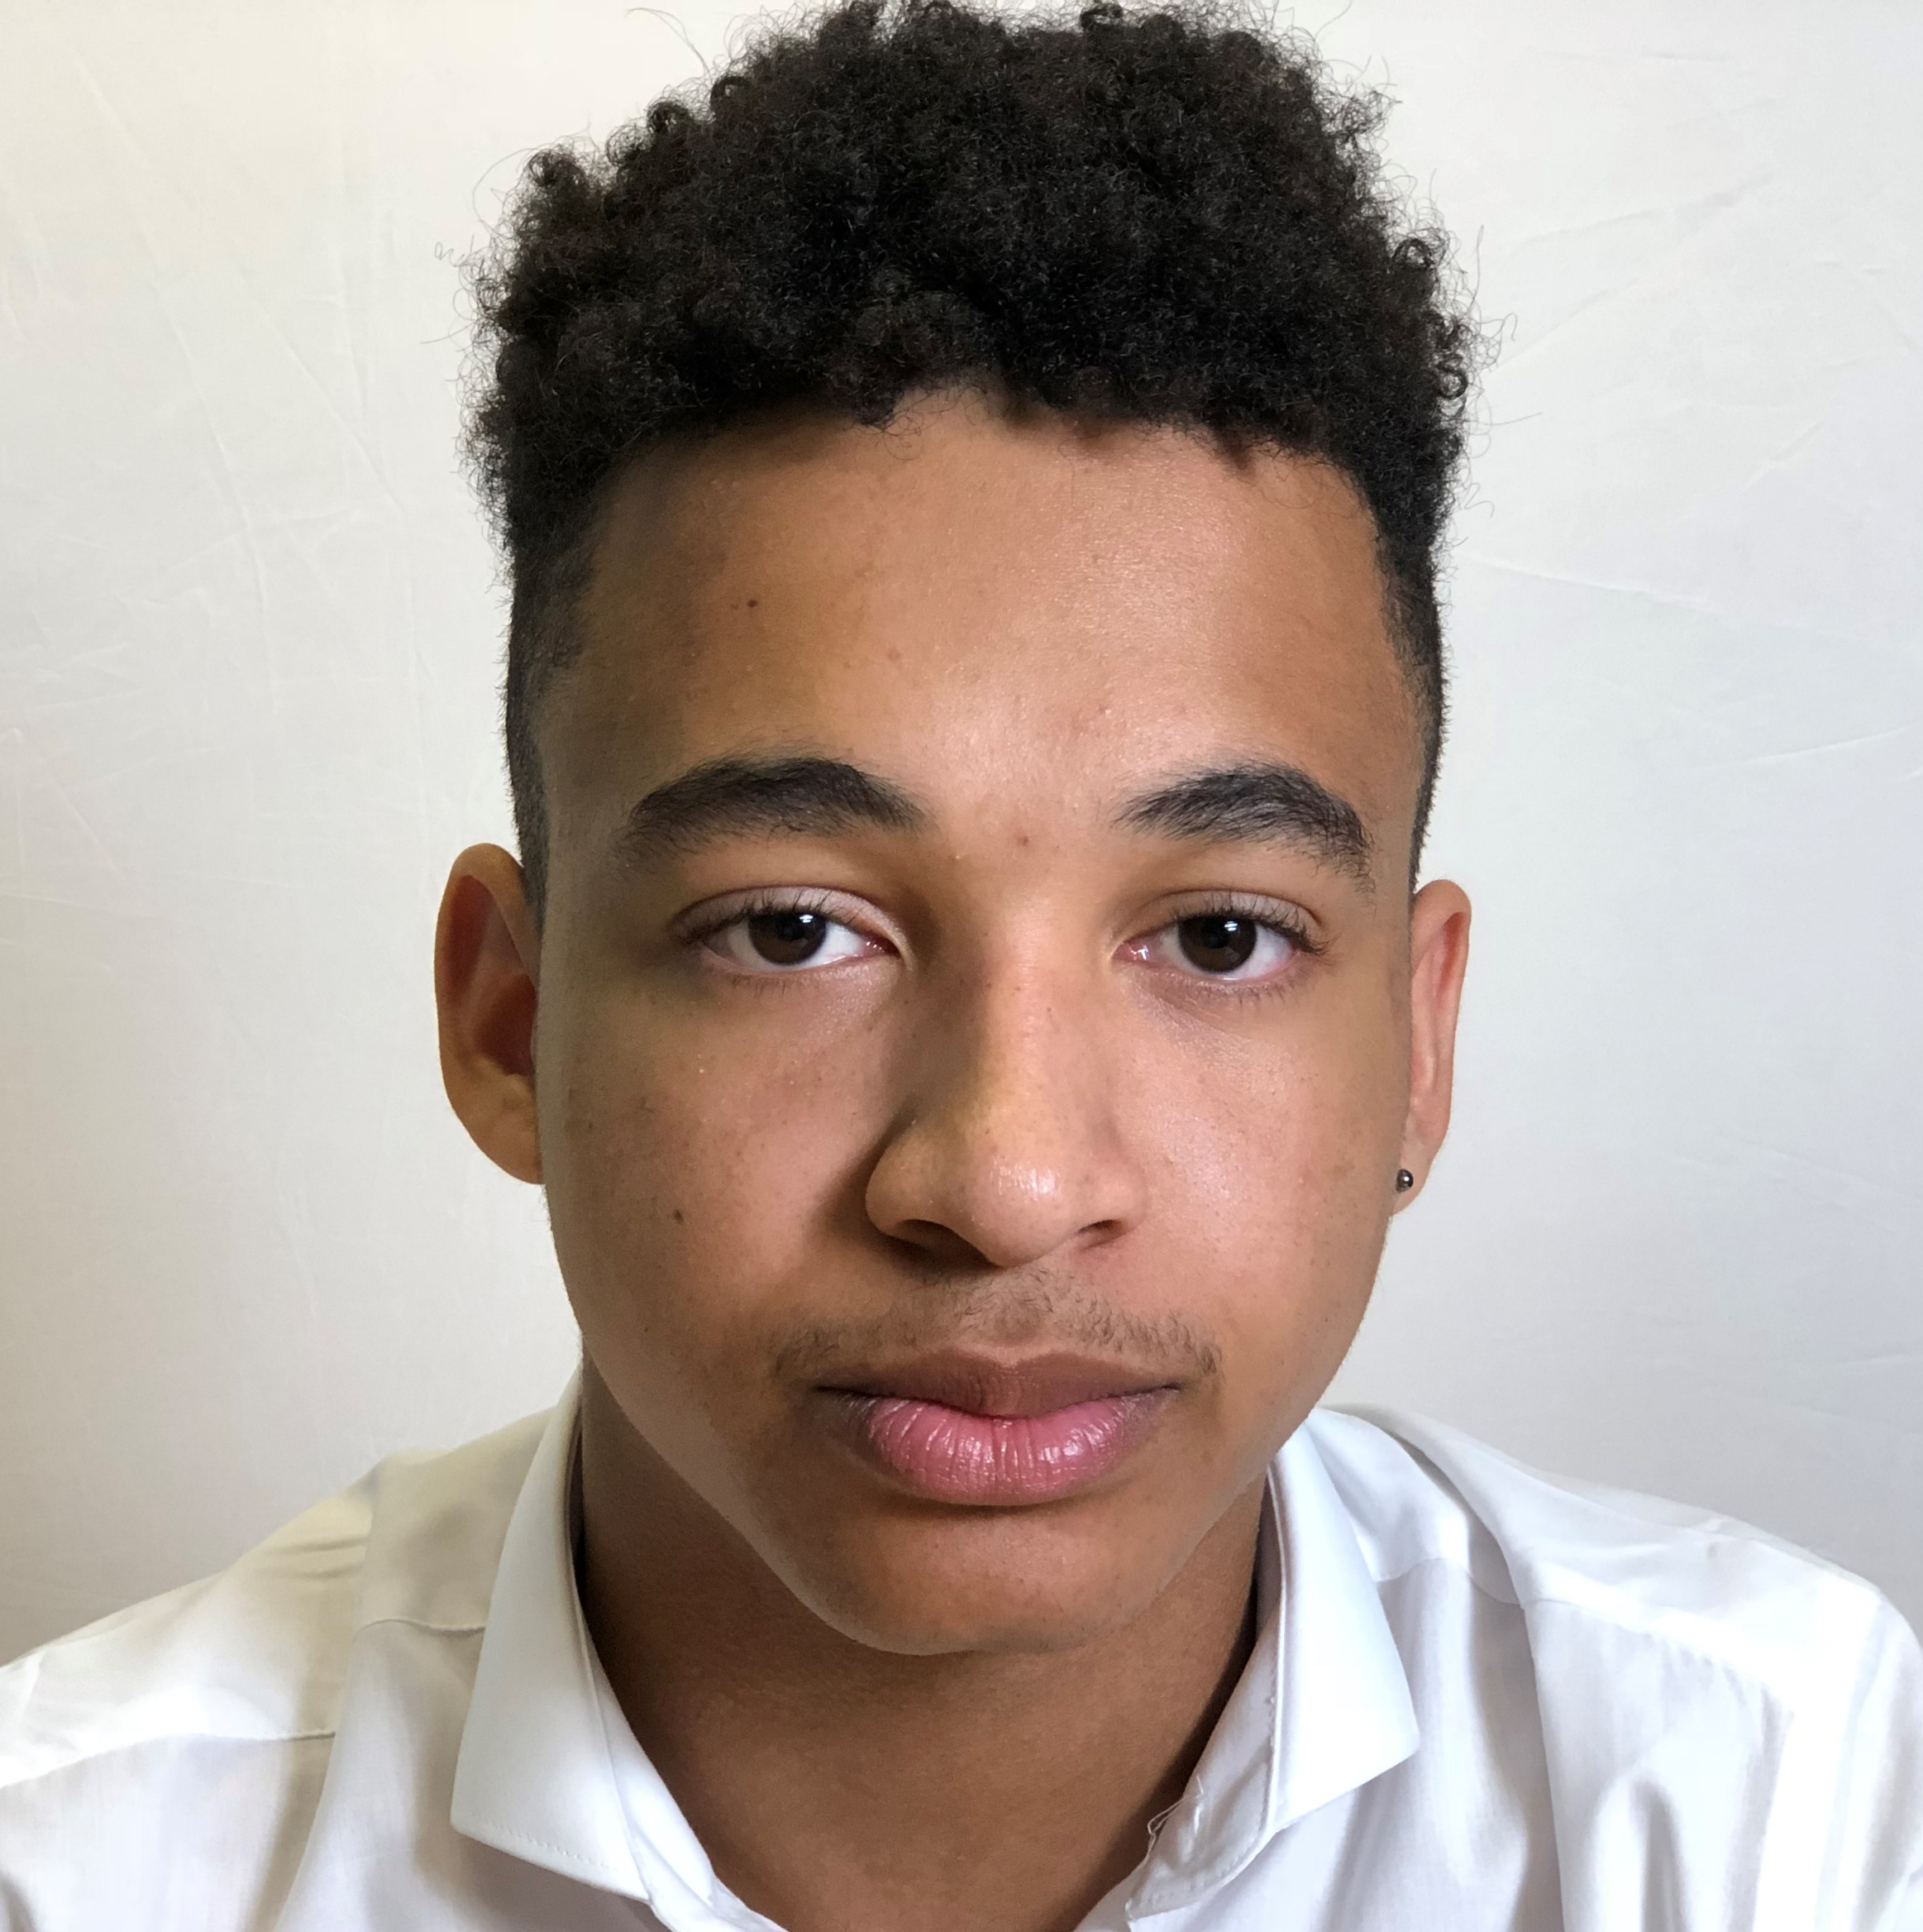
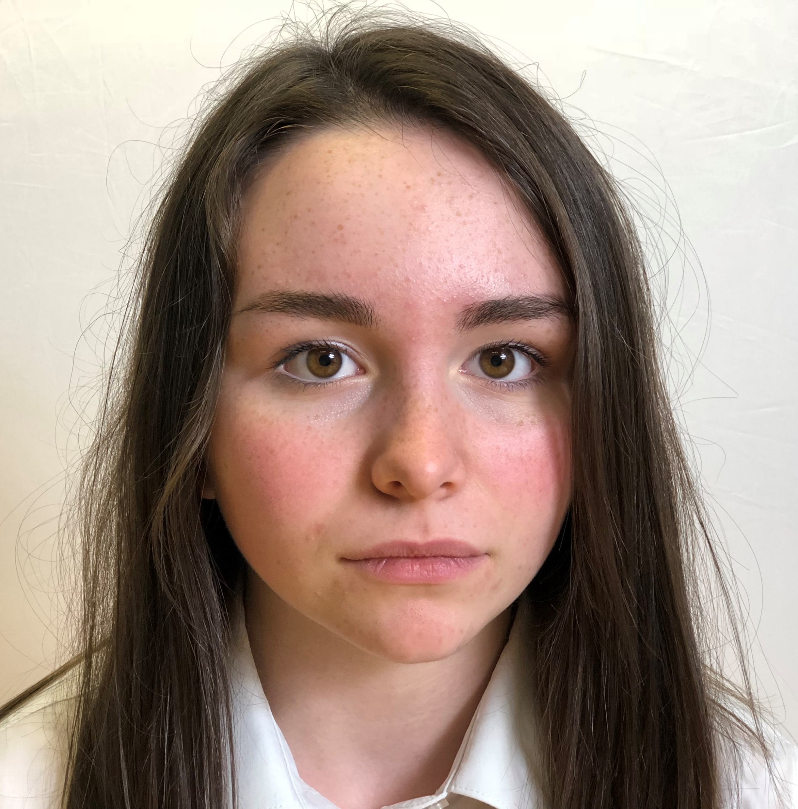
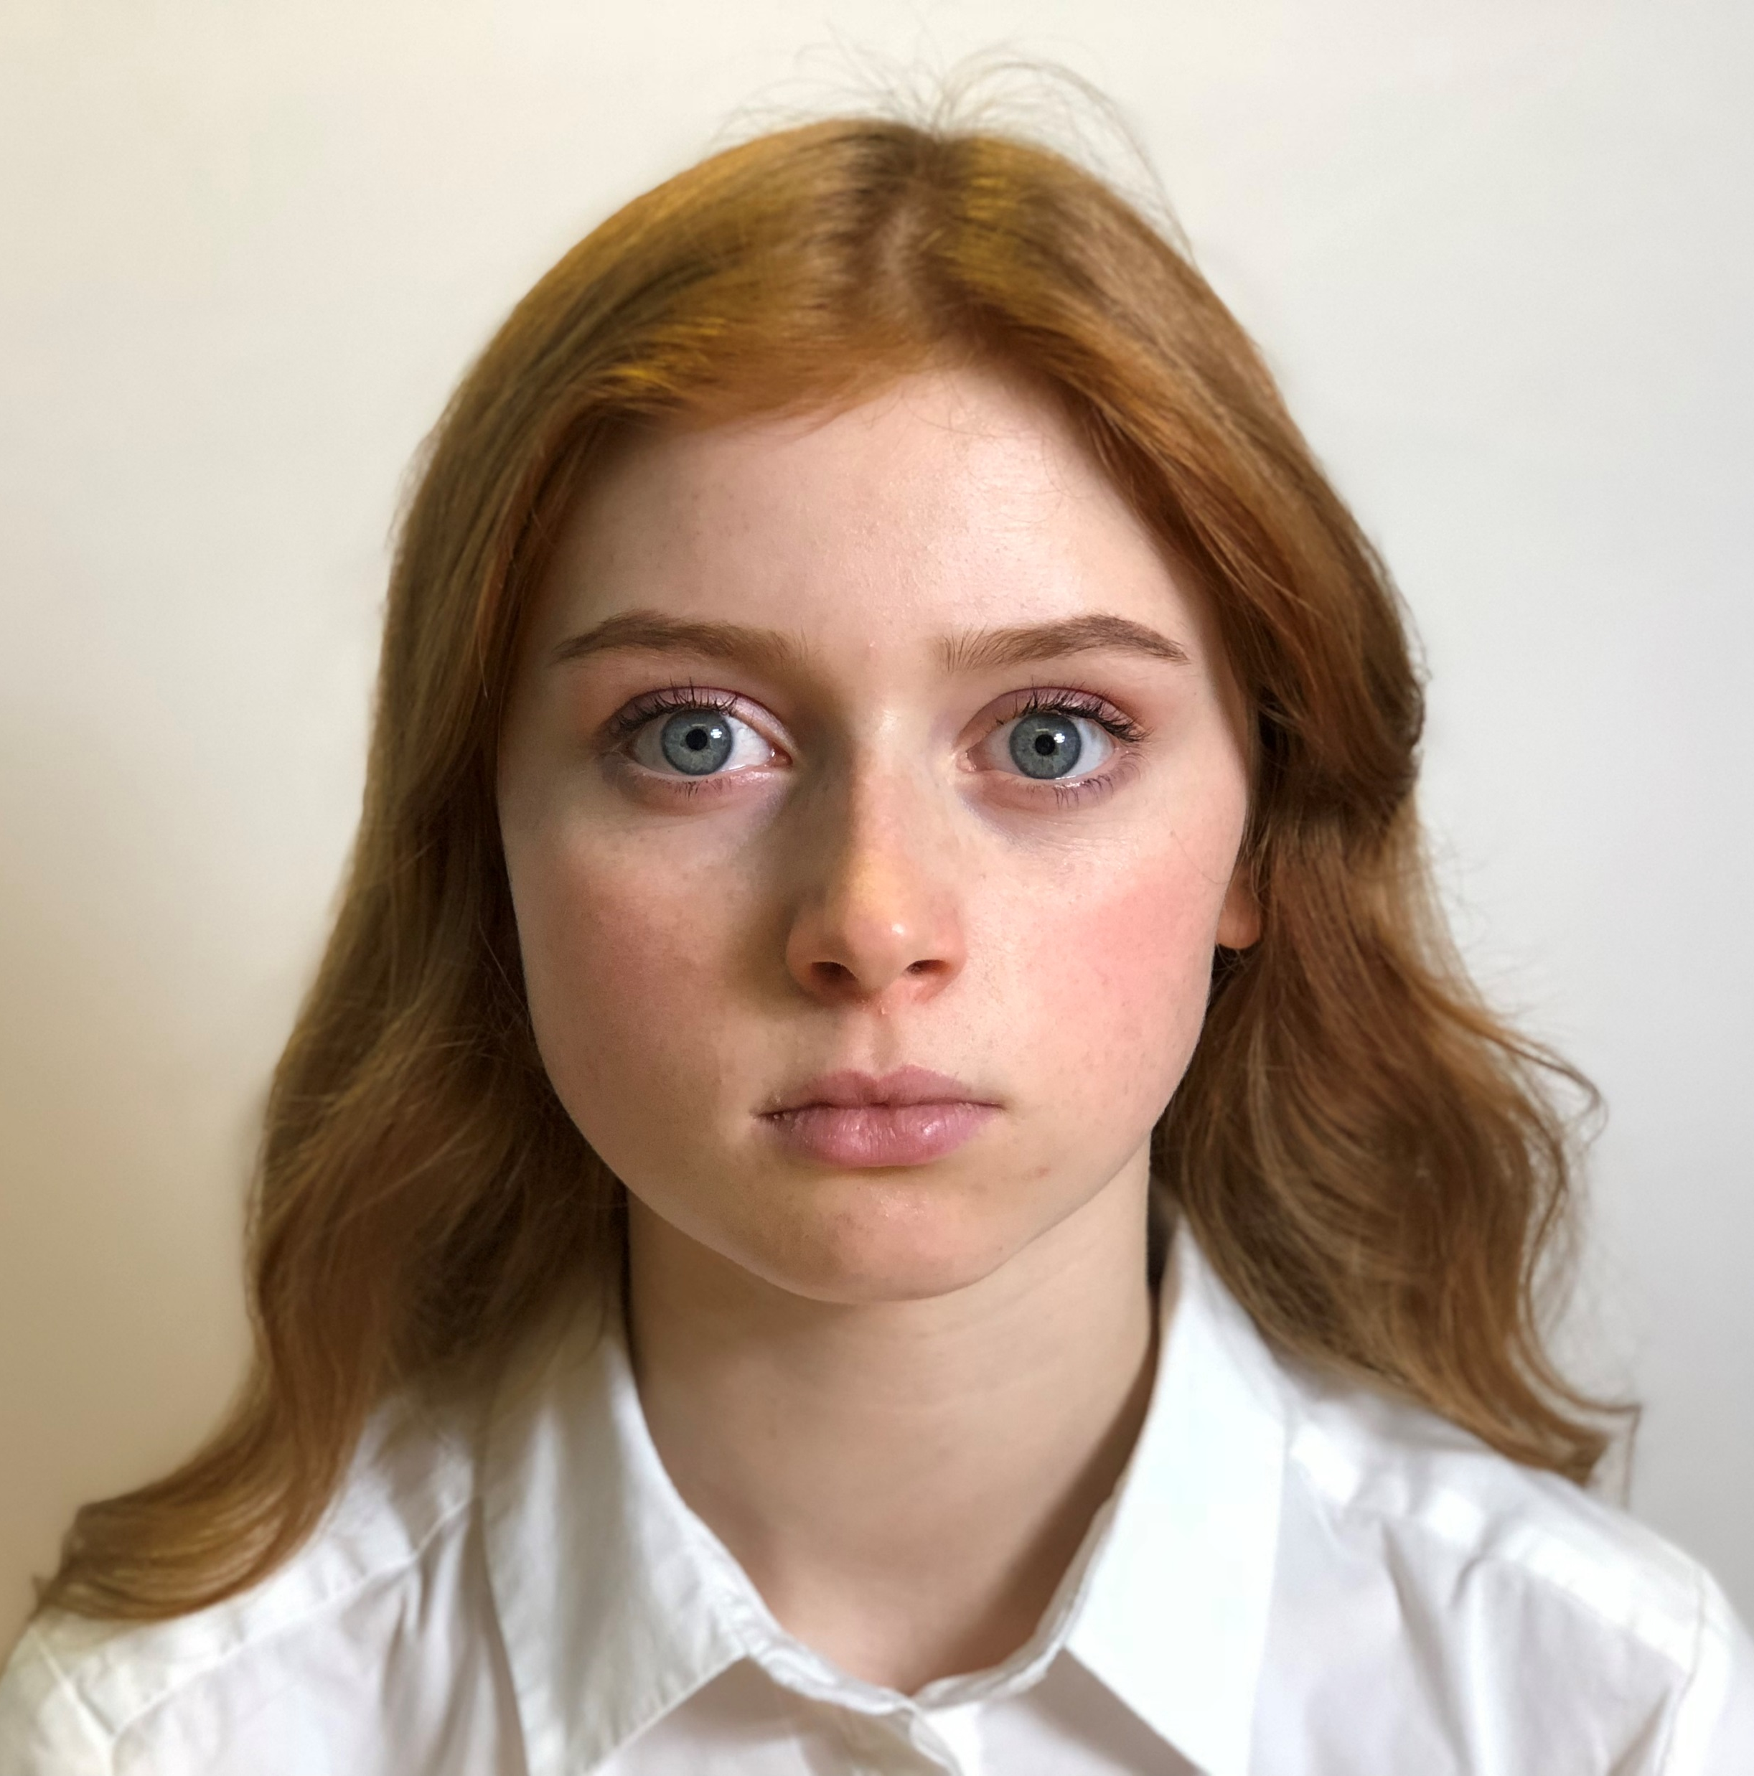
Watch the talking heads
Ryan
“What’s the big deal?”
Beth
“Is this what’s expected of me?”
Sadie
“Let’s get real.”

Slide 8



Ryan
“What’s the big deal?”
Ryan says that pornography is everywhere and that everyone will see it at some point. How true do you think this statement is?
Ryan says he started looking at pornography when he was 11. At what age do you think young people might first see a pornographic image or video? Is it usually accidentally or intentionally?
According to Ryan, he’s learnt everything he needs to know about sex from watching pornography. Do you agree with Ryan that we can learn about sex from pornography?
What kind of influence or impact could pornography have on a relationship?

Slide 9
Beth
“Is this what’s expected of me?”
Is it ok to go ahead and share pornographic images with your friends?
How easy is it to avoid the pressure to see something that you don't want to see?
Beth says that she looks nothing like the women in porn. Do you think that people in pornographic images represent a truthful image of real bodies?
Beth says that the other girls remain silent when porn is shown. Why would someone choose to remain silent and not speak up?

Slide 10
Sadie
“Let’s get real.”
Sadie’s not afraid to speak her mind but gets called ‘frigid’ as a result. Do you think it’s fair that she gets called this?
Sadie says that, ‘Everyone goes along with it and watches pornography.’ Do you think this is true and if so, why?
Sadie talks about her friend who is trying to figure out their sexuality and watches gay porn. Why might someone see pornography as the best place to explore sexuality?
Unlike Sadie, many people might be confused and think that pornography is real. What could be the impact of this belief?

Slide 11
How close to reality do you think the portrayal of relationships are in pornography?
Activity A
Myth or Reality?
Task: Sort the statements on worksheet 1.2 into two piles; myth and reality.
10 minutes
Refer to page 26 of the guidance for full details

Slide 12
Watching pornography is a good way to learn about sex and relationships
Only weirdos watch pornography
More males watch pornography than females
The bodies shown in pornography are what you can expect from future partners
Pornography uses actors
Pornography uses real people and real stories
Women are ‘always up for it’ just like in pornography
Sex in pornography is the same as sex in real life
Pornography only shows men as dominant
Pornography degrades women as it shows them as sex objects
Watching pornography when you are young will affect your future relationships
Women like to be treated as they are in pornography
Watching pornography is bad for you
Watching pornography is just a bit of fun and helps boost your body image and self esteem
You will only feel confident about your body if it looks similar to people in pornography

Slide 13

Activity B
Gender
Stereotypes
Task: Create a word cloud of what would make up a stereotypical male and female actor in pornography.
10 minutes
Refer to page 26 of the guidance for full details

Slide 14
Do you think someone would be affected by seeing these stereotypes of bodies?
How and why?
What impact could this have on someone in the future?

Slide 15

Is it always easy for someone to say no?
Activity C
Resisting the
pressure to watch
Task: Use worksheet 1.3 to discuss different scenarios and propose strategies for resisting peer pressure each time and saying no.
10 minutes
Refer to page 27 of the guidance for full details

Slide 16
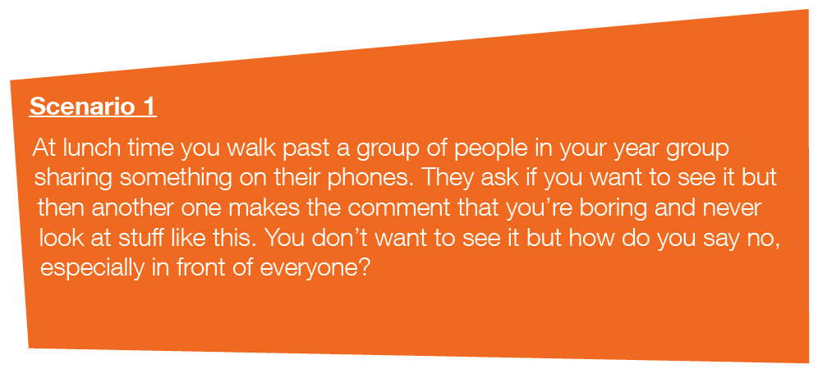

What strategies could be used to resist peer pressure in this situation?
How could someone say no?

Slide 17
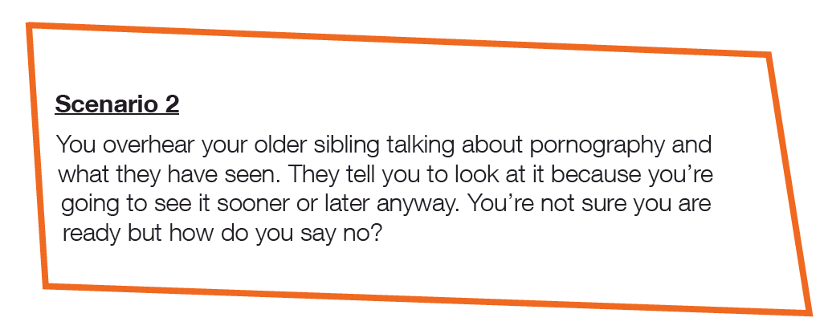
What strategies could be used to resist the pressure in this situation?
How could someone say no?

Slide 18
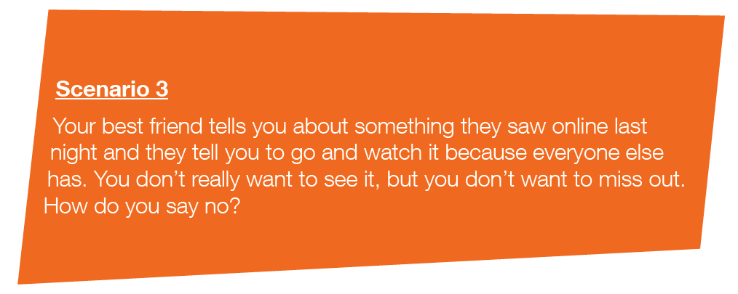
What strategies could be used to resist peer pressure in this situation?
How could someone say no?

Slide 19
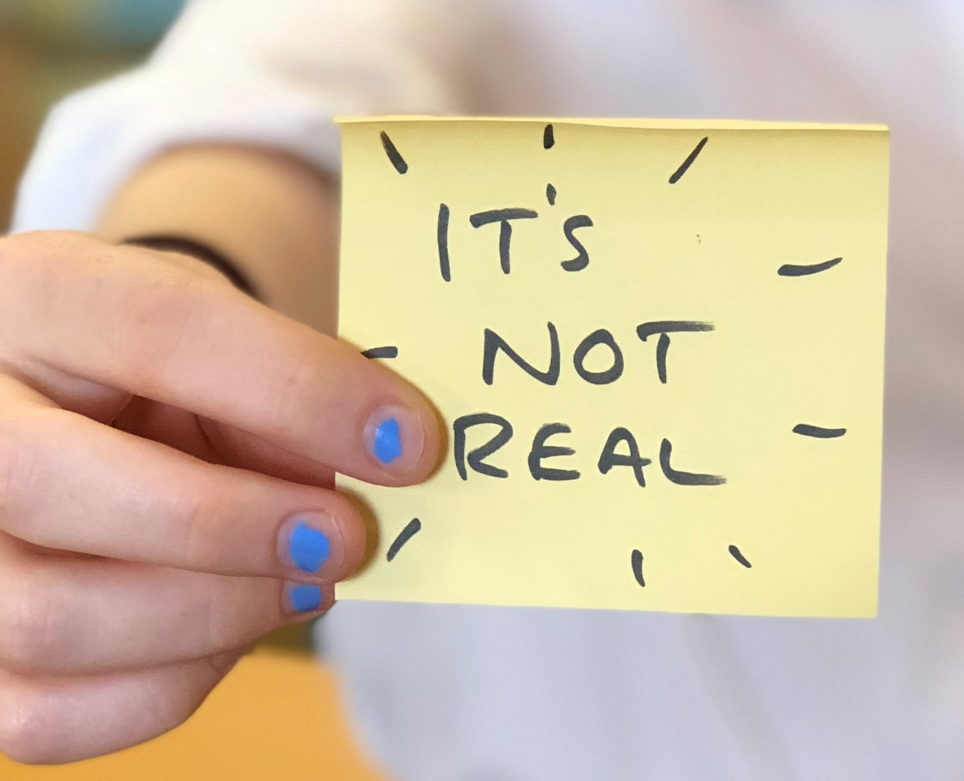
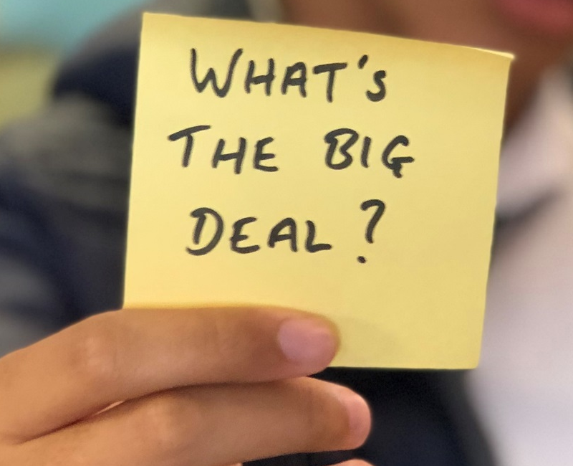
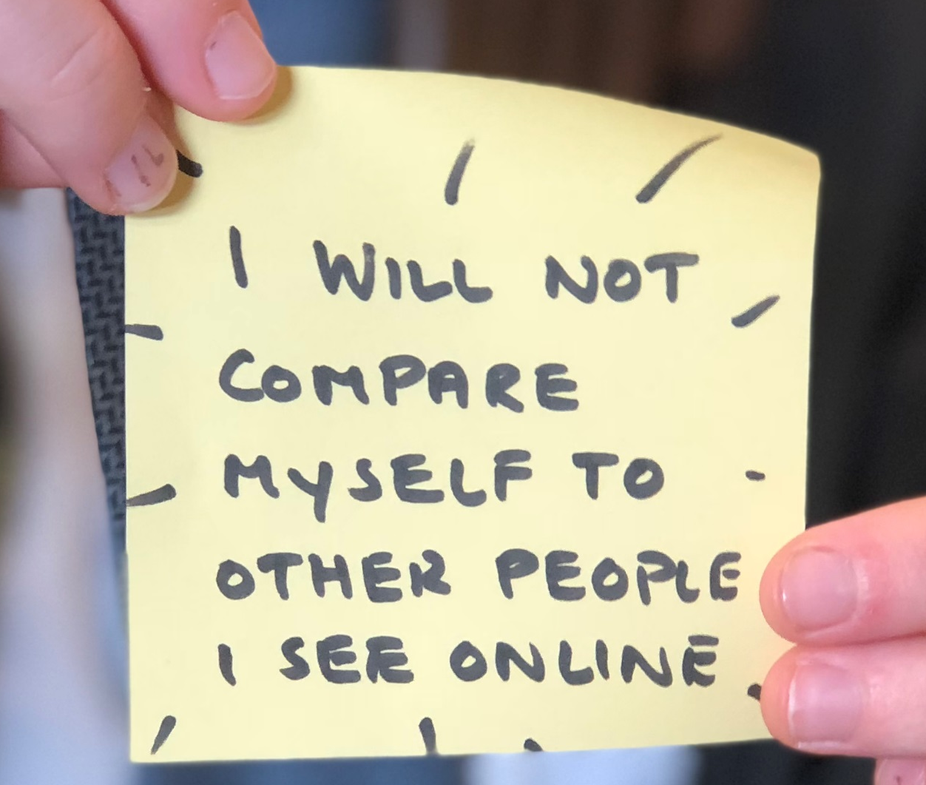

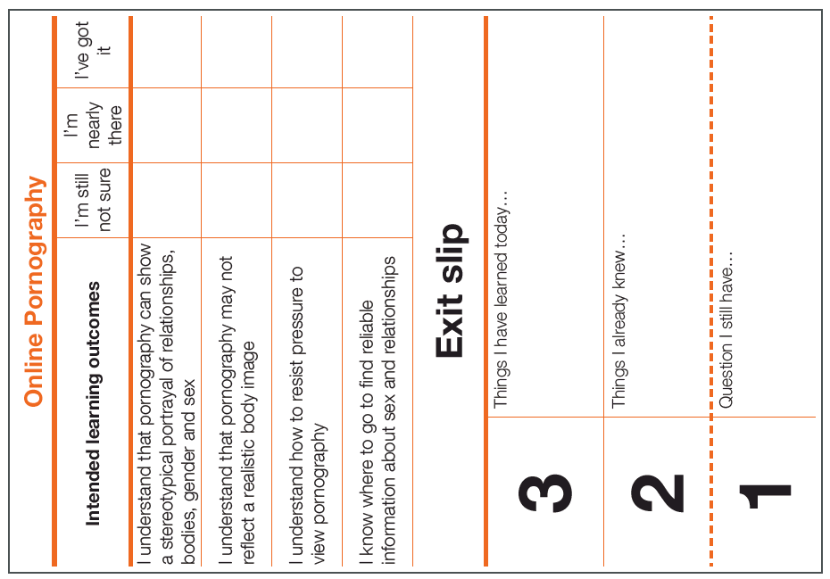
It’s OK to watch porn, everyone does it.
Write your own response to the statement above thinking about:
- Do you agree?
- How would you challenge the comment?
- What advice would you give or questions would you ask?

Slide 20






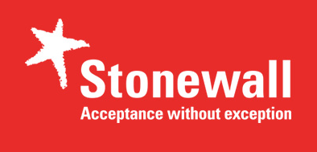
Helplines for young people
Where can I go for advice, help and support?
Services for young people to talk to someone anonymously without judgement via chat, or via phone, on whatever issue they would like.
0800 11 11 - A service for under 18s
0808 808 4994 – A service for 13-25s
Website for advice and support
A sexual health and well-being charity for under 25s which offers information, support and guidance for young people on anything from sex and relationships to gender and sexuality www.brook.org.uk.
A sexual health charity who give straight forward information and support on sexual health, sex and relationships to everyone in the UK www.fpa.org.uk.
Advice
A youth charity focused on mental health and well-being which offers information, advice and guidance for young people on anything which may impact on your wellbeing www.youngminds.org.uk.
Support
An LGBT charity who offer support to anyone on issues like gender, equality and sexuality www.stonewall.org.uk.

Slide 21




Available to download at:
www.childnet.com/pshetoolkits
Myth vs Reality PSHE toolkit 2019 by Childnet International is licensed under a Creative Commons Attribution-NonCommercial-ShareAlike 4.0 International License.

