Slide 1







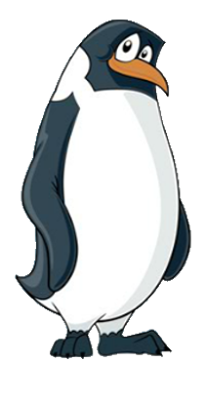






EYFS-B
The Adventures of Smartie the Penguin

Slide 2





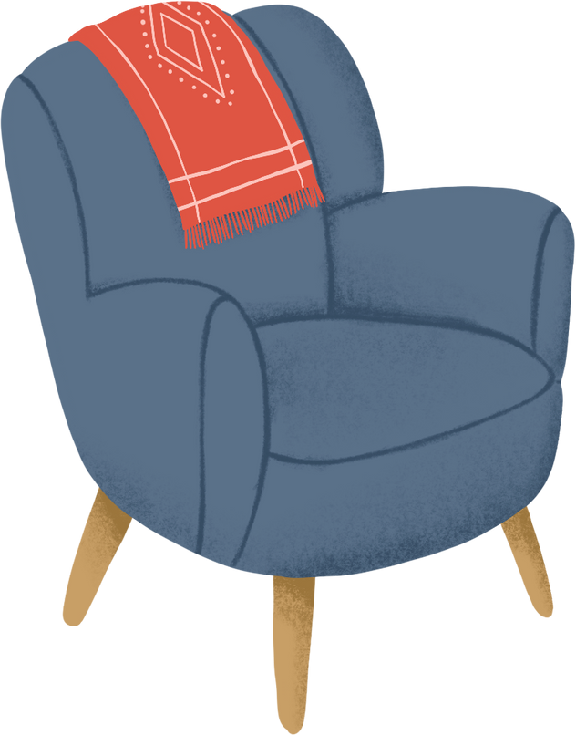







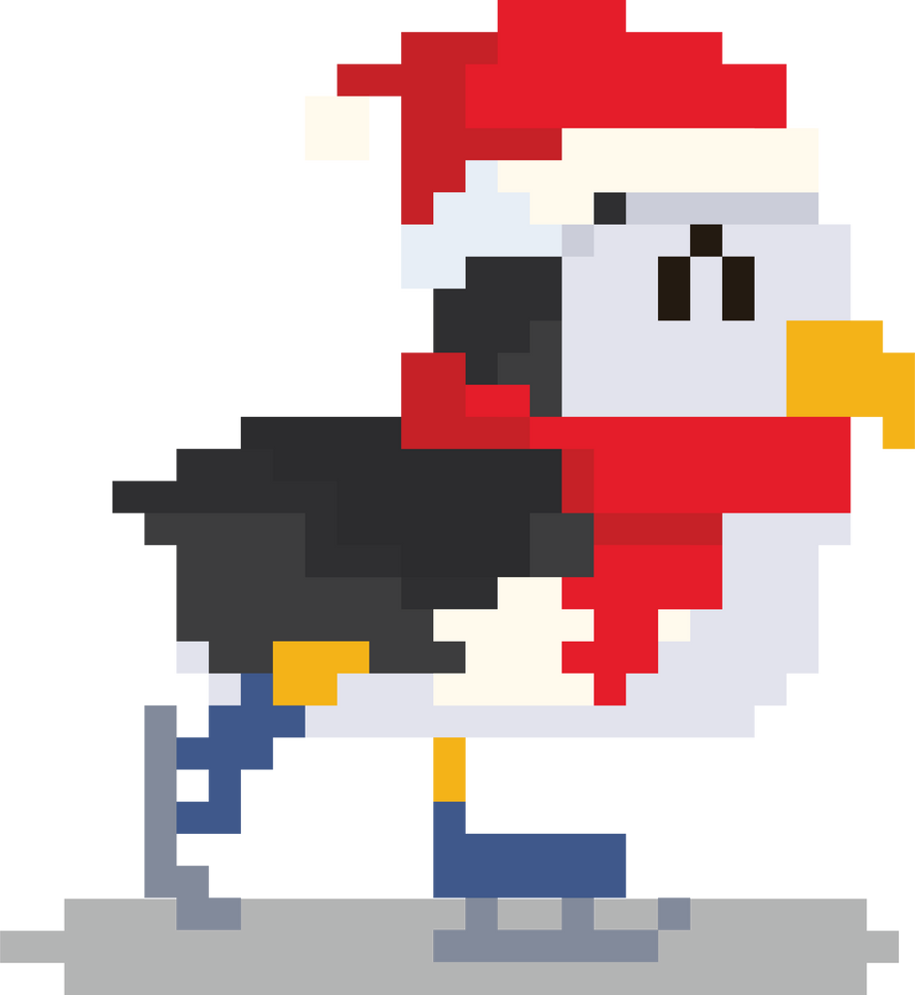

One day, Smartie was on his tablet after school. He was allowed to play games before teatime and he’d been looking forward to relaxing all day!
Everything was going well, but just as Smartie was celebrating finishing a level, the game stopped suddenly.
SNOWCRAFT

Slide 3






A new advert started playing and Smartie didn’t know what to do. “How annoying!” he said. “I’m in the middle of playing and now this is on my screen, and it’s getting in the way! Perhaps if I tap the red cross then I can get rid of it.”
SNOWCRAFT

Slide 4

Smartie tapped the red cross, but a new message popped up, saying ‘ONE FREE SPIN.’
“Oh!” exclaimed Smartie. “Maybe I need to play to get rid of it. It does look like fun!”
SNOWCRAFT
ONE FREE SPIN!

Slide 5



Can you help Smartie make the right decision?
Should he click, ‘ONE FREE SPIN’ and spin the wheel, or should he ask his parents for help?
Time to chat!

Slide 6

“Help!” cried Smartie. “Daddy, Mummy, can you help me please? Something is on my screen, and it says that I can have a free turn!”
HELP!

Slide 7
“Well done, Smartie,” said Daddy Penguin. “What a fantastic choice you made!”
“You did the right thing asking for help, and not trying to fix it by yourself,” said Mummy Penguin.
SNOWCRAFT
ONE FREE SPIN!

Slide 8




Mummy Penguin was so pleased with what Smartie had done, they sang a special song together, to help remind him of his sensible decision, so that he would continue to ask for help in the future.
Before you tap and click…
You need to stop and think…
And TELL someone!
Sing with me!

Slide 9
Mummy Penguin closed the advert that had popped up and Smartie continued to play on his tablet.
SNOWCRAFT
ONE FREE SPIN!

Slide 10



The next afternoon, Smartie was looking forward to playing online again. He went to find his favourite game, but something had changed…
TEENSNOW

Slide 11
This wasn’t right! Smartie was very confused… “Hang on a minute,” he thought to himself, “I know what has happened. My big sister Addie has been using my tablet without asking me!”
TEENSNOW

Slide 12
Smartie knew that this was a game for much older children. He thought that he might know what to do to find his favourite game, and which buttons to press, but on the other hand he wasn’t too sure.
TEENSNOW

Slide 13
What should Smartie do?
Should he try to find his game by himself, or should he ask for help?
Time to chat!

Slide 14


Let’s help Smartie to make the right decision by singing his special song!
One, two, three…
Before you tap and click…
You need to stop and think…
And TELL someone!
Sing with me!

Slide 15
“Help!” shouted Smartie. “Mummy, Daddy, please help me. I’m trying to find my game, but Addie has changed something!”
HELP!

Slide 16




“Well done, Smartie,” replied Mummy Penguin. “You remembered the song brilliantly! You did just the right thing by asking for help and not trying to find the game by yourself.”
Mummy Penguin helped Smartie get back to his game and everything was fine again.

Slide 17



Later that evening… can you guess what Smartie was doing?
That’s right! Smartie was having one last turn on his tablet and was trying to beat his top score from yesterday. His best friend from school, Zo, was online too and they were really enjoying themselves.
SNOWCRAFT

Slide 18

All of a sudden, the other players started saying unkind things and being mean to Zo.
One player said, “You’re not very good at this game, are you?”
SNOWCRAFT
YOU’RE NOT VERY GOOD AT THIS GAME, ARE YOU?

Slide 19
The other player sent another message. “I don’t want you playing on our team anymore,” they teased. Zo quickly left the game and Smartie felt sad. He didn’t understand why they were being mean to her.
SNOWCRAFT
YOU’RE NOT VERY GOOD AT THIS GAME, ARE YOU?
I DON’T WANT YOU PLAYING ON OUR TEAM ANYMORE

Slide 20
What should Smartie do?
Should he just ignore the messages and do nothing, or should he tell Mummy and Daddy instead?
Time to chat!

Slide 21
Let’s help Smartie to make the right decision by singing his special song!
One, two, three…
Before you tap and click…
You need to stop and think…
And TELL someone!
Sing with me!

Slide 22
“Daddy! Mummy!” called Smartie. “The other players are being mean to Zo and said they didn’t want her to play, and now she’s left the game. What shall I do?”
“Oh, Smartie, you were so sensible coming to tell us,” reassured Daddy Penguin.
SNOWCRAFT
YOU’RE NOT VERY GOOD AT THIS GAME, ARE YOU?
I DON’T WANT YOU PLAYING ON OUR TEAM ANYMORE

Slide 23
“Unfortunately not everyone is nice online and sometimes other players can say mean things. If this happens to you or one of your friends, it’s important not to be mean back, and always come to tell us straight away.”
SNOWCRAFT
YOU’RE NOT VERY GOOD AT THIS GAME, ARE YOU?
I DON’T WANT YOU PLAYING ON OUR TEAM ANYMORE

Slide 24

“We can help by blocking the player so that they can’t talk to you again. I will chat to Zo’s mummy too, to check that Zo is okay.”
SNOWCRAFT
YOU’RE NOT VERY GOOD AT THIS GAME, ARE YOU?
I DON’T WANT YOU PLAYING ON OUR TEAM ANYMORE

Slide 25
“Remember, it’s important to be kind to others online, just as you would be if you were playing together in person. We want everyone to feel welcome and happy when using the internet.”
SNOWCRAFT
YOU’RE NOT VERY GOOD AT THIS GAME, ARE YOU?
I DON’T WANT YOU PLAYING ON OUR TEAM ANYMORE

Slide 26


From that day on, Smartie always knew how to be safe when using his tablet and playing on the internet! If anything happened that made him feel worried, upset, or confused, he didn’t try to fix things by himself.
and always asked an adult for help.
He stopped…
thought about what to do…

Slide 27

I am very lucky because I have Mummy and Daddy Penguin to help me!
But who can help you?
Time to chat!

Slide 28
Sing with us!
Before you tap and click…
You need to stop and think…
And TELL someone!

