Slide 1







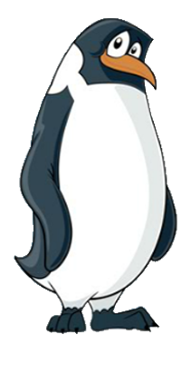

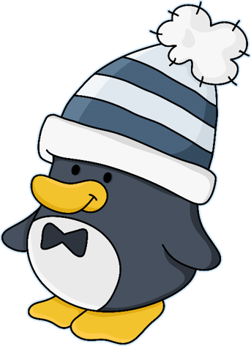




1A
The Adventures of Smartie the Penguin

Slide 2



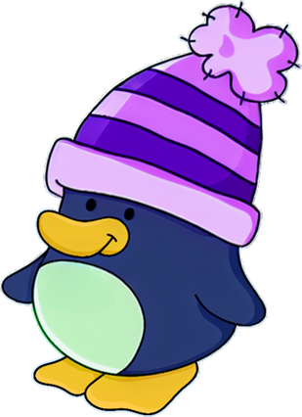
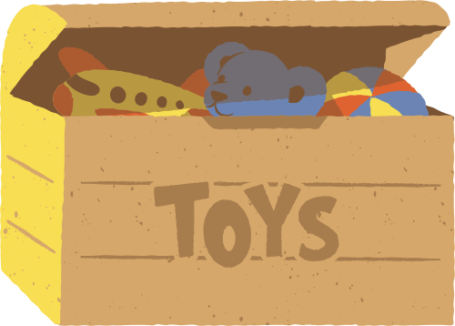








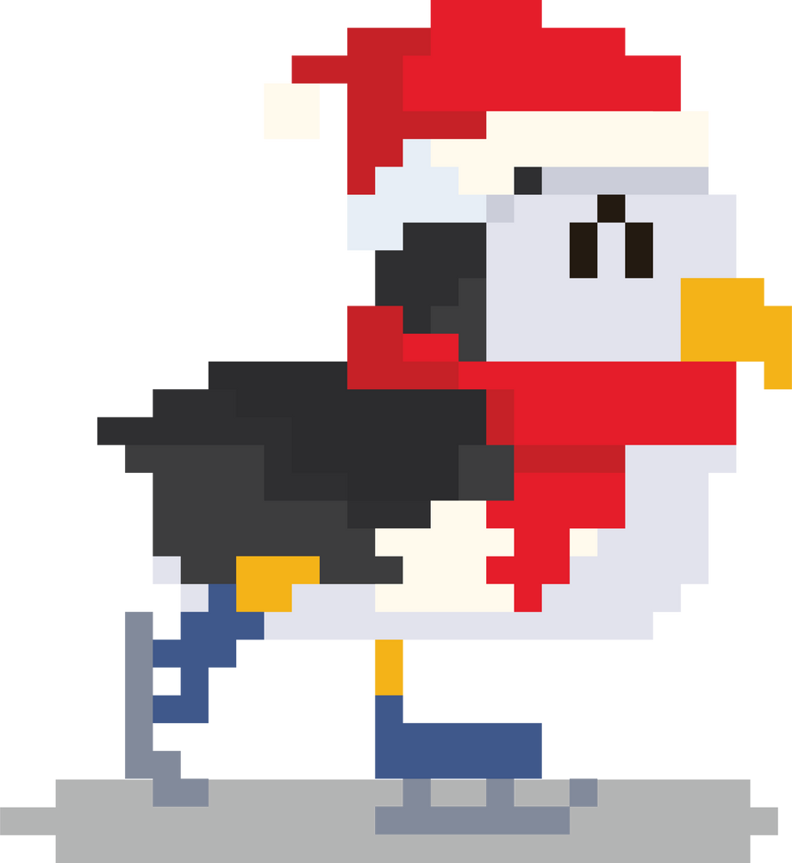




One frosty day after school, Smartie invited his best friend Zo to his house.
When they got home, Smartie asked Mummy Penguin if they were allowed to play on his tablet together. Mummy Penguin helped Smartie and Zo get online, and they were off!
SNOWCRAFT

Slide 3

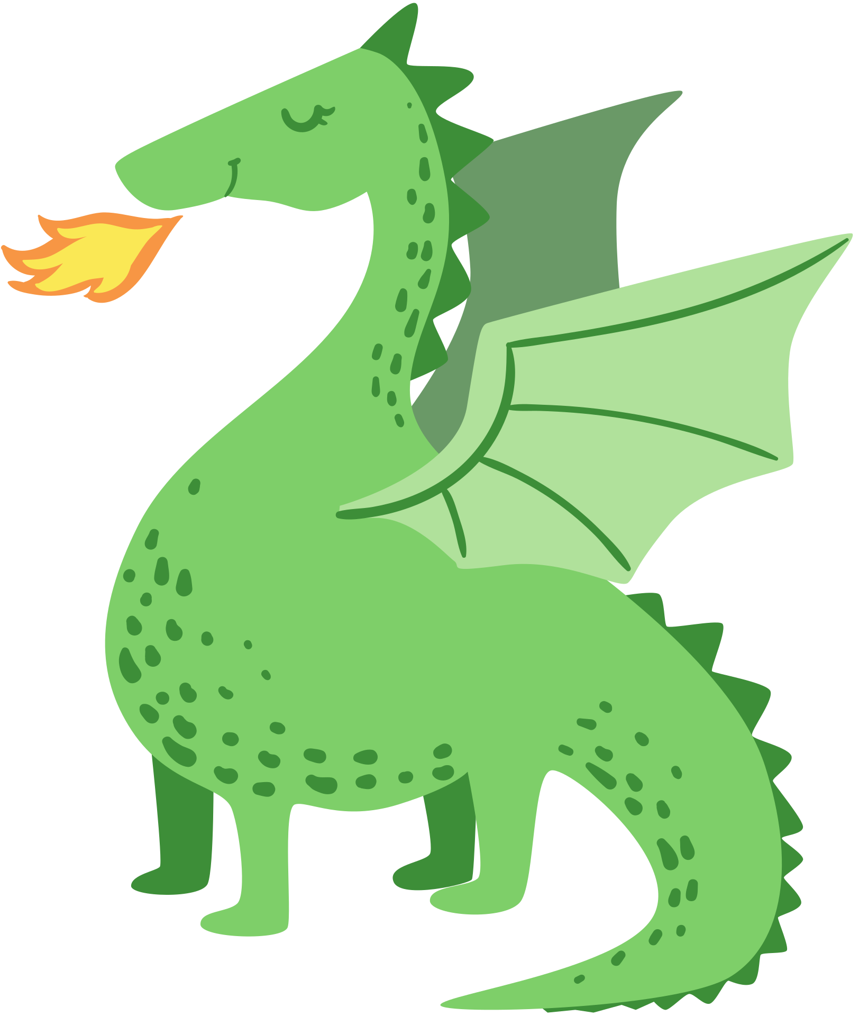


Smartie and Zo were having a wonderful time watching lots of videos and playing games. Being online is so much fun!
Zo asked Smartie if they could watch a video she liked. It was all about dragons! Smartie agreed.

Slide 4


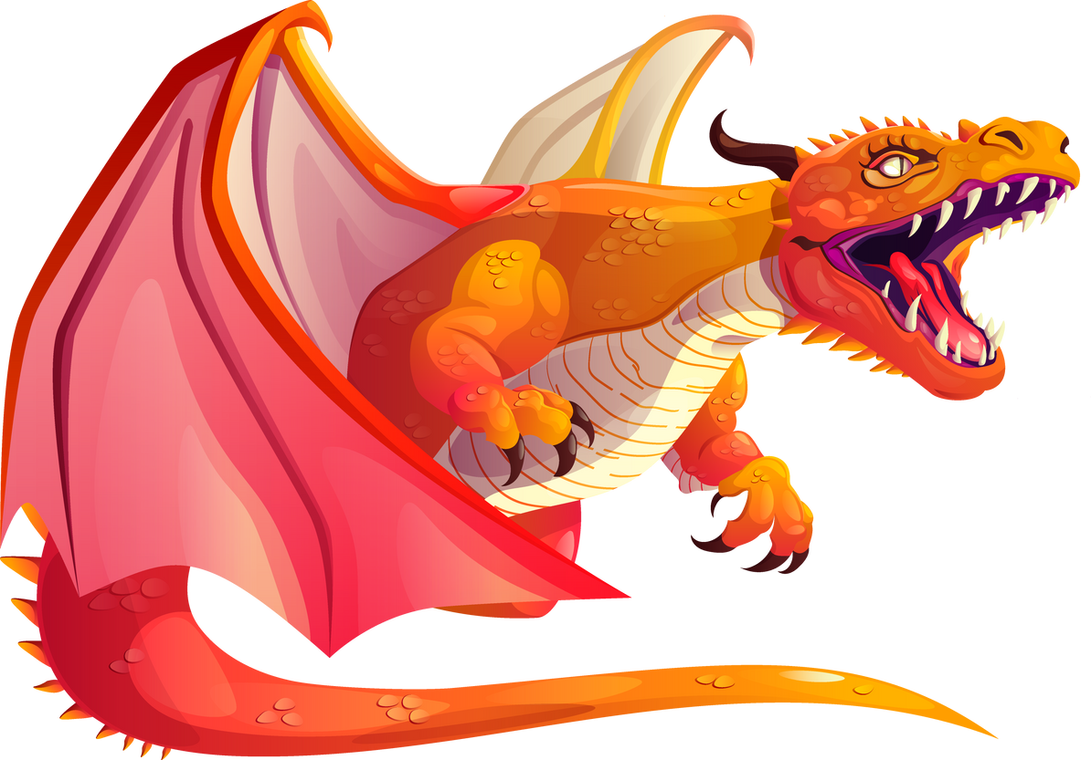
But when the video started to play, Smartie found it very scary! He did not like it at all and he wanted to stop watching it.
“It’s only a dragon!” said Zo. “It’s not even real.”
Smartie felt worried and scared. He wanted to ask Mummy and Daddy Penguin for help, but he didn’t want Zo to get into trouble.

Slide 5



Can you help Smartie make the right decision?
Should Smartie keep watching the video with Zo, or should he ask his parents for help?
Time to chat!

Slide 6

Smartie went to find Daddy Penguin.
”Daddy,“ he whispered, “There’s a scary video on the tablet and I don’t want to watch it anymore!”
I’m
scared!

Slide 7
“Well done, Smartie,” said Daddy Penguin. “You did the right thing by telling an adult. Remember, not everyone will enjoy the same videos. What is funny for one person might worry someone else. If you find something scary, you can turn it off or turn over the screen so you can’t see it anymore.”

Slide 8






Daddy Penguin was so pleased with what Smartie had done, they sang a special song together to help remind him of his sensible decision, so that he would continue to ask for help in the future.
Before you tap and click…
You need to stop and think…
And TELL someone!
Sing with me!

Slide 9
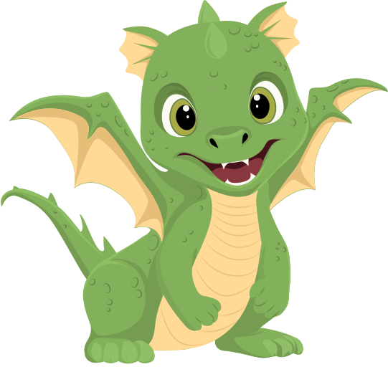
Mummy and Daddy Penguin helped Smartie turn off the video and found a different one that they would both enjoy watching.
Thank you, Mummy!

Slide 10
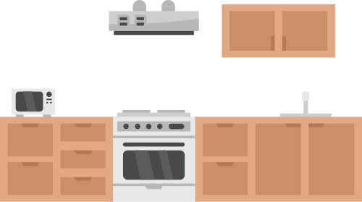

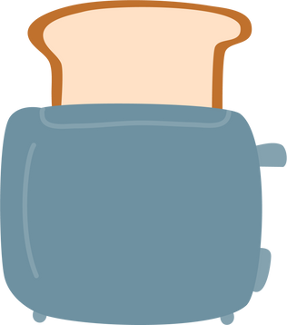


The next day, Smartie rushed downstairs to go online. Mummy Penguin was already awake, drinking a cup of tea in the kitchen.
Smartie grabbed his tablet and started playing his favourite game.
SNOWCRAFT

Slide 11

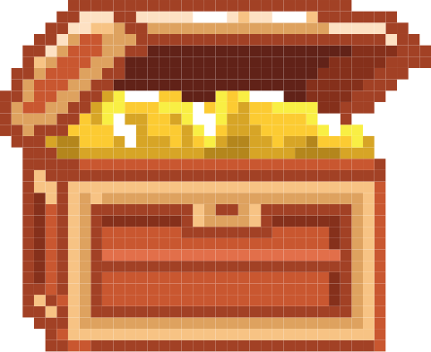
Suddenly, a brightly coloured box popped up on the screen.
SNOWCRAFT
WINNER!

Slide 12
The box said Smartie had won a competition and needed to choose a prize! He found this very exciting. But Smartie started to feel a bit strange. He hadn’t entered a competition and wasn’t sure how he had won a prize without doing anything.
SNOWCRAFT
CHOOSE YOUR PRIZE!

Slide 13
Can you help Smartie make the right decision?
Should Smartie choose a prize, or should he ask for help?
Time to chat!

Slide 14
Let’s help Smartie to make the right decision by singing his special song!
One, two, three…
Before you tap and click…
You need to stop and think…
And TELL someone!
Sing with me!

Slide 15
“Help!” cried Smartie. “Mummy, there is a box on the screen saying I have won a competition! Do I click on a prize?”
“Well done, Smartie!” said Mummy Penguin. “You did the right thing by checking with me.”
HELP!

Slide 16
“It is very important to remember that not everything we see online is true and some things may be trying to trick you. If there is anything you are unsure about, always check with an adult.”
Mummy Penguin helped Smartie close the pop-up so he could carry on playing his game.
SNOWCRAFT
CHOOSE YOUR PRIZE!

Slide 17





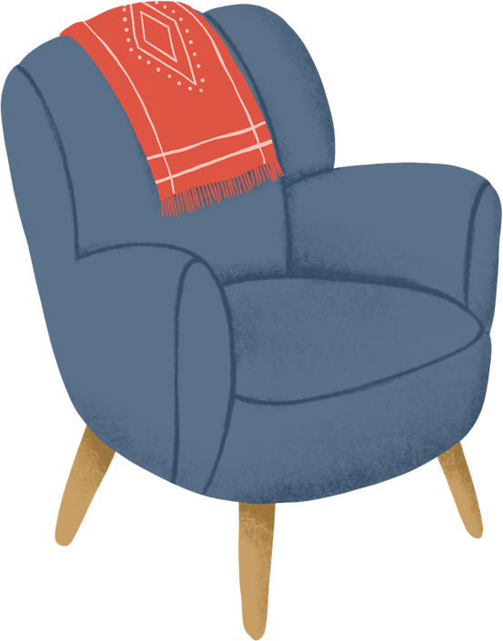
Later on that afternoon, can you guess what Smartie was doing?
Of course! He was back on his tablet! Smartie was playing his favourite game, ‘Snowcraft.’ He was desperately trying to beat his best score.
SNOWCRAFT

Slide 18
After a while, Smartie felt his head getting really sore and his eyes began to sting. This made Smartie feel a little bit sick.
“Ow!” exclaimed Smartie. “I do not feel very well at all! Maybe I should carry on playing anyway, it might go away in a minute.”
SNOWCRAFT

Slide 19
Can you help Smartie make the right decision?
Should he carry on playing his game, or should he ask for help?
Time to chat!

Slide 20
Let’s help Smartie to make the right decision by singing his special song!
One, two, three…
Before you tap and click…
You need to stop and think…
And TELL someone!
Sing with me!

Slide 21
“Mummy!” shouted Smartie. “I was playing on my tablet, and I started to feel unwell. My head hurts and I feel sick.”
“Oh, Smartie,” said Mummy Penguin. “I’m sorry you’re not feeling very well, you did the right thing by coming to tell me.”
My head hurts

Slide 22
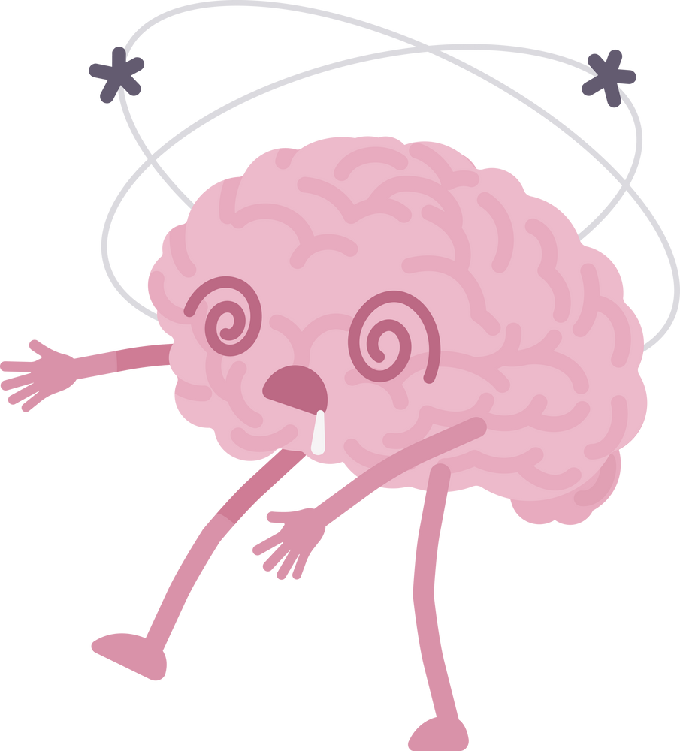





“Sometimes, when we are online for a long time our bodies start to tell us that it is time for a break. This could be an ache on your body somewhere, feeling sick, tired or hungry, or even feeling grumpy. These are all signs that it is time to come away from the screen.”

Slide 23


Mummy Penguin gave Smartie a big hug, a slice of toast, and a glass of water. After that, he felt a lot better.

Slide 24


From that day on, Smartie always knew how to be safe when using his tablet and playing on the internet! If anything happened that made him feel worried, upset, or confused, he didn’t try to fix things by himself.
and always asked an adult for help.
He stopped…
thought about what to do…

Slide 25

I am very lucky because I have Mummy and Daddy Penguin to help me!
But who can help you?
Time to chat!

Slide 26
Sing with us!
Before you tap and click…
You need to stop and think…
And TELL someone!

