Slide 1














2A
The Adventures of Smartie the Penguin

Slide 2











One sunny morning, Smartie the Penguin woke up with a spring in his step. He could not wait to go downstairs and start playing on his tablet!

Slide 3






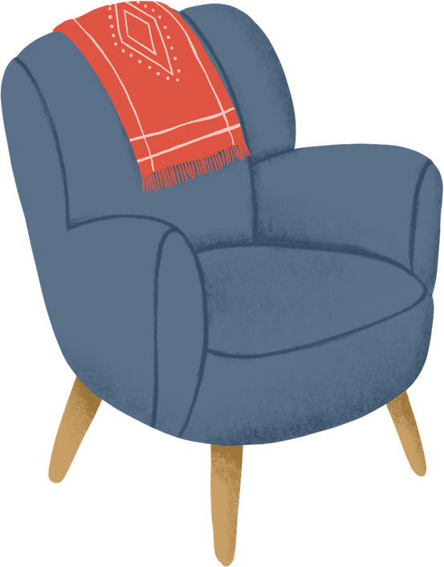







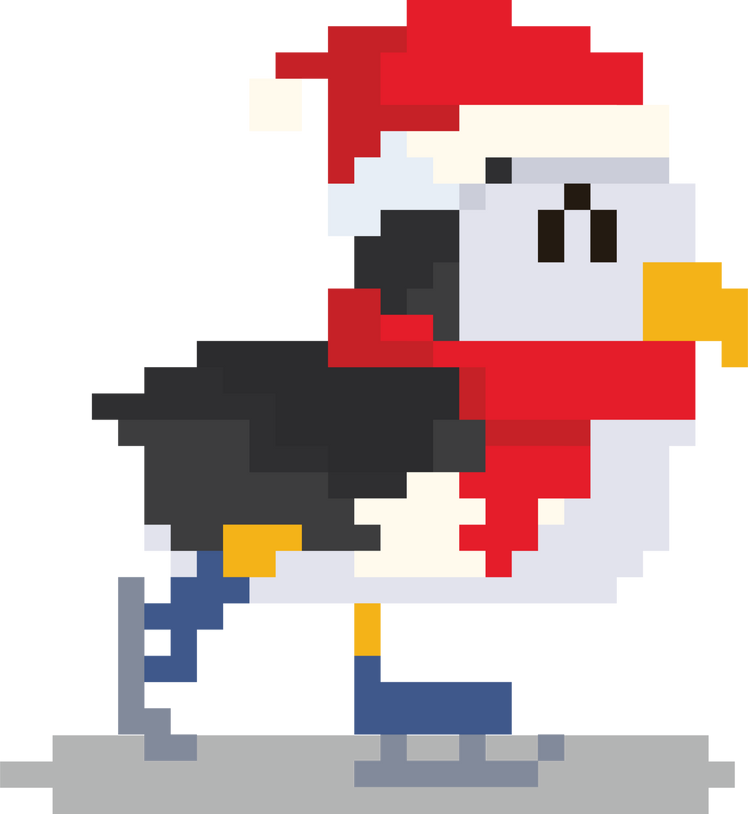

Smartie said good morning to Mummy and Daddy Penguin and asked if he was allowed to go on the tablet.
“Yes, of course!” Daddy Penguin replied. In a flash, Smartie darted to the living room to grab it.
SNOWCRAFT

Slide 4












Smartie scrolled through the apps and games on his tablet and sighed.
“I’ve played these LOADS of times; I want to find something new!”

Slide 5


Smartie loaded up the shop on his tablet, and was so excited to see all the new games he could download. He spotted an app that contained hundreds of different mini-games. Smartie clicked on it straight away.
Arcade Quest
Install
12
1
300k
6.7k reviews
downloads
Fighting
Video Chat
In-app purchases
Ratings and Reviews:
OtterlyDisappointed
Rubbish game! It said it was free and took all of my money!

Slide 6

However, when he clicked the app, he started to wonder whether downloading it was a good choice.
Arcade Quest
Install
12
1
300k
6.7k reviews
downloads
Fighting
Video Chat
In-app purchases
Ratings and Reviews:
OtterlyDisappointed
Rubbish game! It said it was free and took all of my money!

Slide 7
There were some warnings saying the app contained ‘Fighting’ and ‘Video Chats’ and there was a colorful box with the number 12 in it. There were also some terrible reviews and the game was only rated 1 star! He really wanted to download the app, but he wasn’t sure if it was a good idea.
Arcade Quest
Install
12
1
300k
6.7k reviews
downloads
Fighting
Video Chat
In-app purchases
Ratings and Reviews:
OtterlyDisappointed
Rubbish game! It said it was free and took all of my money!

Slide 8


Can you help Smartie make the right decision?
Should Smartie download the app, or should he ask his parents for help?

Slide 9

“Mummy! Daddy!” cried Smartie. “I really want to download this app, but I am not sure if I should?”
“Smartie, that was a really good choice!” said Daddy Penguin. “Well done for asking for help rather than making that decision by yourself.”
Arcade Quest
Install
12
1
300k
6.7k reviews
downloads
Fighting
Video Chat
In-app purchases
Ratings and Reviews:
OtterlyDisappointed
Rubbish game! It said it was free and took all of my money!

Slide 10
“I am not sure this is the right app for you,” said Mummy Penguin. “It has some content that might not be suitable and is aimed for children over the age of 12. Also, the reviews are terrible!”
1
Arcade Quest
300k
Install
6.7k reviews
downloads

Slide 11







Mummy Penguin was so pleased with what Smartie had done, they sang a special song together to help remind him of his sensible decision, so that he would continue to ask for help in the future.
Before you tap and click…
You need to stop and think…
And TELL someone!
Sing with me!

Slide 12

Mummy Penguin helped Smartie find a new game to play, which was more suitable for him.
Mermazing Games
Install
3
4.7
276k
6.7k reviews
downloads
Painting
Creative
Free to Play
Ratings and Reviews:
TidallyStoked
Really fun free games suitable for all ages!

Slide 13




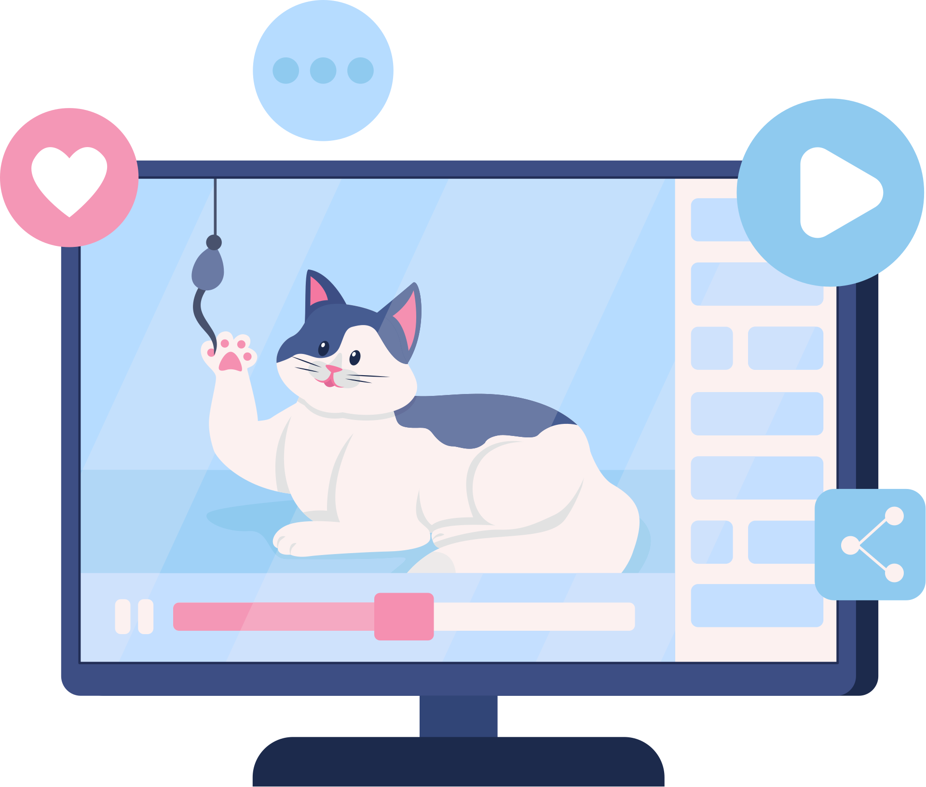
Later on that day, Smartie had been playing tennis all afternoon and he wanted to take a break to go on his tablet.
Smartie decided to watch some videos, so he went onto his favourite video app.

Slide 14
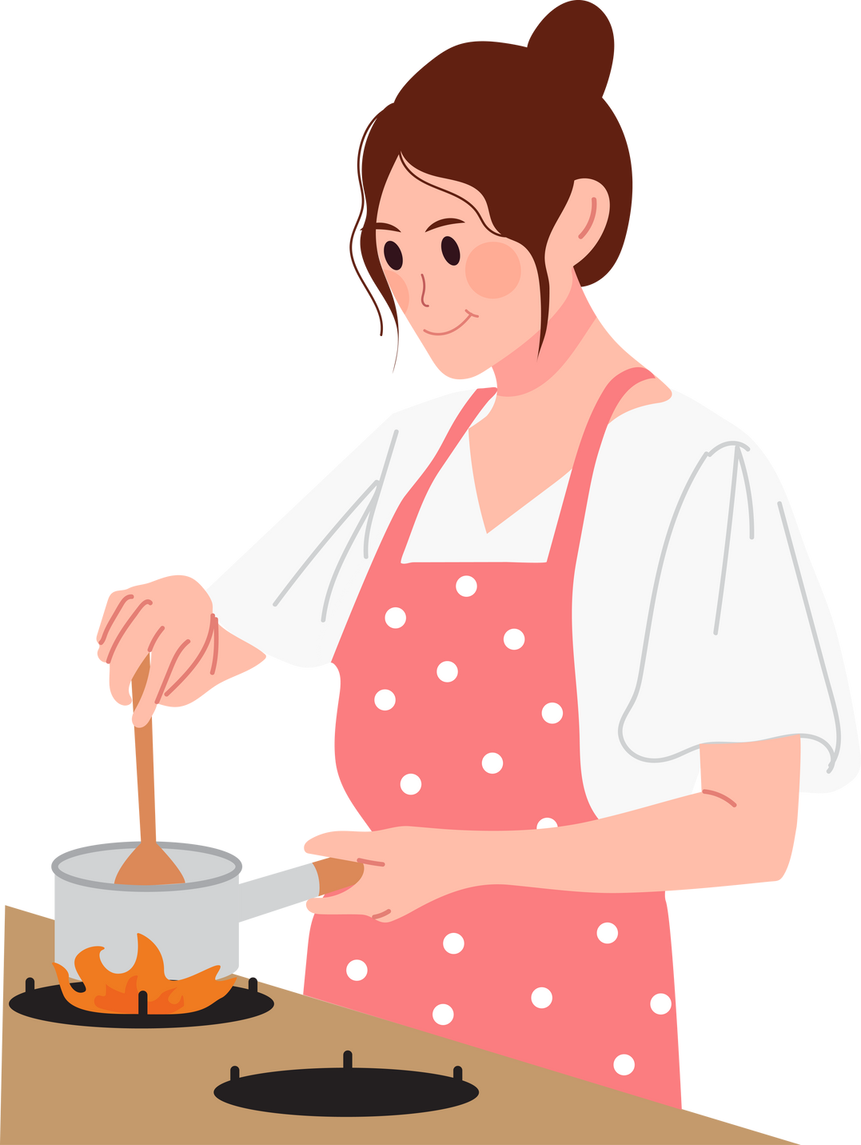

When he was searching, he came across a video with the title: ‘THIS CAKE IS THE BEST IN THE WORLD! WATCH FOR THE RECIPE!’
THIS CAKE IS THE BEST IN THE WORLD! WATCH FOR THE RECIPE!

Slide 15



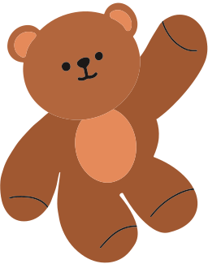

Smartie looked at the video and the cake was vanilla flavour, but his favourite cake was chocolate! He began to feel very confused and wondered if he was wrong. His favourite cake was nothing like the one in the video.
THIS CAKE IS THE BEST IN THE WORLD! WATCH FOR THE RECIPE!

Slide 16

What should Smartie do?
Should he believe what the video says, or should he ask an adult for some help?
Time to chat!

Slide 17
Let’s help Smartie to make the right decision by singing his special song!
One, two, three…
Before you tap and click…
You need to stop and think…
And TELL someone!
Sing with me!

Slide 18

“Help!” shouted Smartie. “I am feeling really confused. This video says my favourite cake is not the best cake in the world!”
HELP!
THIS CAKE IS THE BEST IN THE WORLD! WATCH FOR THE RECIPE!

Slide 19
“Smartie, well done for checking!” said Mummy Penguin. “This is called an opinion. This is just what somebody thinks, it is not truthful for everyone.”
“Just because they think it’s the best cake in the world, does not mean you have to agree with them,” said Daddy Penguin.

Slide 20
Mummy Penguin and Smartie watched the video together. It was interesting to find out about someone else’s opinion, but he was still sure that his favourite cake was the tastiest!
THIS CAKE IS THE BEST IN THE WORLD! WATCH FOR THE RECIPE!

Slide 21

The next day, Smartie was back on his tablet playing his favourite game, Snowcraft. He was getting better and better and trying to beat his top score from yesterday.
SNOWCRAFT

Slide 22


All of a sudden, the tablet beeped, and a message appeared on the screen. It was someone that often played the same games as Smartie, so he was excited to see them online again.
SNOWCRAFT

Slide 23

The other player sent a message saying, “Did you see my last message? Shall we meet up?”
Smartie wanted to reply. He felt it was rude to ignore them. But he was also beginning to feel worried.
SNOWCRAFT
DID YOU SEE MY LAST MESSAGE? SHALL WE MEET UP?

Slide 24
What should Smartie do?
Should he reply to the message and talk to the other player, or should he tell Mummy and Daddy instead?
Time to chat!

Slide 25
Let’s help Smartie to make the right decision by singing his special song!
One, two, three…
Before you tap and click…
You need to stop and think…
And TELL someone!
Sing with me!

Slide 26
“Daddy! Mummy!” called Smartie.
“Someone is asking to meet me, and I don’t know them. What shall I do?”
HELP!

Slide 27
“Smartie, you have been so sensible,” said Daddy Penguin. “It is really important to tell an adult if an online friend ever asks for your personal information or to meet up with you.”
SNOWCRAFT

Slide 28
“If you’re not sure about someone who is talking to you, or they make you feel worried, then always tell us. You don’t need to reply to any messages if you don’t want to.”
SNOWCRAFT

Slide 29



“Not everybody tells the truth on the internet, and because this isn’t a friend that you know offline, they are still a stranger. We can block this player so that they can’t ask you again.”
SNOWCRAFT
PLAYER BLOCKED

Slide 30


From that day on, Smartie always knew how to be safe when using his tablet and playing on the internet! If anything happened that made him feel worried, upset, or confused, he didn’t try to fix things by himself.
and always asked an adult for help.
He stopped...
thought about what to do…

Slide 31

I am very lucky because I have Mummy and Daddy Penguin to help me!
But who can help you?
Time to chat!

Slide 32
Sing with us!
Before you tap and click…
You need to stop and think…
And TELL someone!

