Slide 1







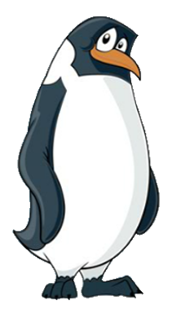






2B
The Adventures of Smartie the Penguin

Slide 2





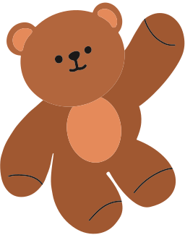
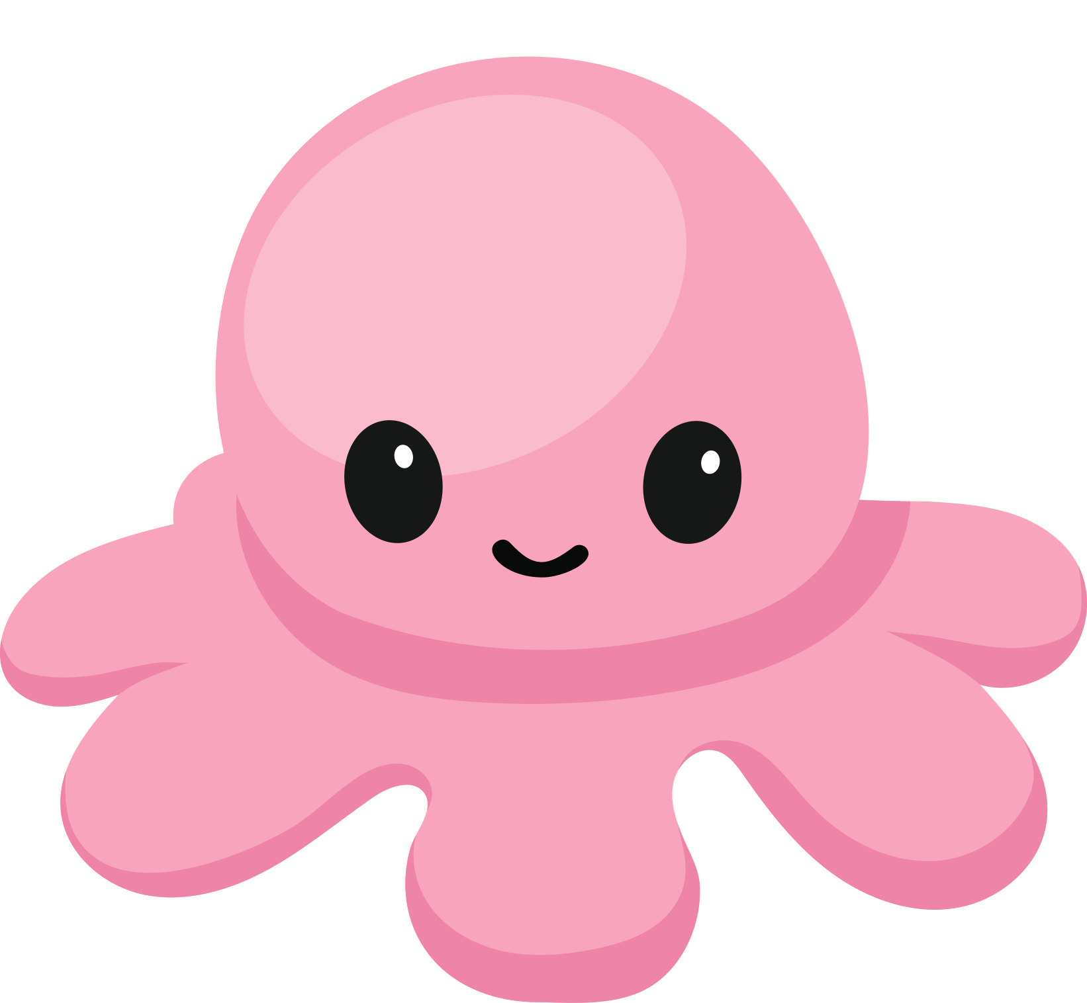
It had been a long week and Smartie was tired. He’d not been feeling well for a few days, so he’d spent more time inside than usual.

Slide 3



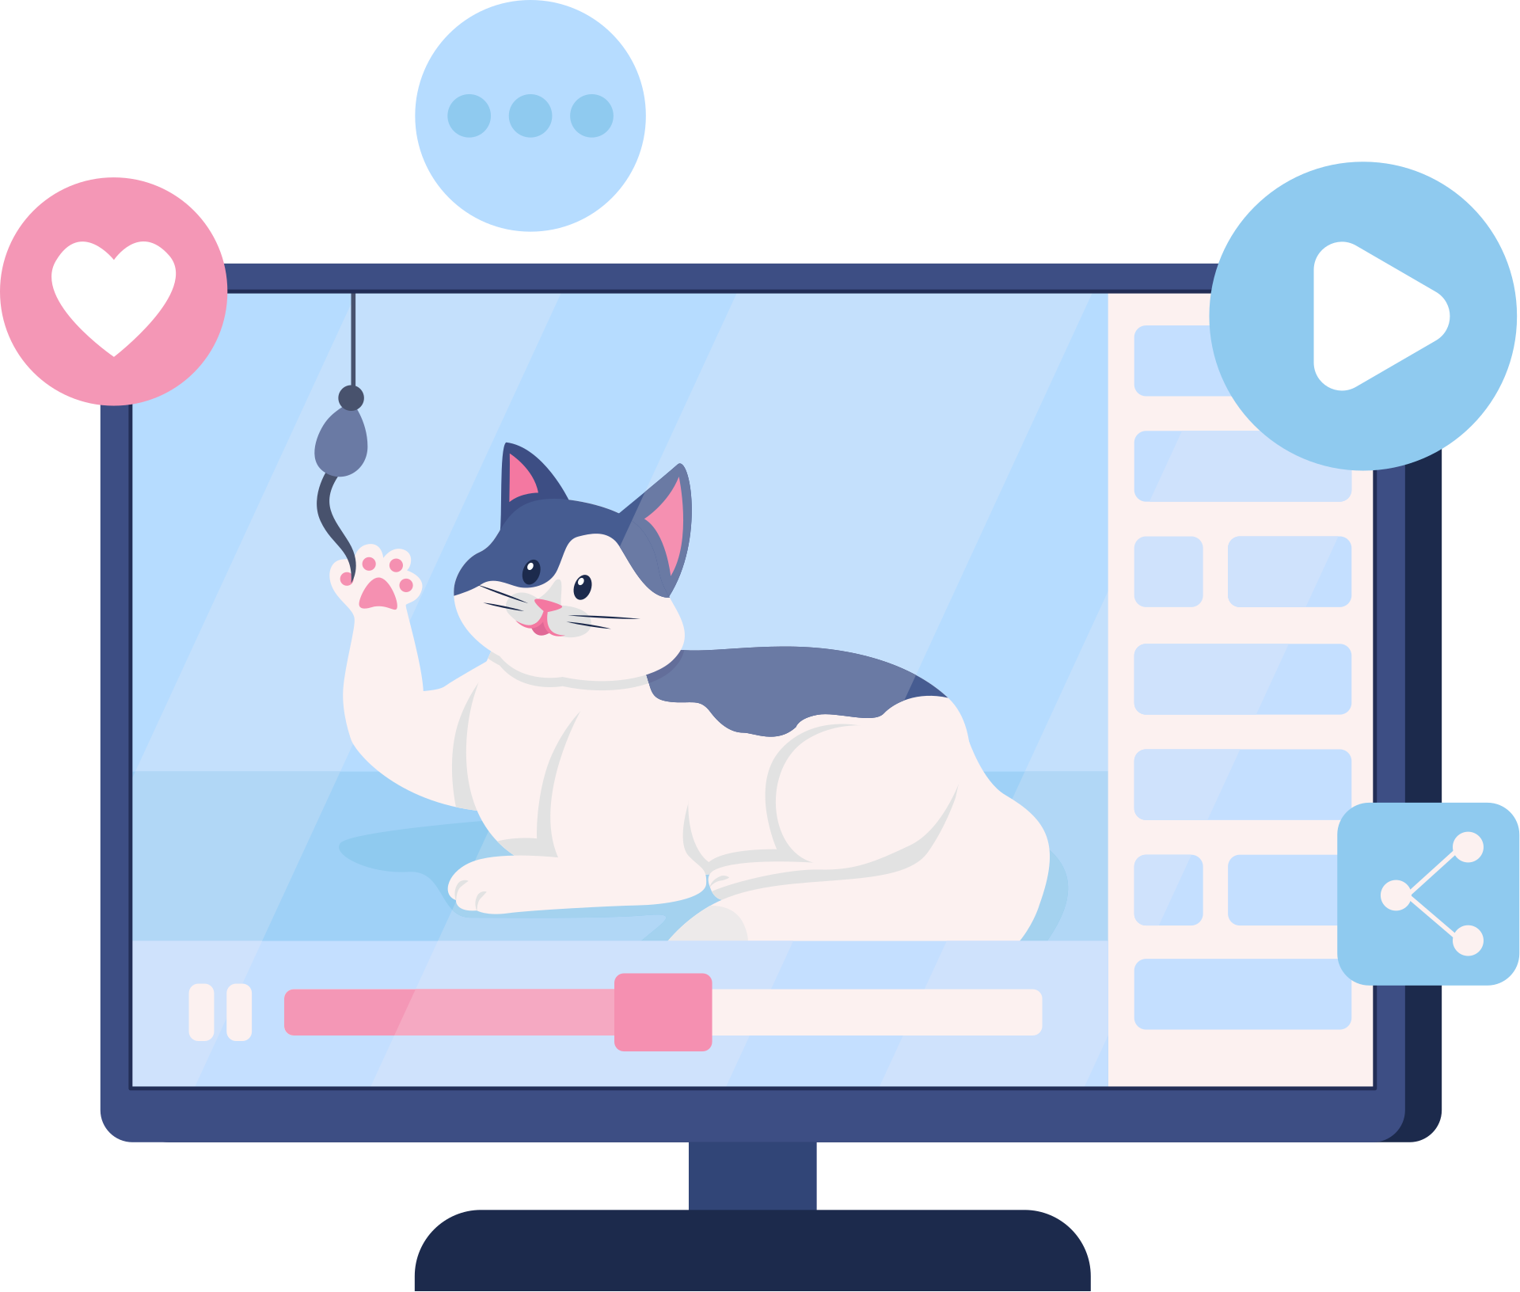
Smartie started to watch a video but, half way through, it stopped. A notification appeared saying, ‘You have reached your screentime limit for today.’
You have reached your screentime limit for today.
SILLIEST cats on EARTH! This will make you LAUGH your HEAD OFF!

Slide 4



He clicked the button saying ‘more time’ but it needed a password to continue.
“What?” Smartie said, crossly. “That’s so unfair!”
You have reached your screentime limit for today.

Slide 5



What should Smartie do?
Should he keep his feelings to himself, or should he let someone know what has happened and talk about how he feels?
Time to chat!

Slide 6

Mummy Penguin was at work, so he went to find Daddy Penguin.
“Daddy!” he said. “The tablet stopped in the middle of my video because my screentime ran out, and now I’m feeling annoyed.”
Daddy!
You have reached your screentime limit for today.

Slide 7
“Oh, Smartie,” said Daddy Penguin. “Well done for coming to tell me. I’m sorry that this upset you, and I understand it’s frustrating having to stop something that you were enjoying.”
You have reached your screentime limit for today.

Slide 8
“I’m surprised it has run out this early in the day though,” said Daddy Penguin.
You have reached your screentime limit for today.

Slide 9
“That must be because I’ve been inside all day, Daddy,” replied Smartie. “I have watched a LOT of videos!”
“I understand,” said Daddy Penguin. “That’s why we have the screentime limits, so that you don’t spend too long online at once.”
You have reached your screentime limit for today.

Slide 10
“It’s important to do other things that you enjoy as well though! I’ll give you five more minutes to finish watching that video, then why don’t you teach me that dance you’ve been learning? I’d love to try it!”
You have reached your screentime limit for today.

Slide 11






Daddy Penguin was so pleased with what Smartie had done, they sang a special song together to help remind him of his sensible decision, so that he would continue to ask for help in the future.
Before you tap and click…
You need to stop and think…
And TELL someone!
Sing with me!

Slide 12



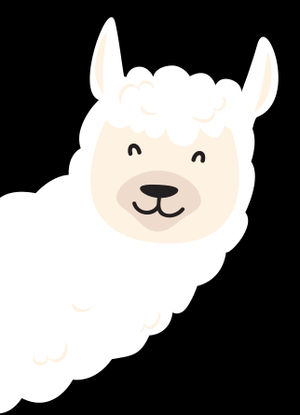

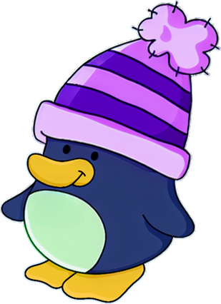









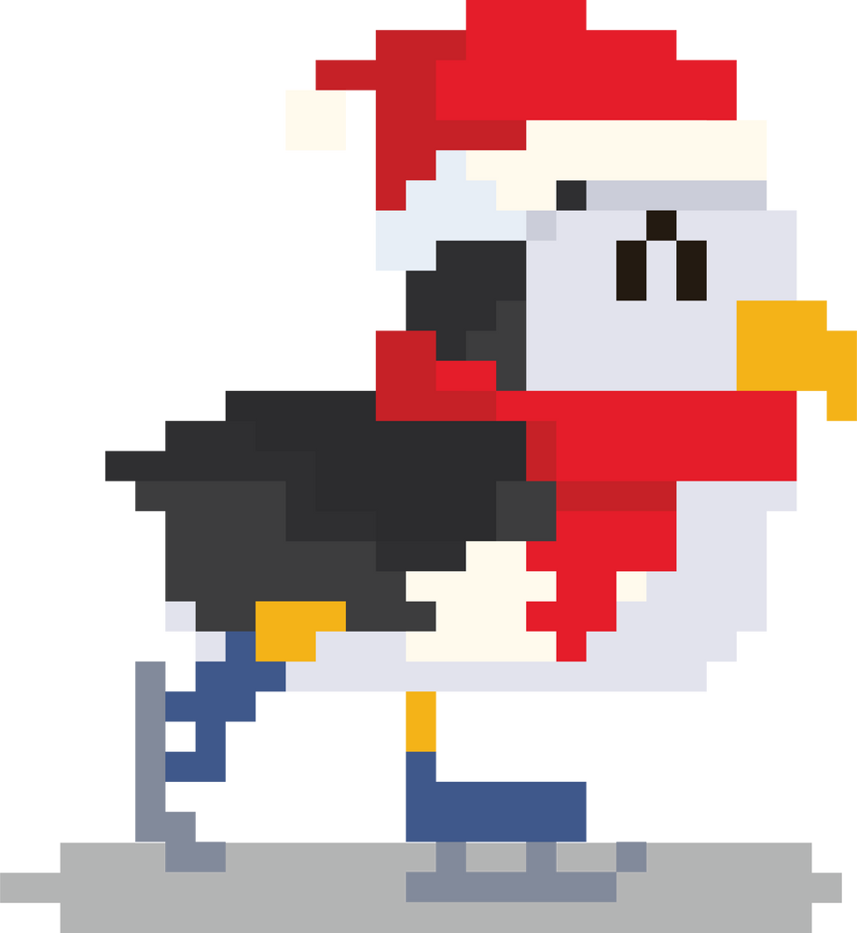

The next morning, Smartie rushed downstairs. He was excited because Zo was coming over to play. When Zo arrived, they headed upstairs and started to chat.
“Can I ask you something, Smartie?” said Zo.
“Sure!” replied Smartie.
SNOWCRAFT

Slide 13
“I’m having trouble on one of the racing tracks, on that game you showed me,” Zo explained. “But, if you told me your password, I could practise on your account and use some of your special speed boosters to get better. I don’t have any of those!”
SNOWCRAFT

Slide 14
Can you help Smartie make the right decision?
Should he tell Zo his password to help her out, or should he ask his parents for help?
Time to chat!

Slide 15
Let’s help Smartie to make the right decision by singing his special song!
One, two, three…
Before you tap and click…
You need to stop and think…
And TELL someone!
Sing with me!

Slide 16
“Let me just check with Mummy,” said Smartie.
Mummy!
SNOWCRAFT

Slide 17
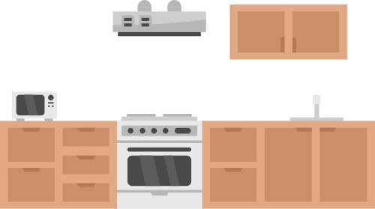




“Well done, Smartie,” said Mummy Penguin. “Asking for help was a great decision. It can be hard to say no to your friends, especially when you want to help them, but a password is personal information. Daddy and I are the only other people that can know it. Why don’t you show Zo how she can earn the speed boosters instead?”

Slide 18
Smartie and Zo thought this was a super idea. By the time Zo went home, she knew exactly what to do!
SNOWCRAFT

Slide 19
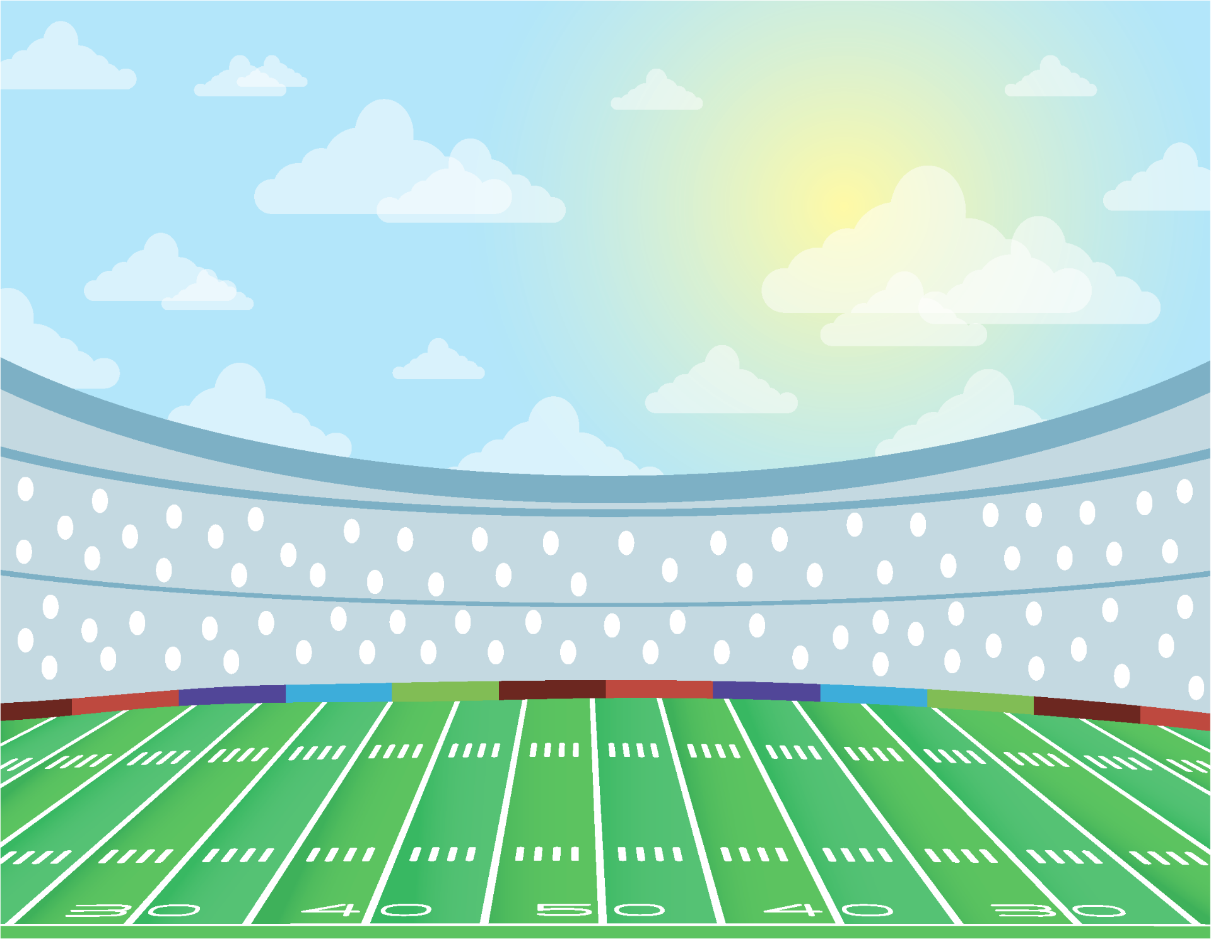



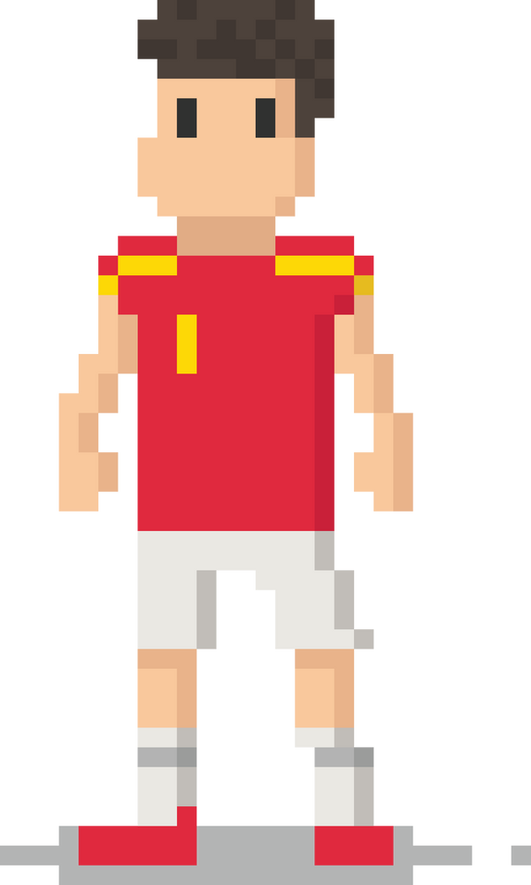
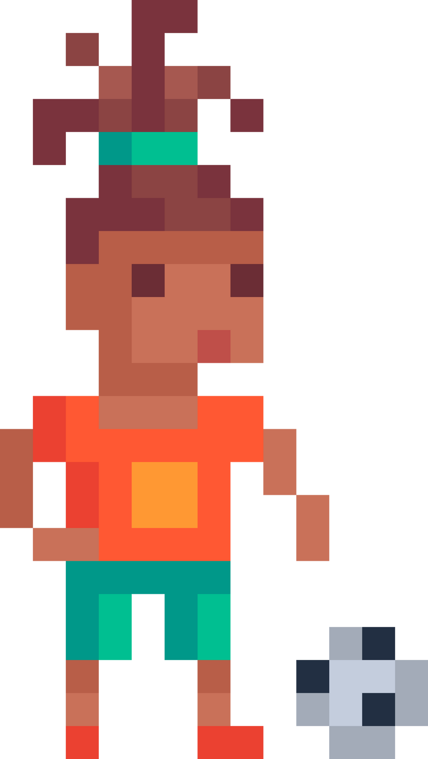
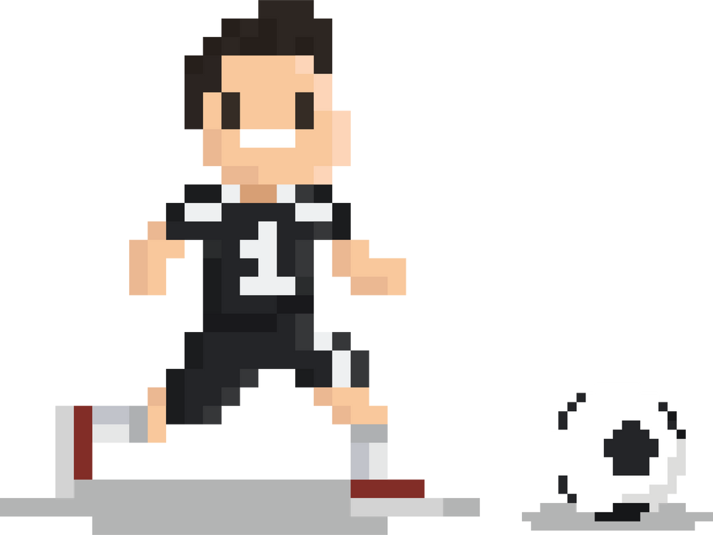
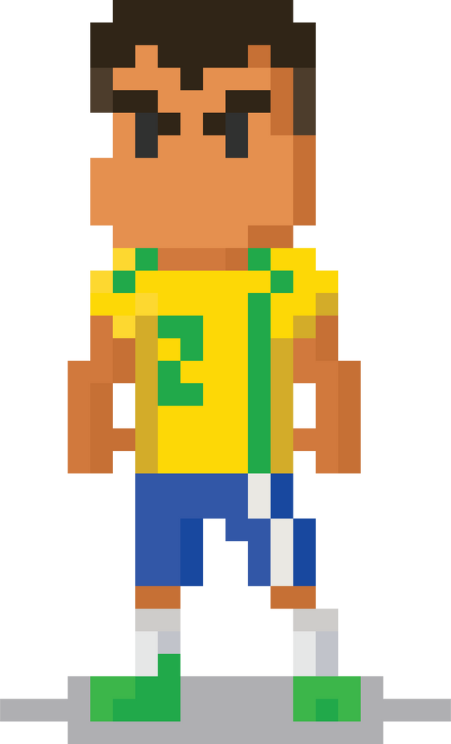
The next afternoon, Smartie was back on his tablet. He was playing a game with his friends, and they were all on one team. The game was really tough! Smartie had the ball and they needed one more goal to win...

Slide 20


Just as Smartie was about to shoot, he was tackled and the game ended. His team had lost.
Soon after, a message appeared in the game chat. It said, “We lost because of you, Smartie. It’s all your fault.”

Slide 21

Smartie felt really sad about what his friend had written. He hadn’t meant to lose the ball. It could have happened to anyone!
We lost because of you, Smartie.
It’s all your fault.

Slide 22
What should Smartie do?
Should he write an angry message back, or let an adult know what is happening?
Time to chat!

Slide 23
Let’s help Smartie to make the right decision by singing his special song!
One, two, three…
Before you tap and click…
You need to stop and think…
And TELL someone!
Sing with me!

Slide 24






“Daddy!” said Smartie, showing him the tablet. “My friends are being mean to me and it’s making me feel really sad.”
“Oh, I’m so sorry to hear that Smartie. That’s not a kind thing to do, is it?” replied Daddy.
Besties

Slide 25
“You did the right thing by not saying anything mean back. Replying when you’re angry might make the situation worse, as words can be misunderstood online.”
Besties

Slide 26
“Sometimes, friends can make mistakes and say things without really thinking about how it might make someone feel. Let’s close this chat for now, and when you see your friends tomorrow, explain to them that their words upset you and you felt left out.”
Besties

Slide 27


From that day on, Smartie always knew how to be safe when using his tablet and playing on the internet! If anything happened that made him feel worried, upset, or confused, he didn’t try to fix things by himself.
and always asked an adult for help.
He stopped...
thought about what to do...

Slide 28

I am very lucky because I have Mummy and Daddy Penguin to help me!
But who can help you?
Time to chat!

Slide 29
Sing with us!
Before you tap and click…
You need to stop and think…
And TELL someone!

