Slide 1

1. Rosie & Maisie
Charlton Horethorne Church of England Primary School

Slide 2
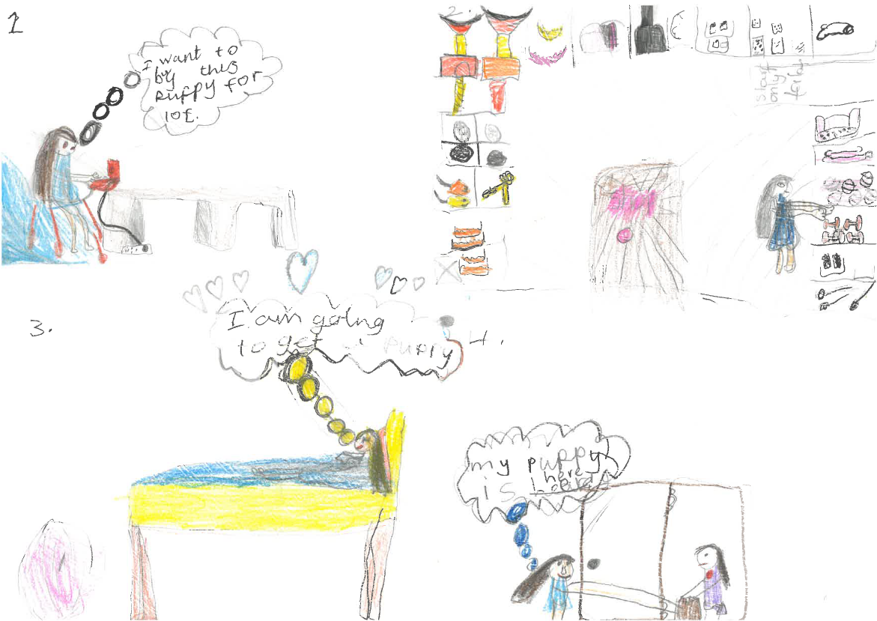

Slide 3
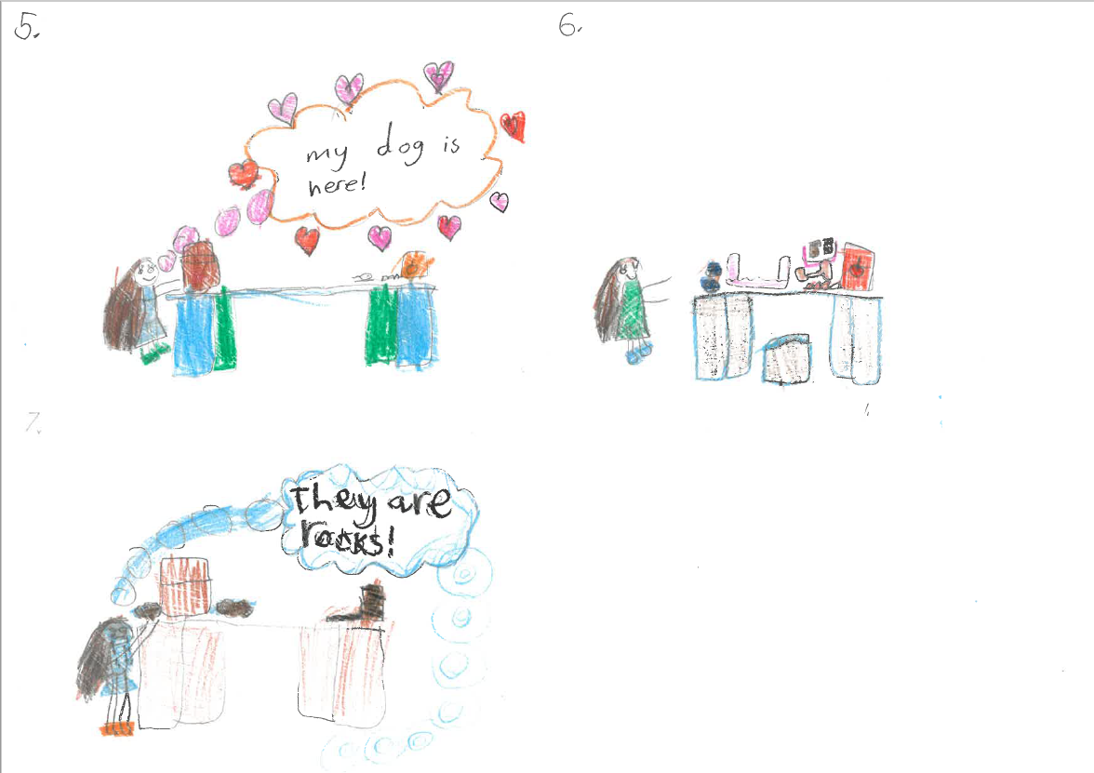

Slide 4
2. Evie & Faye
Charlton Horethorne Church of England Primary School

Slide 5
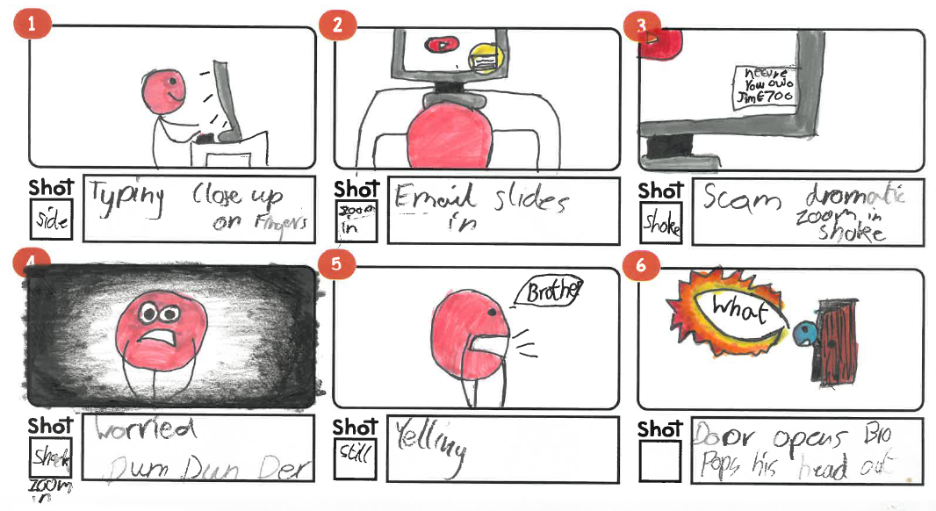

Slide 6
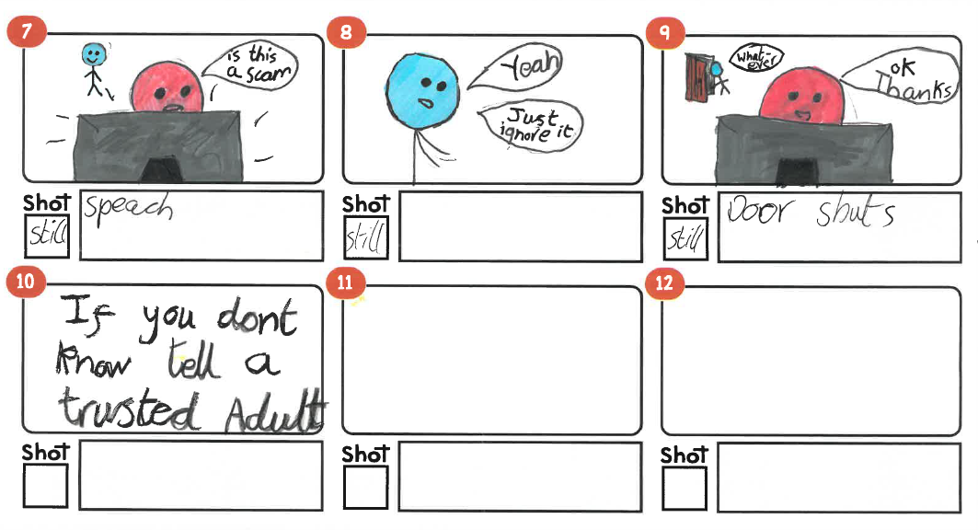

Slide 7
3. Jaina
Frome Vale Academy

Slide 8
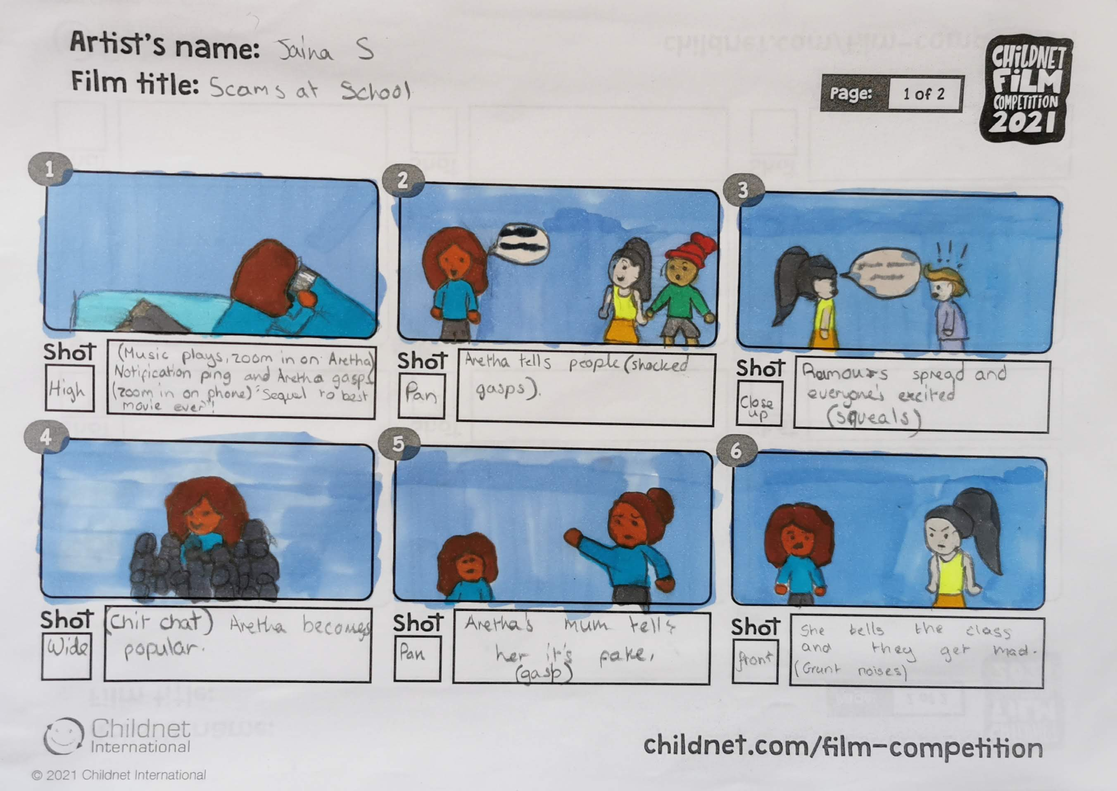

Slide 9
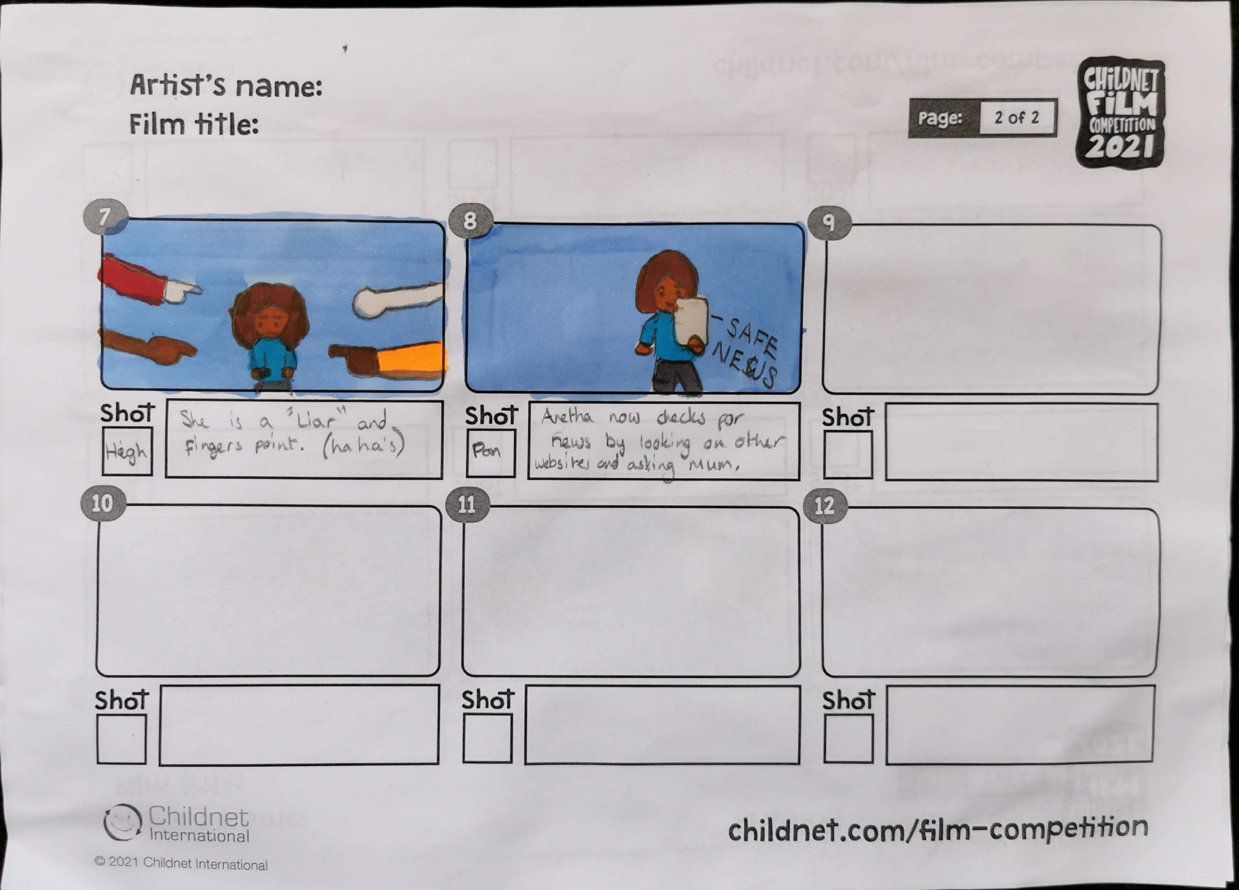

Slide 10
4. Ashton
Kingscourt School

Slide 11
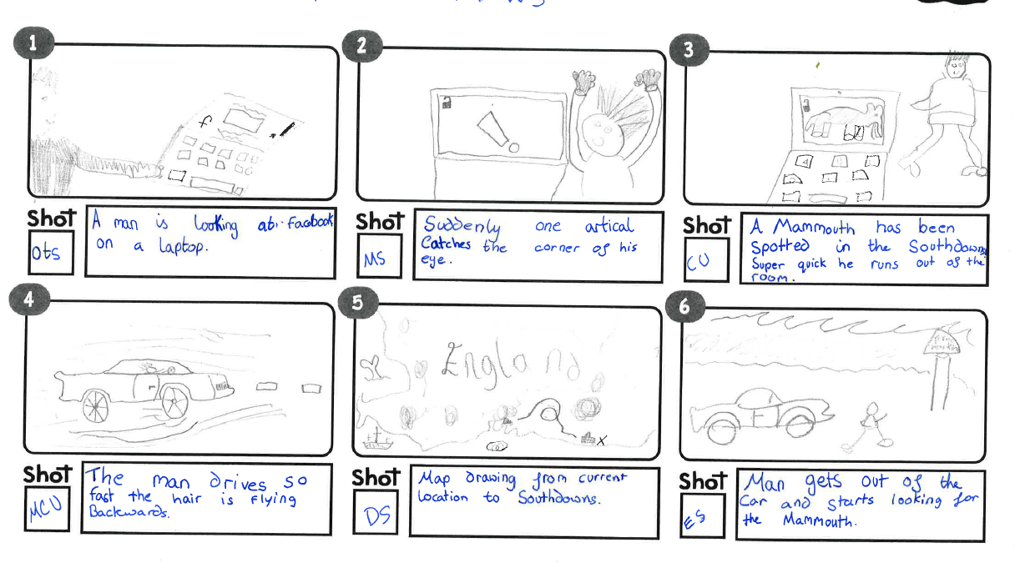

Slide 12
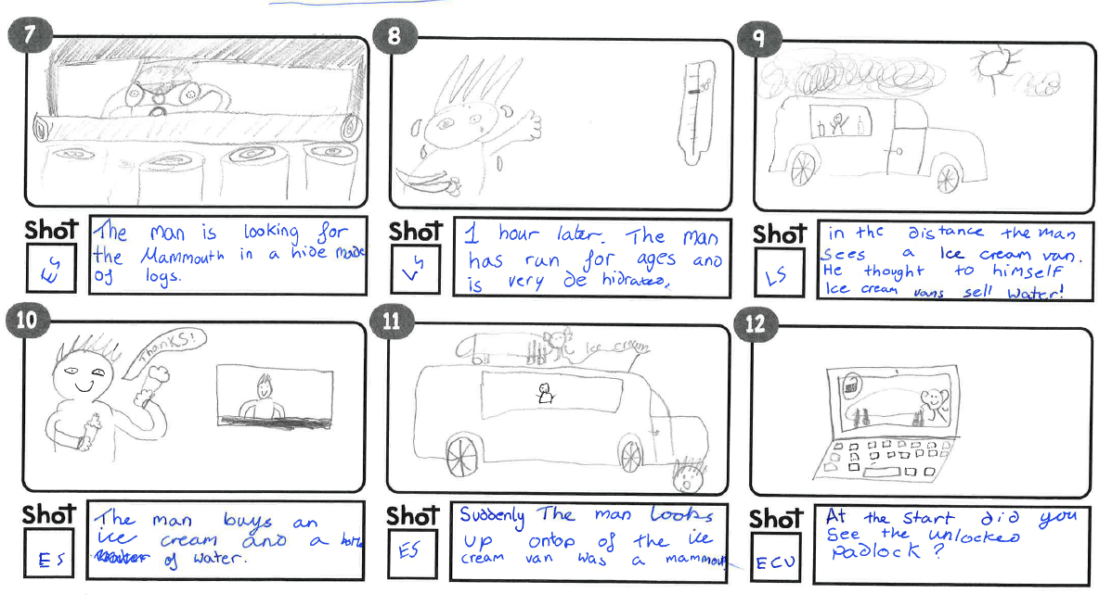

Slide 13
5. Charlie
Kingscourt School

Slide 14
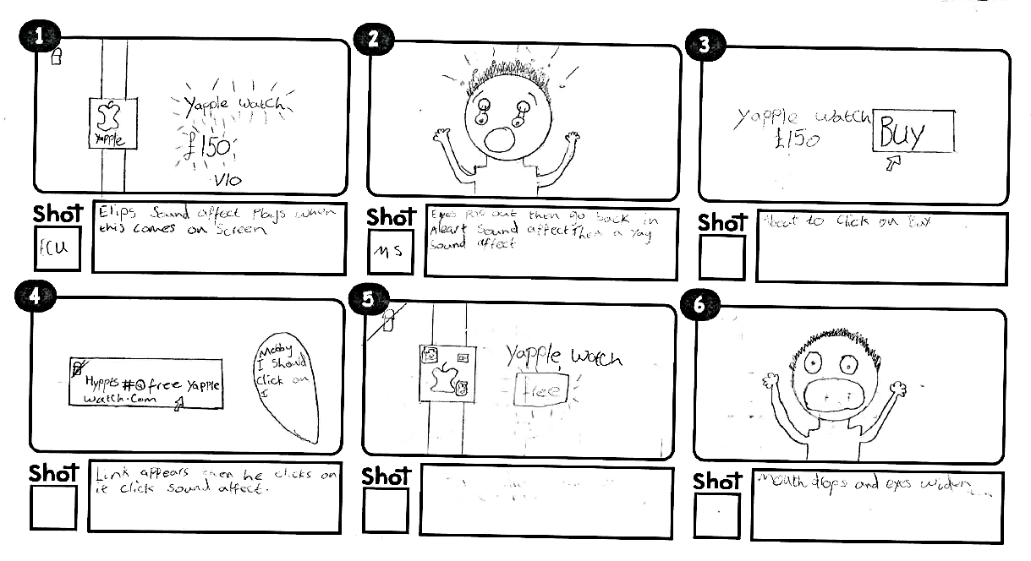

Slide 15
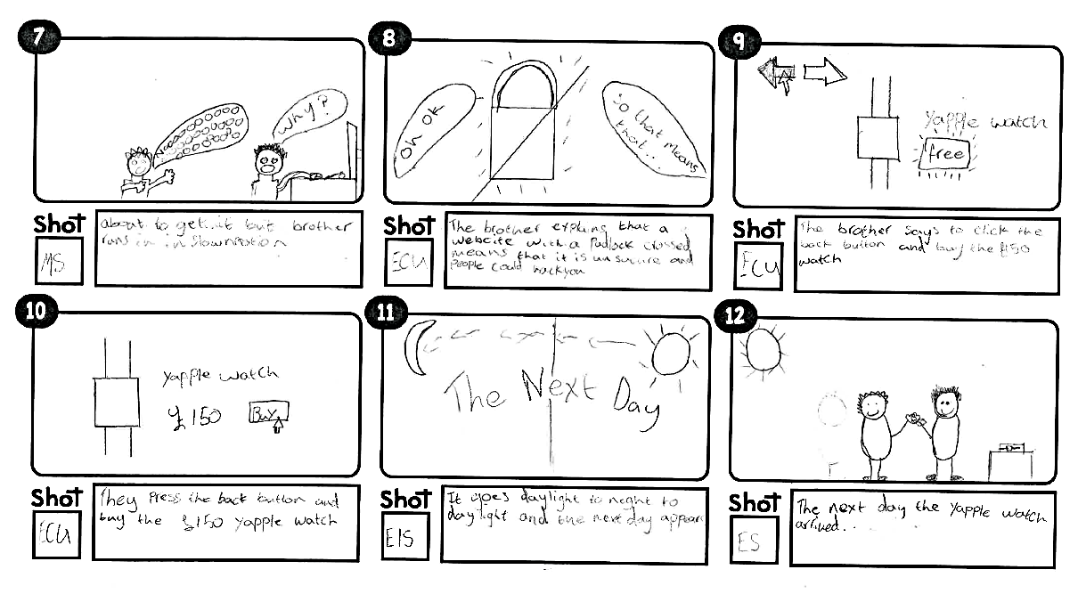

Slide 16
6. Elizabeth
Kingscourt School

Slide 17
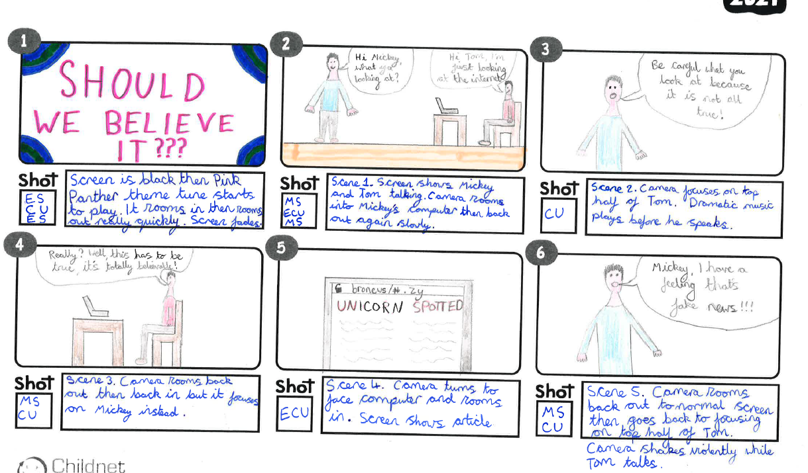

Slide 18
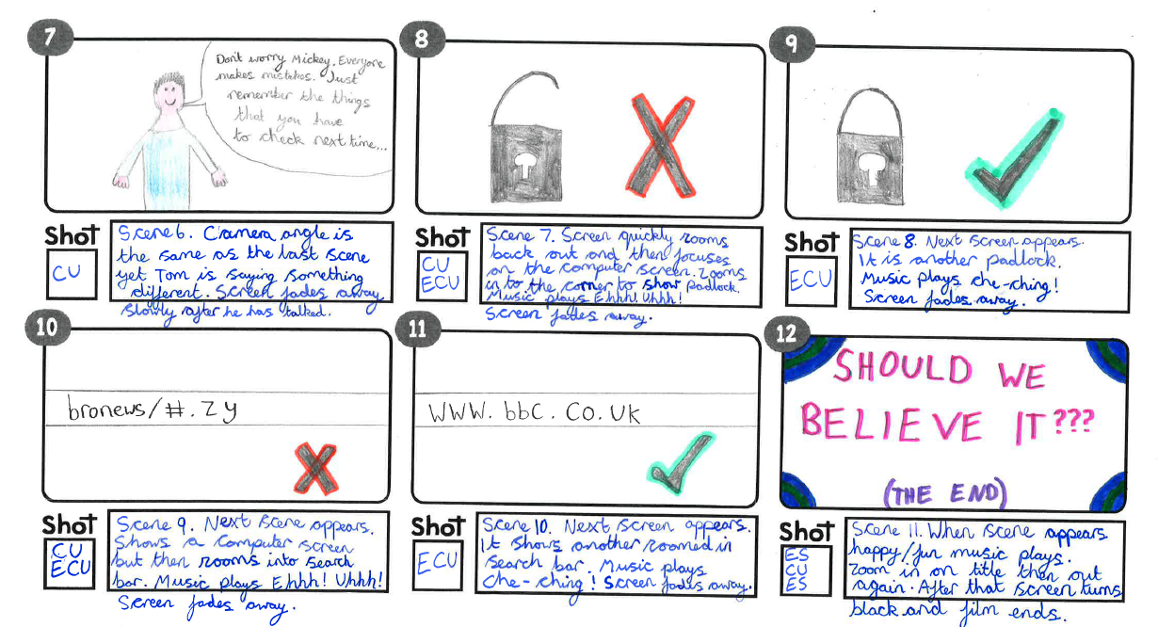

Slide 19
7. Eva
Kingscourt School

Slide 20
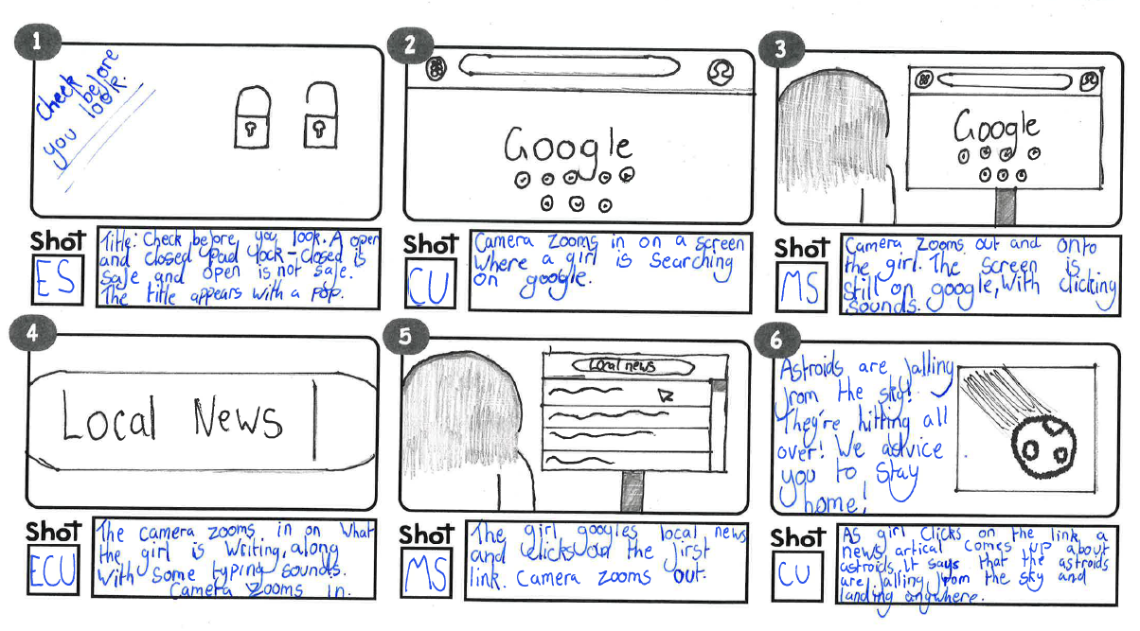

Slide 21
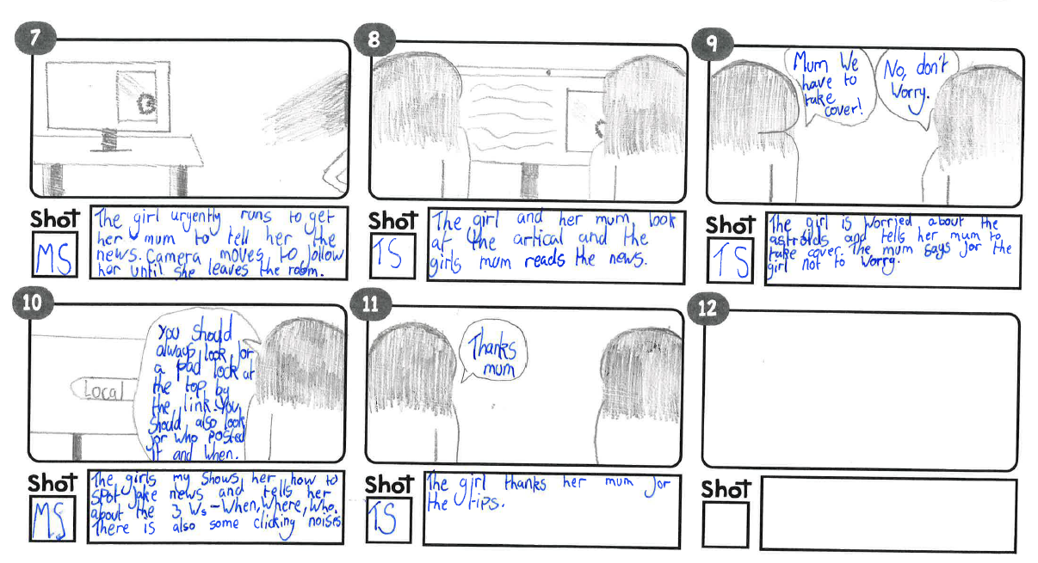

Slide 22
8. Devarjun
Two Mile Ash

Slide 23
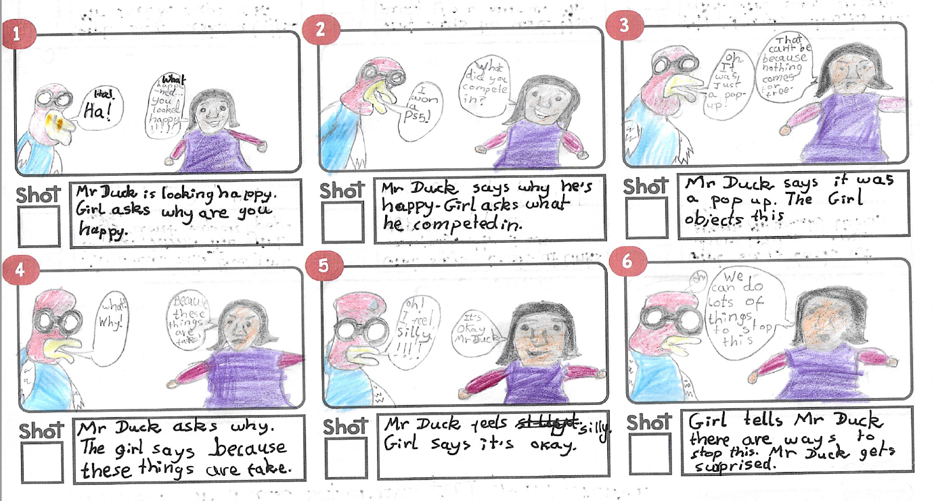

Slide 24
