Slide 1

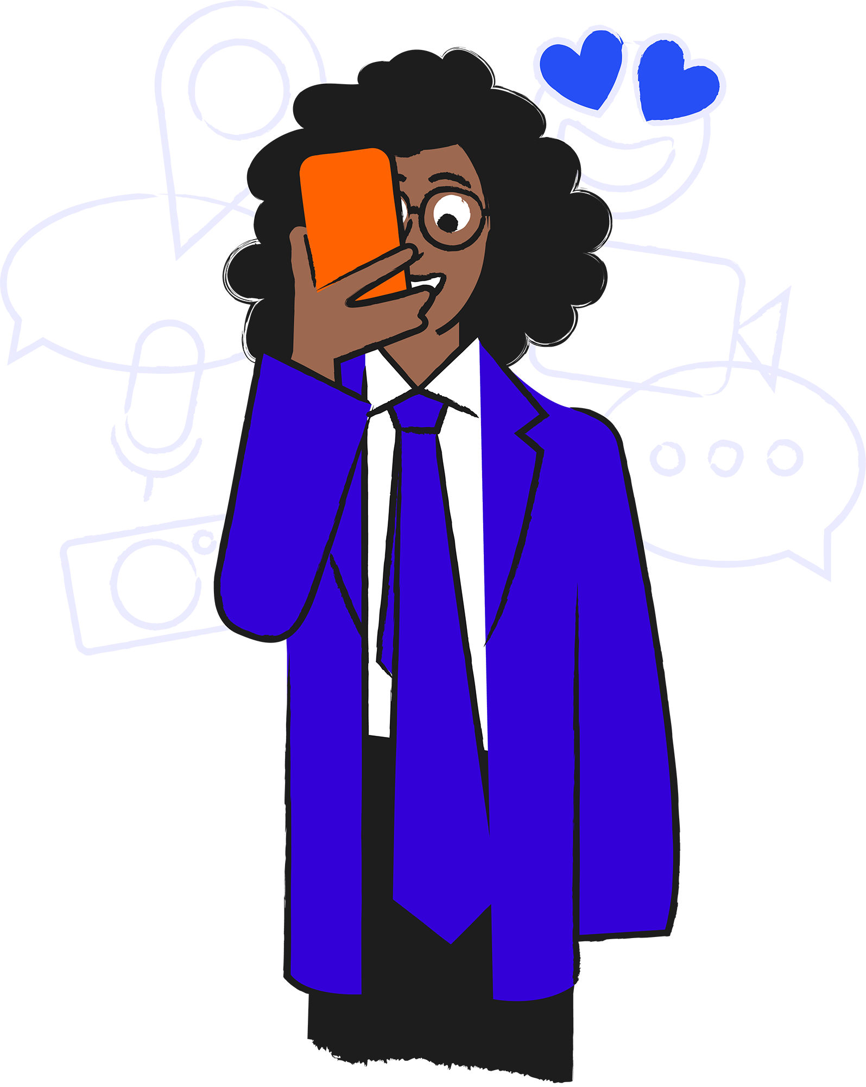
Moving on up!

Slide 2

Starter
Would you rather?
For each slide, you can only choose ONE option.
Be prepared to explain your choice!

Slide 3


Would you rather…
or
Have a phone
not have a phone?

Slide 4


Would you rather…
or
Use a phone
use a games console?

Slide 5

Would you rather…
or
Play games online
watch videos online?

Slide 6


Would you rather…
or
Chat to friends online
see friends face-to-face?

Slide 7
Moving on up!
In this lesson we will be looking at:
How new and old friendships can change when moving to a new school with a focus on the role that technology can play.
Learning objectives:
Describe how friendships may change online and offline when moving schools.
Explore how changing friendships can make us feel.
Understand how to resolve issues that these changing friendships may bring.

Slide 8
Activity 1: Finding solutions: Part A
Changes involved in moving to secondary school

Slide 9
Activity 1: Finding solutions: Part B
Change
How using technology could help
Close friends going to a different school
Travelling to school alone
Not knowing many people at a new school/making new friends
Old friends being in different classes
Increased amount of homework
Remembering what to take to school each day

Slide 10
Activity 1: Finding solutions: Part B
Change
How using technology could help
Close friends going to a different school
Travelling to school alone
Not knowing many people at a new school/making new friends
Old friends being in different classes
Increased amount of homework
Remembering what to take to school each day
Using messaging apps to stay connected.
Call or message to let them know you’ve arrived.
Using games to strengthen friendships at the new school.
Messaging each other to arrange to meet at lunchtime etc.
Using an online planner, or your device’s calendar to plan homework.
Setting reminders for what needs to go to school each day.

Slide 11
Activity 2: Two sides to every story: Part A
A ‘friend’ is...

Slide 12
Activity 2: Two sides to every story: Part B
Kayla and Kian have been close friends for many years, but are going to different secondary schools. Kian wants to spend as much time together as possible, but Kayla is actively trying to make new friends in advance.
Kayla’s dad asked online and helped her find families whose children are also starting at her secondary school. She’s now in a group chat with a few people from her year group, and has added some as friends online.
This has caused a rift and Kian thinks Kayla is no longer concerned about their friendship and just wants to move on.

Slide 13



Hey, where were you?? You didn’t come to Noor’s party.
Kian
Sorry!! Today was the bbq at Al’s house. I finally got to meet Al and Sam!
Kayla
I can’t believe you missed it.
We got chatting and totally lost track of time… It was like we’d known each other for ages! I’m so sorry Are you ok??
No, not really. You’ve known them for like two weeks, and we’ve actually been friends for years. I feel like you’re choosing them over me.

Slide 14
Activity 2: Two sides to every story: Part B
Do you agree with Kian that Kayla is putting her new friends first?
Can Kayla call her new friends ‘friends’ if she’s only recently added them online and they’ve only met once?
It can be hard when it feels like a friendship is changing, or drifting apart. What advice would you give to Kayla and Kian?

Slide 15
Our ‘Code of Conduct’
Issue
Statement
Feeling frustrated when friends don’t reply to messages straight away
‘We understand that friends are allowed to respond in their own time.’

Slide 16




Explore more resources at childnet.com/resources
Co-financed by the Connecting Europe Facility of the European Union
© Childnet International 2022

