Slide 1
Hanni and the Magic Window
This simplified version of ‘Hanni and the Magic Window’ could be used:
to pre-teach the story before reading the rhyming version.
to recap the main plot points.
to develop a sensory story for learners with special educational needs and disabilities (SEND) or additional learning needs (ALN).
as an ordering activity to help learners retell the story.

Slide 2
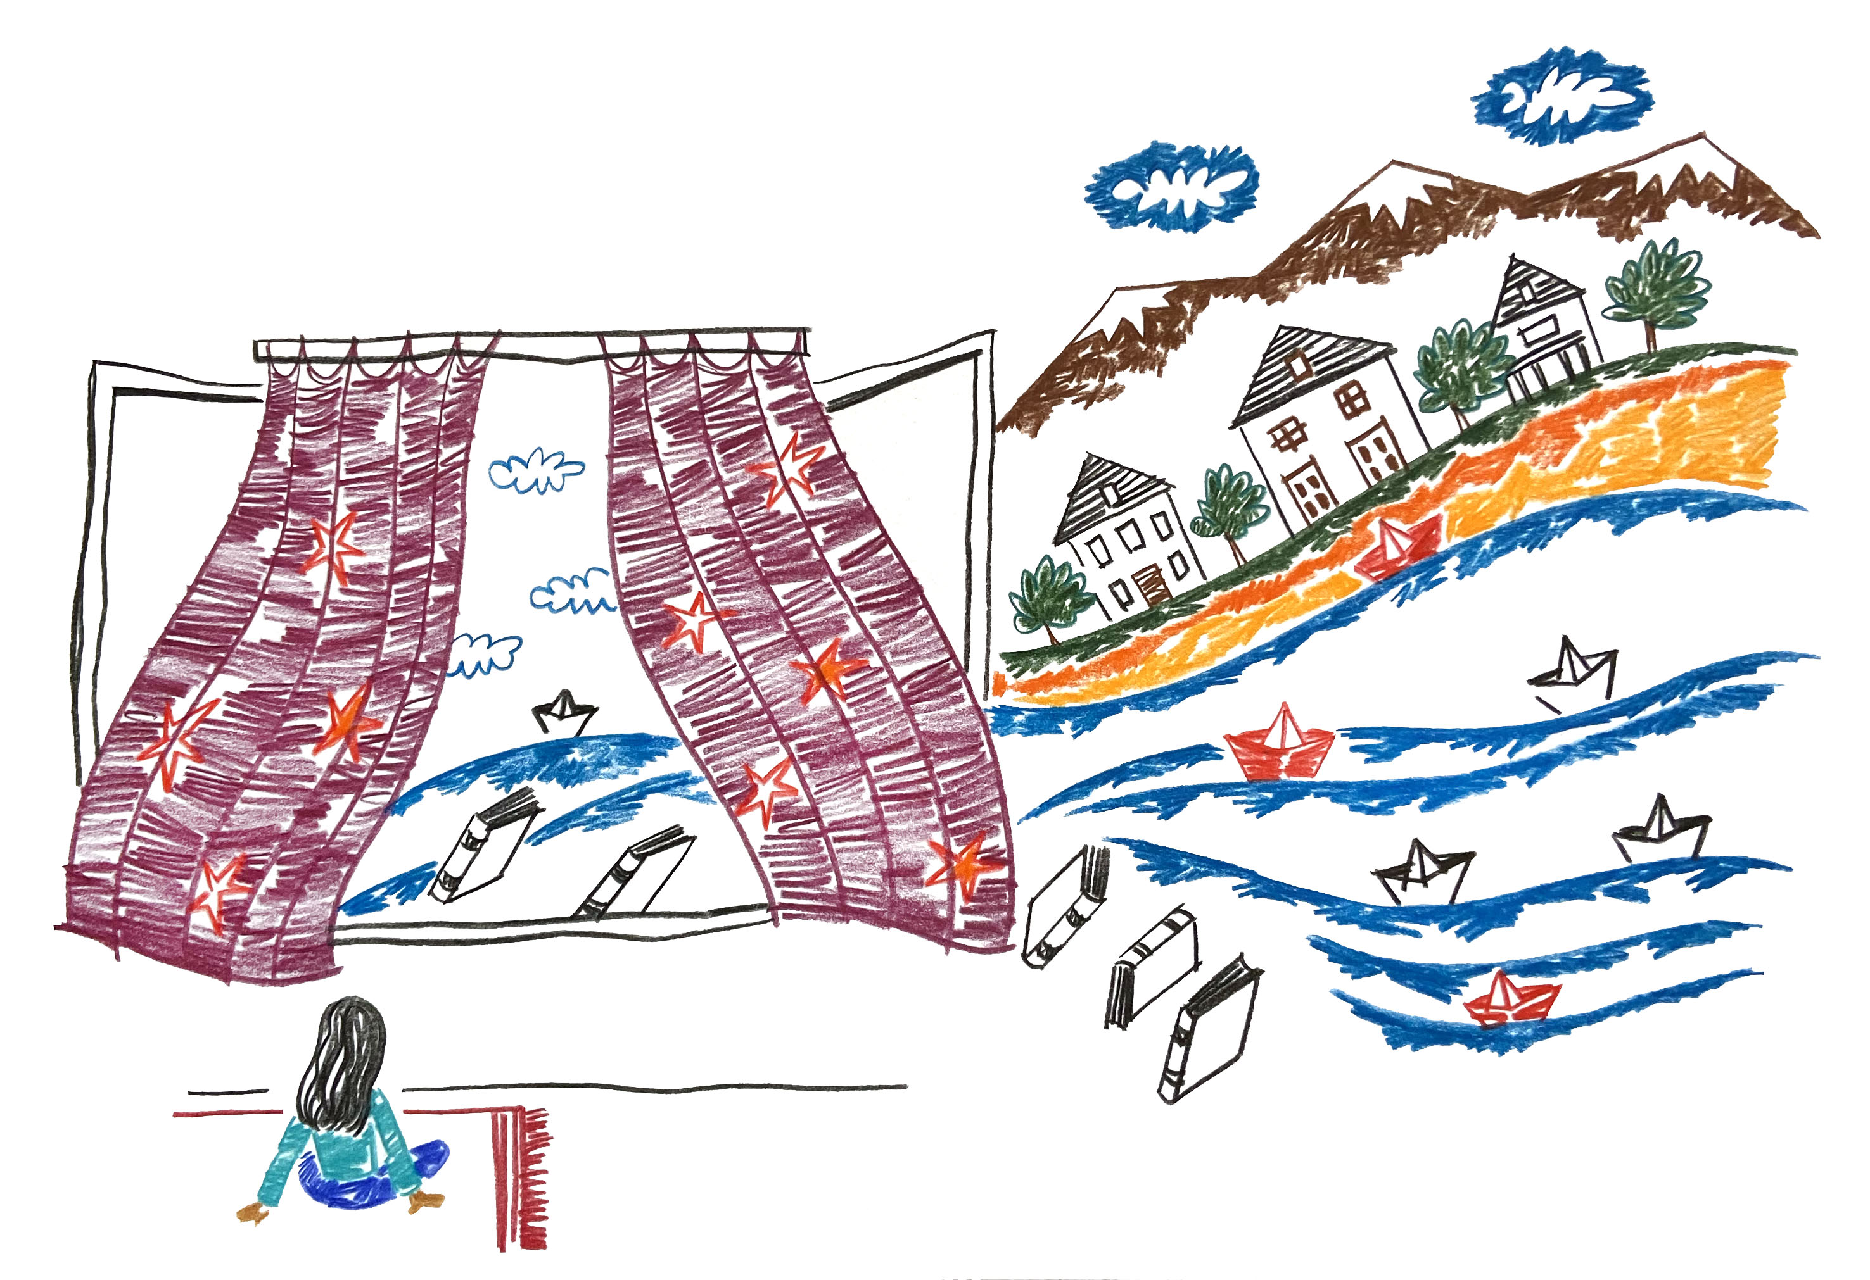
Hanni and the Magic Window
Written by Amy Lockwood
Illustrated by Saba Lasheiei

Slide 3
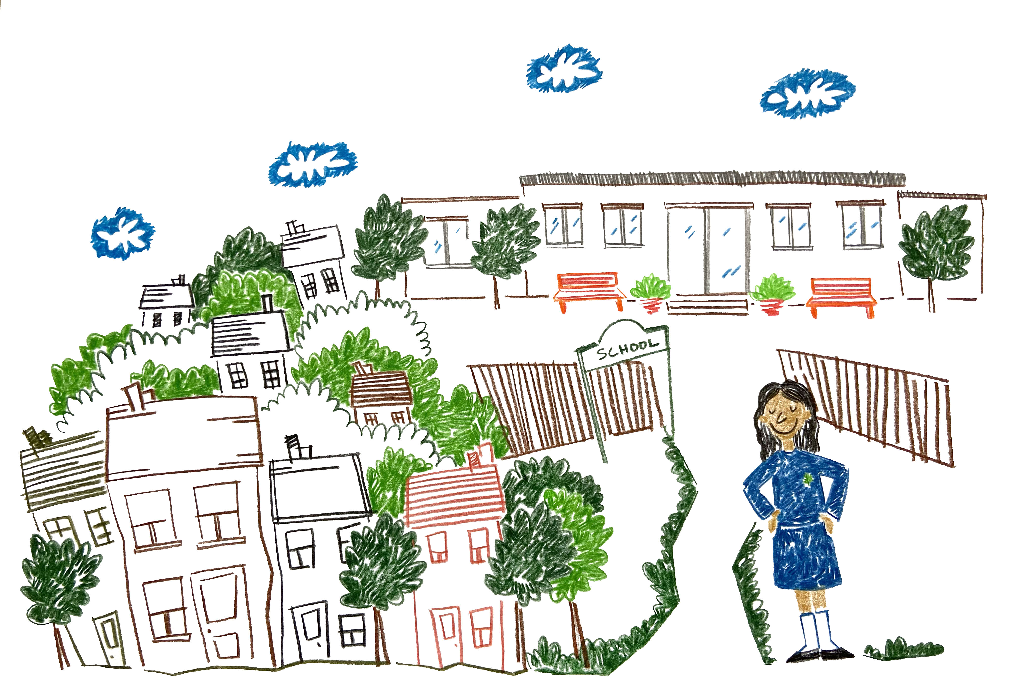
This is Hanni.

Slide 4
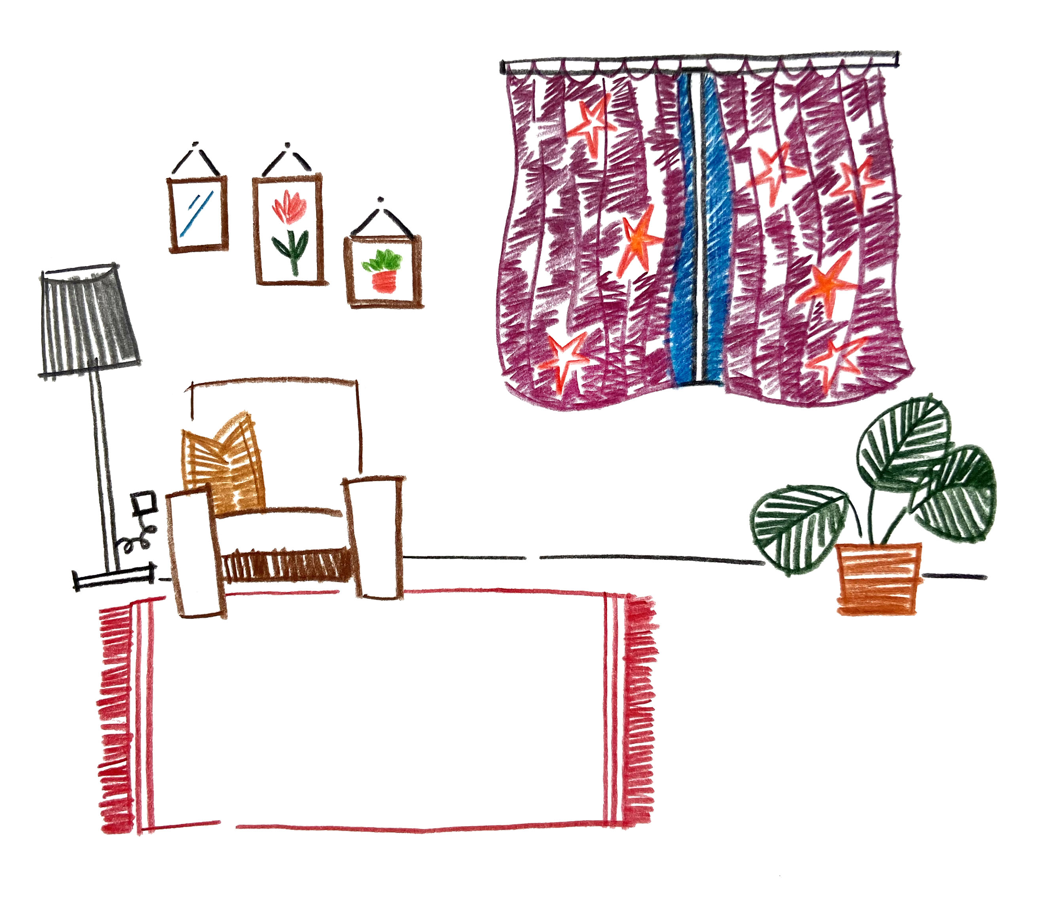
Hanni’s house has a magic window.
The magic window let’s Hanni see amazing things.

Slide 5
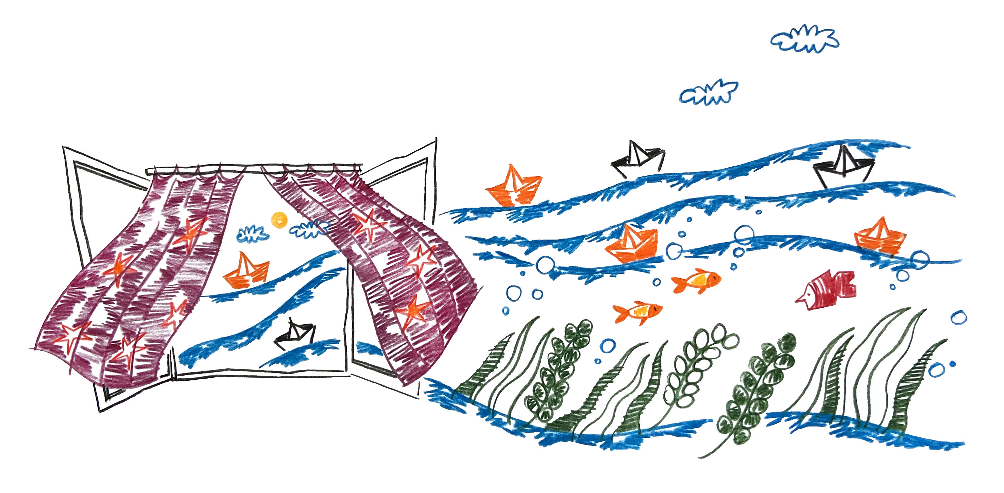
The magic window shows Hanni fishes under the sea.

Slide 6
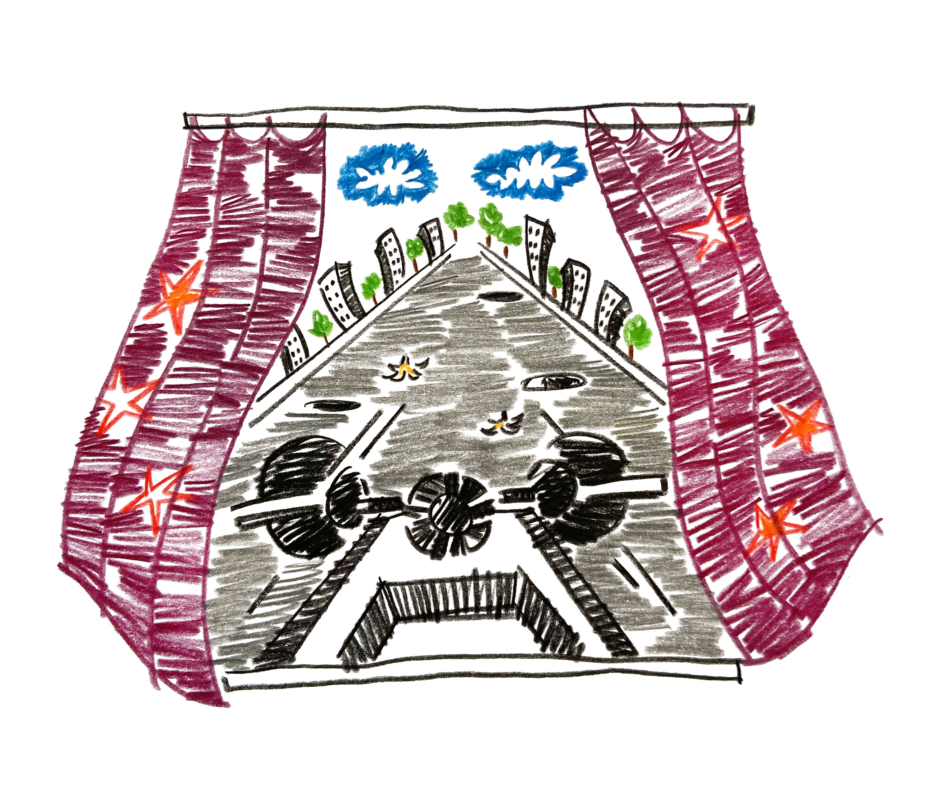
The magic window shows Hanni what it’s like to drive a racing car.

Slide 7
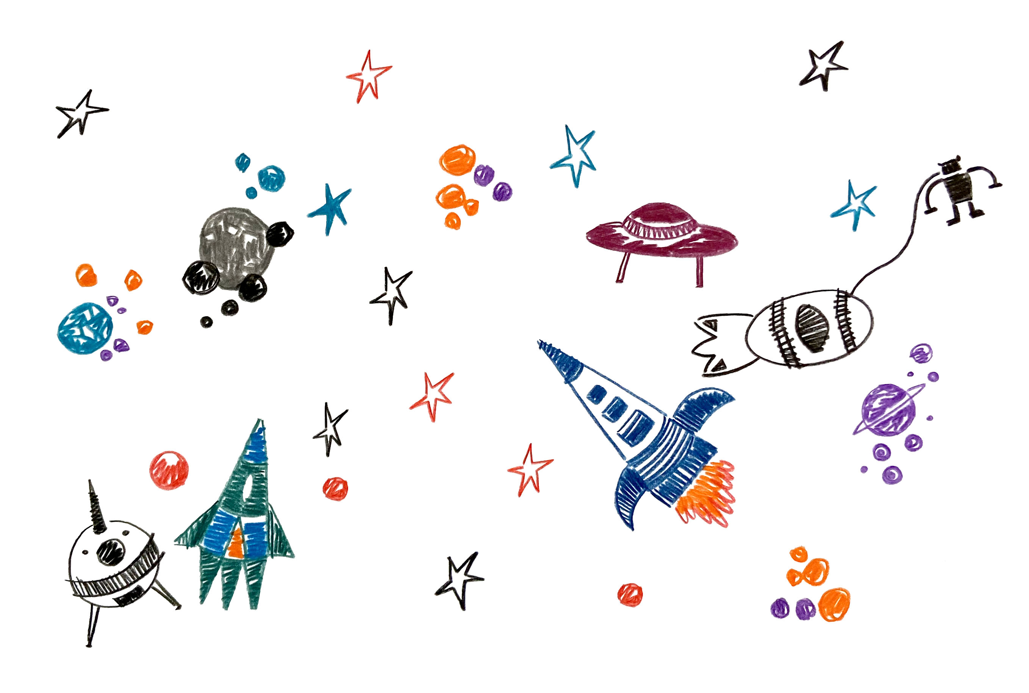
The magic window shows Hanni outer space.

Slide 8
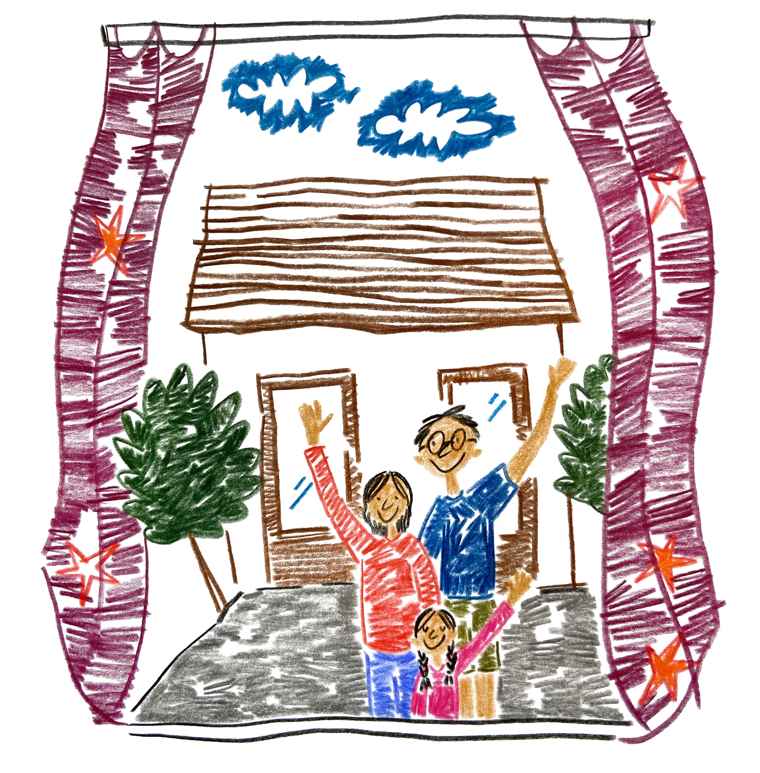
The magic window shows Hanni her family who live far away.

Slide 9
The magic window makes Hanni happy.

Slide 10
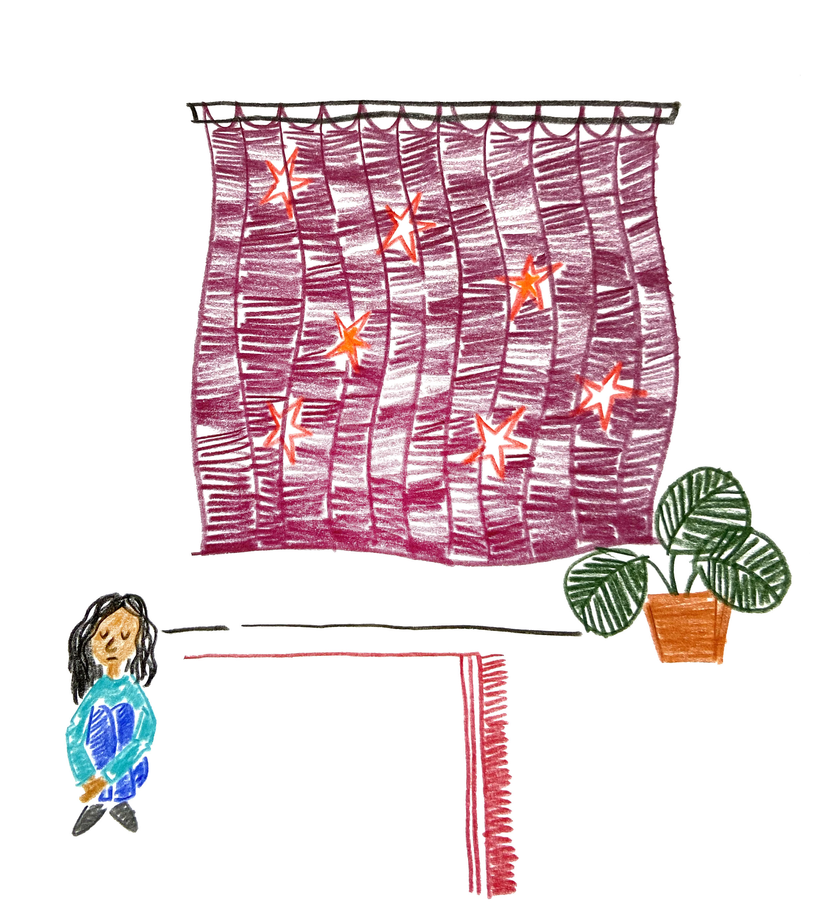
One day Hanni looks in the window and what she sees makes her feel worried.

Slide 11
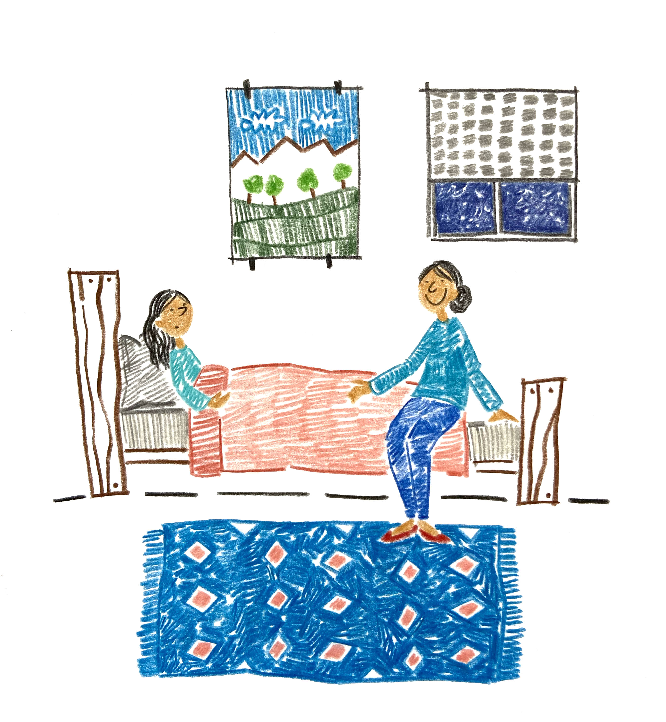
Hanni doesn’t tell Mum what she saw in the magic window.

Slide 12
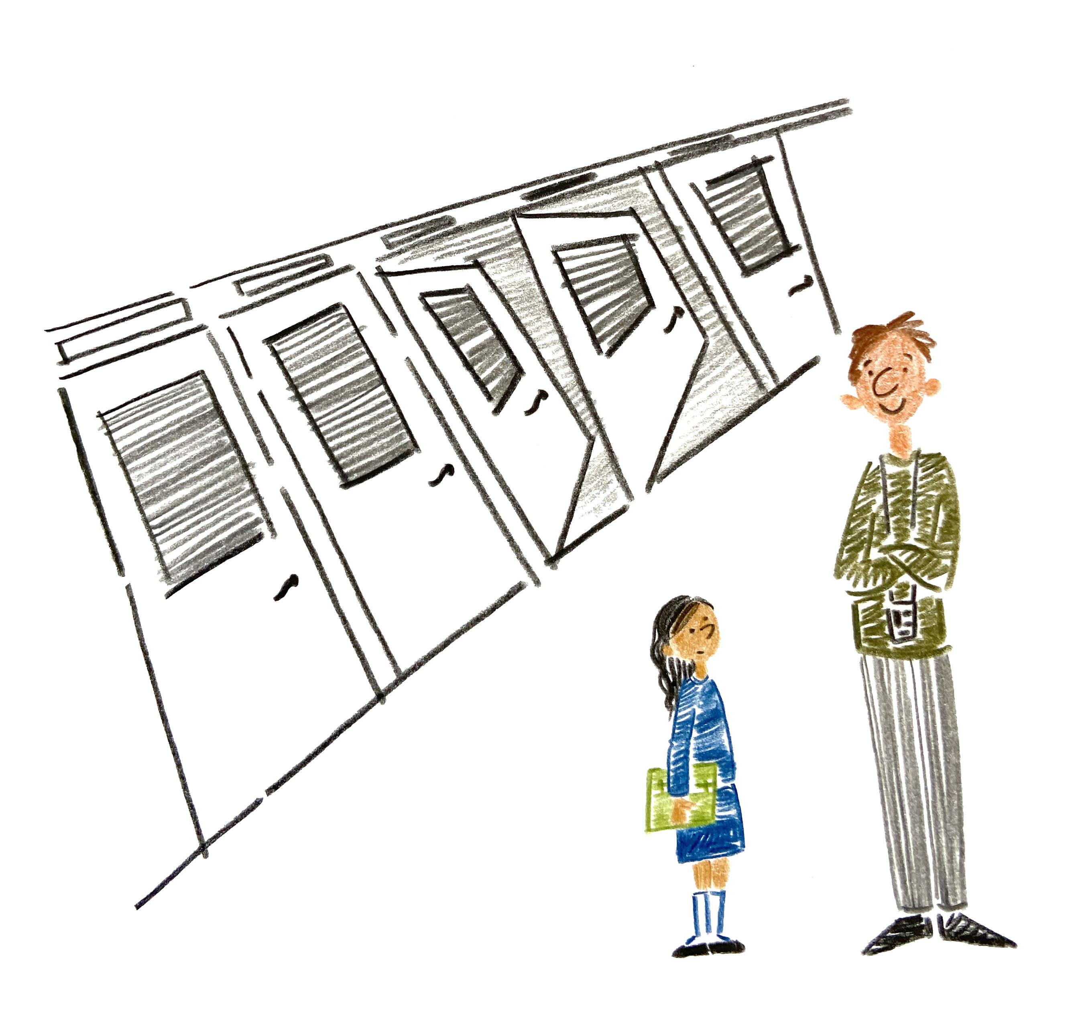
Hanni doesn’t know what to say to her teacher about what she saw.

Slide 13
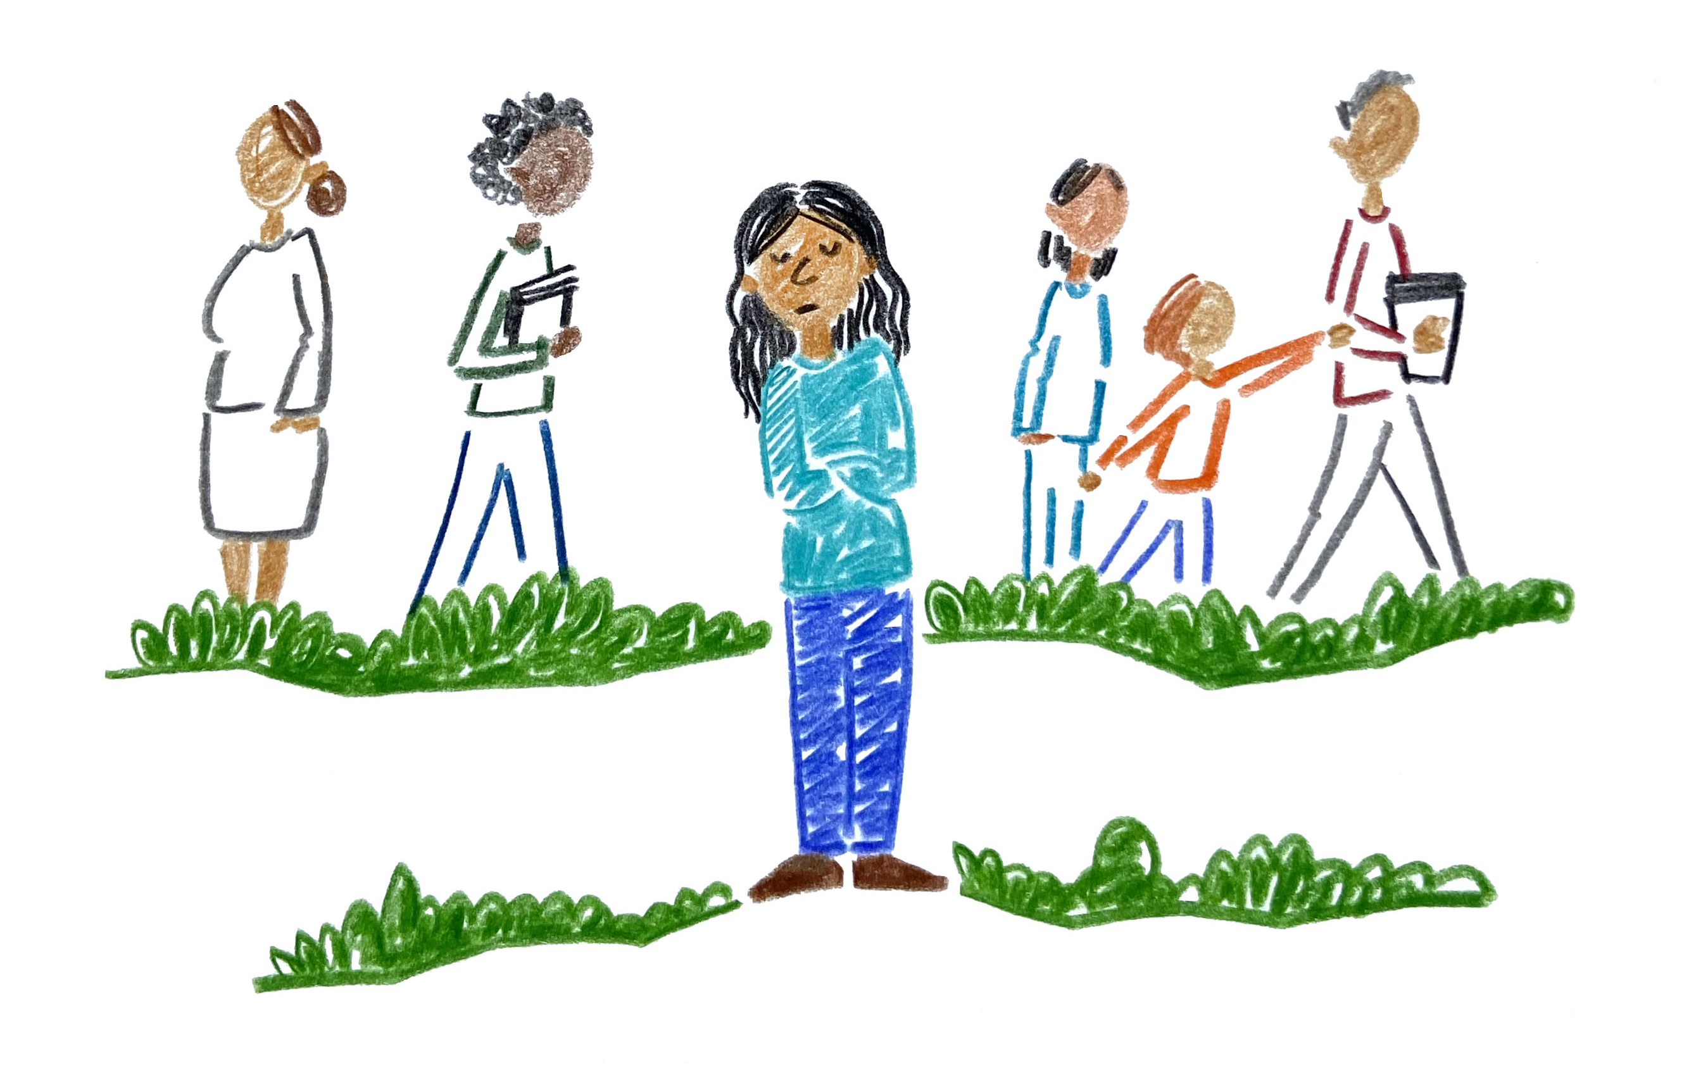
Hanni doesn’t want to play with her friends because she feels sad.

Slide 14
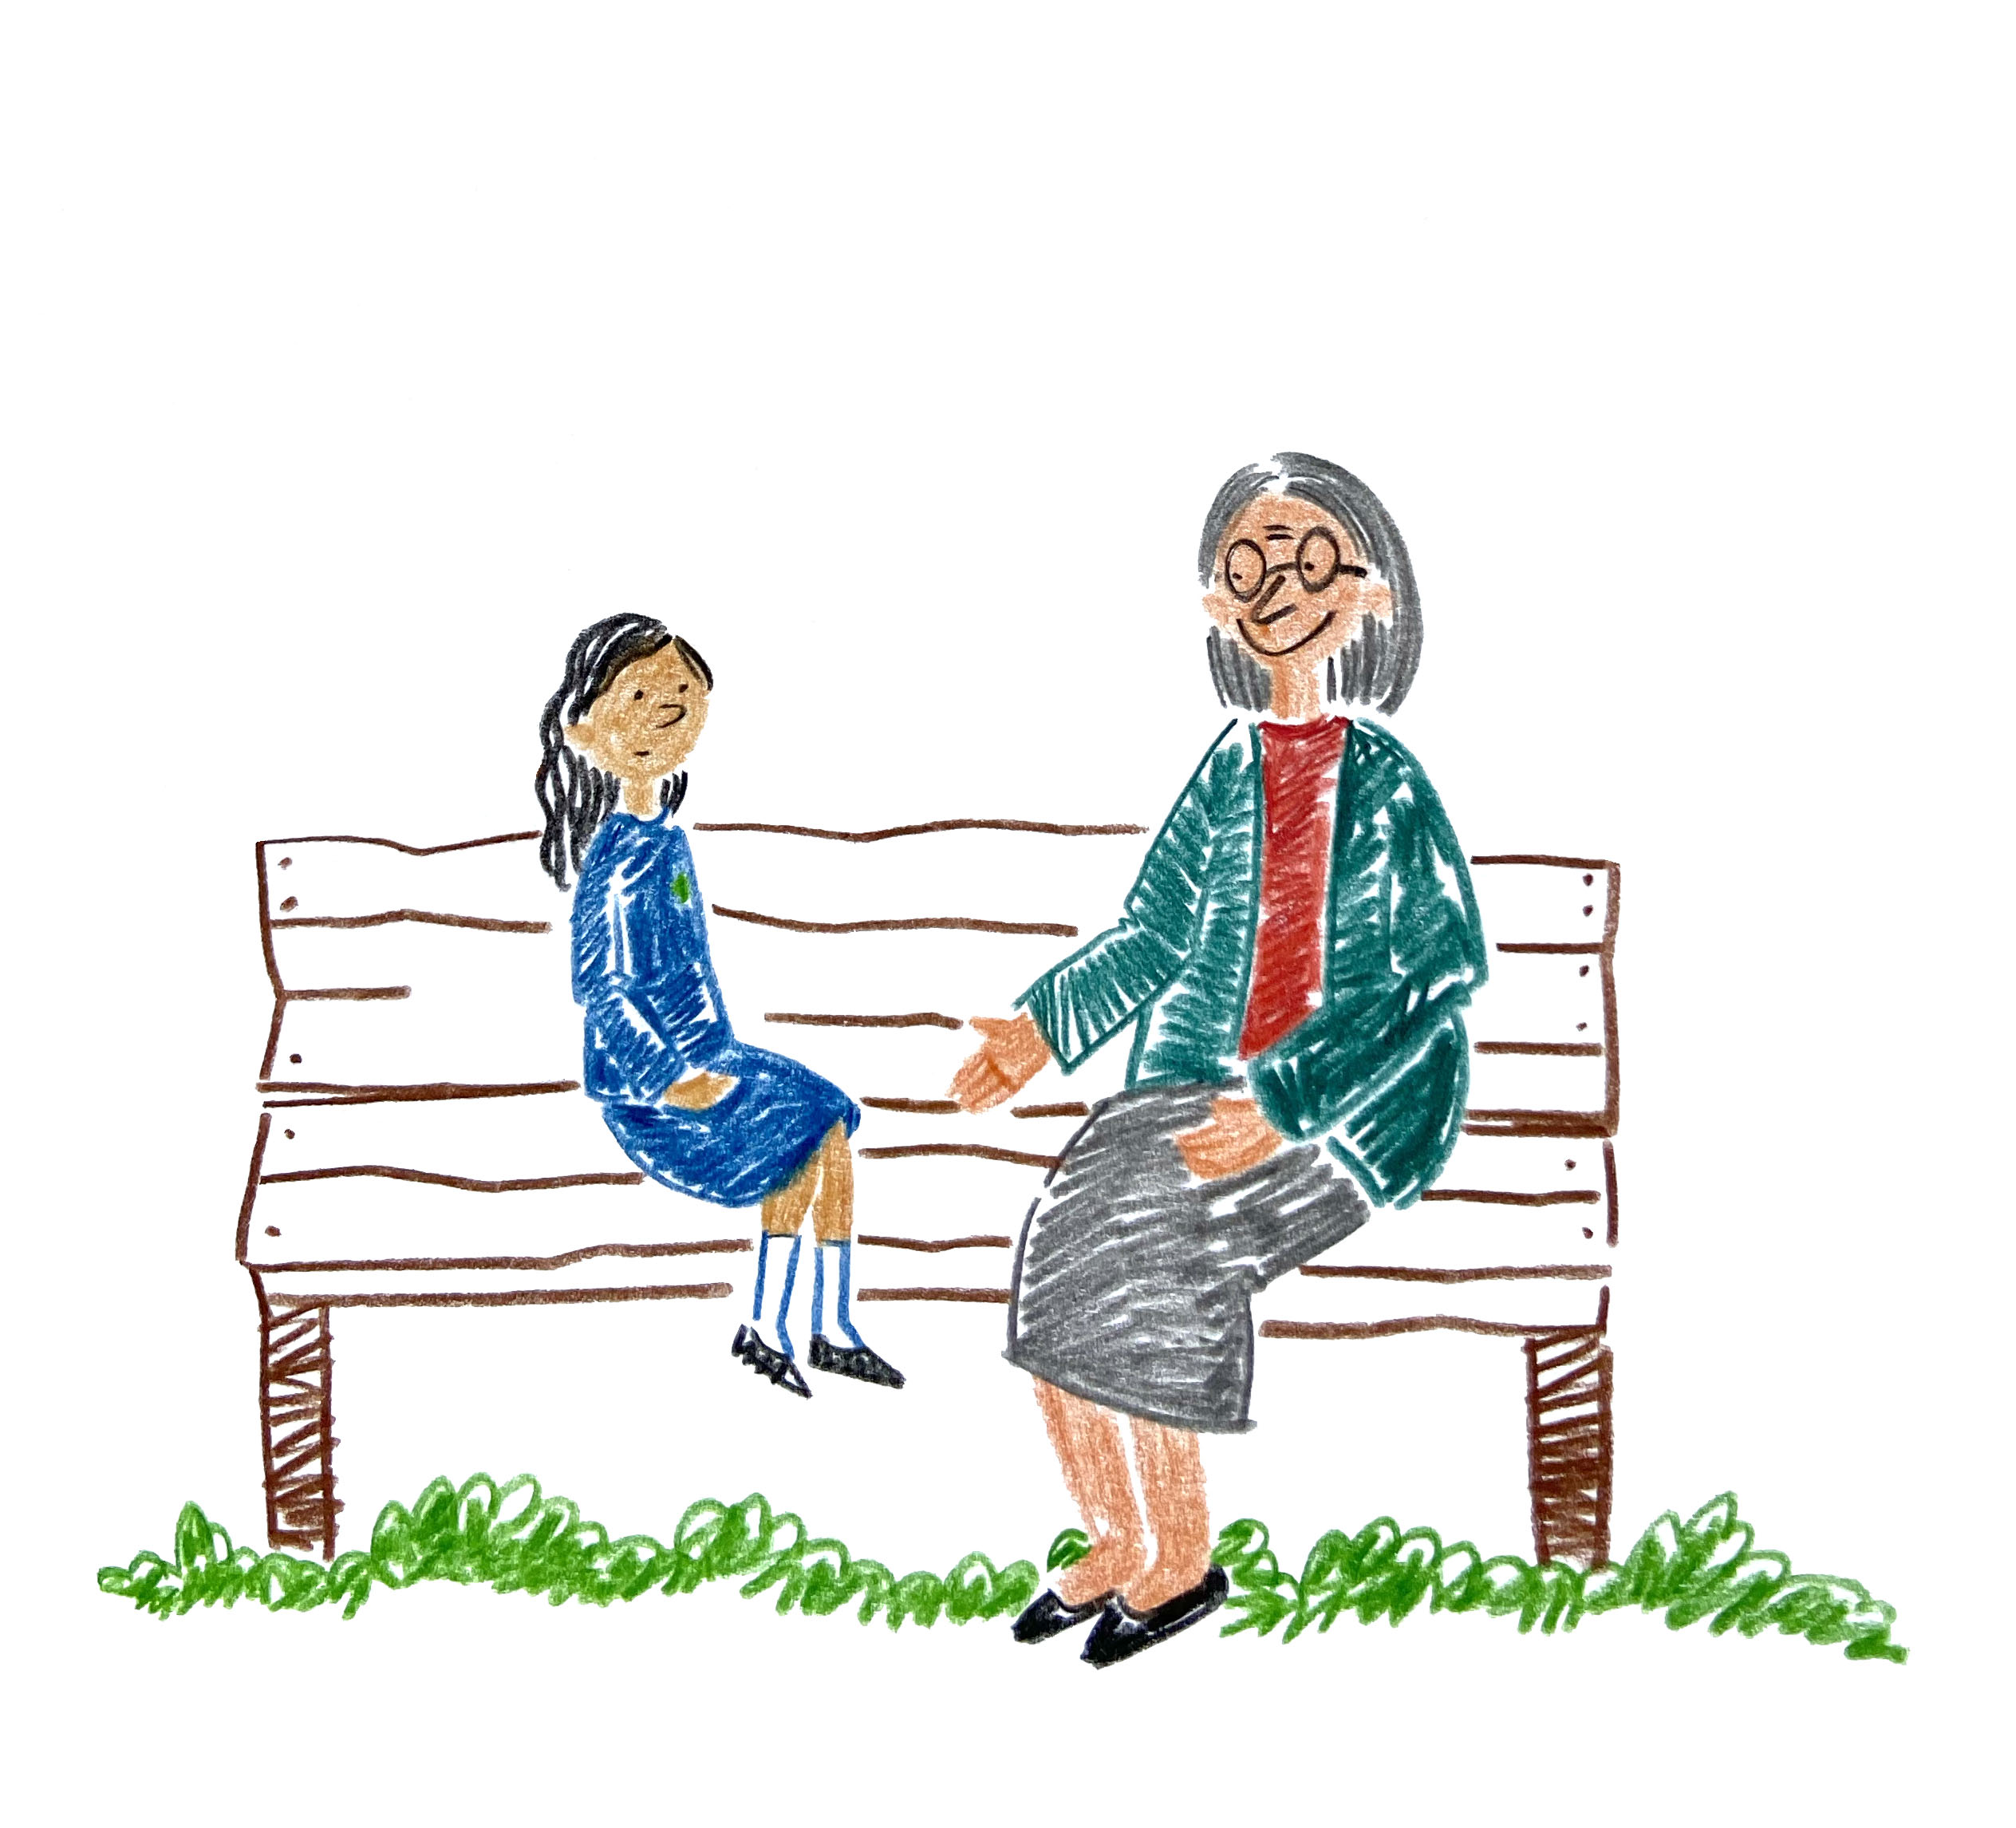
Mrs Rodwell asks Hanni if she wants to talk.
Hanni explains what she saw in the magic window and how it made her feel.

Slide 15
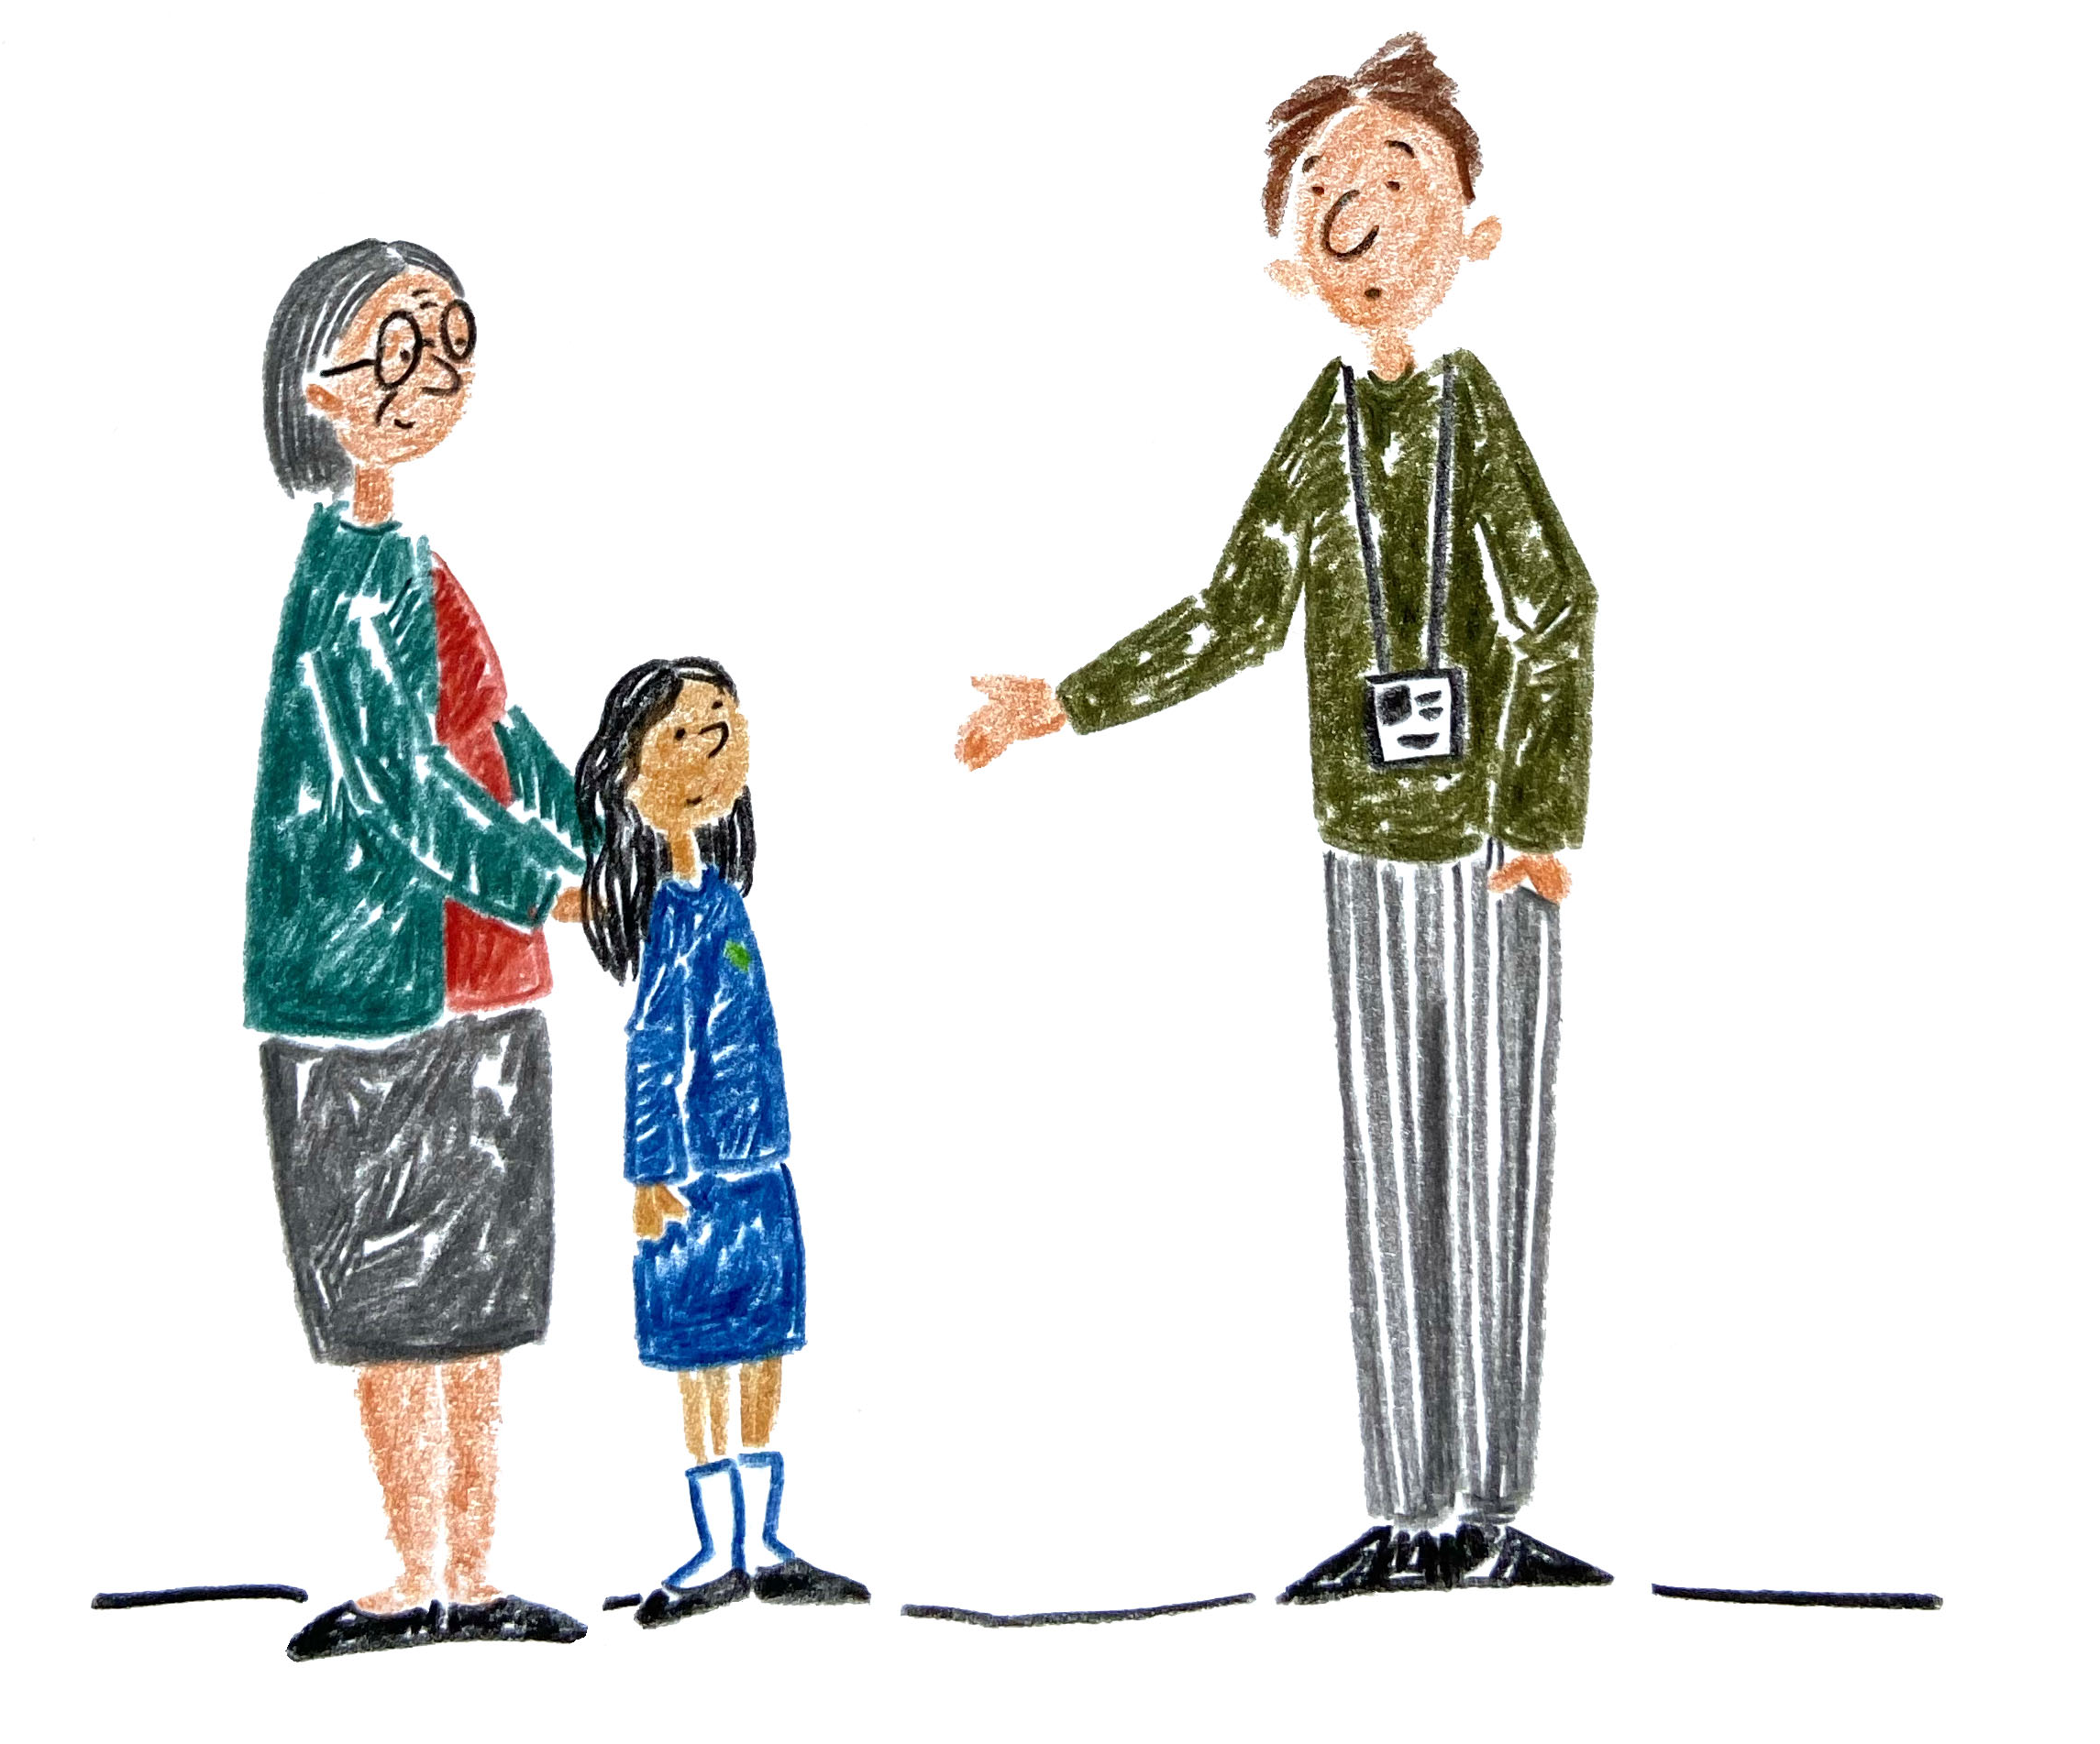
Mrs Rodwell helps her talk to her teacher.
Hanni’s teacher helps her talk to her Mum.

Slide 16
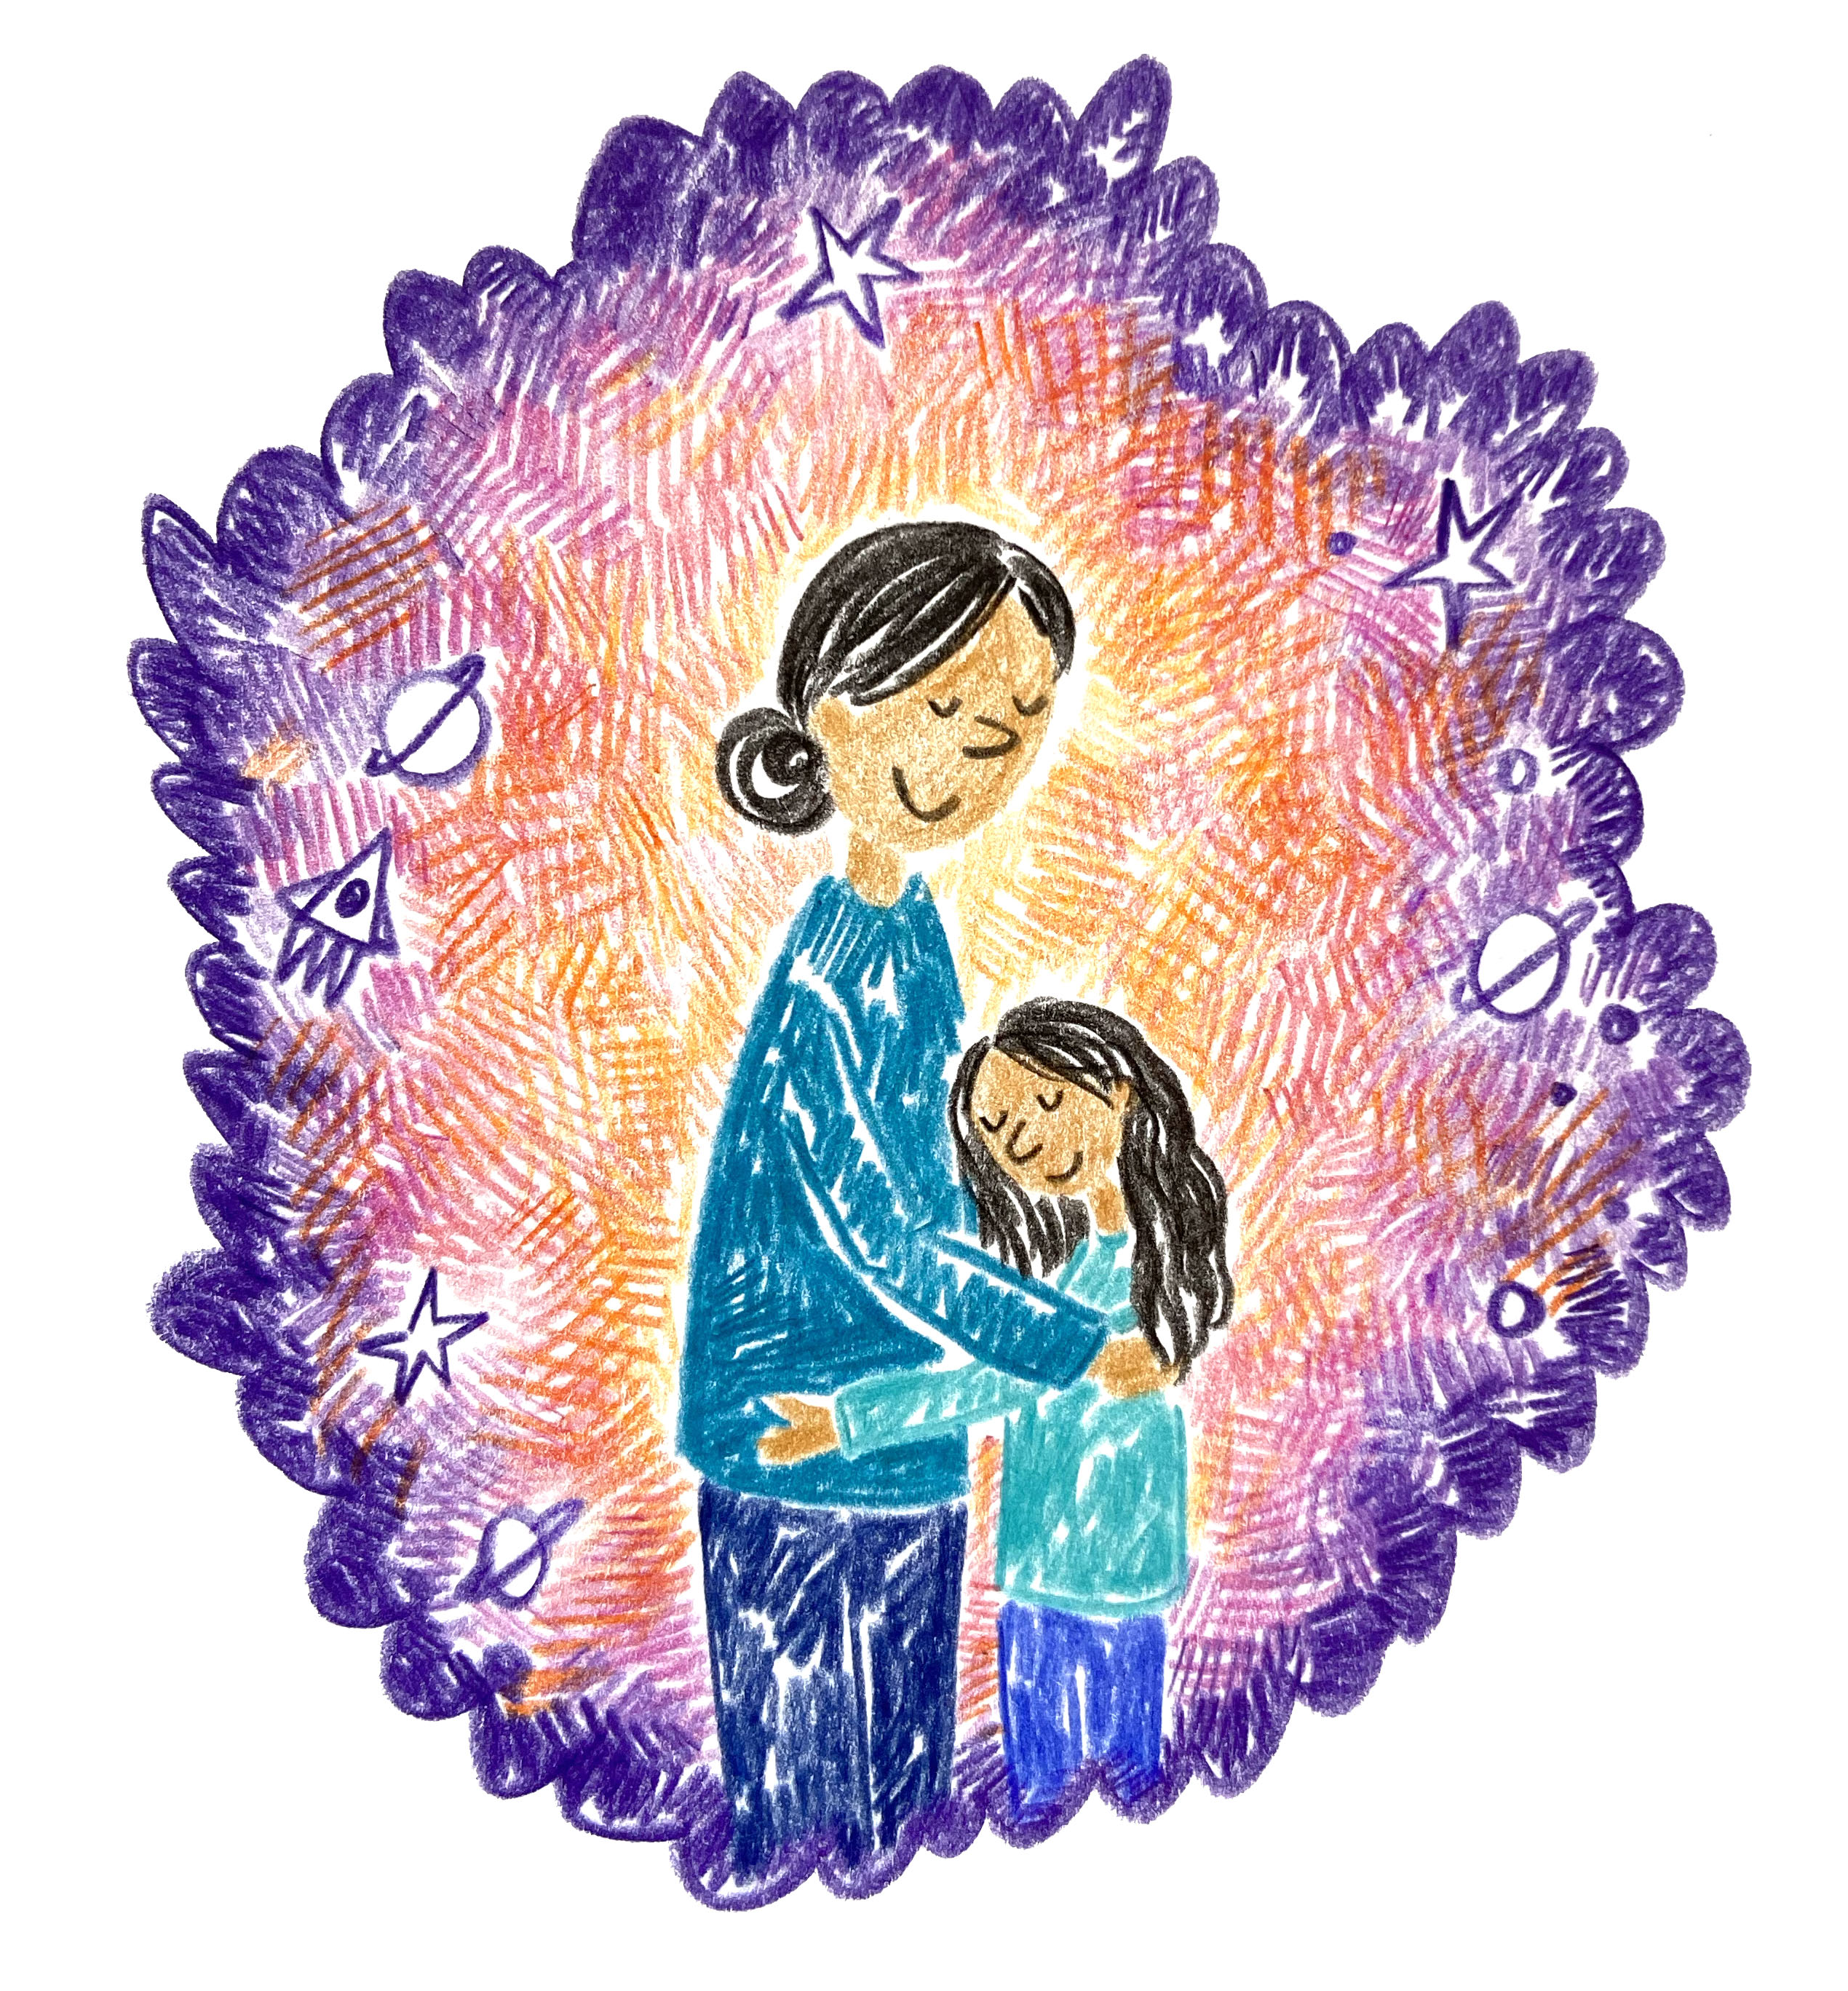
Hanni’s Mum helps her feel better by giving her a big hug.

Slide 17
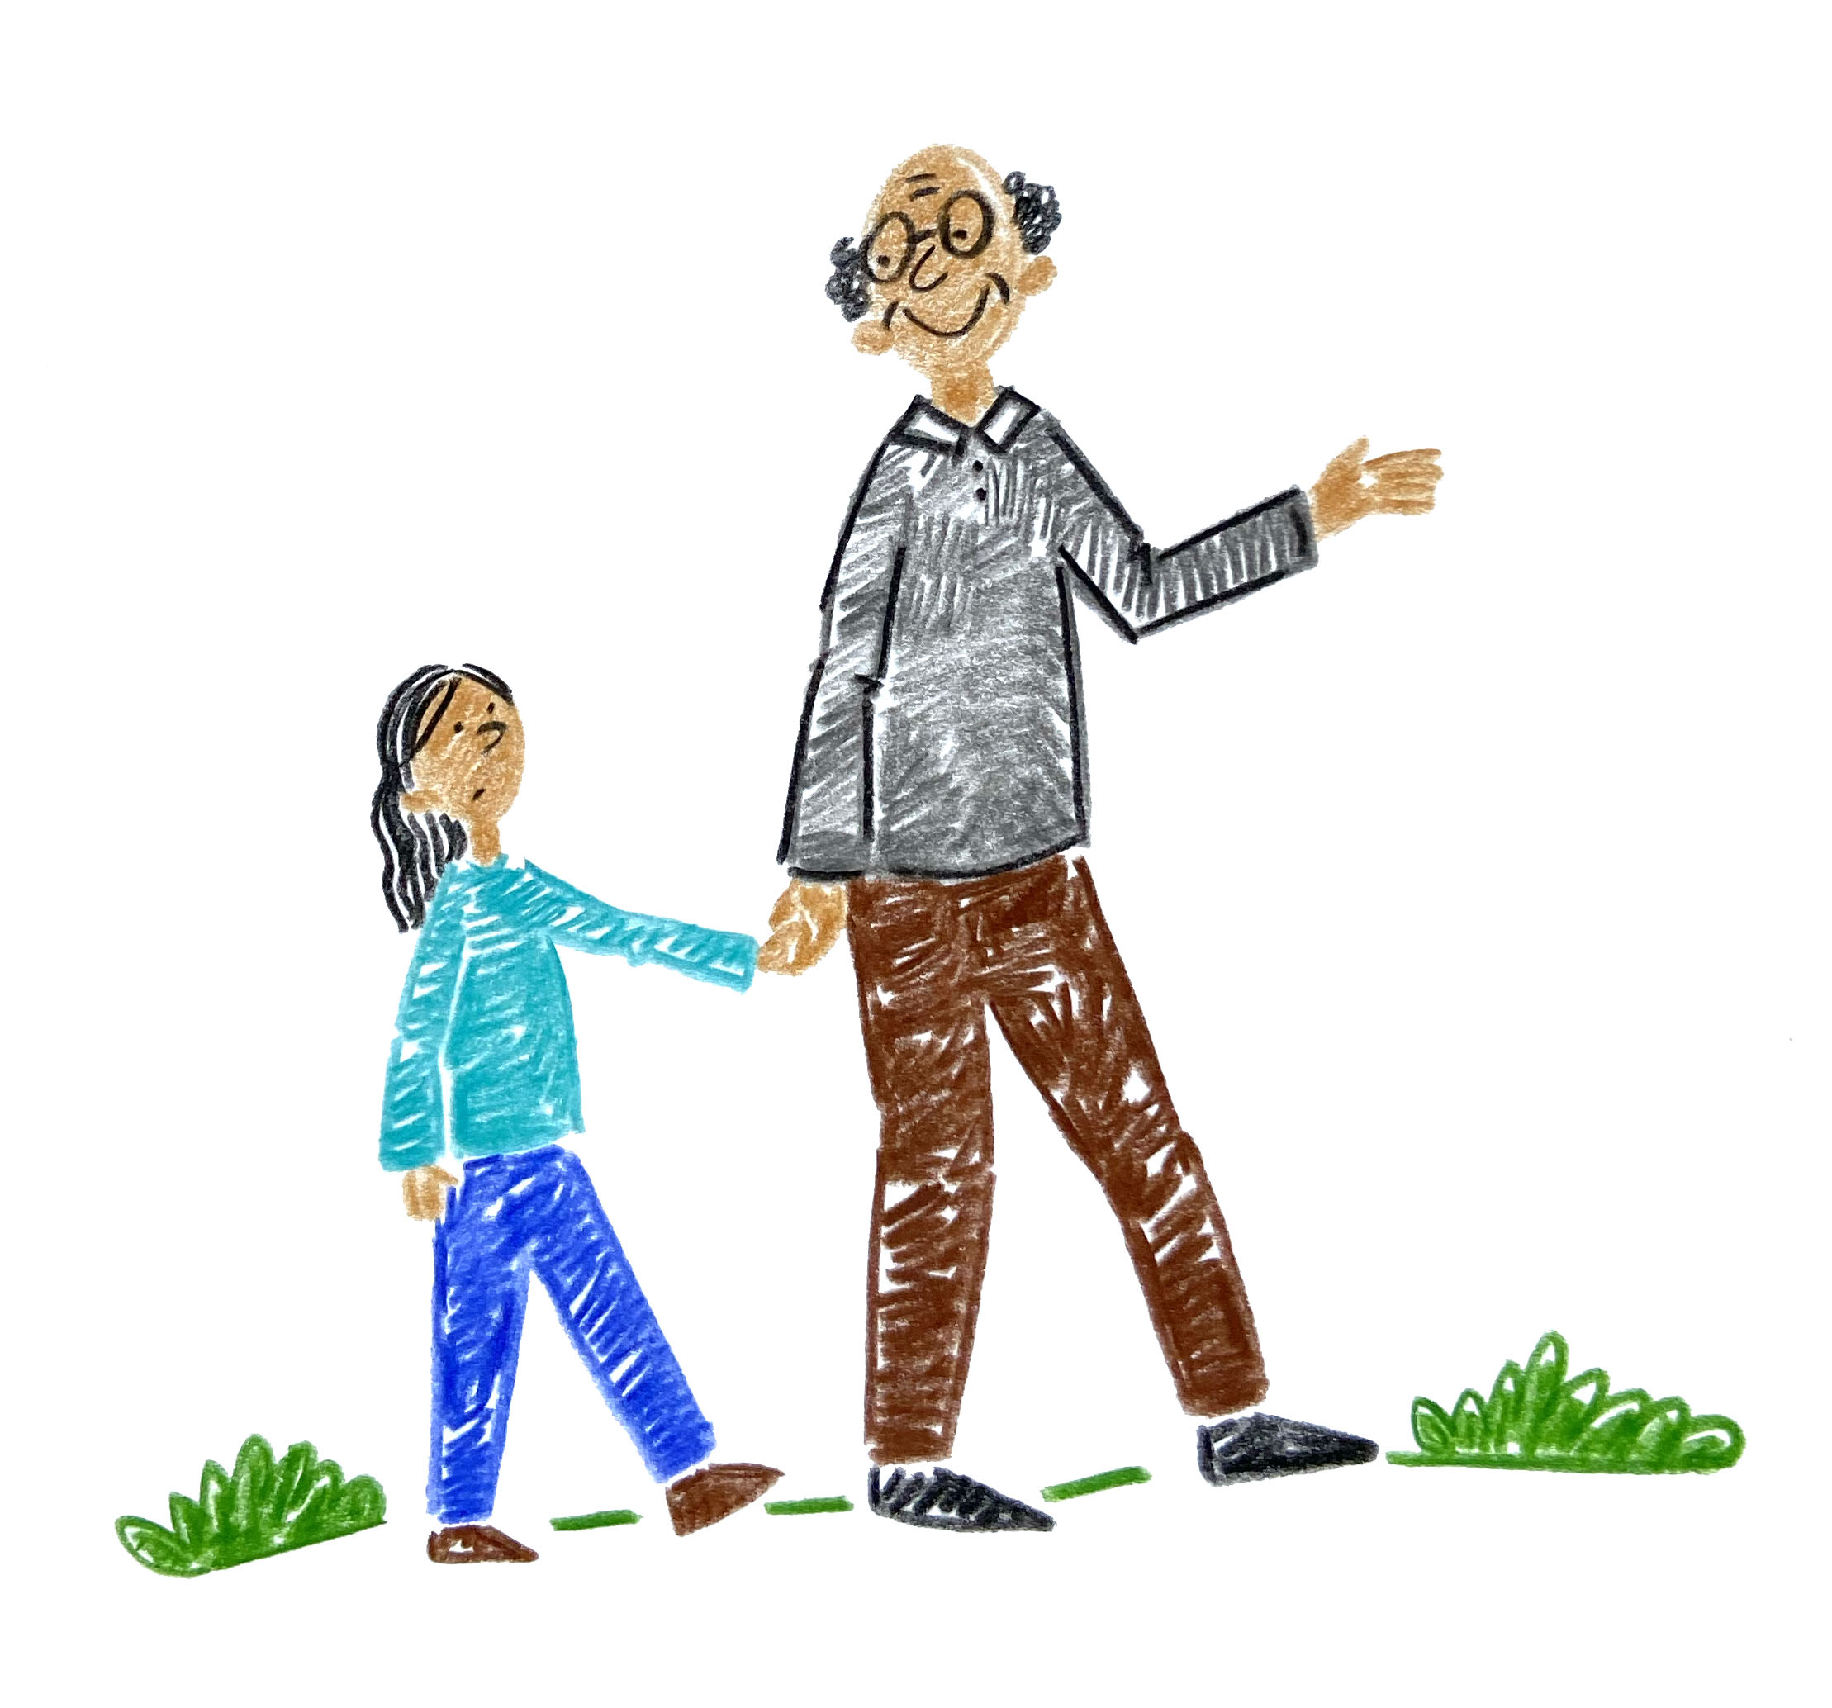
You can always talk to a grown up if you feel worried or sad.
They are here to help.
It can help you feel better.

