Slide 1
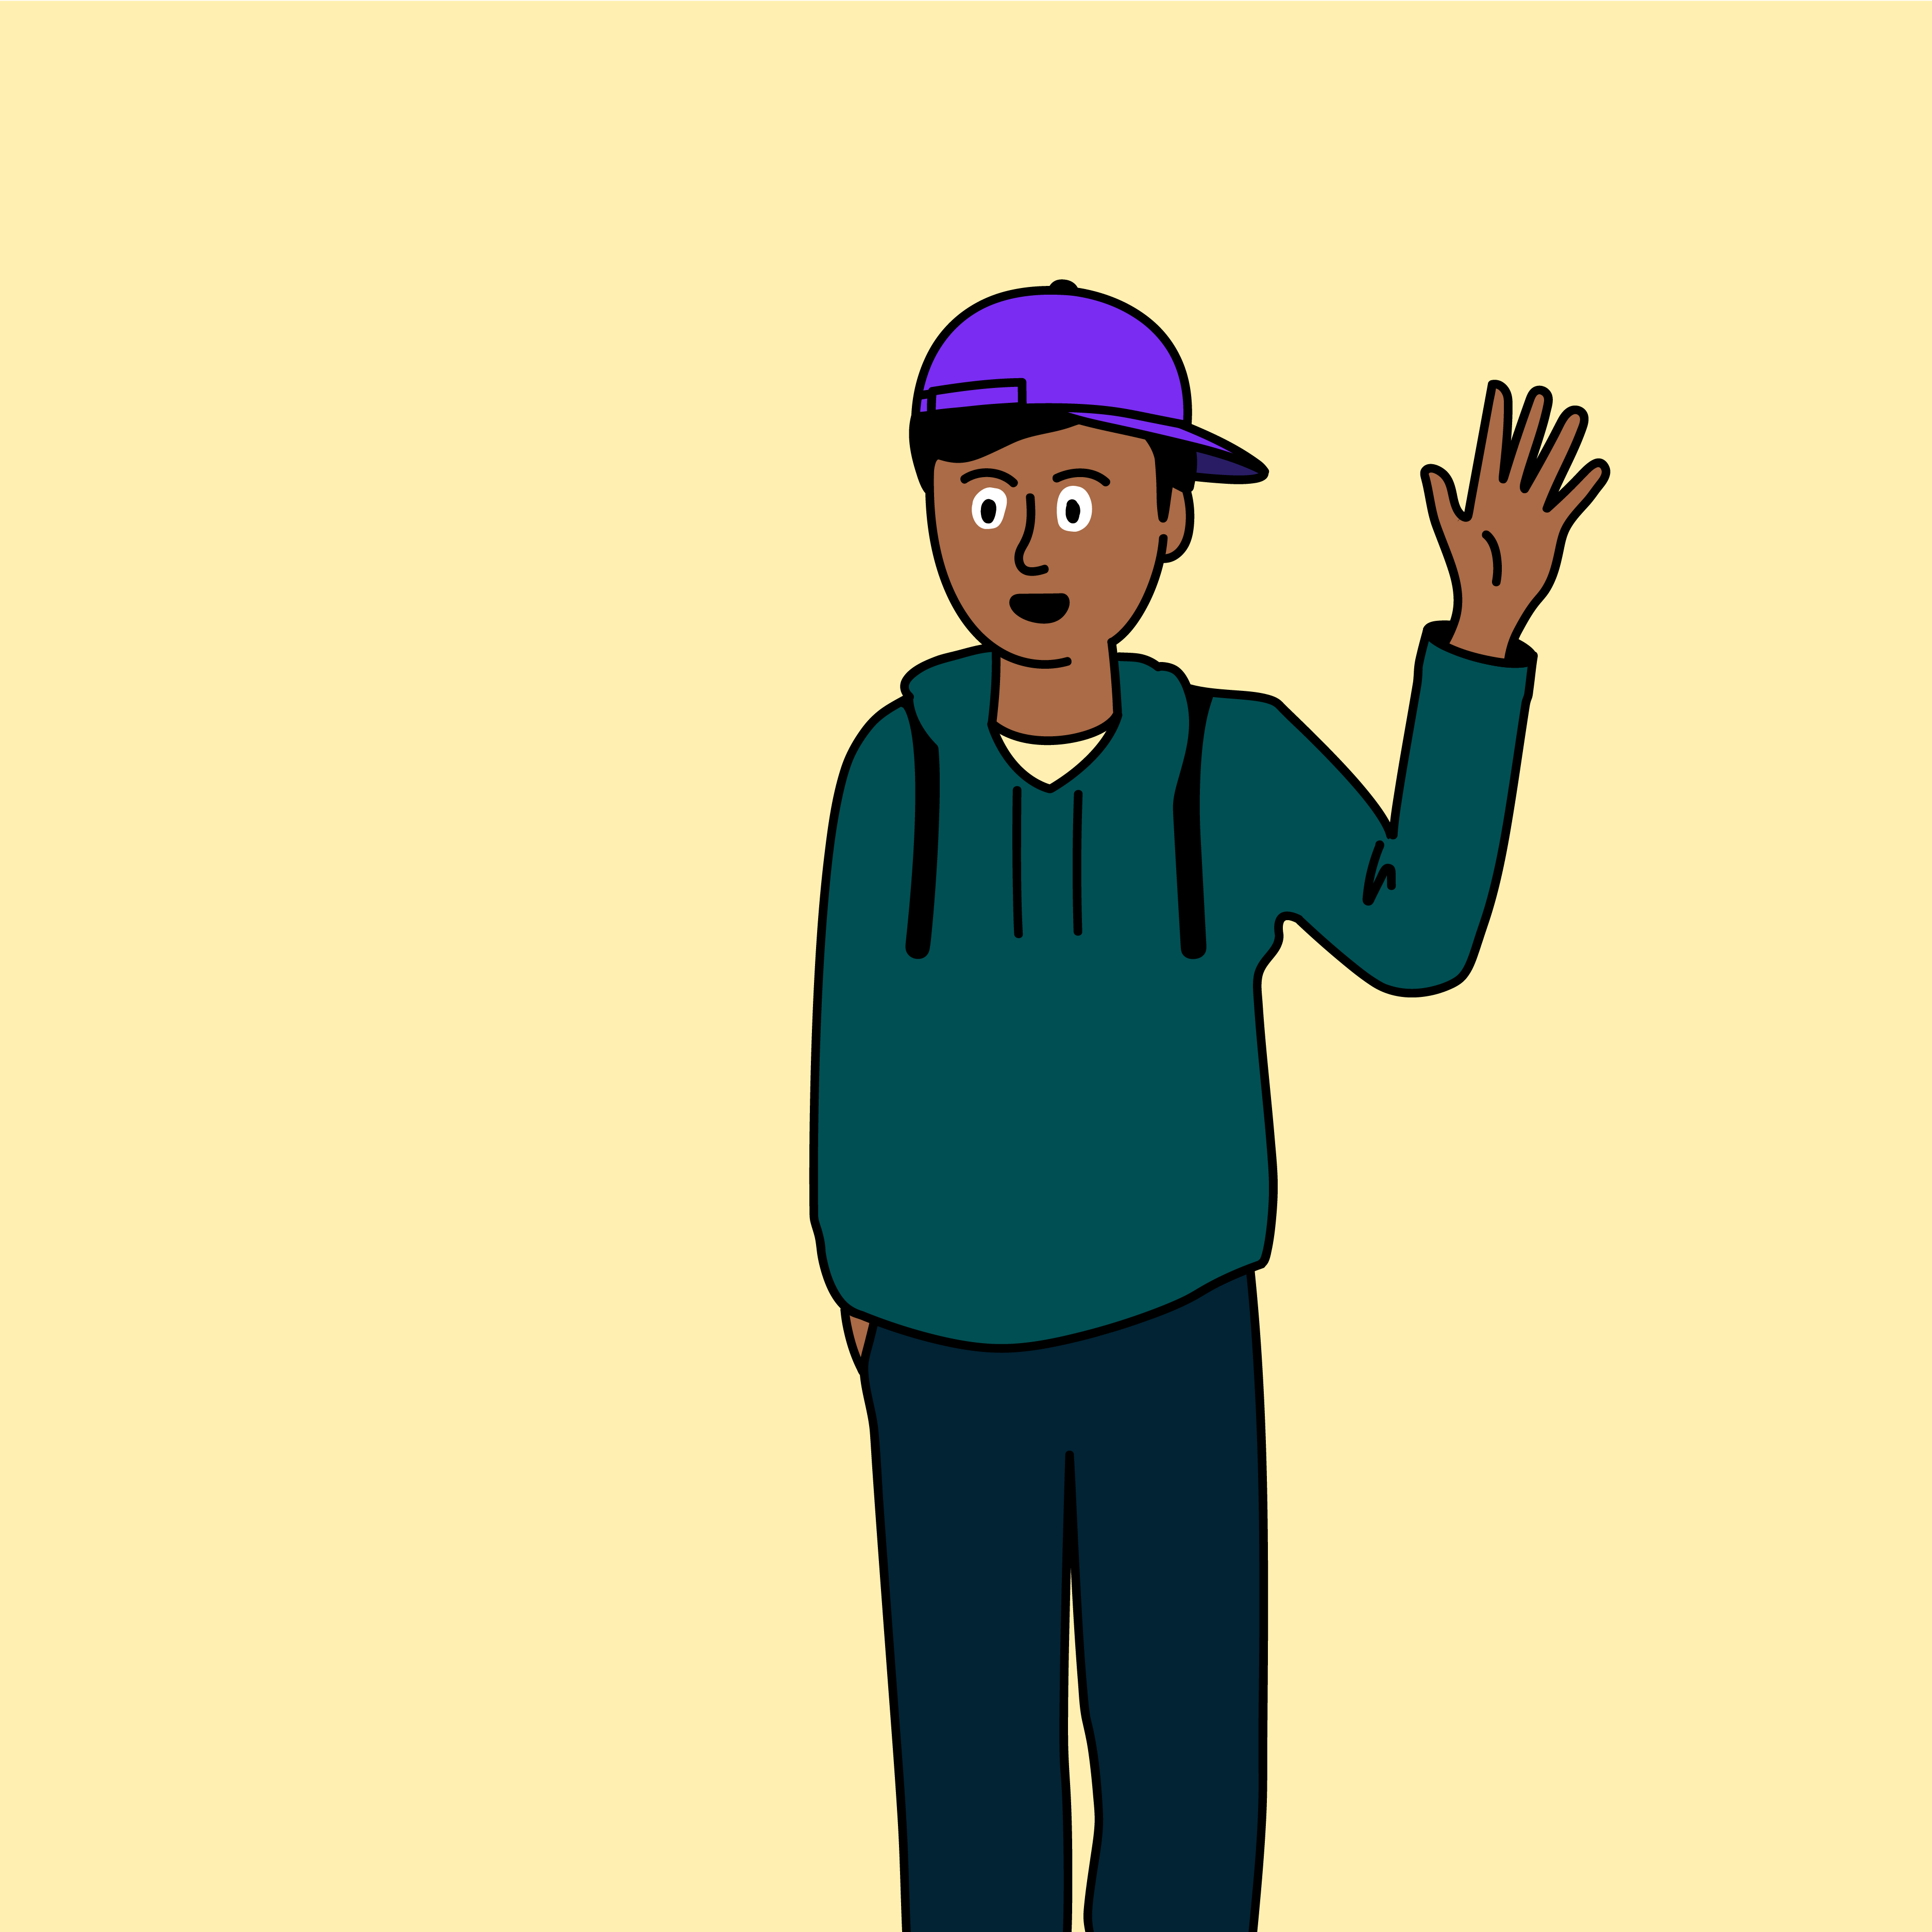
Connect with respect

Slide 2
Kai learns about in-app purchases

Slide 3
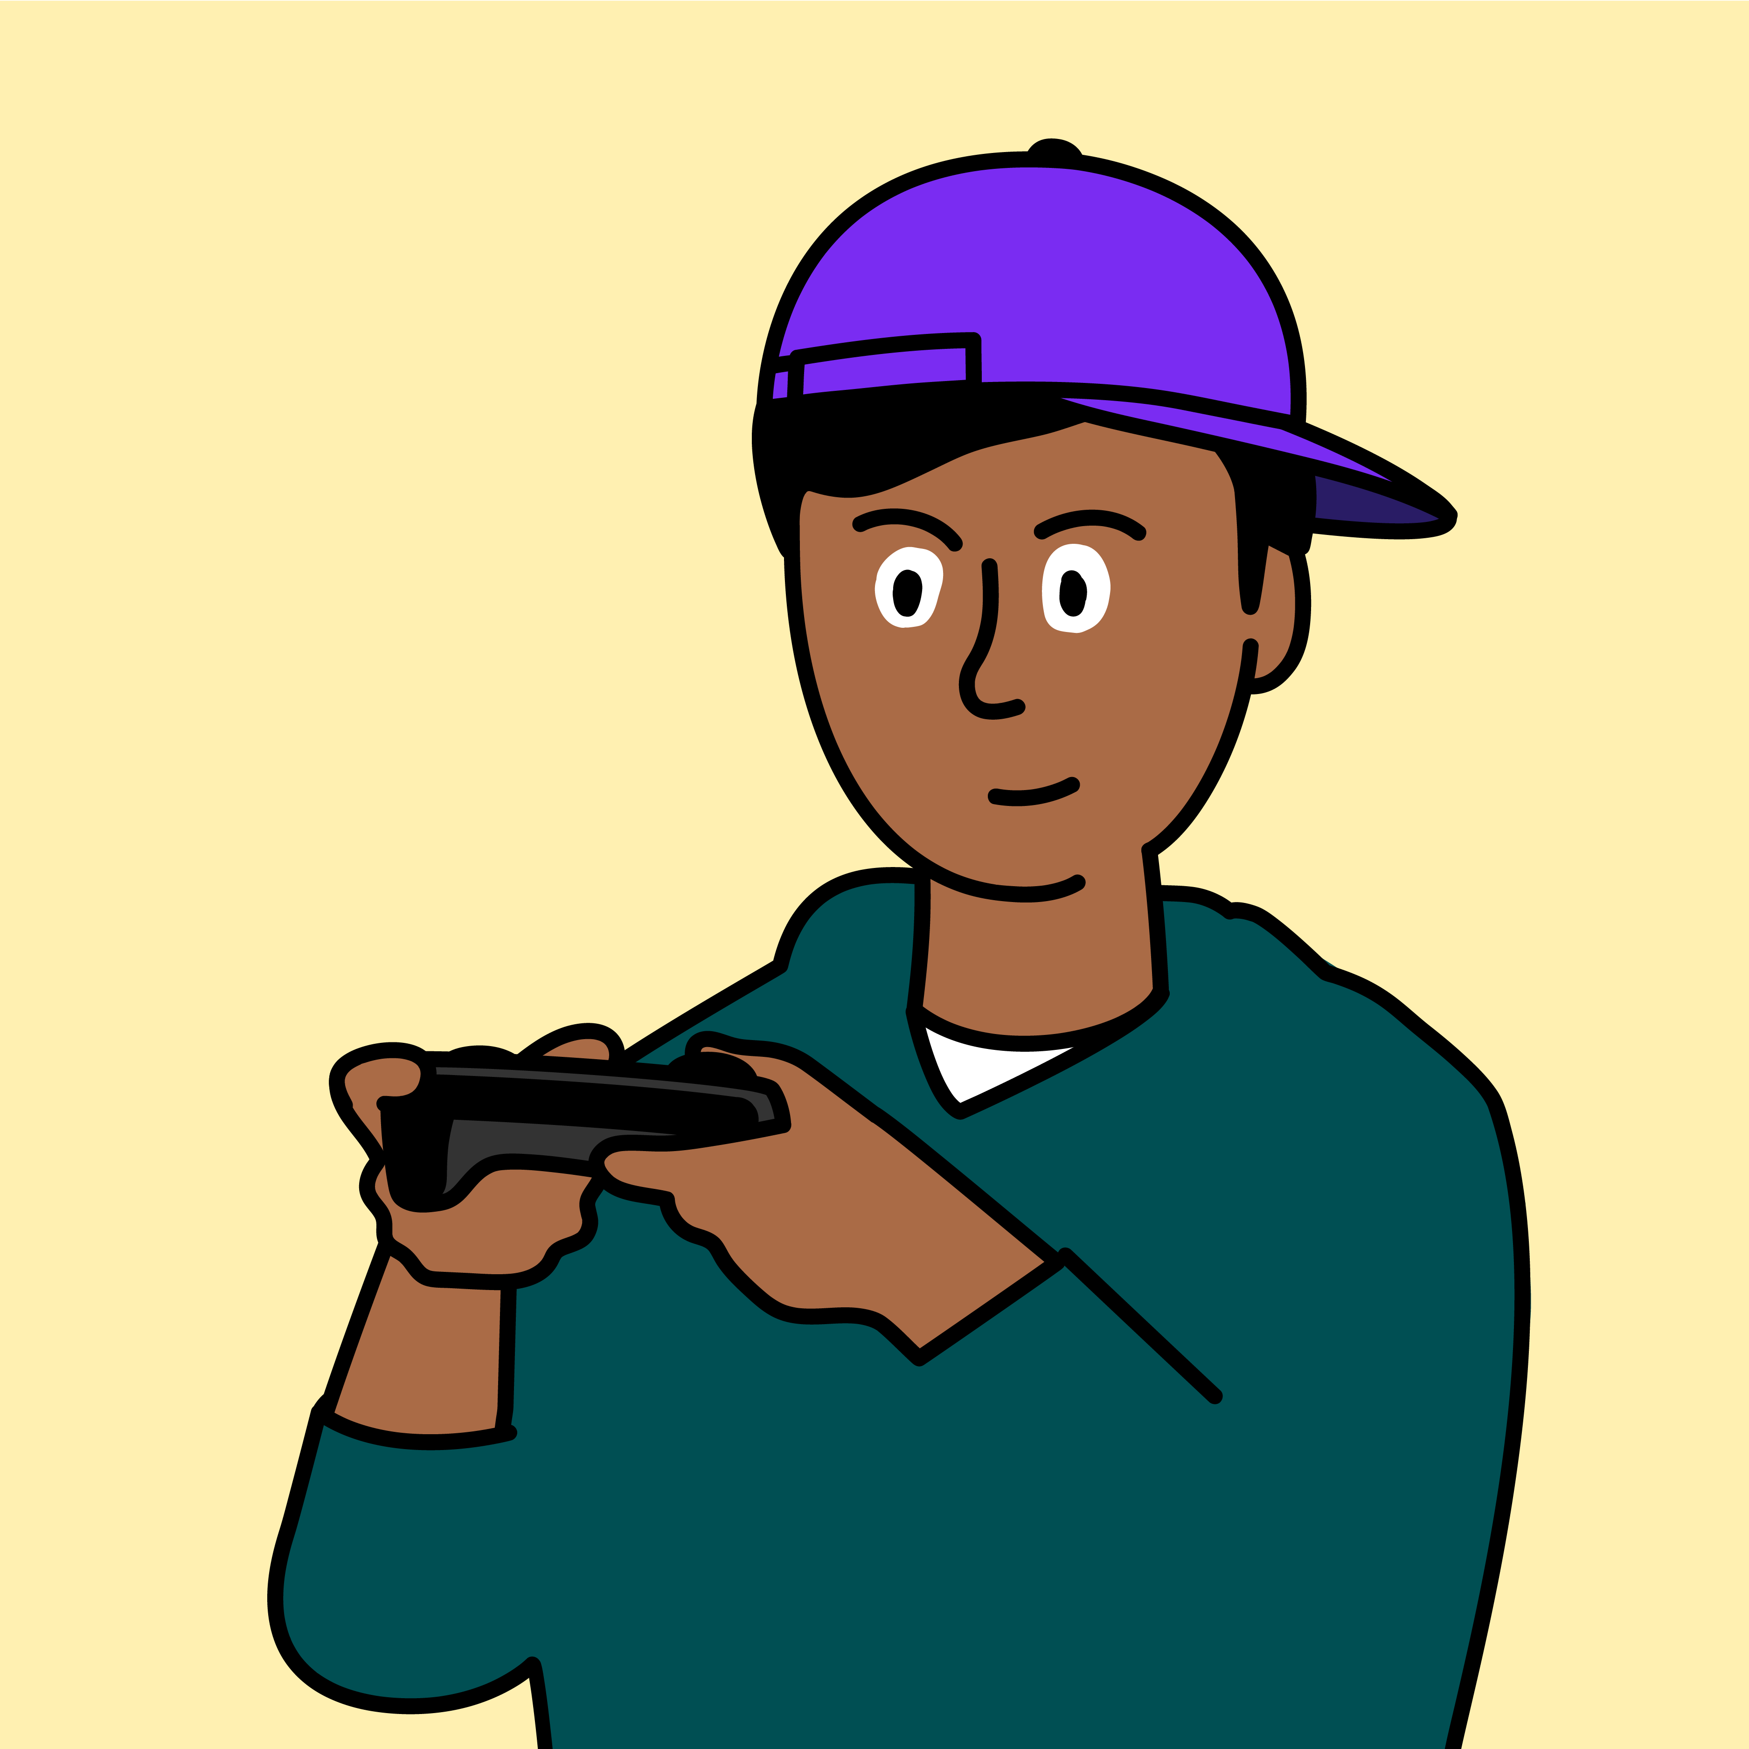
This is Kai.
He likes to play games online.

Slide 4
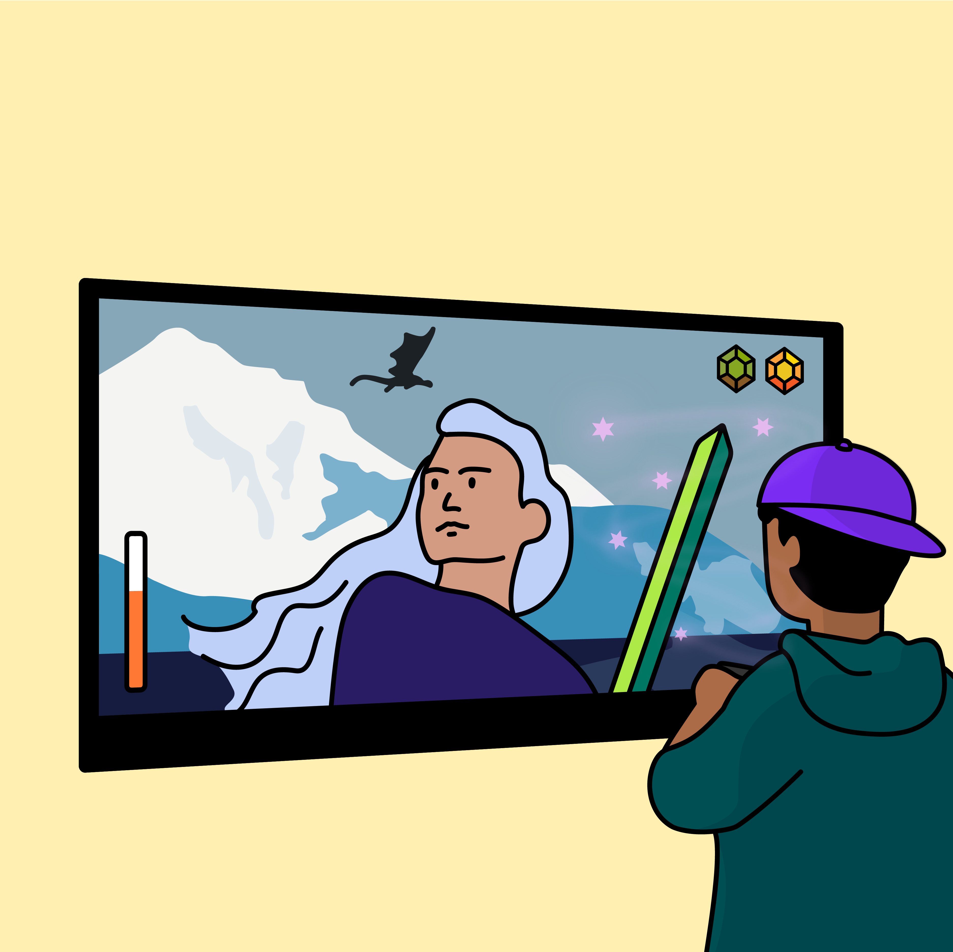
He is playing a new game called ‘Magic Heroes’.

Slide 5
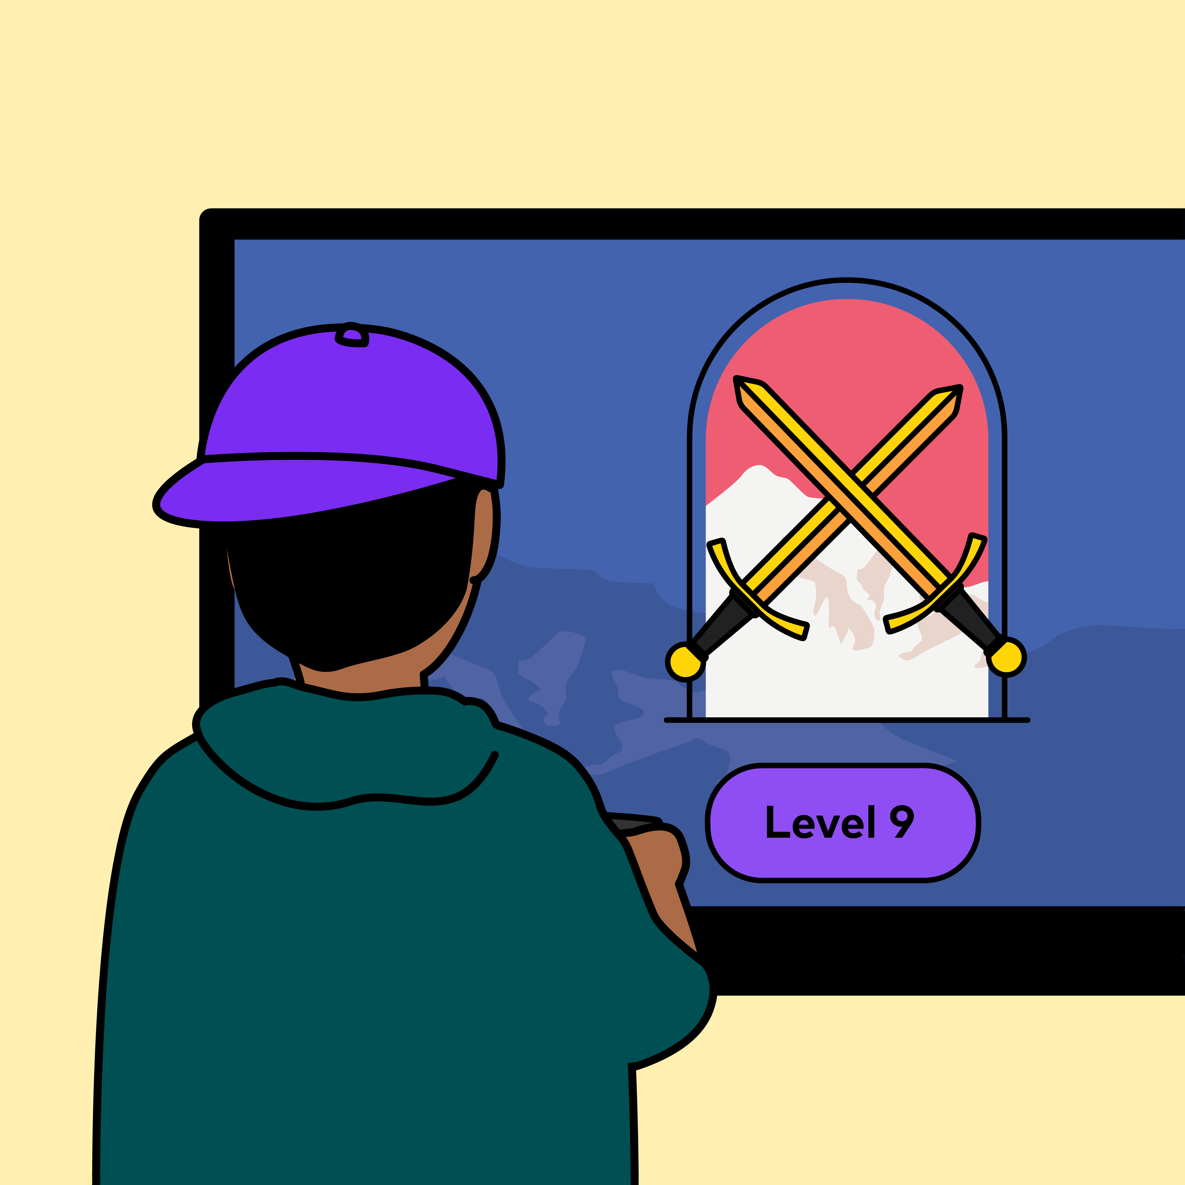
He likes to complete levels and unlock new items.

Slide 6
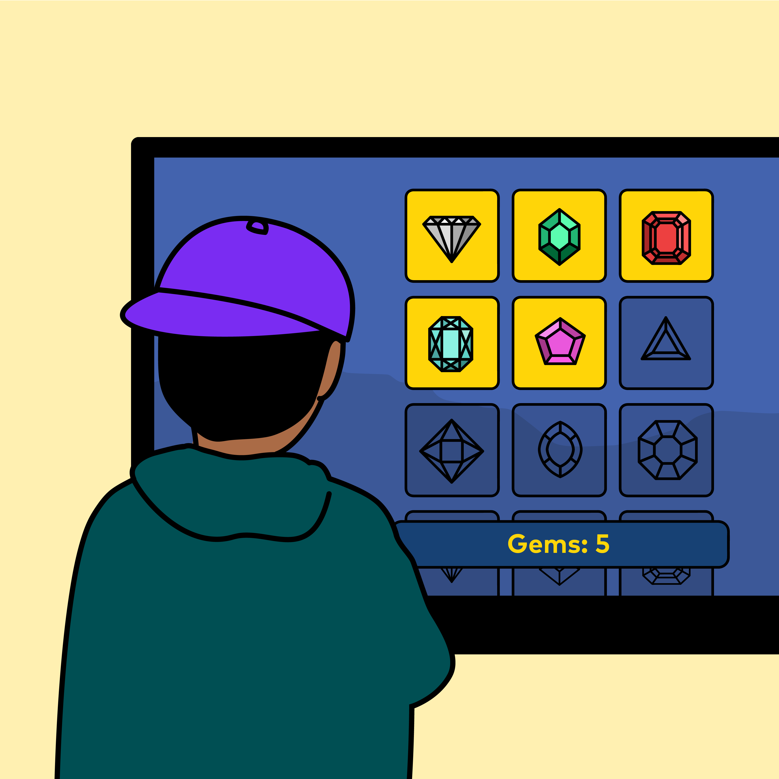
Some items need to be bought with gems.

Slide 7
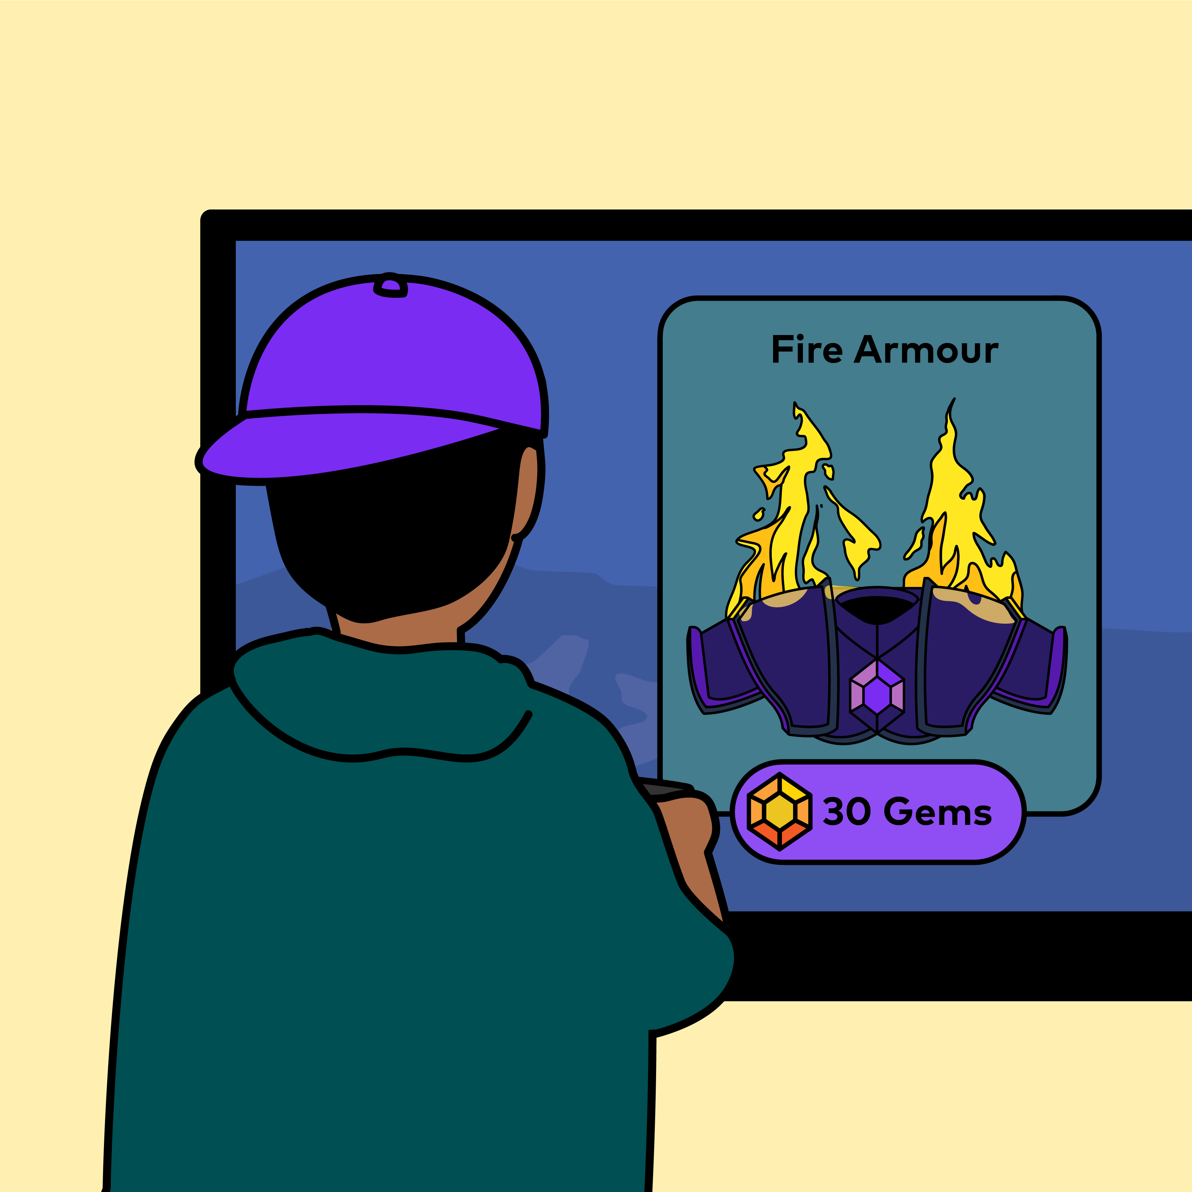
Kai really wants the Fire Armour for his character but he does not have enough gems.

Slide 8
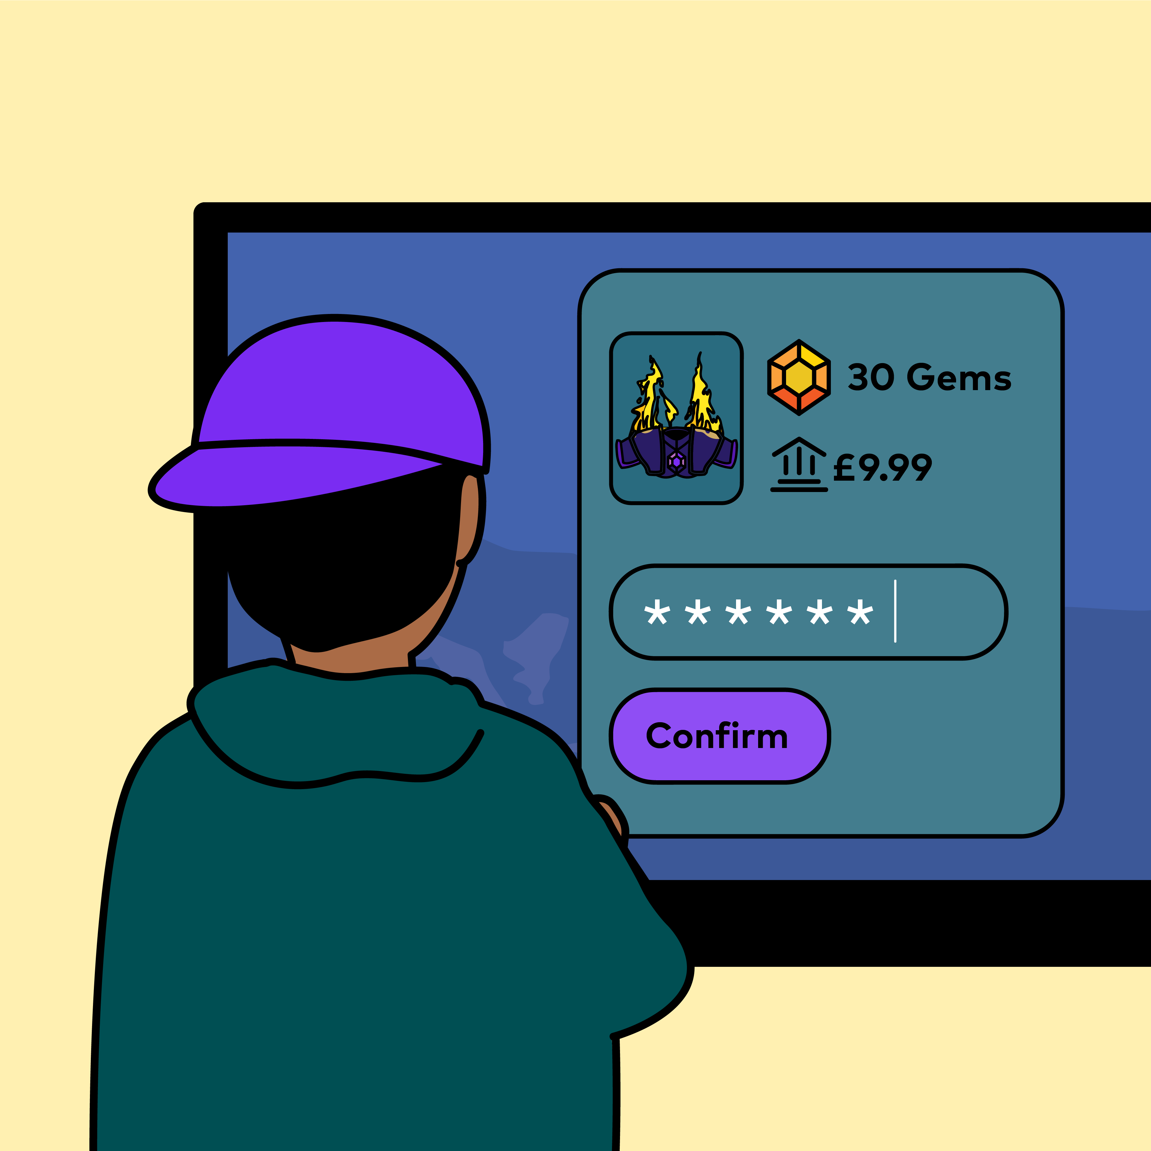
He clicks on the ‘Magic Heroes’ shop and sees he can buy more gems!
The shop asks for a password.
Kai knows his dad’s password, so he puts it in and gets more gems.

Slide 9
Have you ever bought something from an online game before?
When Kai bought more gems, was he spending real money?
Whose money do you think it was?
Do you think Kai should have used the password?
What should Kai have done instead?

Slide 10
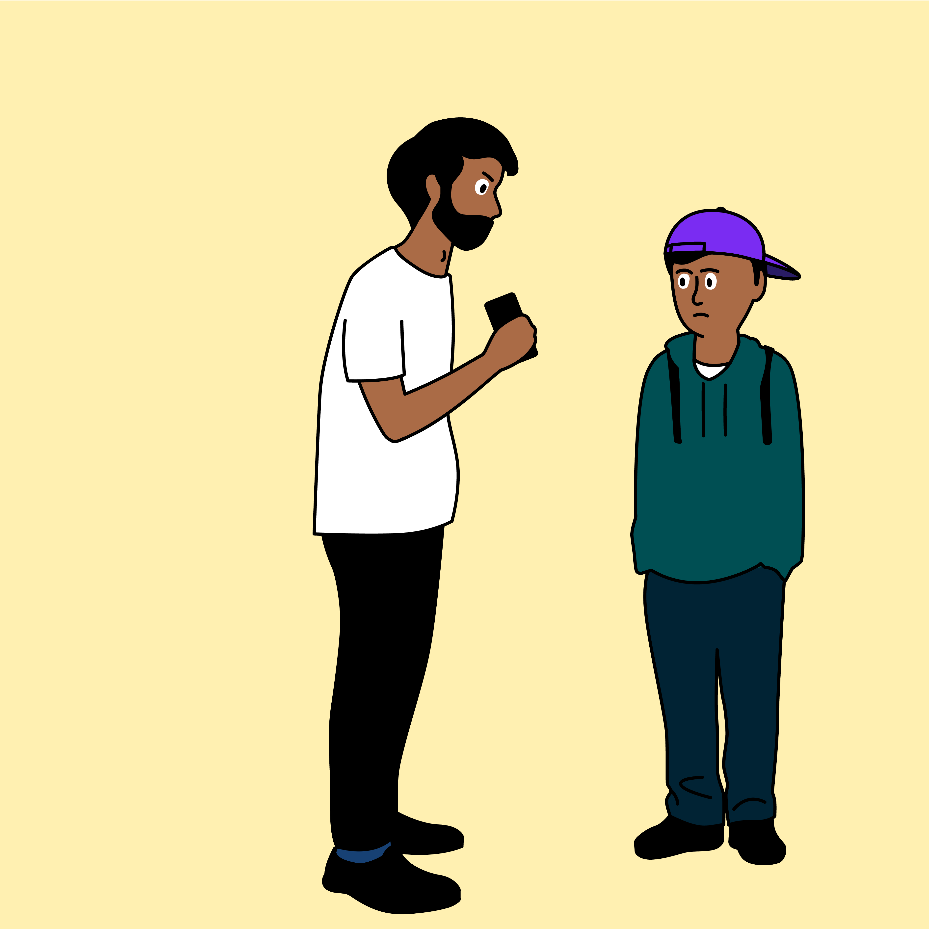
Later that day, Kai’s dad asks him if he has bought something on ‘Magic Heroes’.

Slide 11
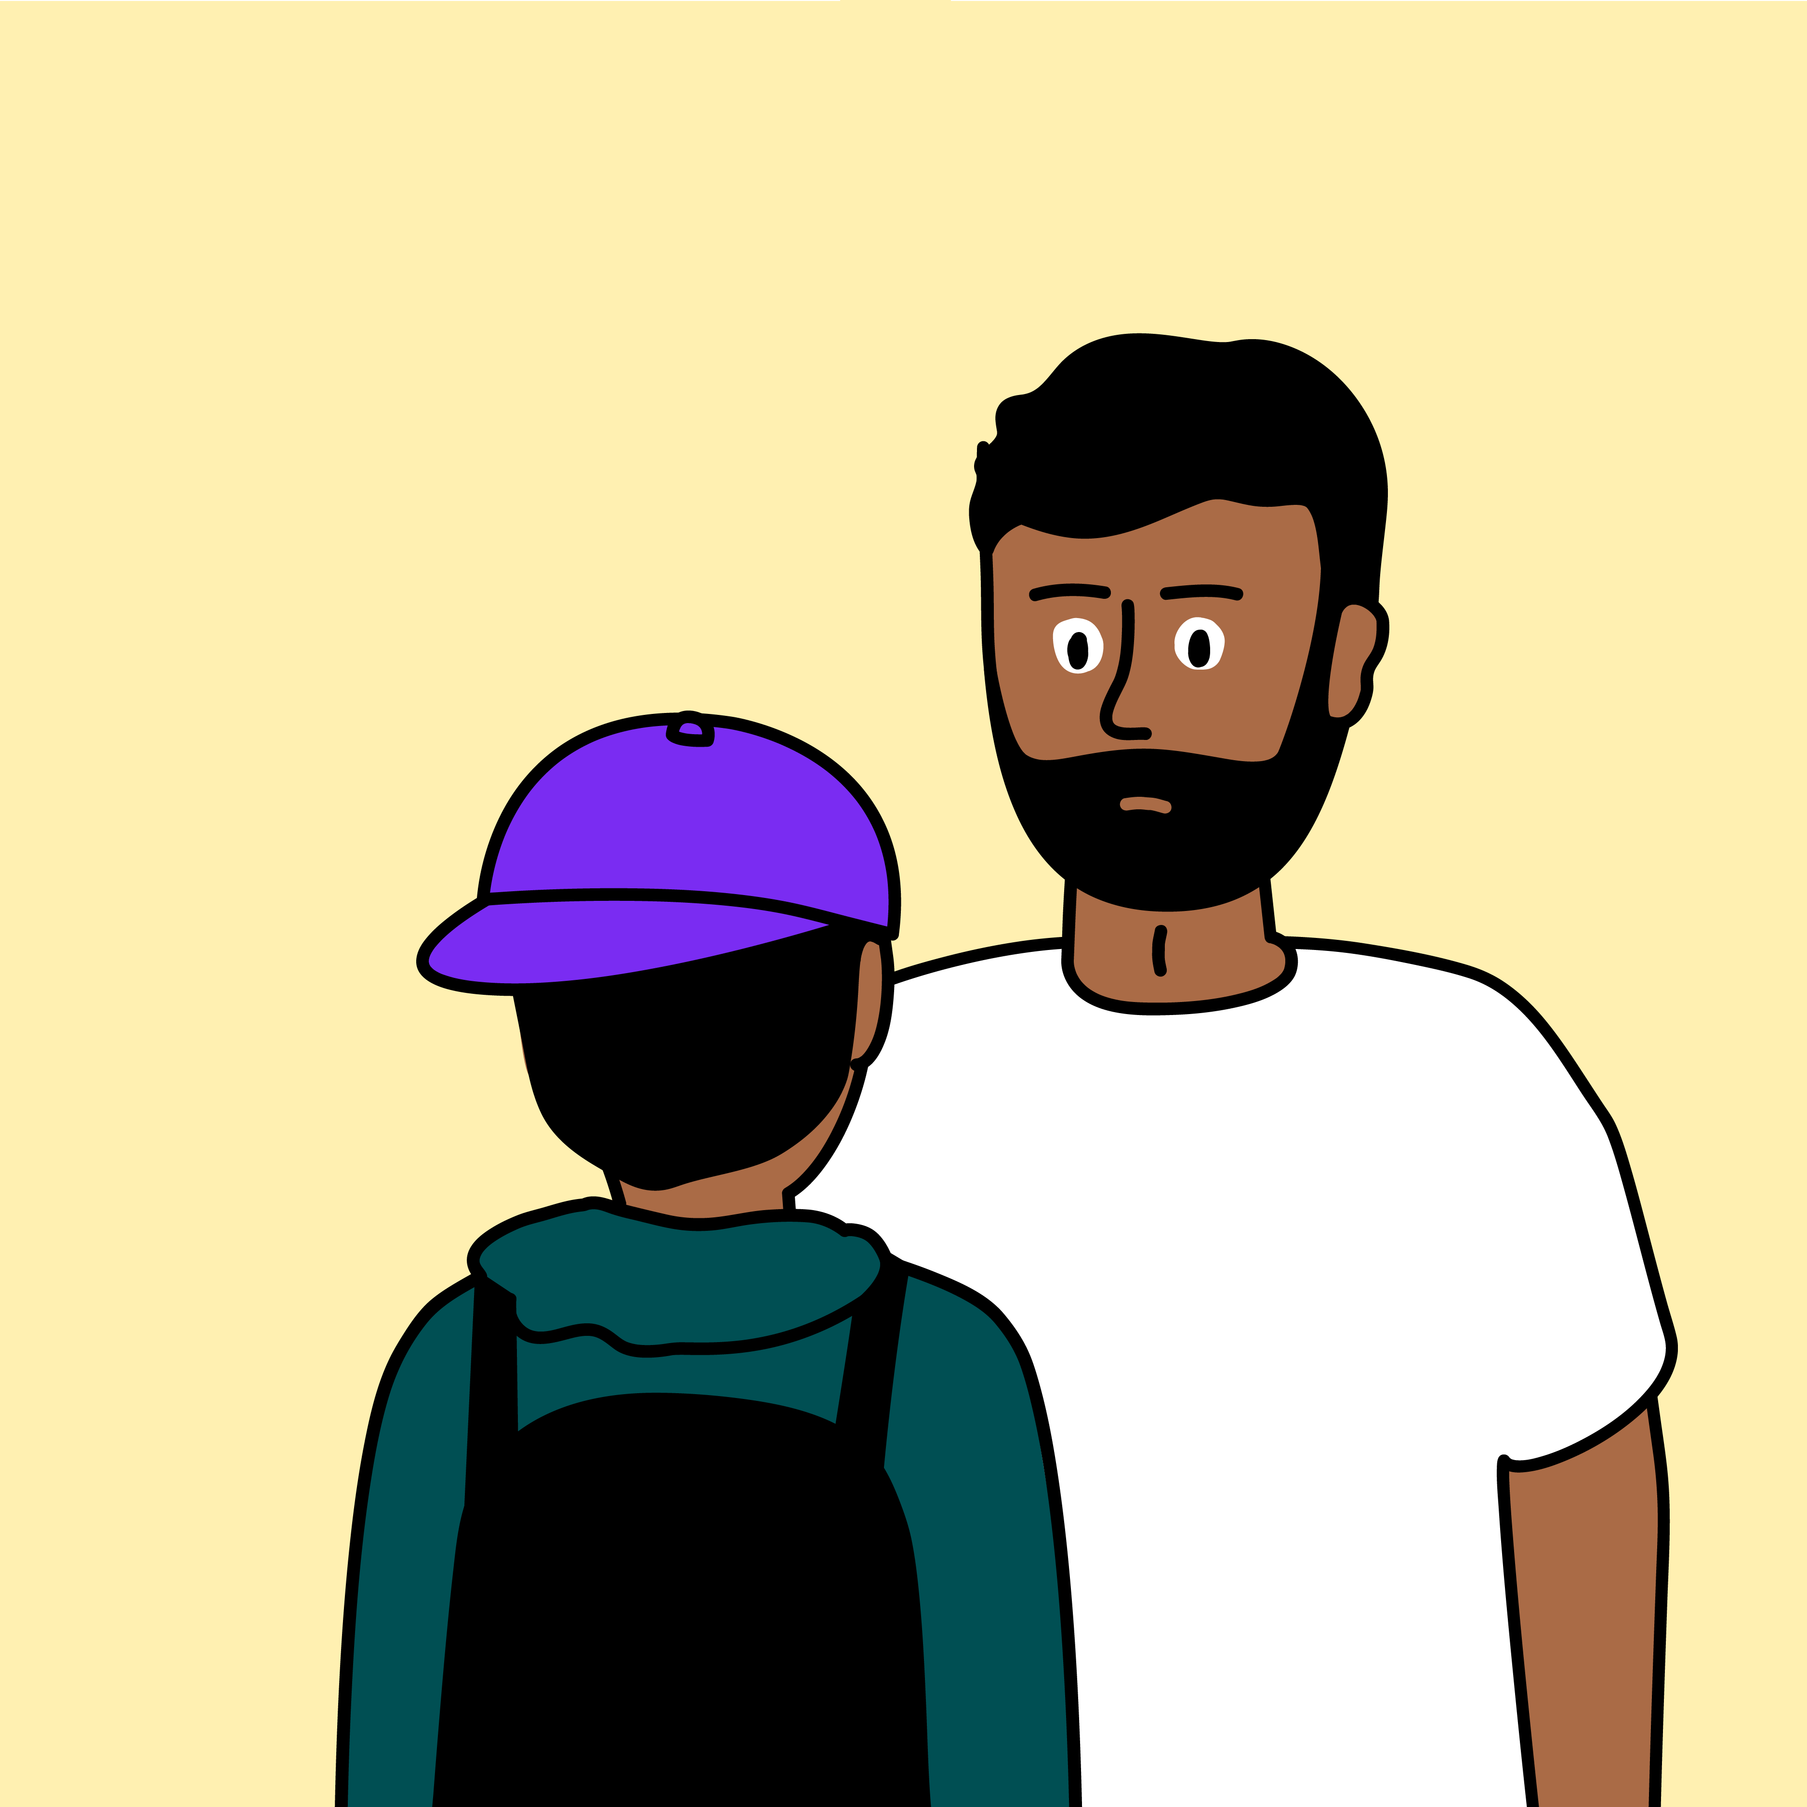
Yes, I did. I needed the Fire Armour, so I put in your password and got more gems.

Slide 12
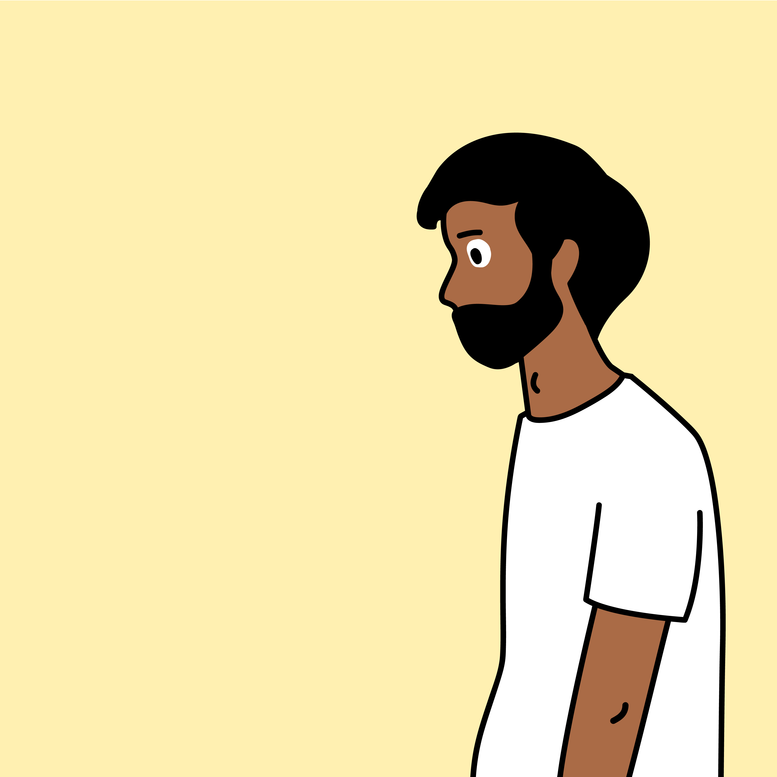
You should never use, or share, someone else’s password, even if you know it.
Buying things online can sometimes cost real money.
By using my password to buy gems, you used my money.

Slide 13
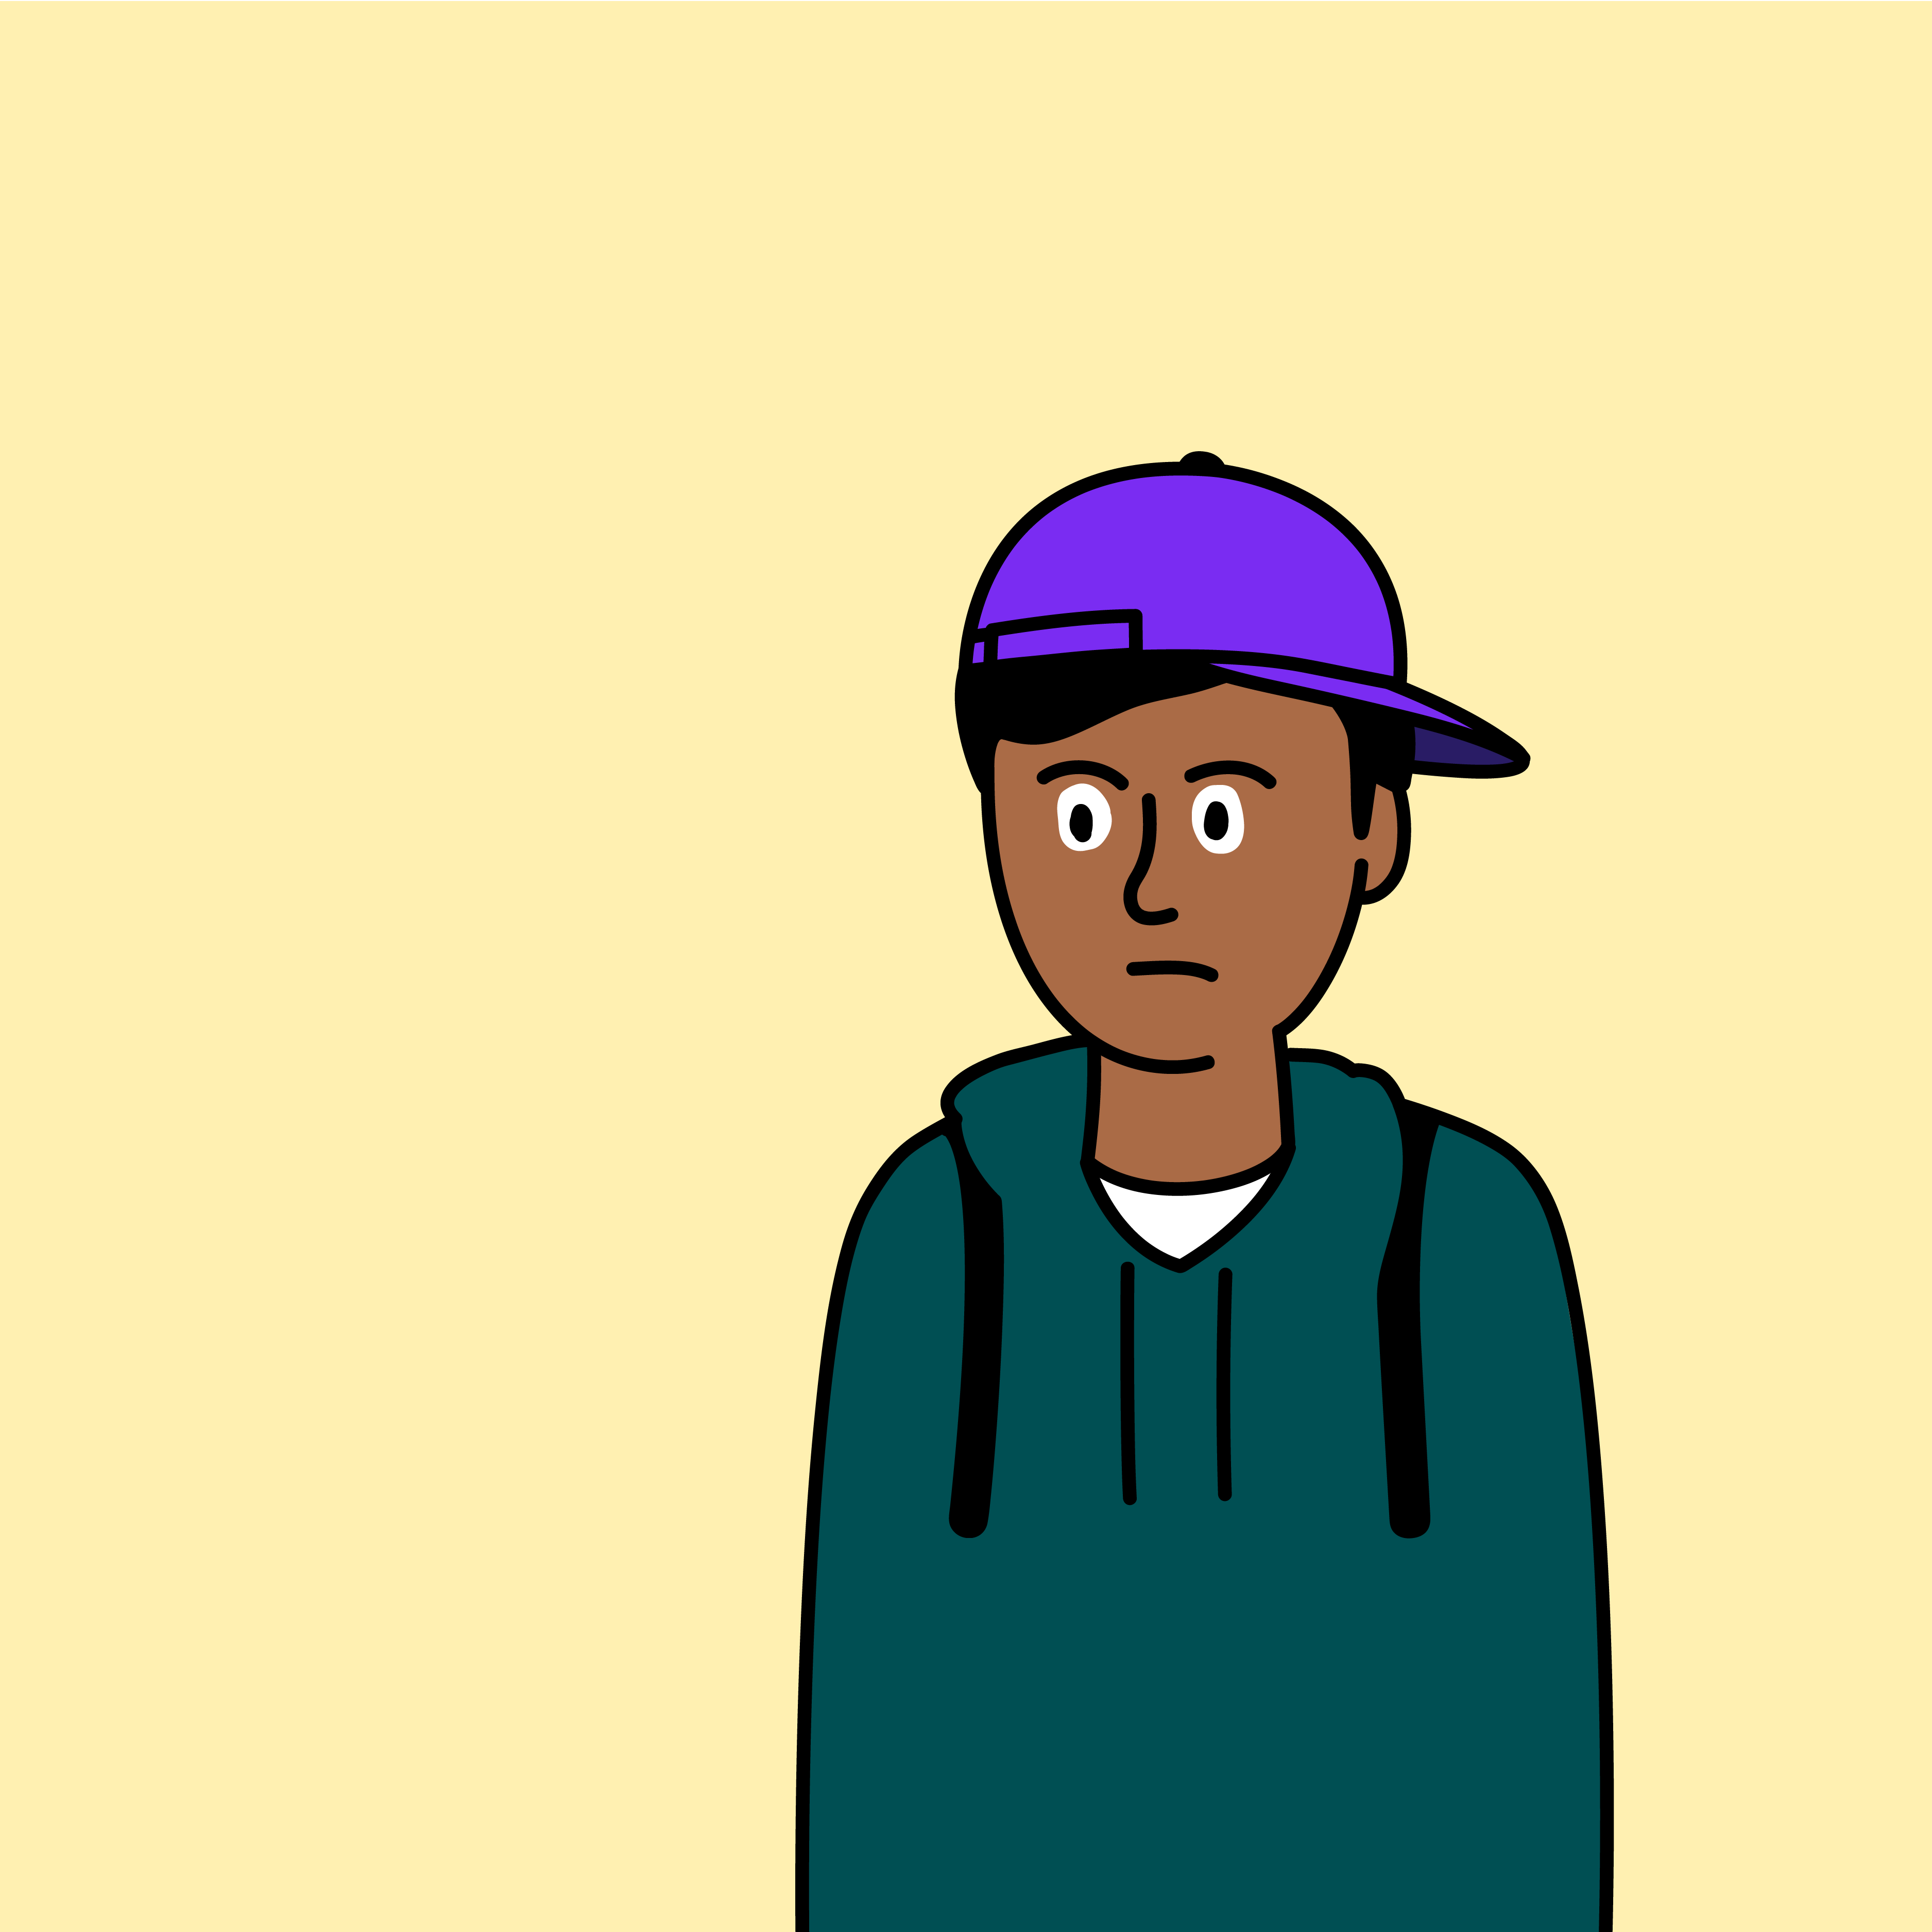
Sorry, Dad. I will always check with you when I want to buy something online from now on.

Slide 14
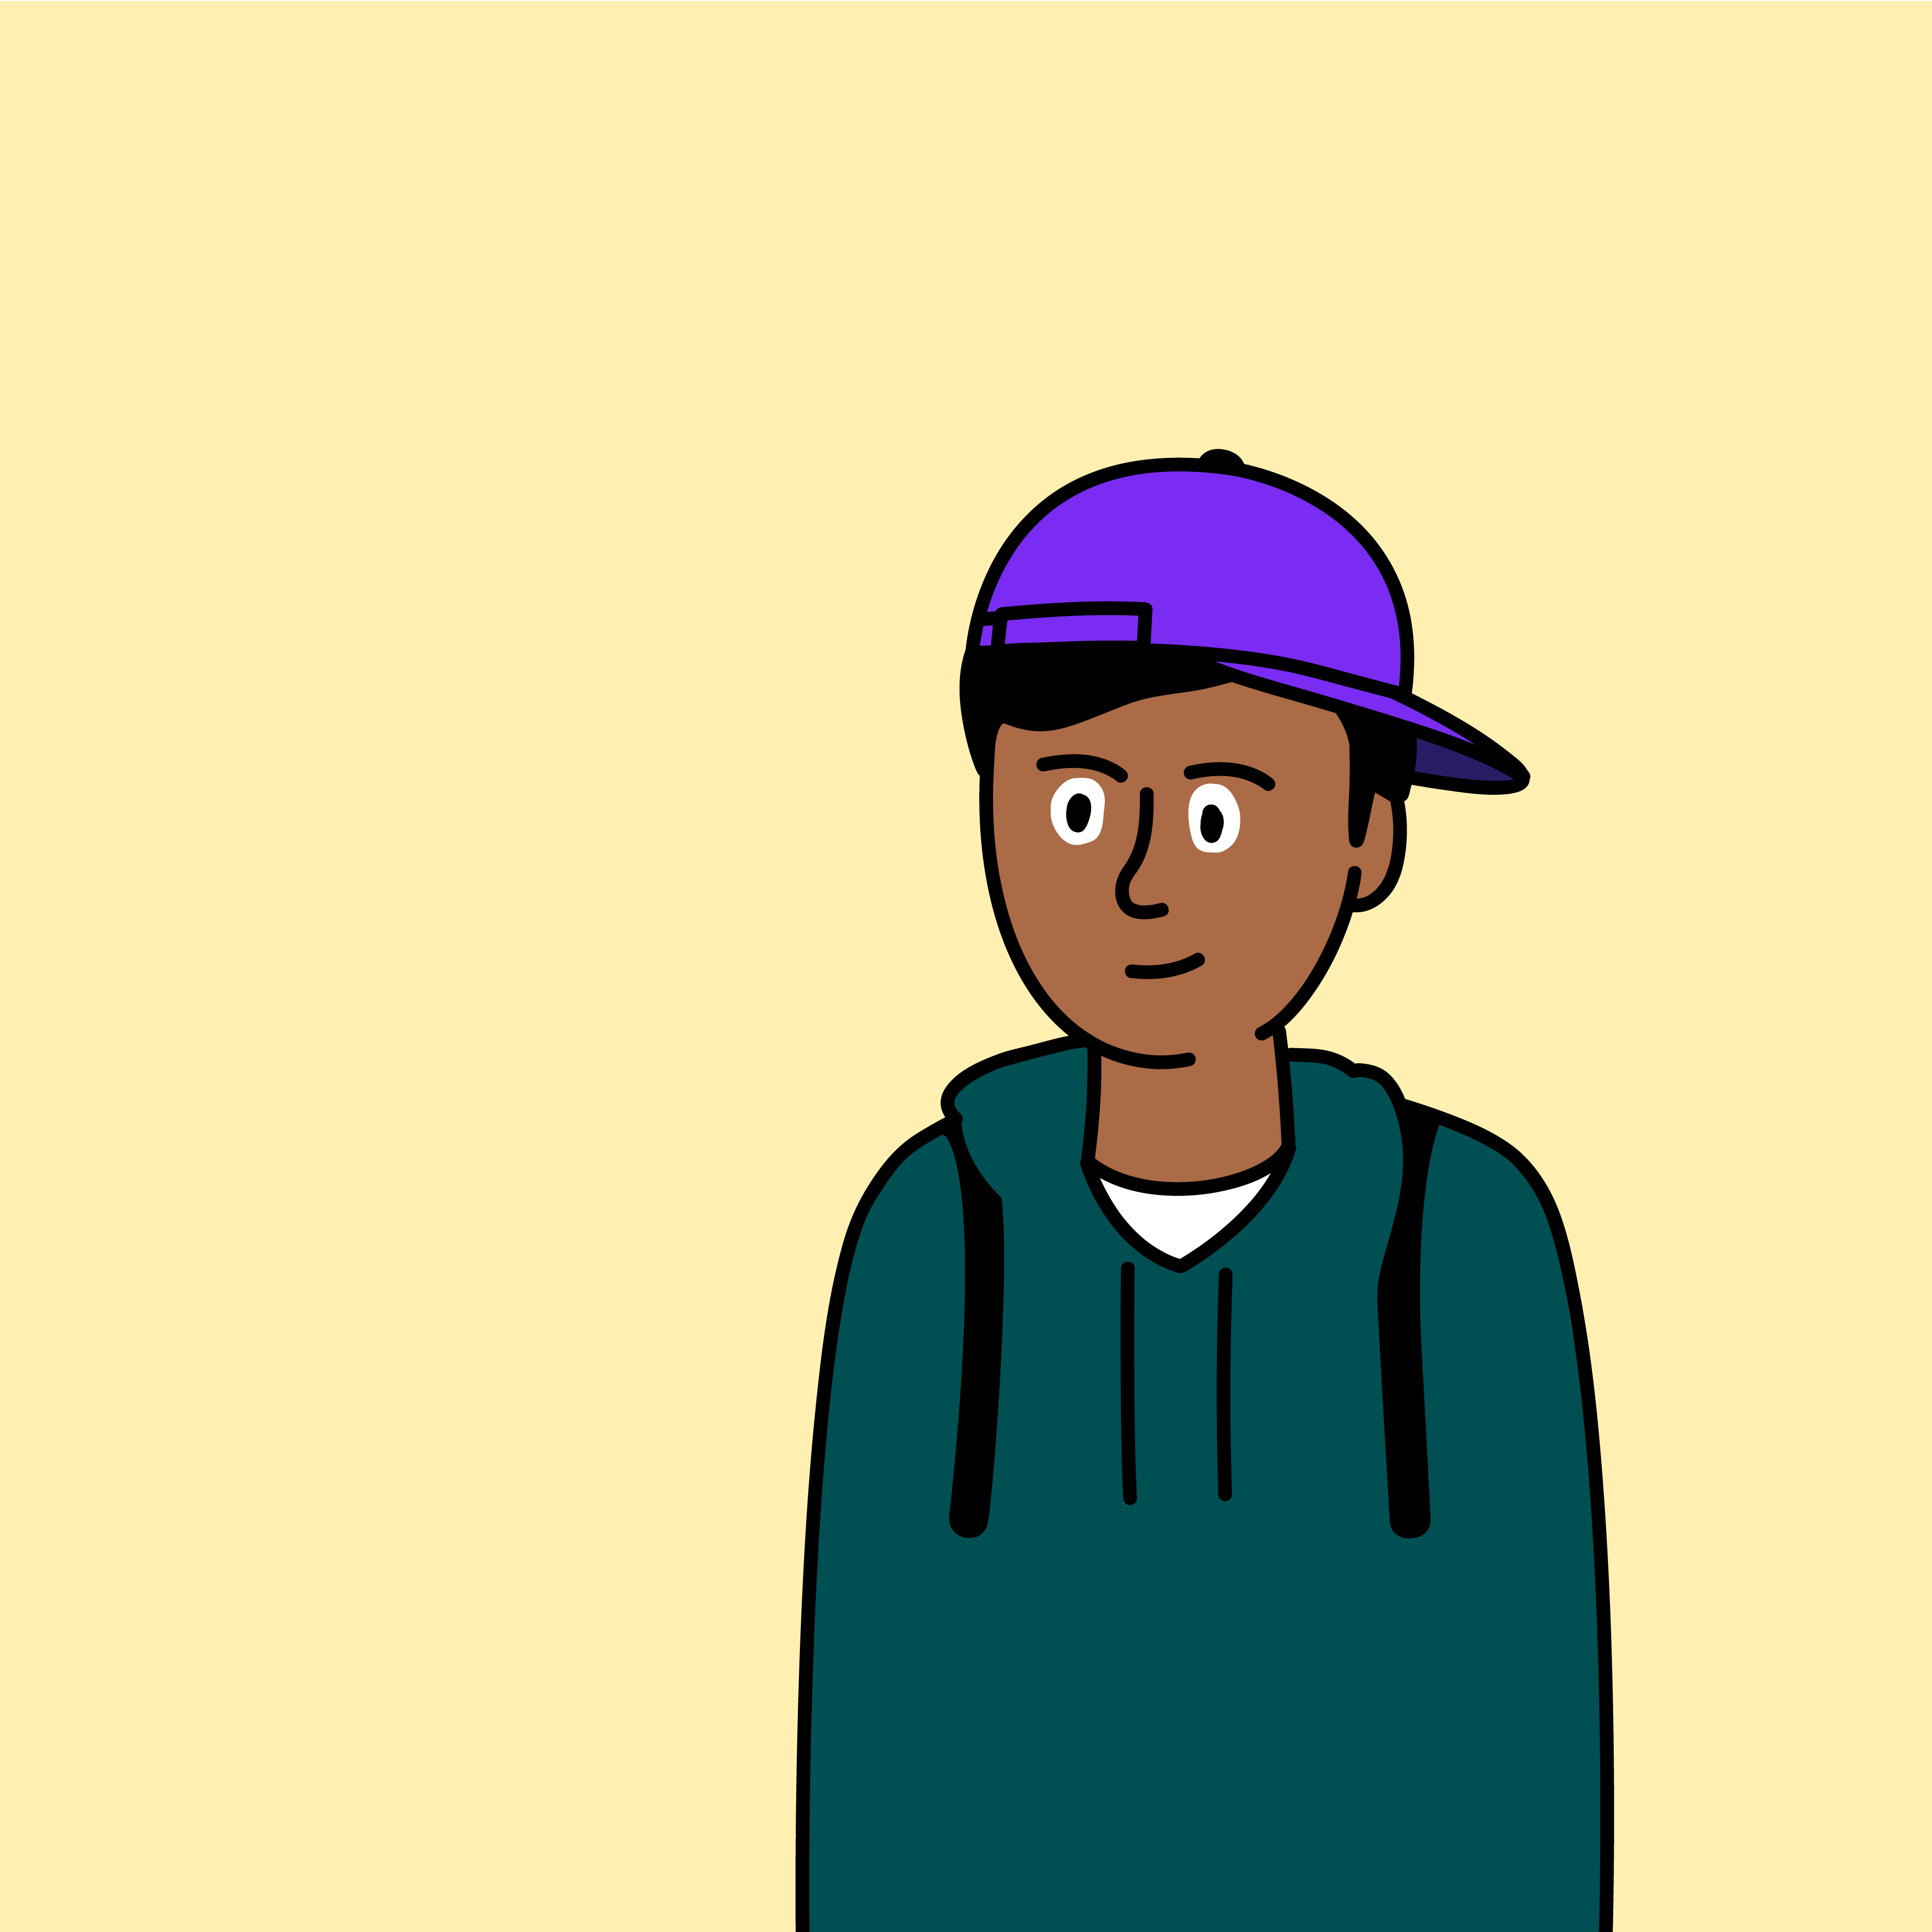
What have you learnt from Kai’s story?
Remember – always ask permission before you buy something online.

Slide 15




Explore more resources at childnet.com/resources
Part-funded by Nominet
© Childnet International 2023

