Slide 1
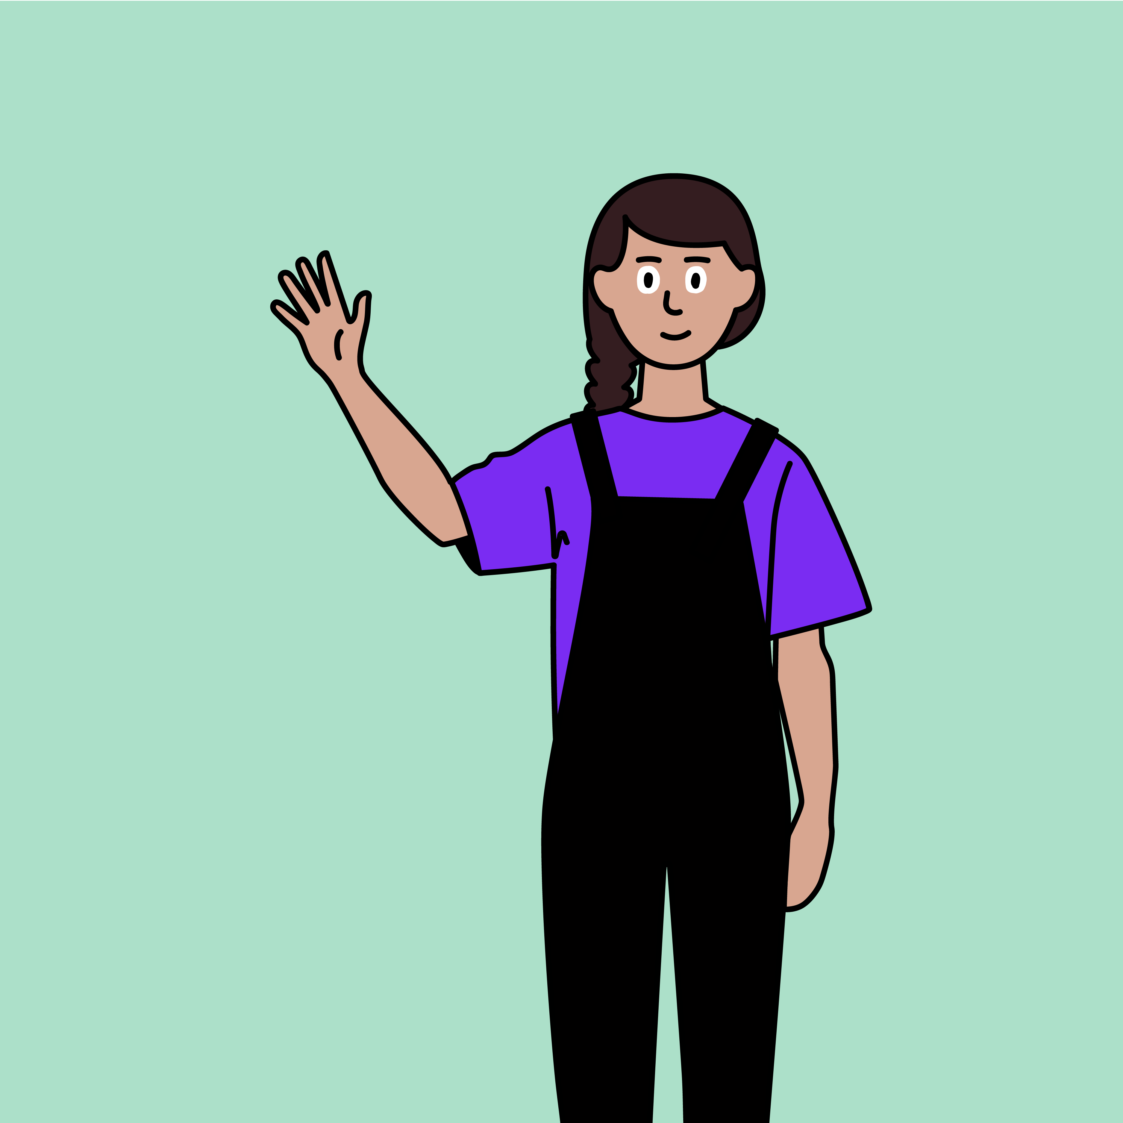
Connect with respect

Slide 2
Zoe and the mean online messages

Slide 3
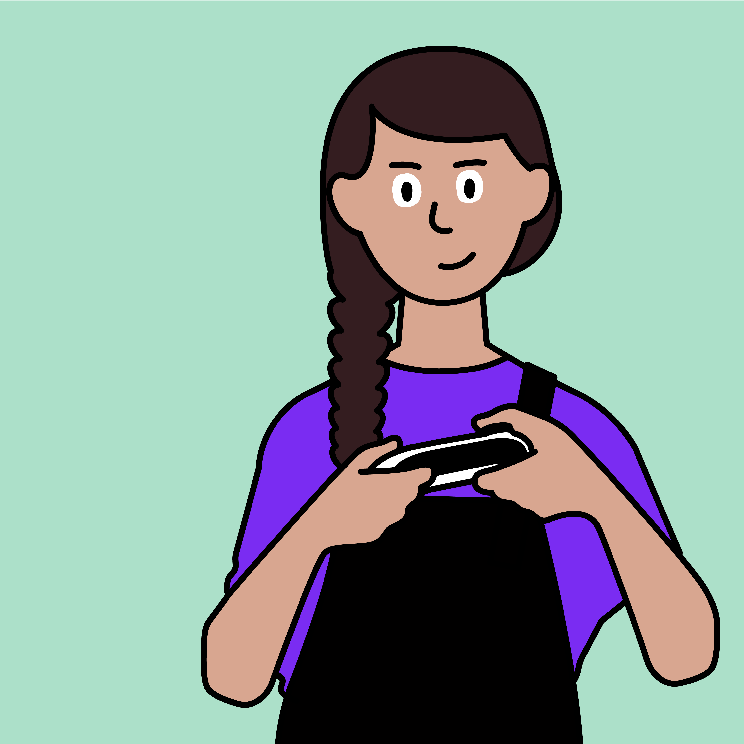
This is Zoe.
Zoe likes to play games online with her friends from school.

Slide 4
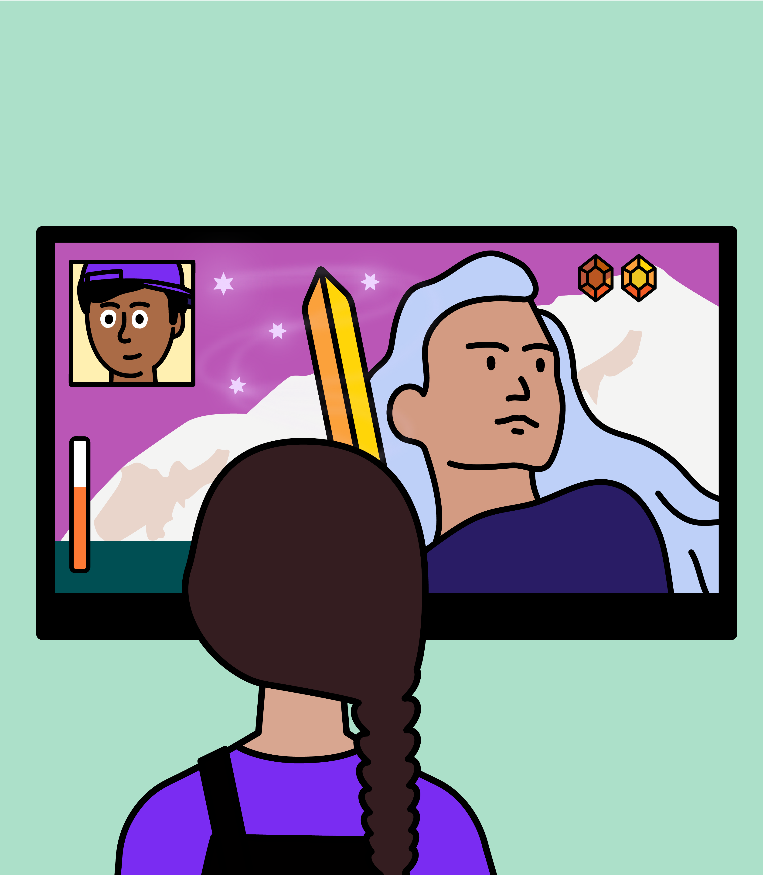
She likes to play lots of games, but Zoe’s favourite game is ‘Magic Heroes’.
She likes to talk to her friends whilst playing the game.

Slide 5
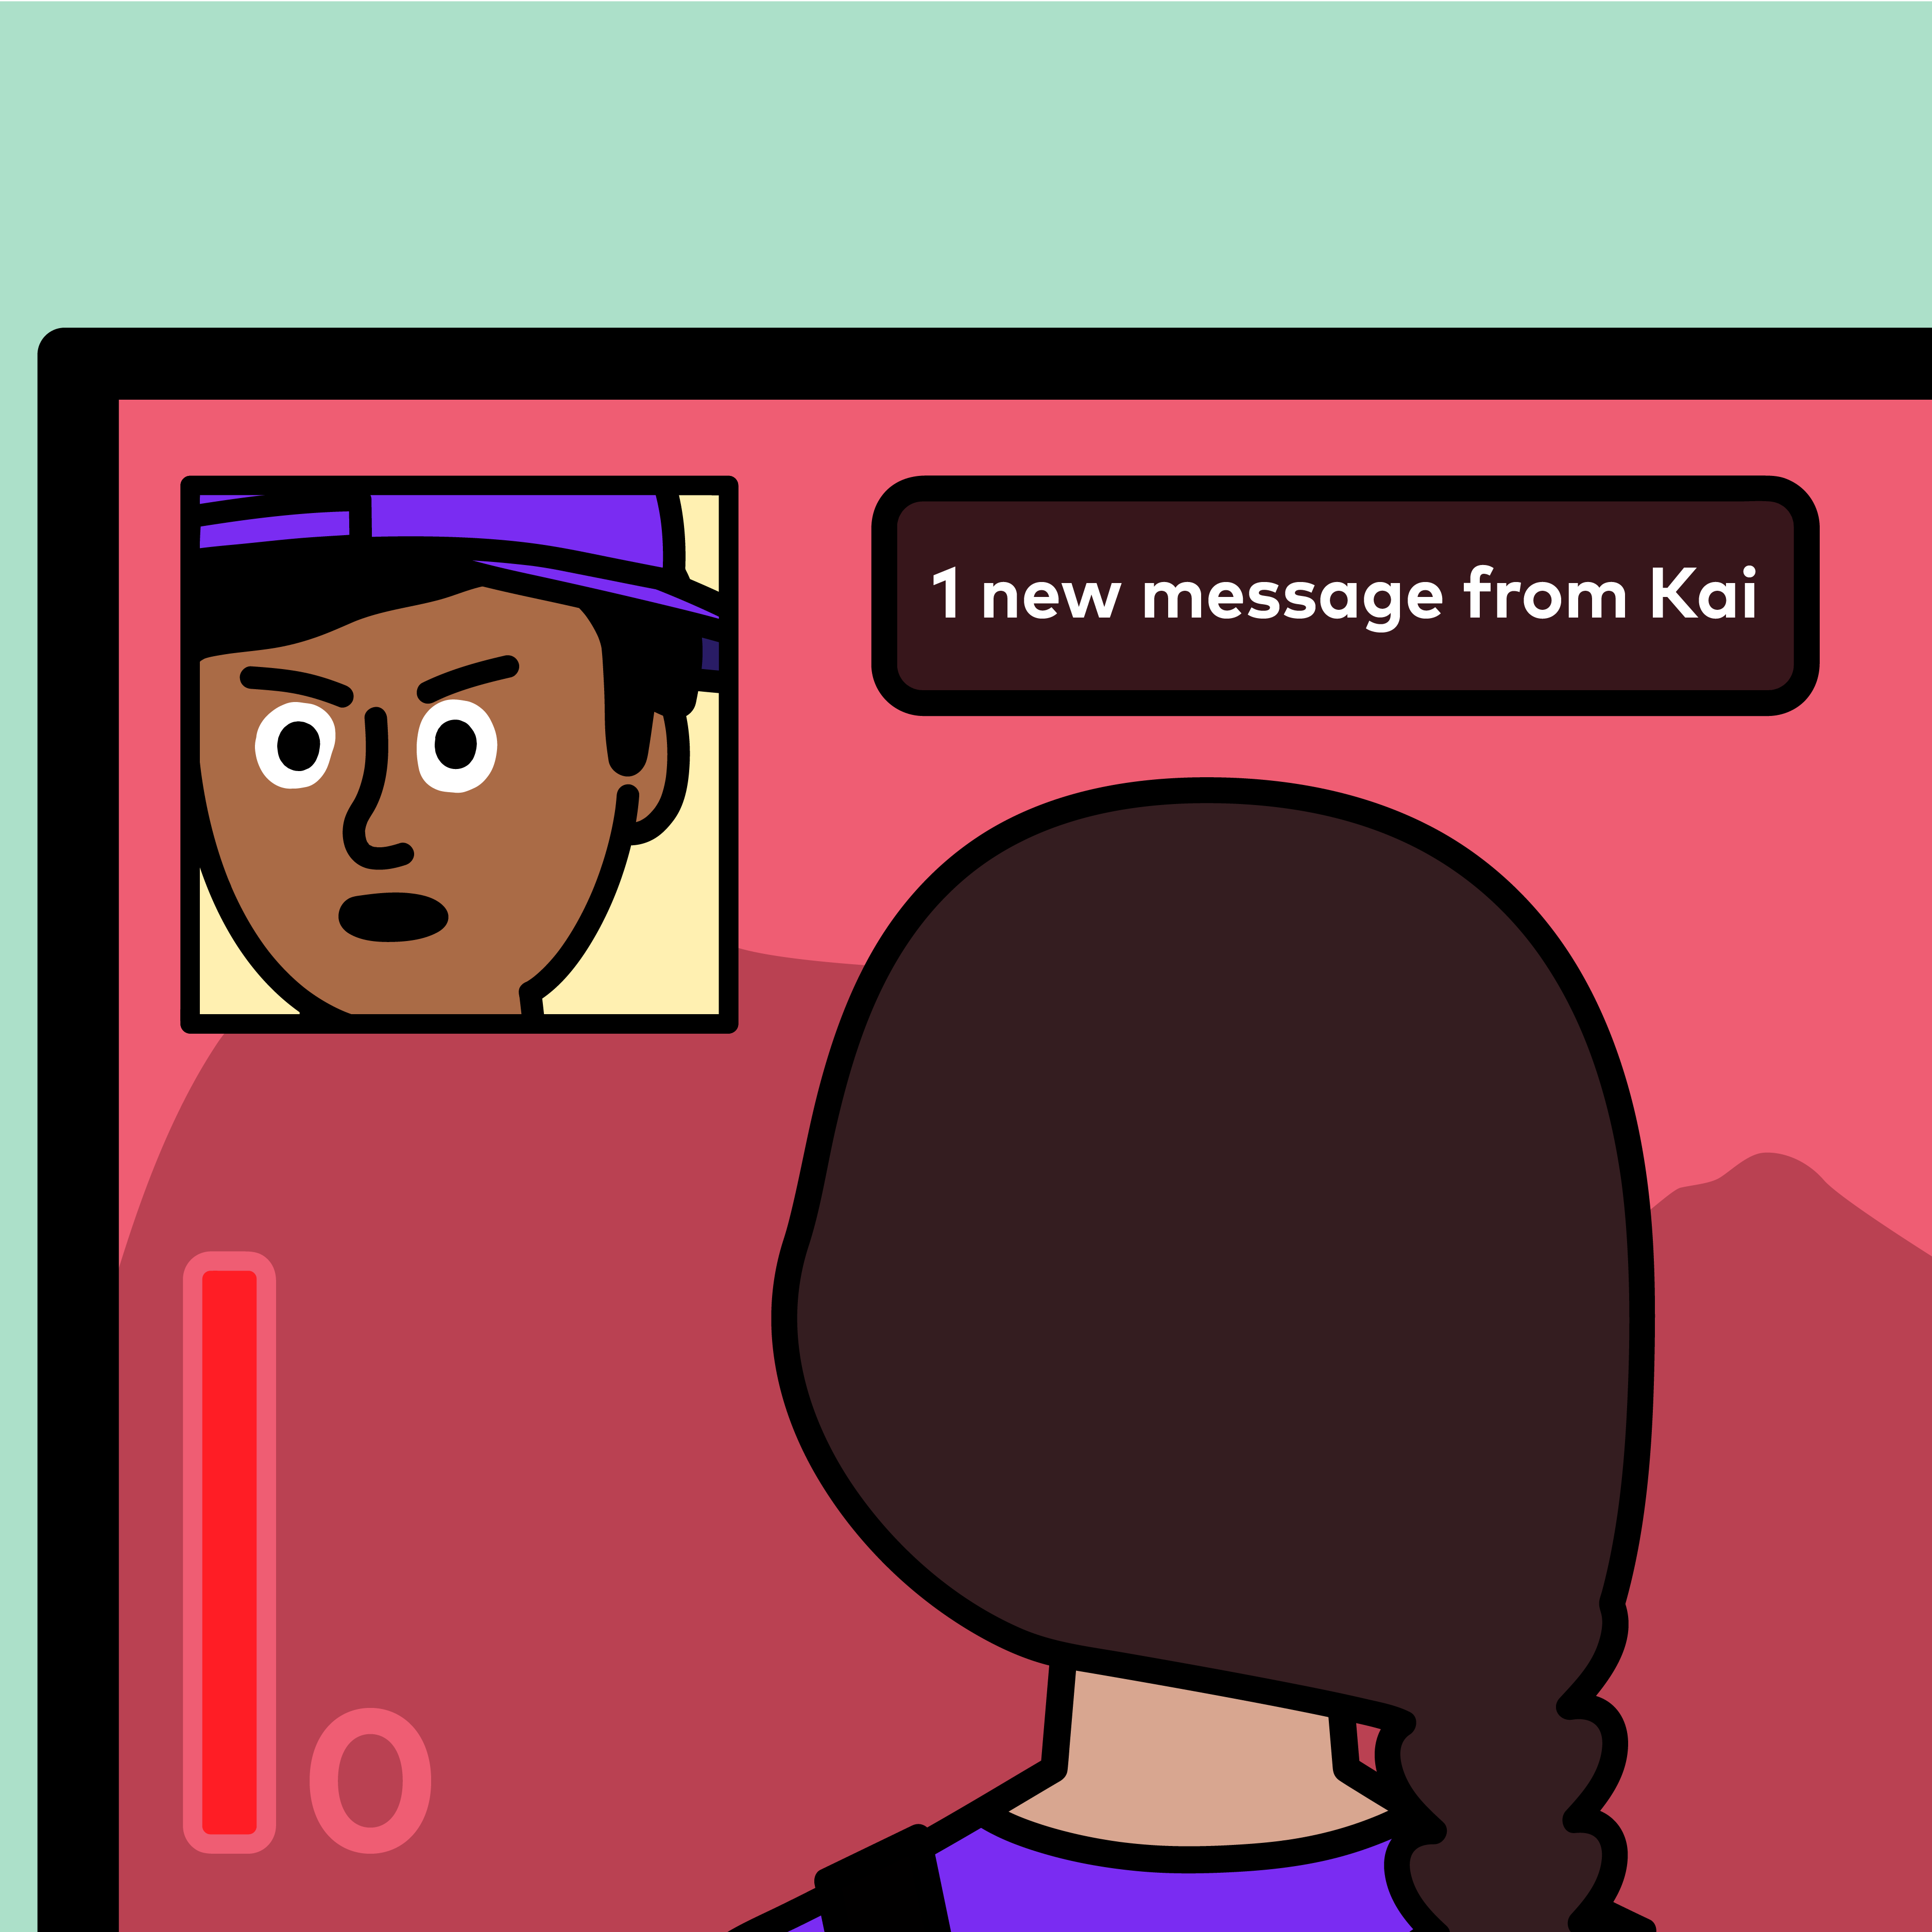
Zoe is playing ‘Magic Heroes’ with Kai.
They lose the game.
Kai blames Zoe, and sends her a mean message.

Slide 6
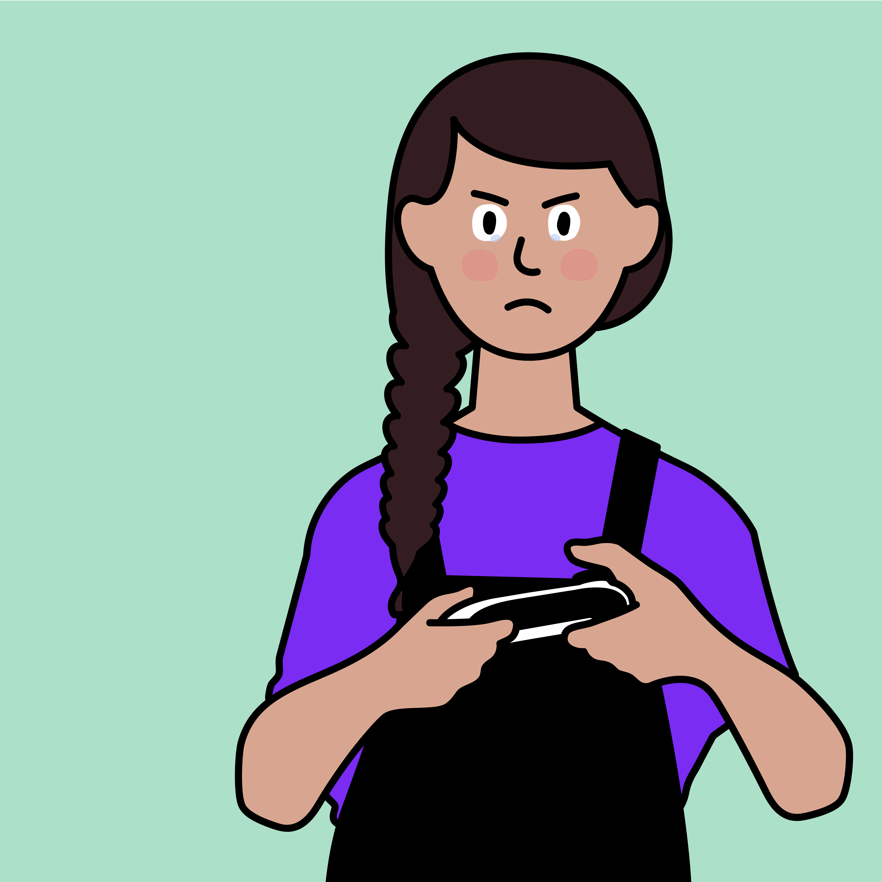
This makes Zoe feel sad and angry, so she sends him a mean message back.

Slide 7
Are people meaner online than they are offline?
How might a mean message online make you feel?
When Kai was mean to Zoe, she said something mean back. Is that the right choice?
What makes a good friend?
What should Zoe do if she sees a mean message?

Slide 8
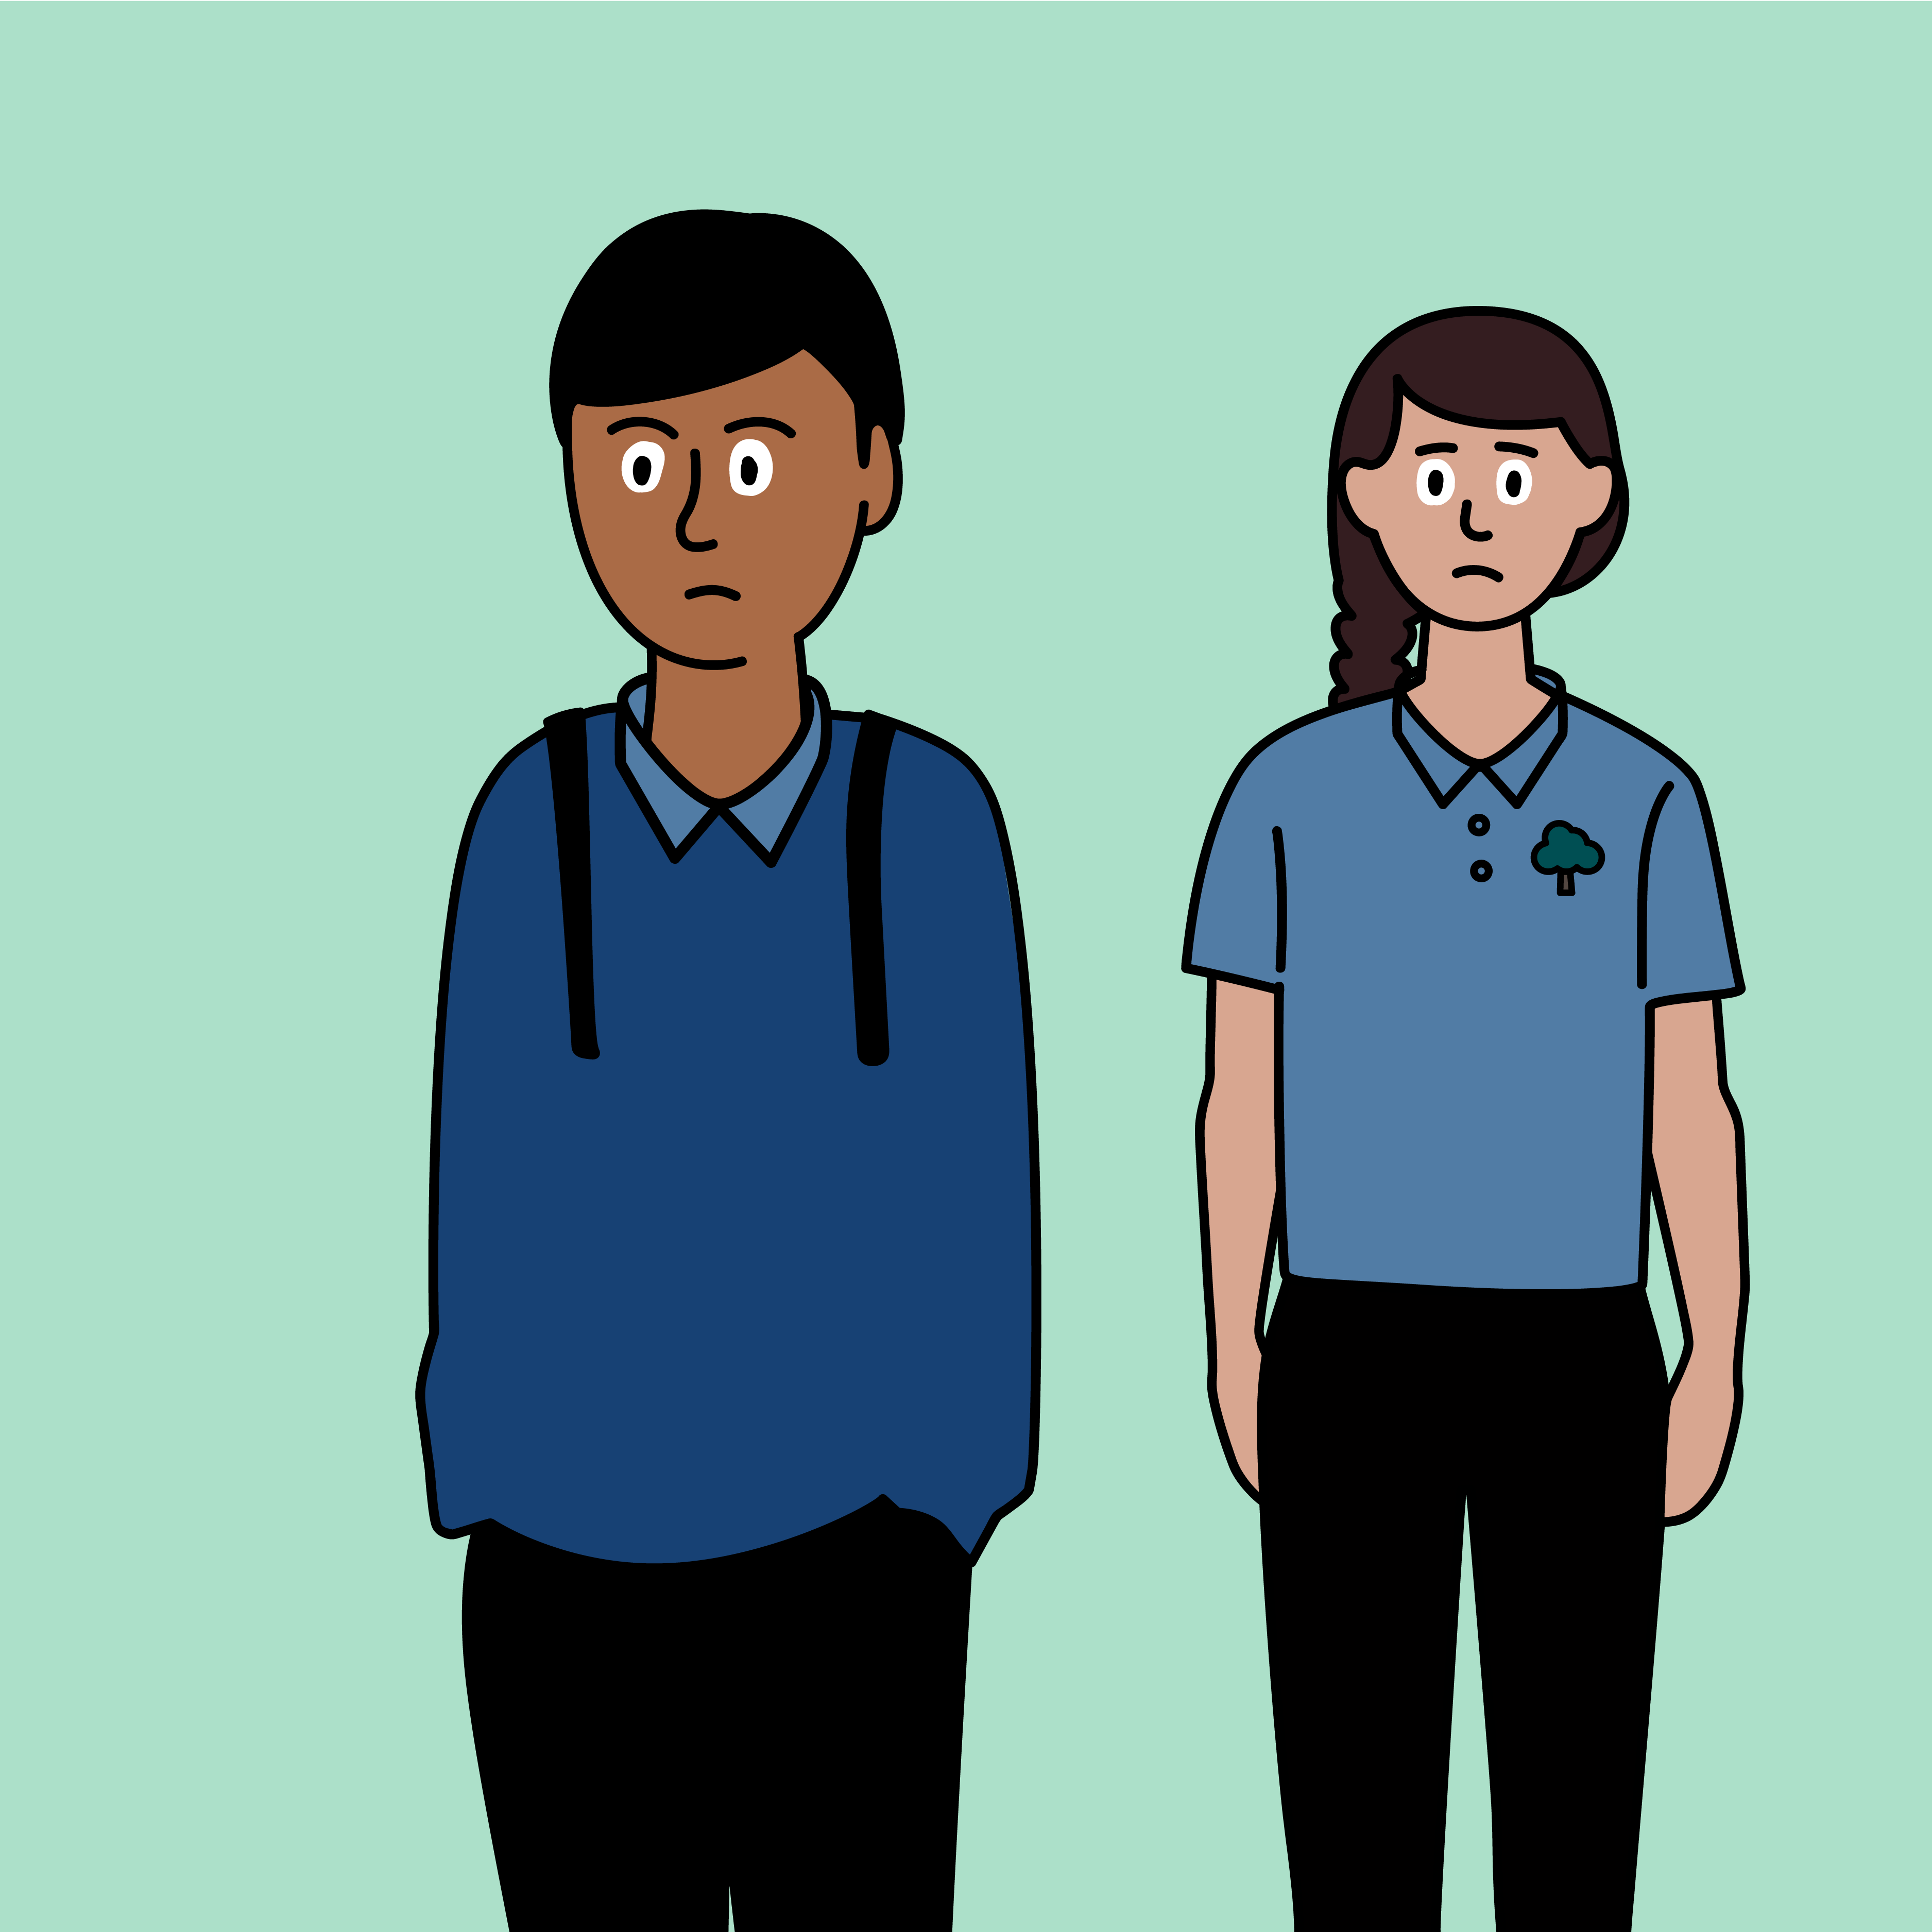
Zoe sees Kai in school the next day, but he will not talk to her or play with her.
This makes Zoe sad.

Slide 9
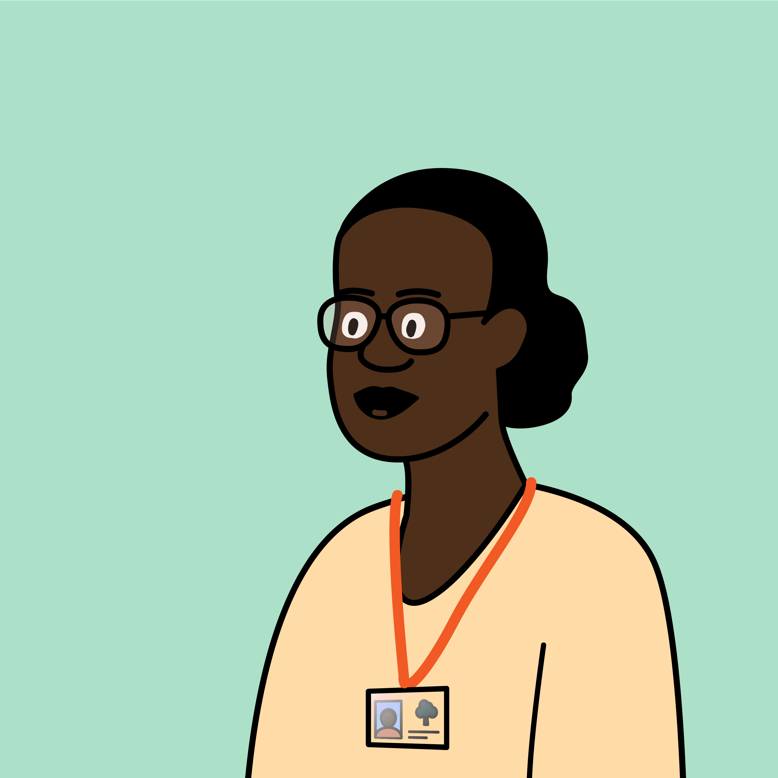
Zoe and Kai’s teacher calls them over for a chat.
Are you okay? You haven’t been playing with each other like you usually do.

Slide 10
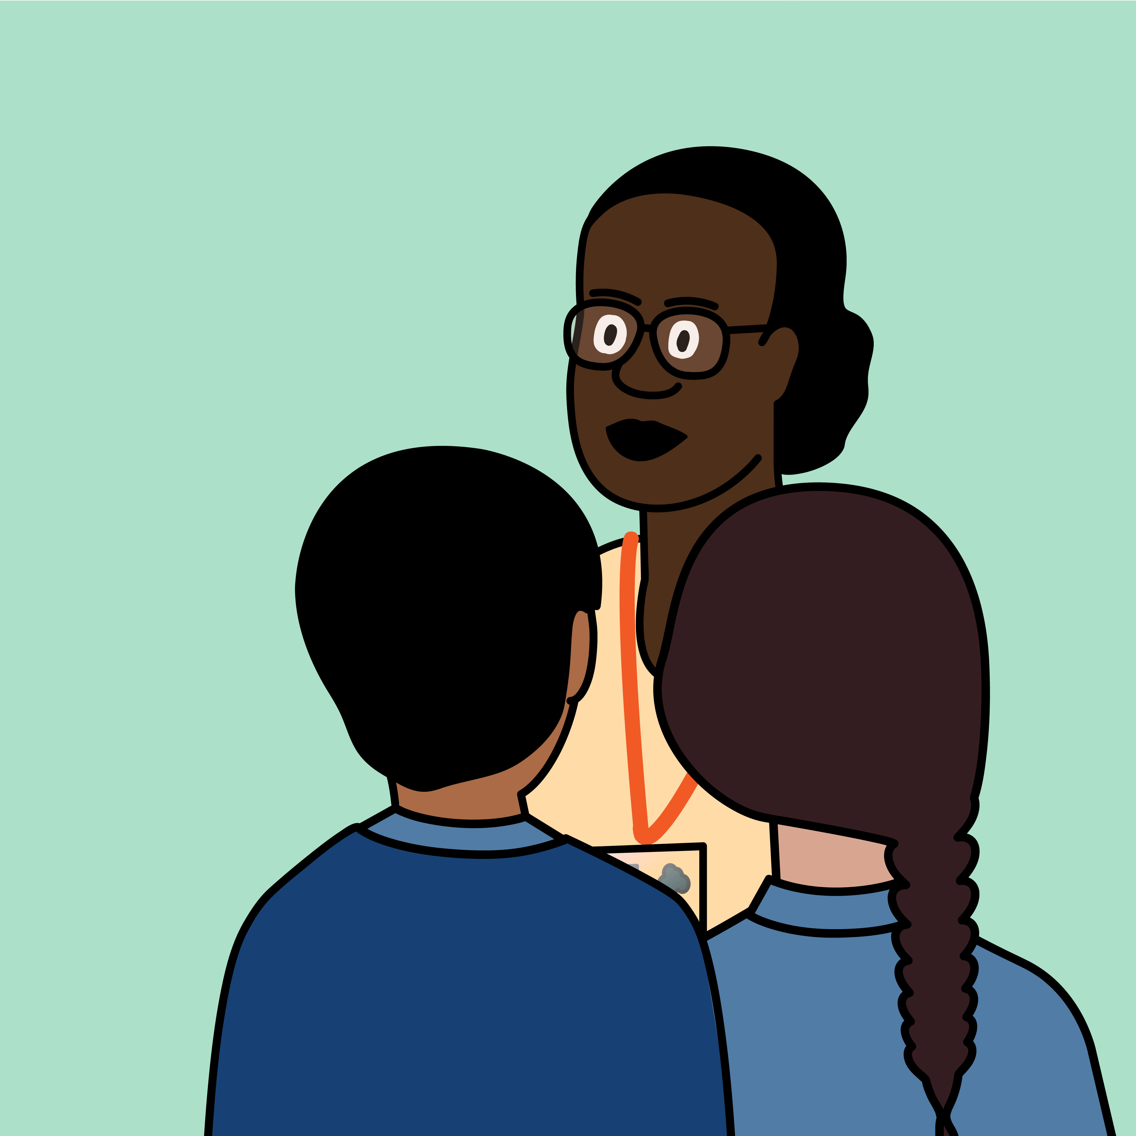
Zoe and Kai tell their teacher what happened when they were playing ‘Magic Heroes’.

Slide 11
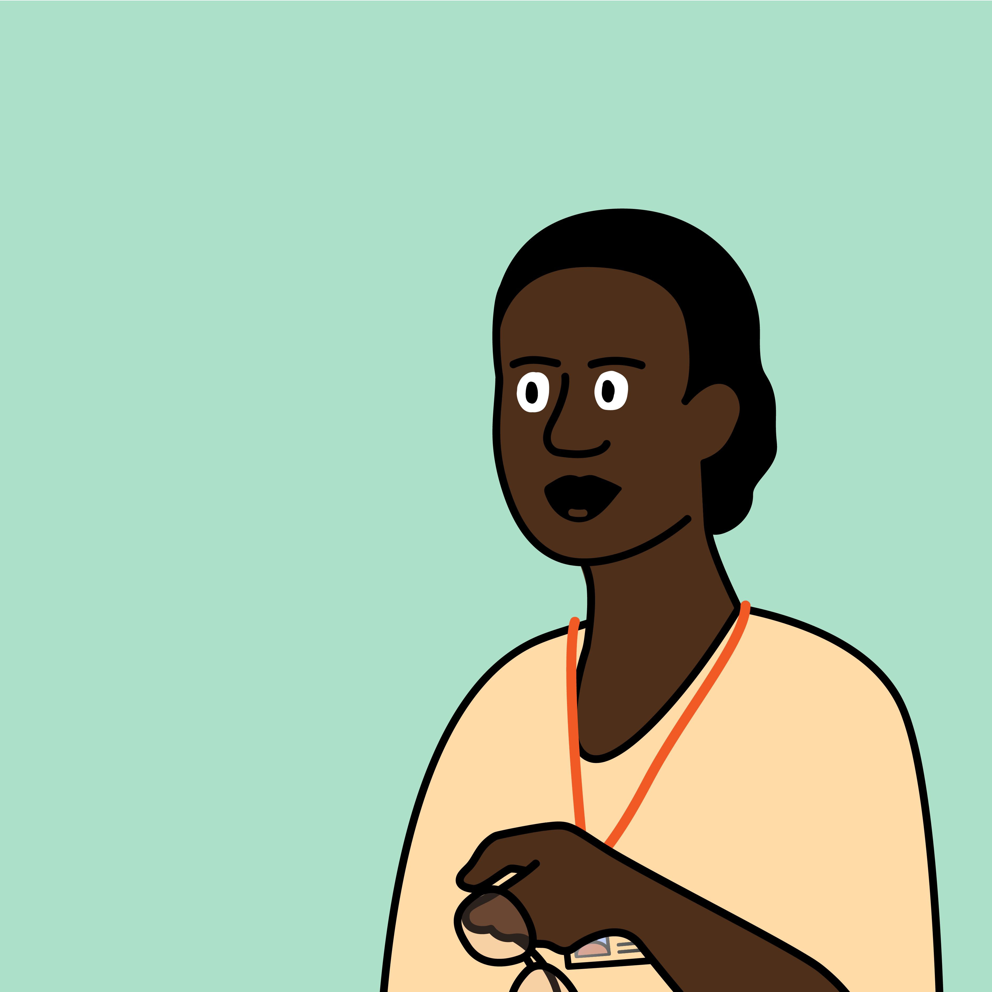
Saying something mean to someone can upset them. Sending someone a mean message online can upset them too.
It’s important to be kind to each other offline and online.

Slide 12
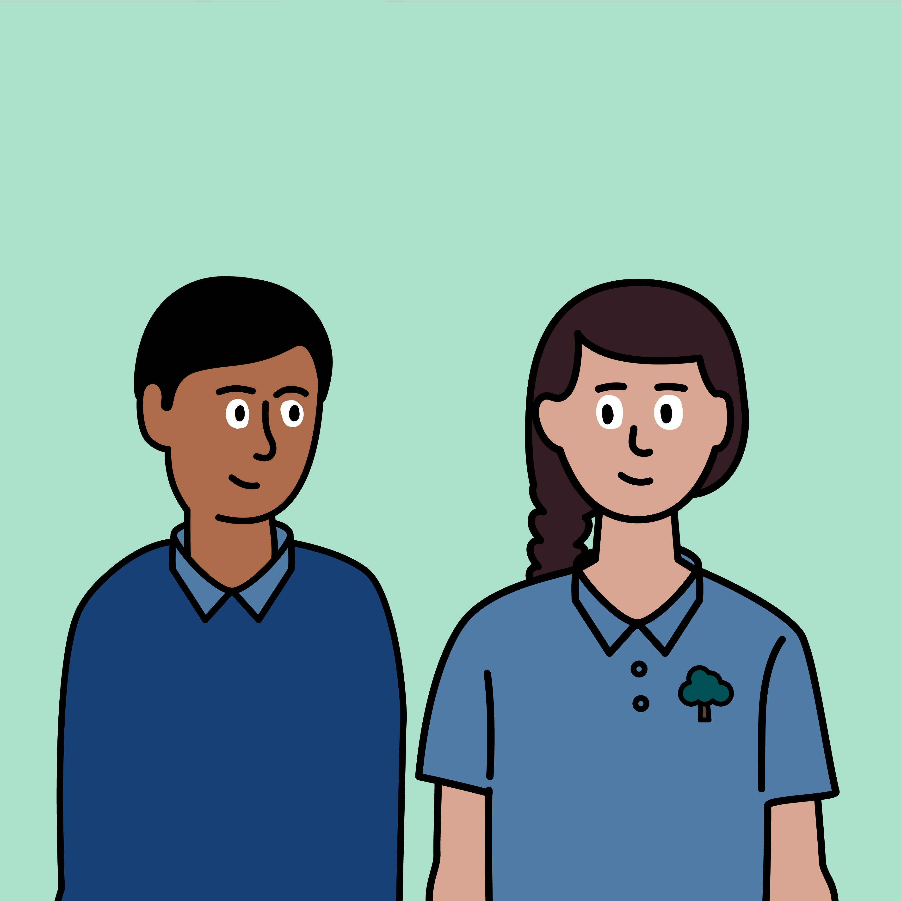
Zoe and Kai knew that what they said to each other was unkind.
I’m sorry, Zoe. I should not have said mean things to you.
I’m sorry too.

Slide 13
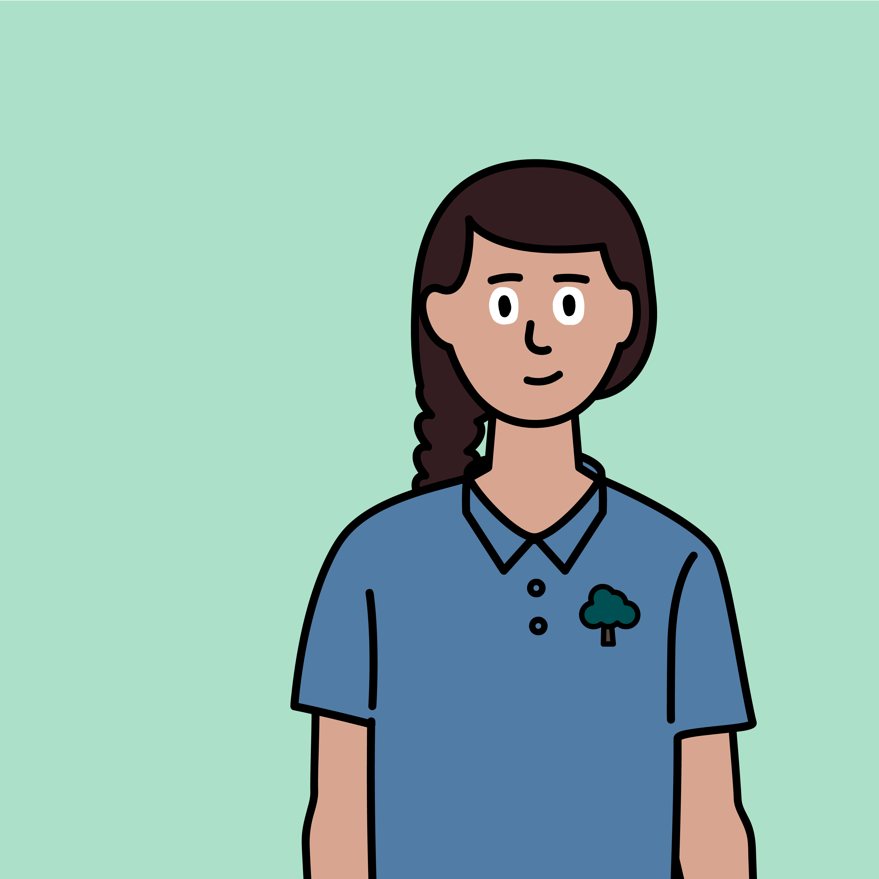
What have you learnt from Zoe’s story?
Remember – always tell a trusted adult if someone upsets you online.

Slide 14




Explore more resources at childnet.com/resources
Part-funded by Nominet
© Childnet International 2023

