Slide 1

Back to School Assembly
Read through the slides in advance of delivery and fill in details relevant to your school or setting on slide 14 and 15.
Under the slides you can find a script to help with delivery. To print the script, under print settings select print ‘Notes Pages’.

Slide 2










Welcome back!
Let’s talk about online safety
Notes:
Hello everyone and welcome back from your summer holidays! In our assembly today, we will be talking about online safety.

Slide 3









How does going online make you feel?
frustrated
unsure
relaxed
happy
entertained
Notes:
There are so many things you can do online but different things online might make you feel different ways – can you think of a time where going online has made you feel relaxed? Tell the person next to you. How about a time when it has made you feel unsure? Share it with the person next to you.
Lots of the time, going online will make us feel things like happy, entertained or excited, but sometimes there might be things online that make us feel more negative emotions like confused or worried. That’s why it’s important to think about what we do to keep ourselves safe online, and what we can do if we start to feel these negative emotions.

Slide 4








What did you do online during the summer holidays?
Notes:
You probably did lots of fantastic things during the summer holidays and some of them might have been online. You might have listened to music online, had a video call with your friends or family, or played an online game!
Take 30 seconds with the person next to you to discuss what you did online during the summer holidays.

Slide 5
What can you do to stay safe online?
Notes:
Many of the things that you did online during the summer holidays might be things you continue to do after school or on the weekends, but there will also be different ways you access the online world when you are at school. Can you think of any ways that you can stay safe whilst doing these activities online?
[Take responses]

Slide 6








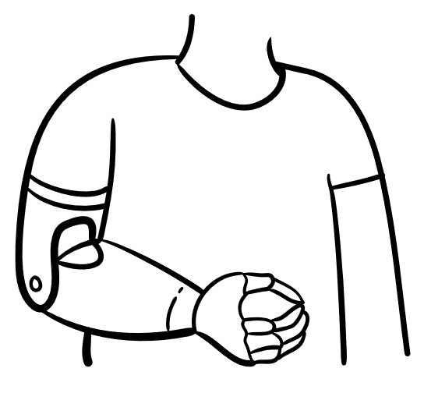


Group Chats
I had a group chat with my friends, but lots of people have been added who I don’t know. Some people are being unkind to each other in it.
The other day, someone shared something that I didn’t like when I clicked on it.
Notes:
One thing you might do online is use group chats. This is where people can chat with more than one person at once. They can be really fun and useful as people might use them to chat with their friends, share information and talk about things they enjoy. However, Josh has been using group chats and says this: I had a group chat with my friends but lots of people have been added who I don’t know. Some people are being unkind to each other in it. The other day, someone shared something that I didn’t like when I clicked on it. What advice would you give Josh?
[Take responses]

Slide 7






Top tips for group chats…
Make sure to only add people who know each other in group chats.
Only share images, videos or links that everyone would enjoy.
Talk to a trusted adult if anything in a group chat worries or upsets you.
Notes:
Thank you for all your suggestions for Josh. Let’s have a look at some top tips to help if you use group chats… Firstly, make sure to only add people who know each other in group chats. Secondly, only share images, videos or links that everyone would enjoy. Think about everyone’s feelings before you share something. And finally, talk to a trusted adult if anything in a group chat worries or upsets you.

Slide 8
Online Gaming
Are these positive or negative?
Someone asks where you go to school in the chat.
Someone says they will trade with you but takes your item.
You play with your friends.
You beat the final boss.
Your friends have fallen out in a game.
Notes:
Another thing you might do online is play games. Lots of people really enjoy doing this and have great fun. Here we have 5 things that may happen when you are playing online games, for each one I would like you to show me whether you think it would be a good thing to happen or a bad thing to happen by giving a thumbs up or down.
Someone says they will trade with you but takes your item
Someone asks where you go to school in the chat
You play with your friends
Your friends have fallen out in a game
You beat the final boss
What advice you would give someone in one of the negative situations so that they can turn it into a positive one?
[Take responses]

Slide 9


Top tips for gaming…
Treat others kindly when you are playing.
Only trade using in-game trading systems to keep your items safe.
If anyone asks for personal information, photos, videos, livestreams or to meet up, tell an adult.
Talk to a trusted adult if anything in a game worries or upsets you.
Notes:
Sometimes there can be problems when you are online gaming, so let’s have a look at some top tips to help us. Our first tip is a really important reminder to always treat others kindly and respectfully while you are playing online.
Secondly, remember to only trade using the official ways to trade or only with people you trust so you can keep your items safe.
If you are chatting on a game and anyone asks for personal information, photos, videos, livestreams or to meet up, always tell an adult.
Finally, if you are gaming and you start to feel upset or worried, talk to a trusted adult.

Slide 10




Sharing online
Photos of yourself
Your birthday
Your address
Which of these are okay to share online?
Art you’ve created
Your favourite footballer
Your school
The book you’re reading
Notes:
Something a lot of people enjoy doing online is sharing. You might share a funny video, what you are up to or a photo you took. Some things are okay to share but some things we should keep to our friends and family who we know face-to-face. Look through these examples and decide whether they are okay to share or not okay to share.
[Take responses]
It might be okay to share your favourite footballer, the book you are reading and art you’ve created, but the others should be kept private.

Slide 11
Top tips for sharing online…
Keep personal information private.
Make sure any profiles are private.
Check with an adult if you are unsure.
Notes:
So let’s remind ourselves of some top tips to keep safe when sharing online. It’s important to keep personal information private, that’s all those little details that tell someone who you are like your address or your school.
Secondly, we should make sure any profiles you use on apps or games are private, so only the people you choose can see them.
Finally, if you are unsure about anything when you are sharing online, ask an adult and they can help.

Slide 12






What do you enjoy offline?
Notes:
When we think about the time we spend online, it’s important to think how we balance this with our time offline too. There are so many fun things to do online like we’ve mentioned so far, but what activities do you enjoy doing offline?

Slide 13
Top tips for managing time online…
Enjoy spending time on online and offline activities.
Check in with how you are feeling.
Talk to a trusted adult if you start to feel negative emotions when you are online.
Notes:
It’s good that we spend time both online and offline, so taking part in all those things you told me about is great for your mood! When you are going online, check in with how you are feeling and look for signs you have been online too long, like feeling tired or having sore eyes. If you do start to feel negative emotions when you are online, a trusted adult can help you with what to do.

Slide 14
When you are online at school…
Use these bullet points to remind learners of your setting’s expectations.
Use these bullet points to remind learners of your setting’s expectations.
Use these bullet points to remind learners of your setting’s expectations.
Notes:
Many of the things we’ve talked about are things you might do after school, but you will also go online in school sometimes so I want to share a few reminders to help you…

Slide 15
Who can you talk to?
An adult in your family
Your teacher
A parent or carer
Childline
Space to fill in your safeguarding lead.
Notes:
Like we’ve said, a trusted adult can always help you if you are ever worried or upset about something online, or just want to chat about something you’ve seen. There are so many trusted adults that want to help you, in school we have people like your teachers, teaching assistants and [insert name of safeguarding or pastoral lead here] that you can always talk to.

Slide 16

Online safety challenge
Your challenge is to find the answers to these questions…
What is your class's top tip for staying safe online?
Who can you go to if you are upset or worried about something online?
What does your class like to do online?
Notes:
Now we have talked about going online, we want the conversations to continue so I have a little challenge for you. I have three questions about going online that I want you to have a think about and discuss in your classes. [You may wish to give learners the opportunity to come and tell you once they have the answers.]
The questions are: what does your class like to do online? What is your class’s top tip for staying safe online? And who can you go to if you are upset or worried about something online?

Slide 17
© 2024 Childnet International V09.24 www.childnet.com education@childnet.com Registered UK Charity: 1080173

